Slide 1
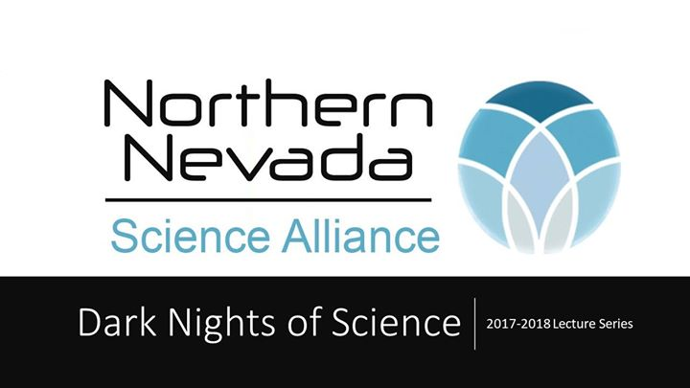
Science
A Historical, Philosophical, and Sociological Take

Slide 2
What is Science?
Historical, Philosophical, and Sociological Perspectives

Slide 3
What is Science?
Sociology: What do scientists believe? How do they investigate the world?
Philosophy: What separates science from pseudoscience?
History: How does science change over time?

Slide 4
Sociology of Science
Part I

Slide 5
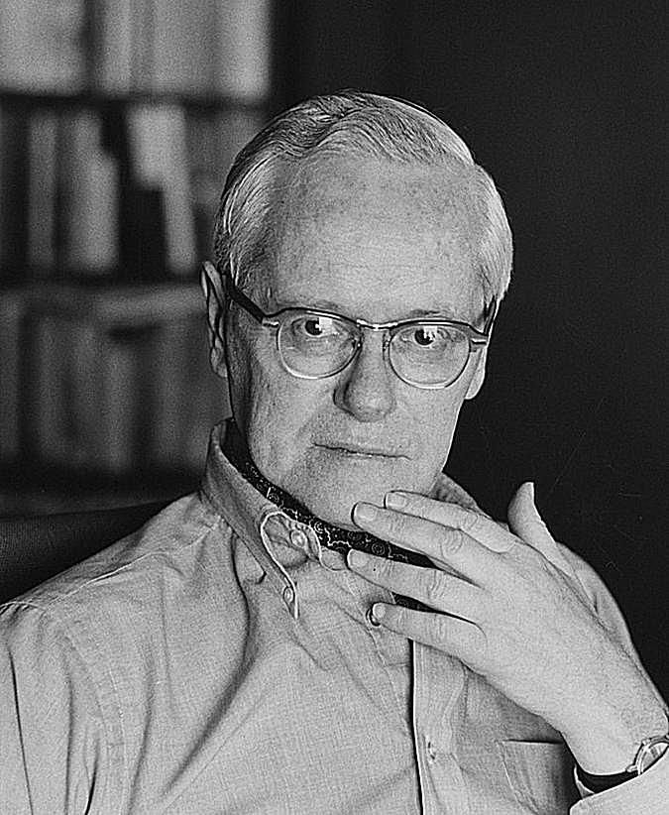
Robert King Merton (1910-2003)
Born Meyer Robert Schkolnick
First Sociologist of Science (1936)
Who are scientists and what norms bind and guide them?

Slide 6
The Norms of Science (CUDOS)
Communalism –common ownership of scientific discoveries.
Universalism –claims are evaluated in terms of universal or impersonal criteria
Disinterestedness –scientists are rewarded for acting selfless
Originality – science requires new problems, approaches, data, theories, or explanations
Skepticism – all ideas are subject to scrutiny

Slide 7
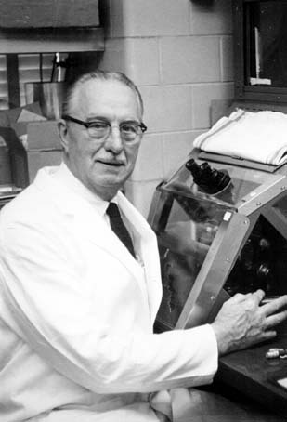
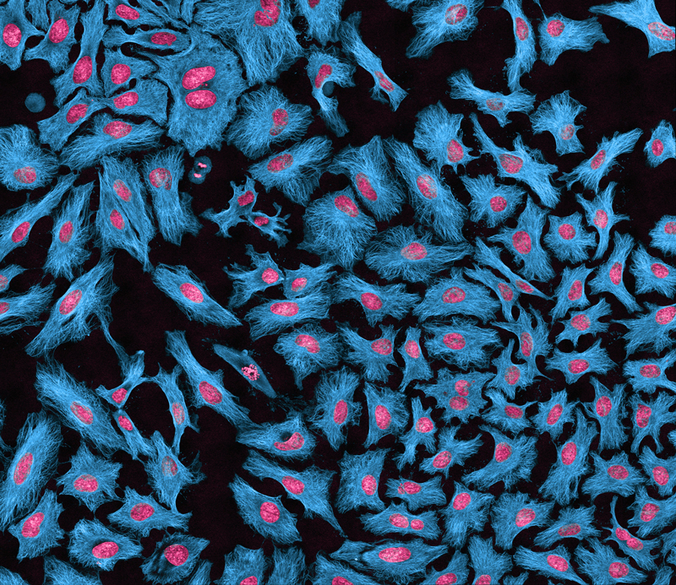
George Otto Gey
Communalism

Slide 8
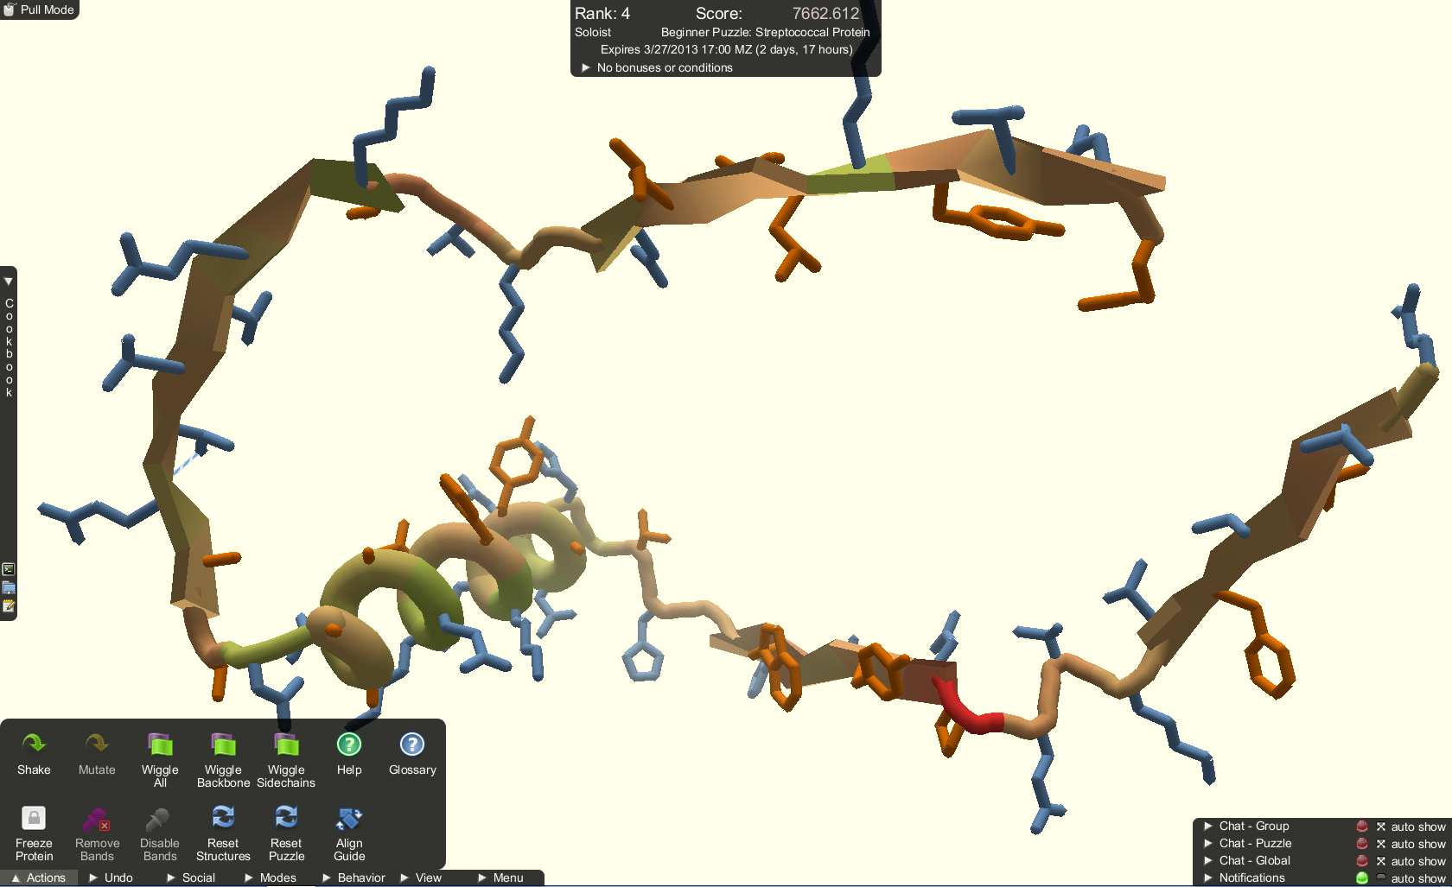
Universalism
Fold.it

Slide 9
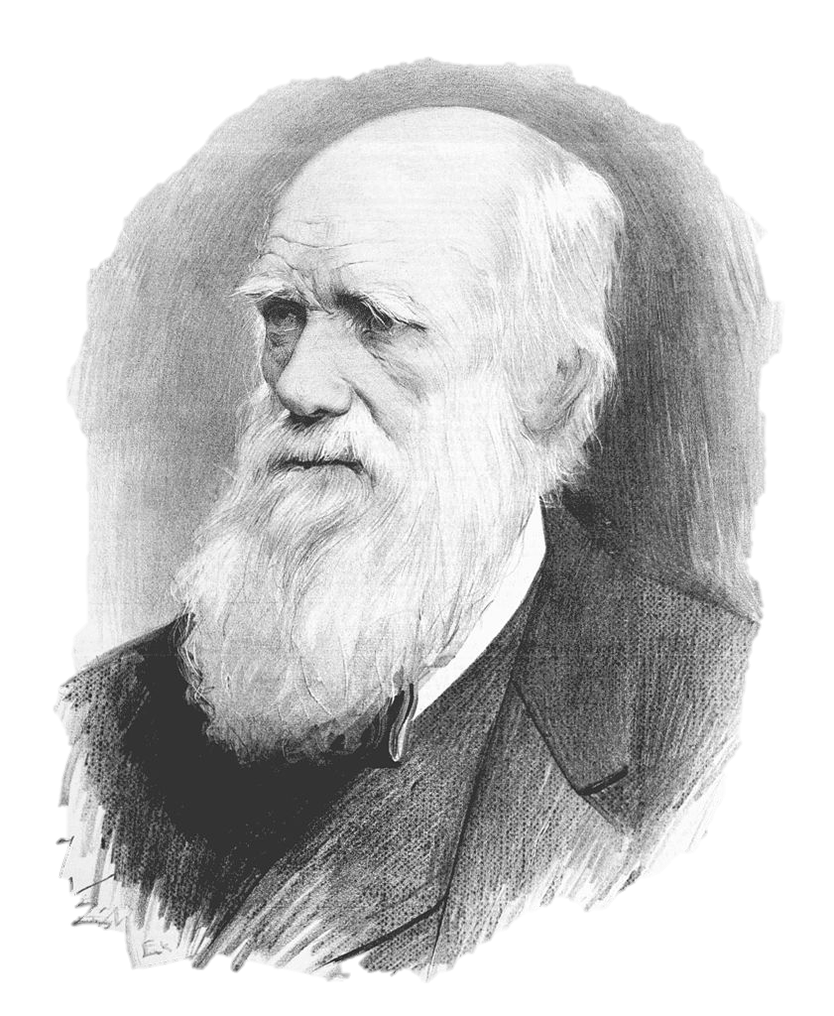
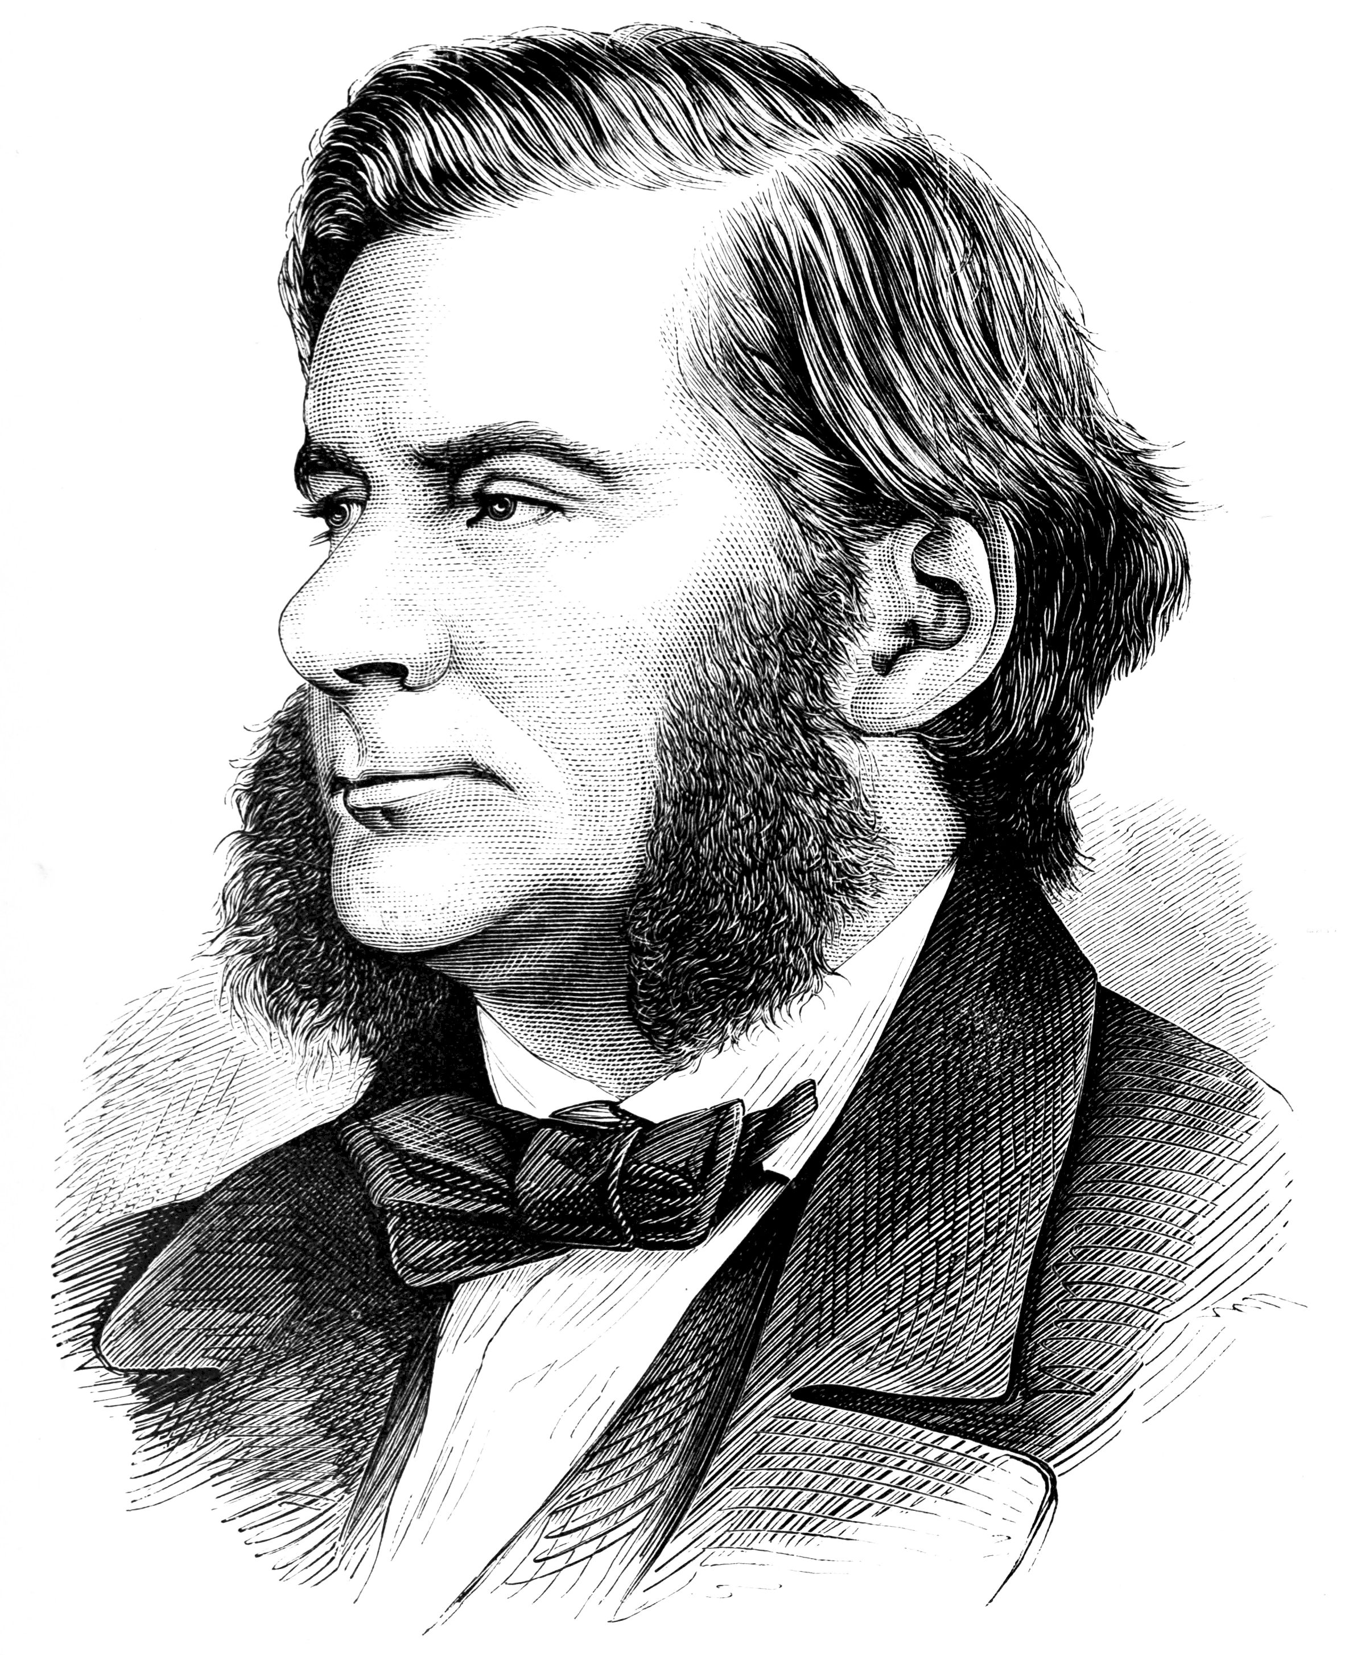
Disinterestedness
Charles Darwin
T.H. Huxley

Slide 10
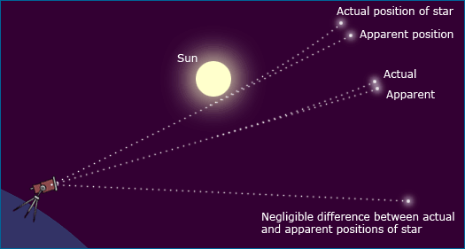
1919
Originality

Slide 11
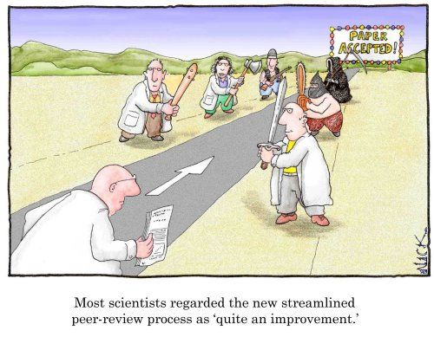
Skepticism

Slide 12
The Counternorms of Science (SPID)
Solitariness – scientists keep findings secret to ensure profit or primacy
Particularism – scientists do judge people based on institution, familiarity, or country of origin
Interestedness –scientists are invested in their research being well received
Dogmatism – careers are often built on assumptions holding true

Slide 13
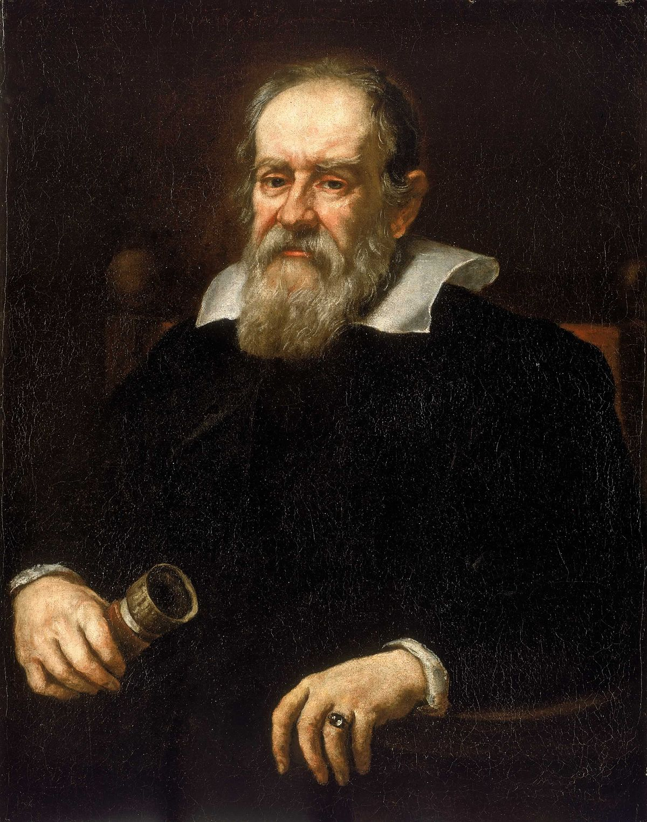
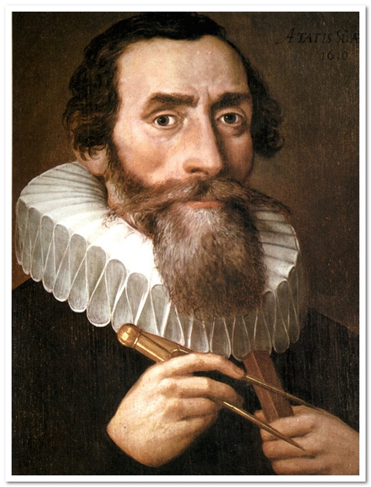
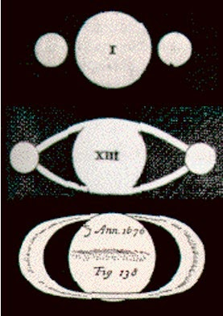
Solitariness
“smaismrmilmepoetaleumibunenugttauiras”
“Altissimum planetam tergeminum observavi”
"I have observed the highest of the planets three-formed"
Johannes Kepler
Galileo Galilei

Slide 14
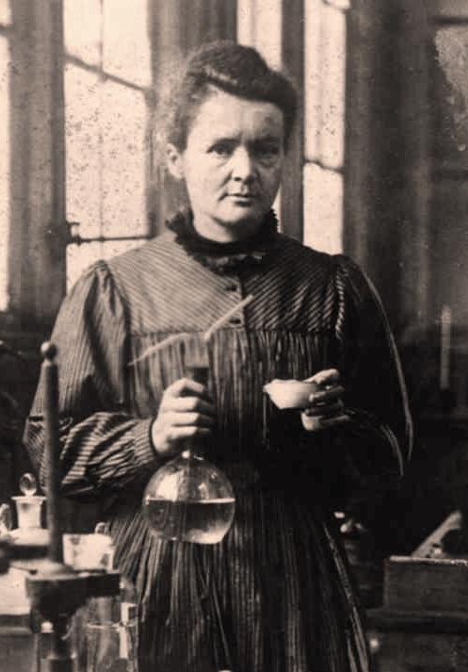
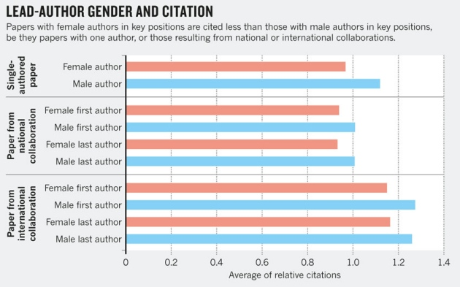
Particularism
Marie Curie

Slide 15
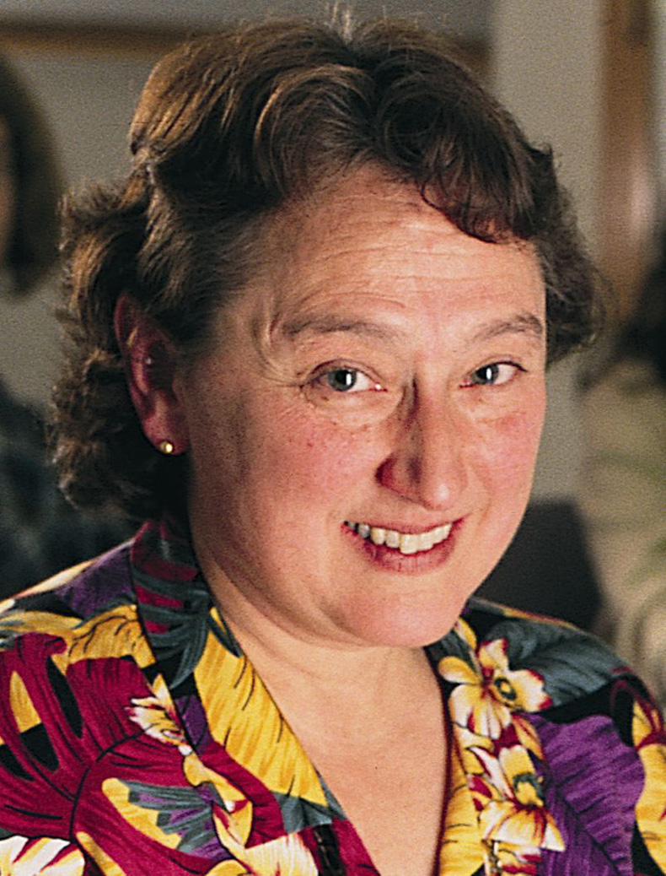
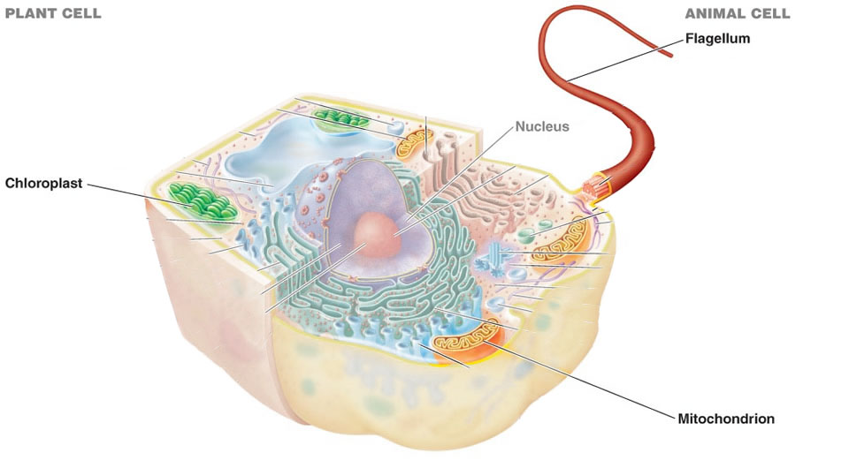
Interestedness
Lynn Margulis

Slide 16
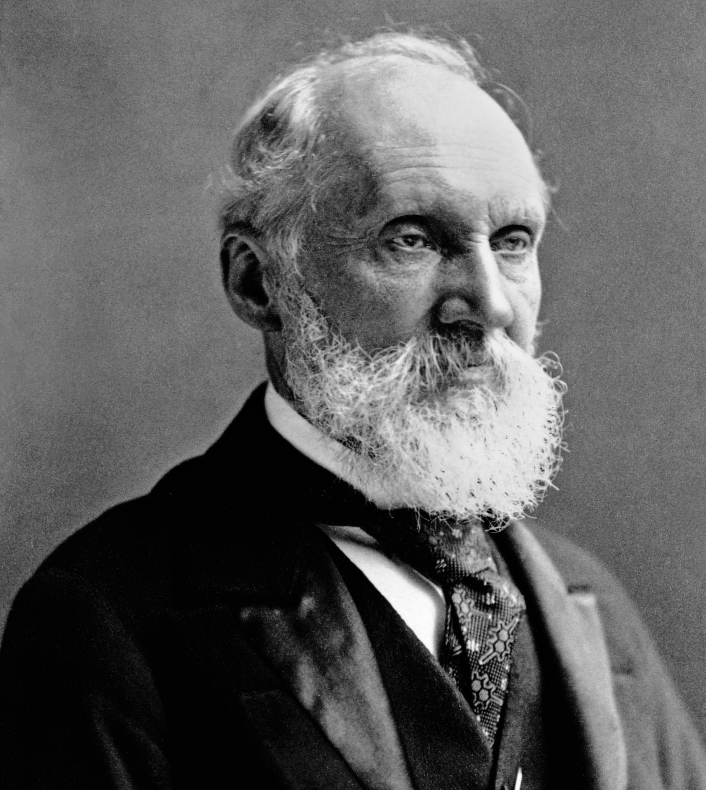
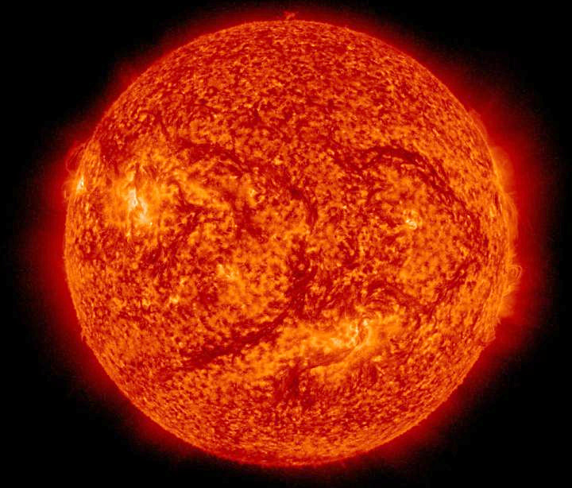
Dogmatism
William Thompson
a.k.a. Lord Kelvin

Slide 17
The Norms of Science (CUDOS & SPID)
Communalism
Universalism
Disinterestedness
Originality
Skepticism
vs
vs
vs
vs
Solitariness
Particularism
Interestedness
Dogmatism
Is this the whole of the story? Do other internal or external factors intercede? Should they?

Slide 18
Philosophy of Science
Part II

Slide 19
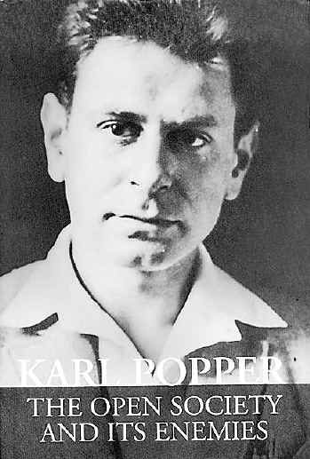
Sir Karl Popper (1902-1994)
Worked in an Adlarian psychology lab
Fled Austria in 1935
What makes something count as science and what makes it count as pseudoscience?

Slide 20
What is pseudoscience?
Examples:
  Freudian psychoanalysis
  Nazi science
  Astrology
  Homeopathy
  Phrenology

Slide 21
Explanations are cheap
“Admirers of Marx, Freud and Adler… saw confirming instances everywhere; whatever happened always confirmed it… I could not think of any human behaviour which could not be interpreted in terms of either theory. It was precisely this fact — that they always fitted, that they were always confirmed — which in the eyes of their admirers constituted the strongest argument in favour of these theories. It began to dawn on me that this apparent strength was in fact their weakness.”
Every possible thing confirms their theories, nothing falsifies them.

Slide 22
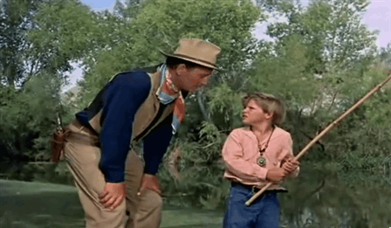

Slide 23
Explaining John Wayne
John Wayne tries to drown child
John Wayne tries to teach child
Freudian explanation:
John Wayne is repressed (say, from an Oedipus complex)
Freudian explanation:
John Wayne has achieved sublimation

Slide 24
What is Science?
Examples:
  Boyle’s air pump tests
  Newton’s Opticks
  Darwin’s Origin
  Wegener’s Continental Drift hypothesis
  Einstein’s General Theory of Relativity

Slide 25
1919

Slide 26
“The Problem of the Criterion”
Observation: Pseudoscientific theories take no risk, but Einstein’s was very risky.
So, Popper claims: Falsifiability is the criterion of science
Falsifiability: the logical possibility of being shown to be false by observation. The possibility of such proof existing without self-contradiction.
Notes:
Non-falsifiability is, AT BEST, an exercise in creativity
BUT: Non-falsifiability is not meaningless:
“I personally do not doubt that much of what they say is of considerable importance and may well play its part one day in a psychological science which is testable” (Popper, 1963)

Slide 27
Mr. Popper’s Principles
Scientists should accept the boldest/riskiest/highest content theory which is falsifiable, but not yet falsified.
  Timid: the Earth has been around for a long time
  Bold: the Earth has been around for many millions of years
  Boldest: The Earth came into being 4.55 Billion years ago.
It is only when theories are falsified that we get feedback from Nature and a chance to improve our knowledge.
Theories that survive rigorous attempts at falsification are NOT proved, they are “corroborated” but can only be held tentatively.

Slide 28
History of Science
Part III

Slide 29
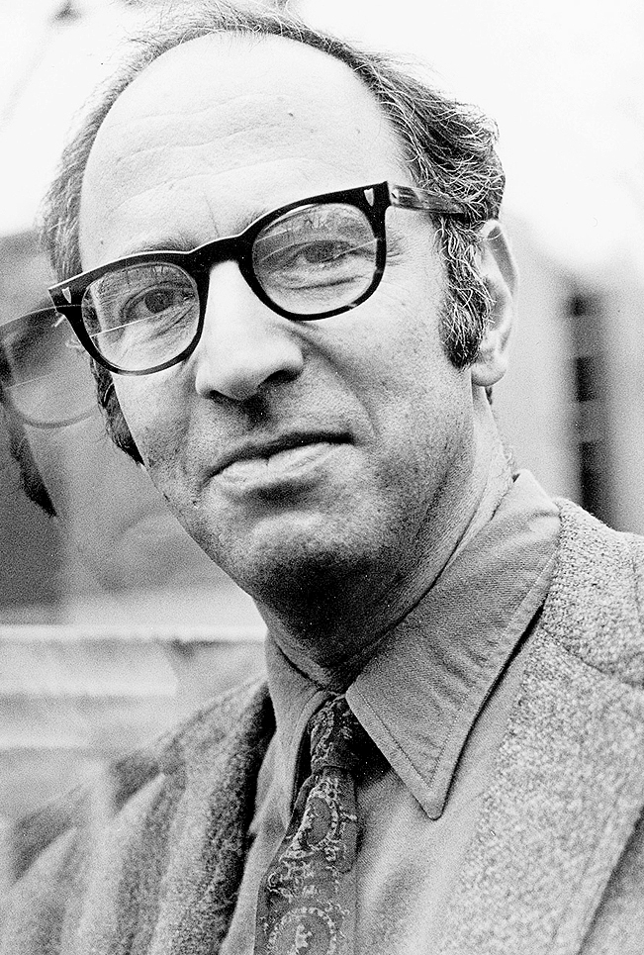
Thomas Kuhn (1922-1996)
Harvard Ph.D. in quantum physics (1949)
Taught a course in humanities of science, realized he had misunderstood early science based on his own assumptions
When scientific theories undergo a revolution, what changes and what stays the same?

Slide 30
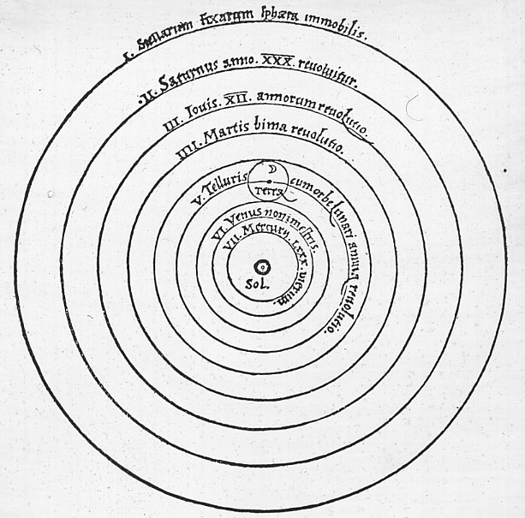
Historical Episodes in Science
Copernican Revolution/Kepler Equations/Exoplanets
Aristotleian Physics/Newtonian Physics/Einsteinian Relativity
Lavoisier’s Chemical Revolution/Second Chemical Revolution
Darwinian Revolution/Modern Synthesis/Genomics
Freudian Revolution/Behaviorism/Cognitive Revolution
Catastrophism/Uniformitarianism/Plate Tectonics

Slide 31
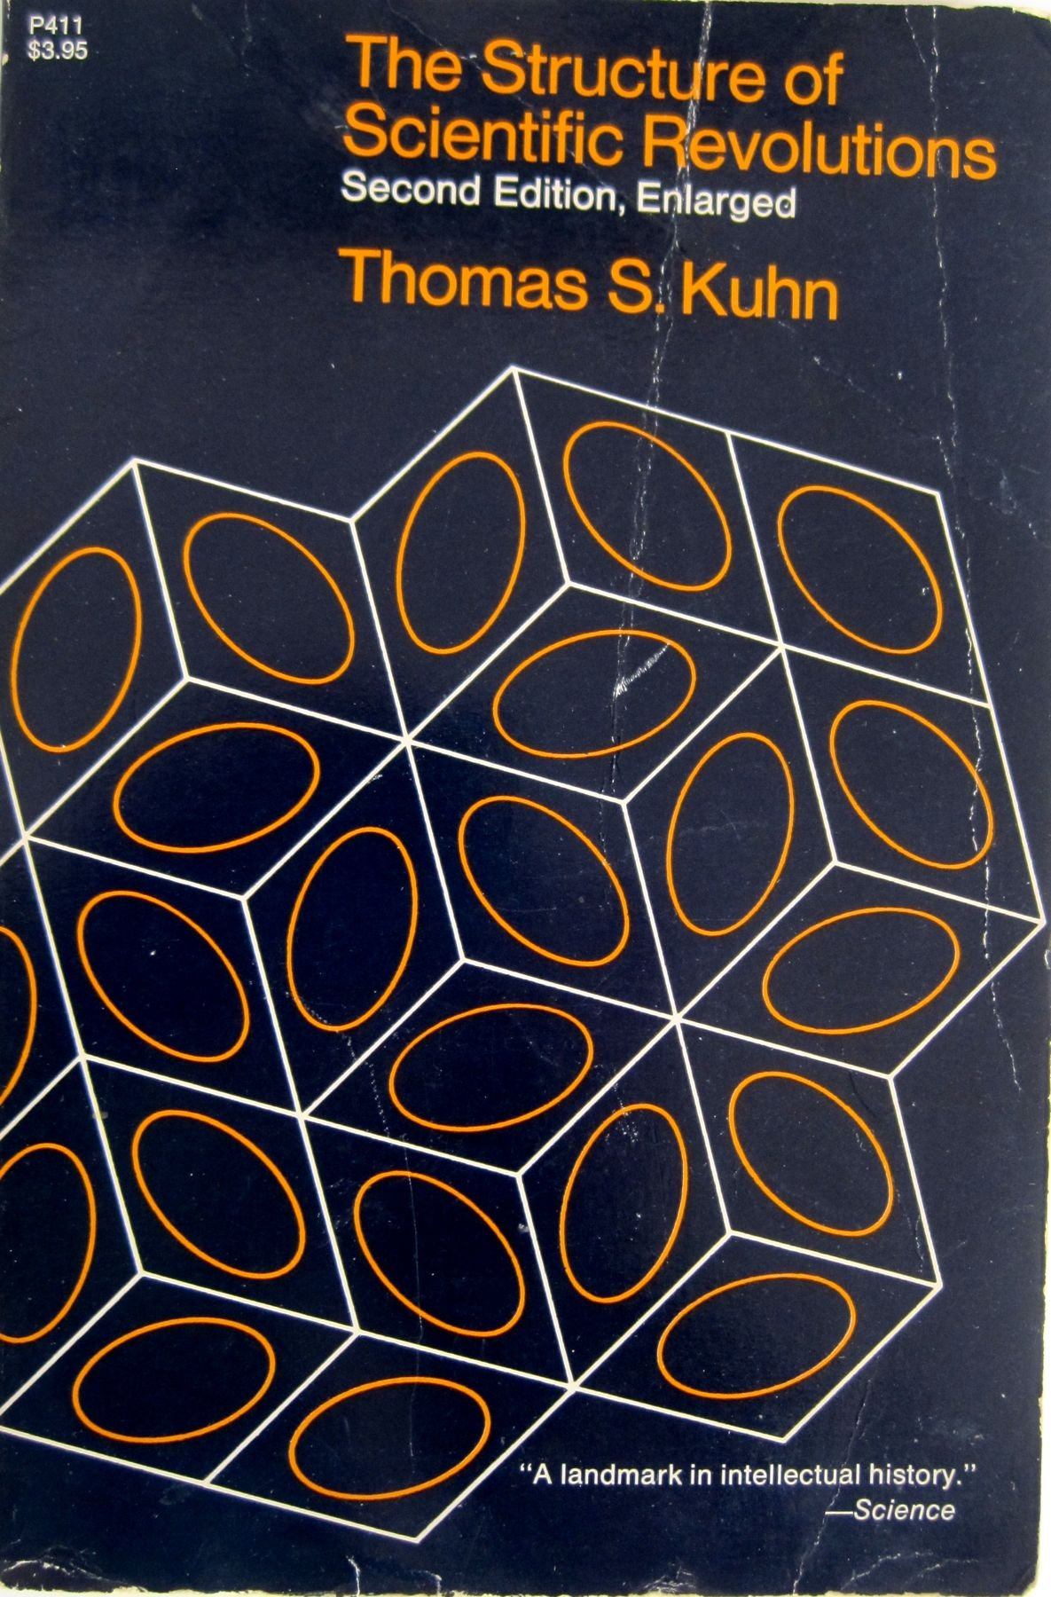
The Structure of
Scientific Revolutions
History shows scientific communities operate in two modes:
  Normal Science: what scientists actually do in daily life
  Theory change: periods of massive historical change
1962

Slide 32
Normal Science
A scientific community cannot practice its trade without some set of received beliefs. A paradigm must exist.
Normal science:
“research firmly based upon one or more past scientific achievements, achievements that some particular scientific community acknowledges for a time as supplying the foundation for its further practice”
  Fact gathering and problem solving
Scientists assume they know what the world is like, disruptive novelties are suppressed, observations are forced into the conceptual boxes supplied by professional scientists
“To desert the paradigm is to cease practicing the science it defines.”

Slide 33
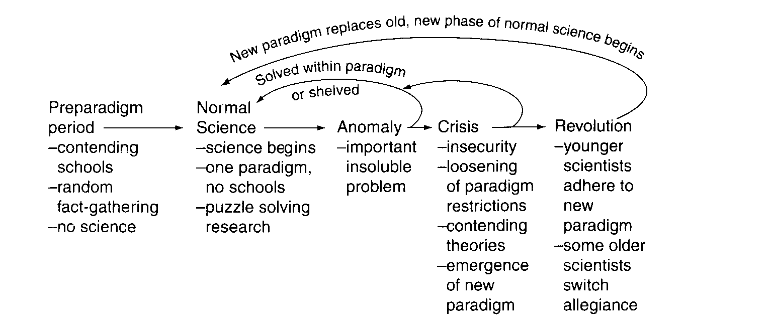

Slide 34
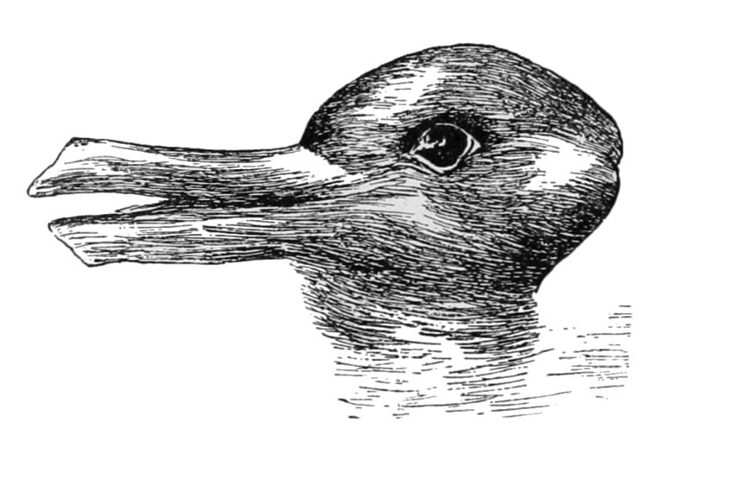
Gestalt switch: one cannot see both the rabbit and the duck at the same time.
One view is not more true than the other

Slide 35
Scientific Revolutions
When a shift takes place,
"a scientist's world is qualitatively transformed [and] quantitatively enriched by fundamental novelties of either fact or theory" (7)
A scientific theory is declared invalid only if an alternative candidate is available to take its place.
Paradigm choice can never be settled by logic and experiment alone
Some scientists never accept the new paradigm:
  “Science advances one funeral at a time” – Max Planck

Slide 36
What is Science?
Conclusions

Slide 37
Kuhn vs. Popper
Kuhn: Normal science is puzzle solving. If the puzzle is not solved, the community assumes the failure reflects on the scientist not on the paradigm.
  “novelty emerges only with difficulty, manifested by resistance, against a background provided by expectation.”
  “To turn Sir Karl’s view on its head, it is precisely the abandonment of critical discourse that marks the transition to a science”
The scientist who pauses to examine every anomaly he notes will seldom get significant work done.

Slide 38
Kuhn vs. Merton
CUDOS conditions seem to be a decent first-pass description of how scientists see themselves as policing themselves.
But scientific norms change over time, field, and across revolutionary periods.
Perhaps these norms guide us in accepting paradigms, or sabotage us in overcoming them

Slide 39
In sum…
Sociology of science reveals the norms that bind scientists, the norms that scientists feel bind them, and the difference between.
Philosophy of science explores what science is and why it is so successful.
History of science reveals patterns of revolutions that should caution us on being overconfident
All of these approaches are helpful in providing a true look at science that respects it as an endeavor but acknowledges that scientists are people, too

Slide 40

Thank You for your attention
carlos@unr.edu

Slide 41
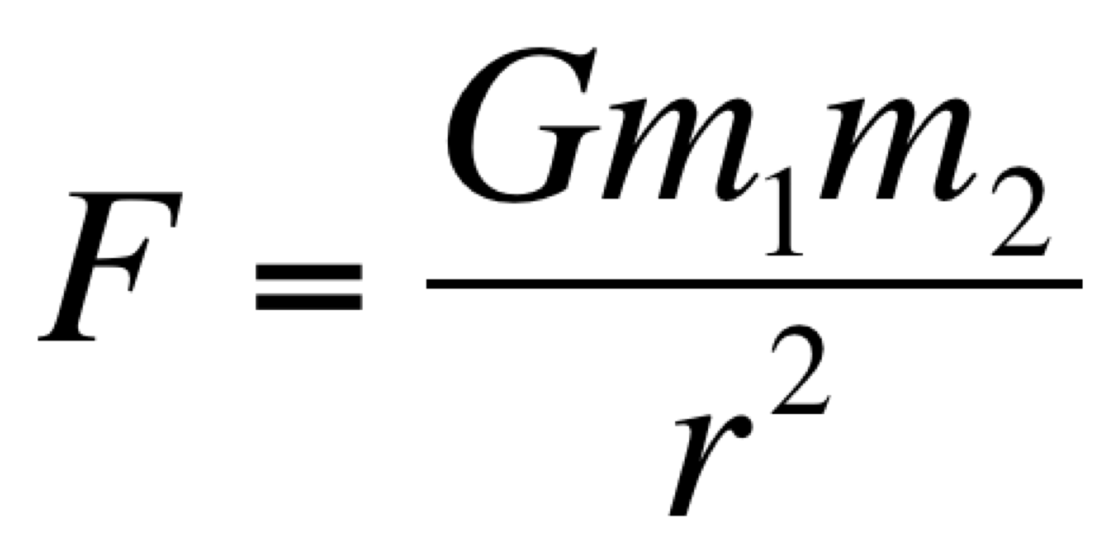
Case Study: Neptune
Newtonian Gravitation Theory: Predicts that every acceleration of every body can be traced to an interaction with some other body, according to their masses and the distance between them.
BUT: In 1821, a slight discrepancy is noted between the actual motion of Uranus and the motion predicted by Newton’s law of gravitation. Do we reject Newton?
No: The theory demands that the missing mass be found. In 1843, John Crouch Adams deduces, from Newton’s law and Uranus’ orbit, the approximate location of a new planet, discovering it in 1846.

Slide 42
Case Study: Vulcan
Newtonian Gravitation Theory: Predicts that every acceleration of every body can be traced to an interaction with some other body, according to their masses and the distance between them.
BUT: Mercury’s perihelion is found to precess at a rate that does not agree with Newton’s theory. The difference is 43” per century. Astronomers posit…
  There is another planet, Vulcan, near Mercury
  The force of gravity is not r², but r^{2.000000097}
  There is a cloud of matter that affects Mercury’s orbit.
In 1916, Einstein shows that general relativity predicts precisely the missing 43”, with Eddington’s observation in 1919, we finally reject Newton.

