Slide 1

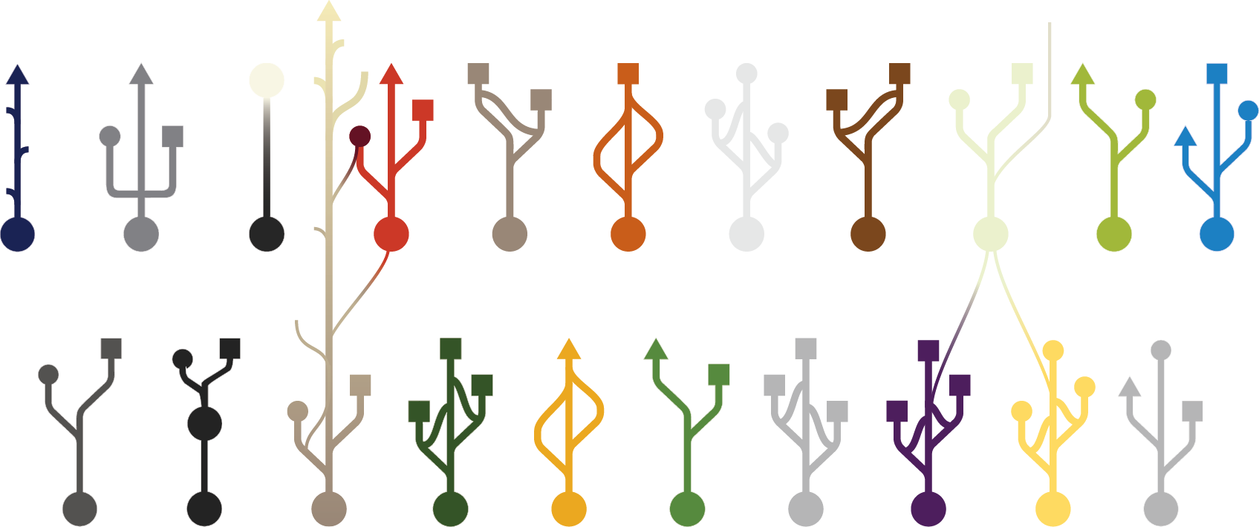
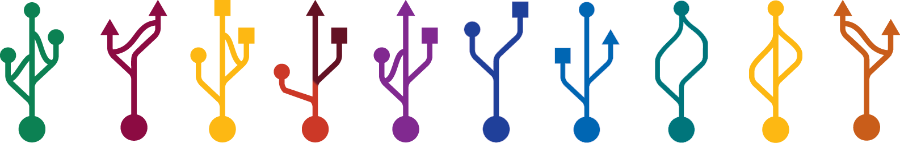

Life in the Universe:
Astrobiology and Universal Biology
UNR Osher Lifelong Learning Institute
Sept. 17, 2019
Carlos Mariscal
Philosophy Department
Ecology, Evolution, & Conservation Biology Program
Integrative Neuroscience Program
Core Humanities Department

Slide 2
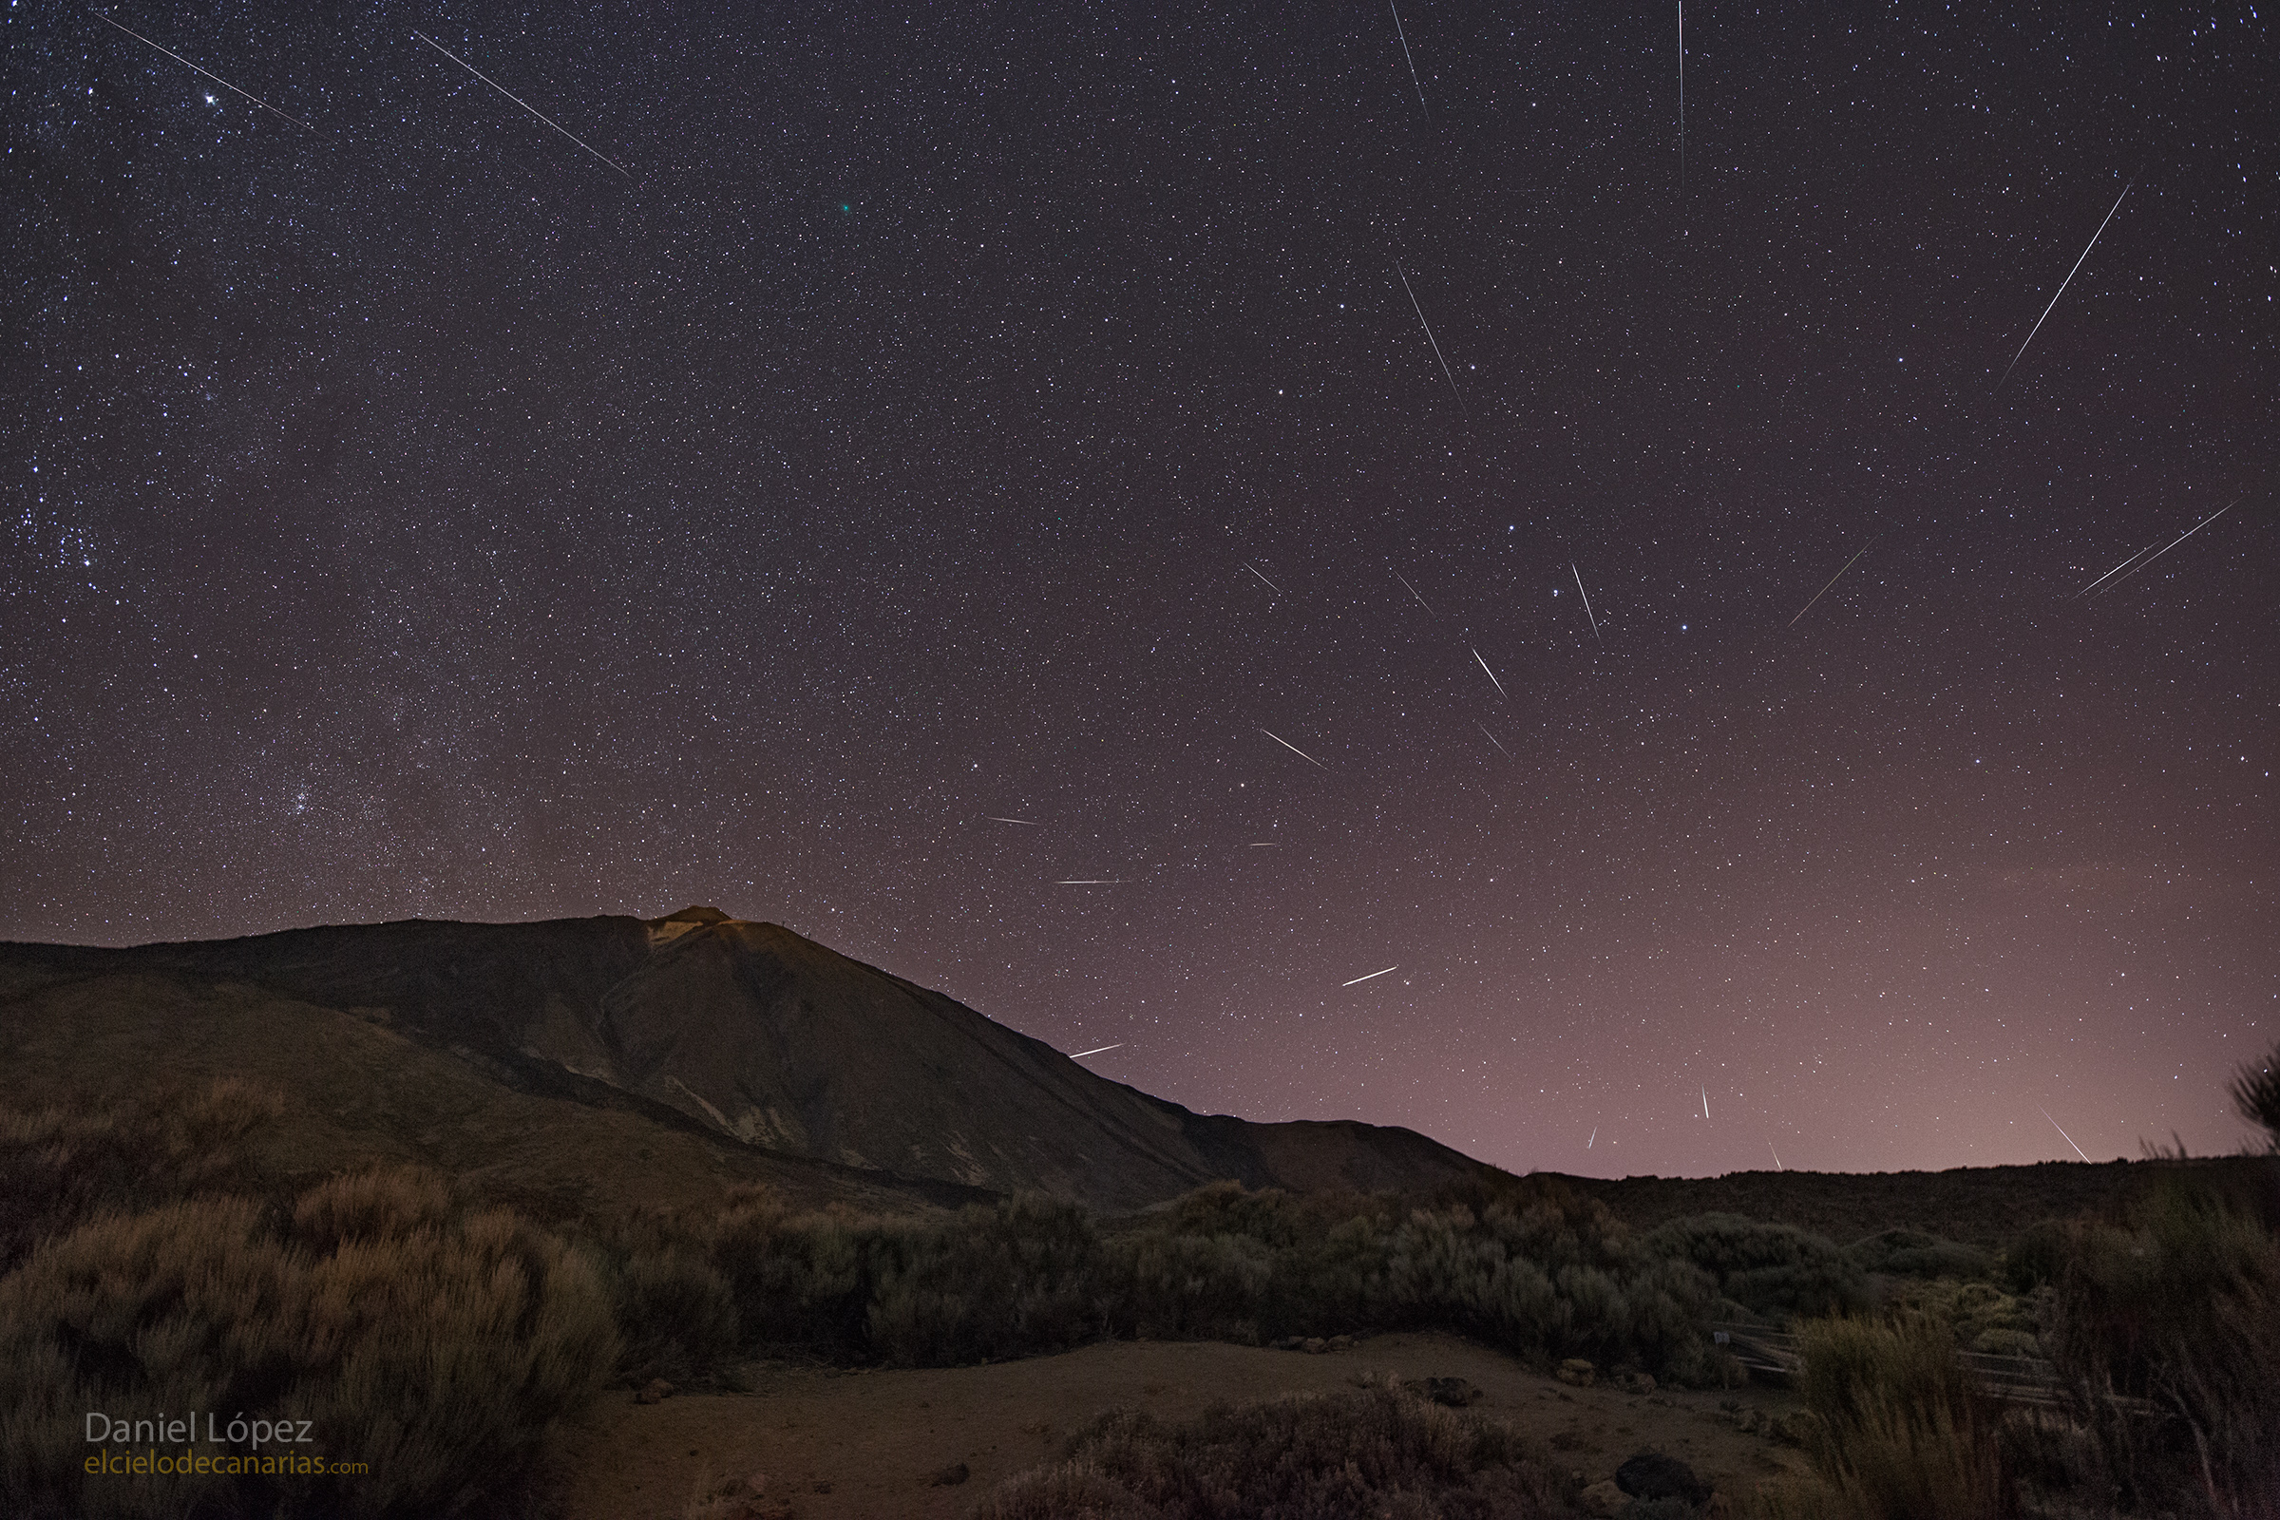
Quadrantid Meteor Shower — Daniel Lopez (NASA) 2018

Slide 3
2 x 10²² stars in observable Universe
4 x 10²¹ planets in the Habitable Zone
Silburt, A., Gaidos, E., and Wu, Y. (2015) Statistical reconstruction of the planet population around Kepler solar-type stars. Astrophys J 799, doi:10.1088/0004-637X/799/2/180.
Petigura, E.A., Howard, A.W., and Marcy, G.W. (2013) Prevalence of Earth-size planets orbiting Sun-like stars. Proc Natl Acad Sci USA 110:19273–19278.

Slide 4
Pessimism Line: life forms once in every 1,000,000,000,000,000,000,000,000 (10²⁴) tries
Frank, A., & Sullivan III, W. T. (2016). A new empirical constraint on the prevalence of technological species in the universe. Astrobiology, 16(5), 359-362.
Notes:
Septillion

Slide 5
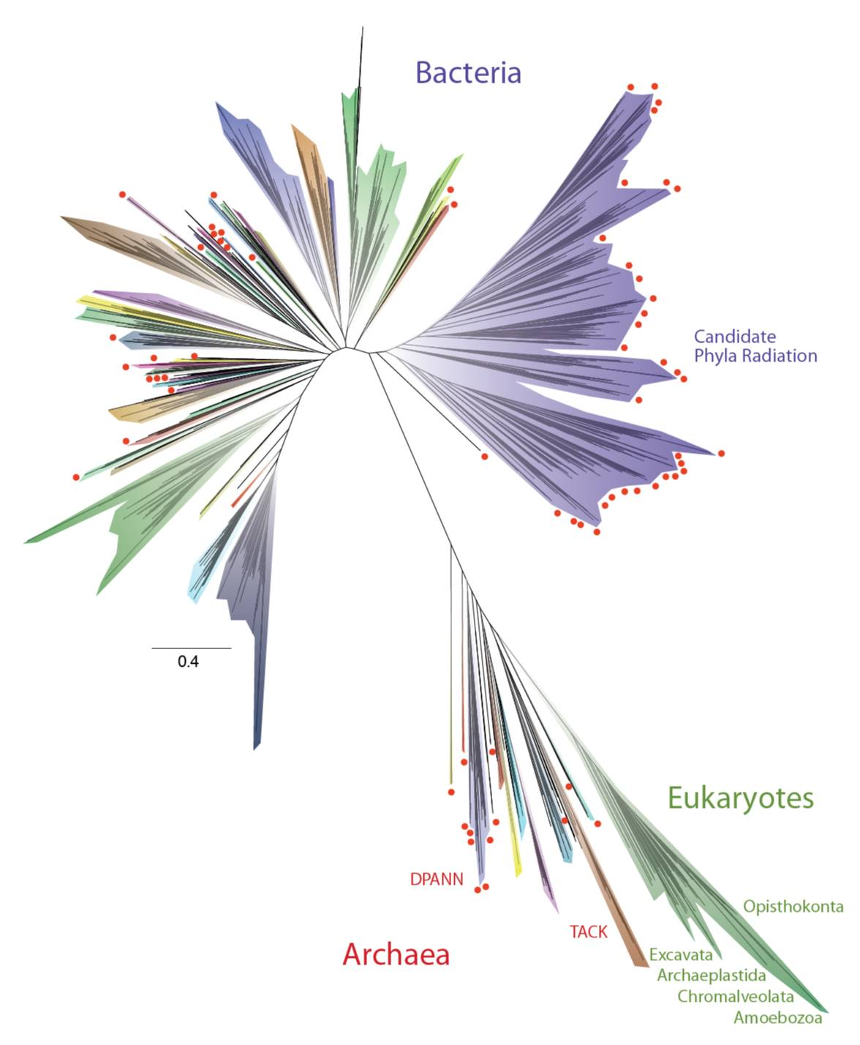
Hug LA, Baker BJ, Anantharaman K, Brown CT, Probst AJ, Castelle CJ, Butterfield CN, Hernsdorf AW, Amano Y, Ise K, Suzuki Y. A new view of the tree of life. Nature microbiology. 2016 May;1(5):16048.
Notes:
Explanations are more robust if backed by universal principles
A provincial biology would be limited in domain of application to life in new environments.
Steve Benner & Craig Venter
Could there be a middle ground between provincial and universal? Logically no, but you can imagine fairly broad provinciality

Slide 6
Us
Hug LA, Baker BJ, Anantharaman K, Brown CT, Probst AJ, Castelle CJ, Butterfield CN, Hernsdorf AW, Amano Y, Ise K, Suzuki Y. A new view of the tree of life. Nature microbiology. 2016 May;1(5):16048.
Notes:
Explanations are more robust if backed by universal principles
A provincial biology would be limited in domain of application to life in new environments.
Steve Benner & Craig Venter
Could there be a middle ground between provincial and universal? Logically no, but you can imagine fairly broad provinciality

Slide 7
Granny
Us
Hug LA, Baker BJ, Anantharaman K, Brown CT, Probst AJ, Castelle CJ, Butterfield CN, Hernsdorf AW, Amano Y, Ise K, Suzuki Y. A new view of the tree of life. Nature microbiology. 2016 May;1(5):16048.
Notes:
Explanations are more robust if backed by universal principles
A provincial biology would be limited in domain of application to life in new environments.
Steve Benner & Craig Venter
Could there be a middle ground between provincial and universal? Logically no, but you can imagine fairly broad provinciality

Slide 8

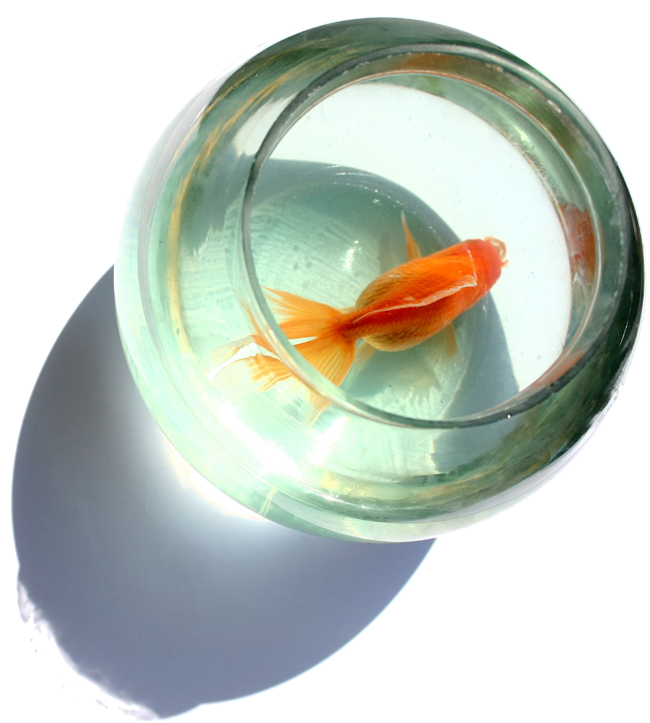
All Alone
Notes:
Explanations are more robust if backed by universal principles
A provincial biology would be limited in domain of application to life in new environments.
Steve Benner & Craig Venter
Could there be a middle ground between provincial and universal? Logically no, but you can imagine fairly broad provinciality

Slide 9
All Alone
Is Life on Earth weird?
Notes:
Explanations are more robust if backed by universal principles
A provincial biology would be limited in domain of application to life in new environments.
Steve Benner & Craig Venter
Could there be a middle ground between provincial and universal? Logically no, but you can imagine fairly broad provinciality

Slide 10

All Alone
Is Life on Earth weird?
Is Life on Earth representative?
Notes:
Explanations are more robust if backed by universal principles
A provincial biology would be limited in domain of application to life in new environments.
Steve Benner & Craig Venter
Could there be a middle ground between provincial and universal? Logically no, but you can imagine fairly broad provinciality

Slide 11

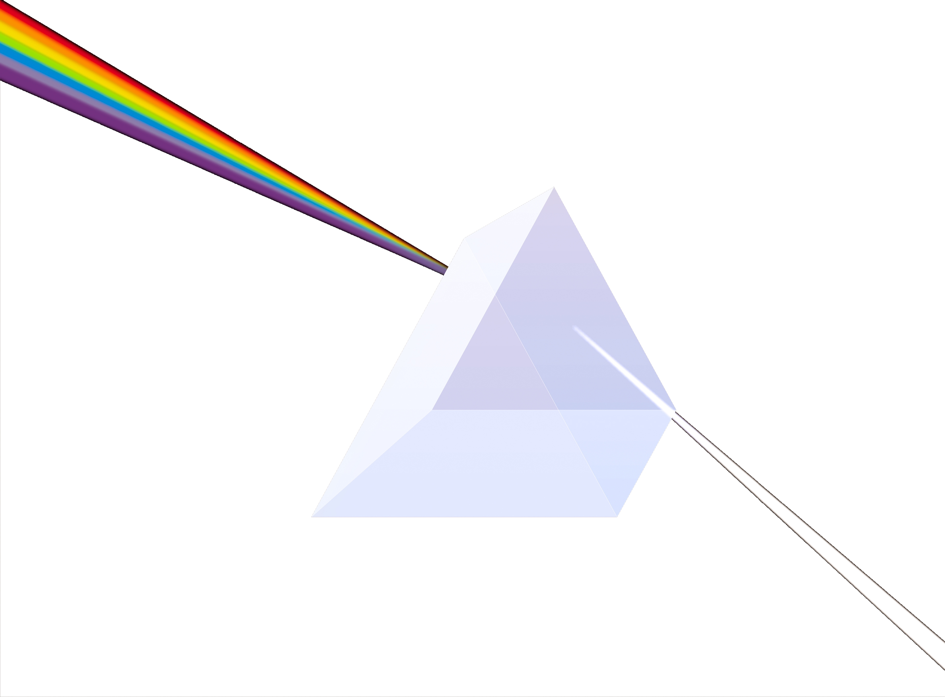
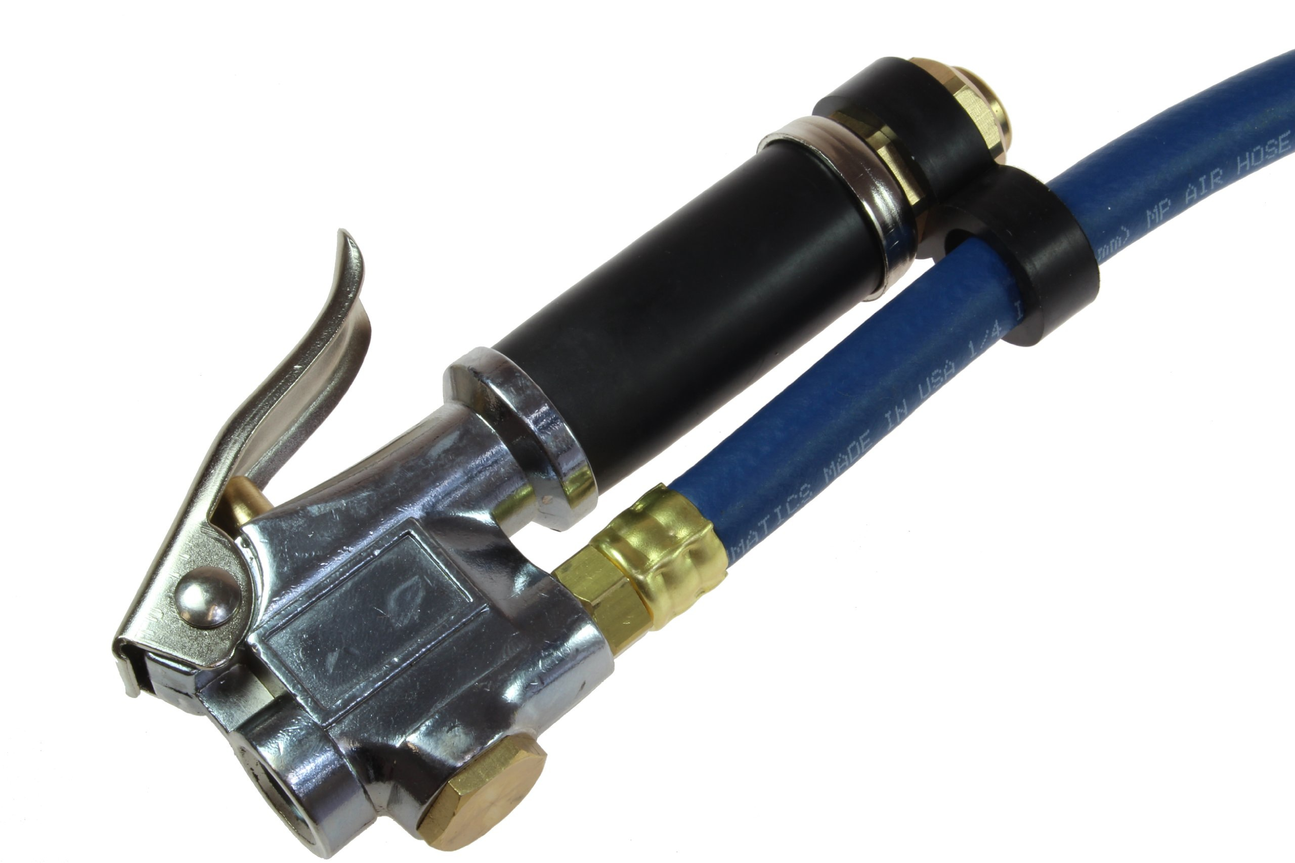
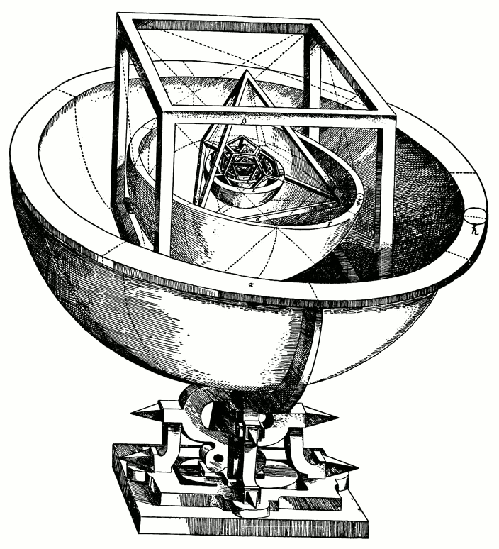

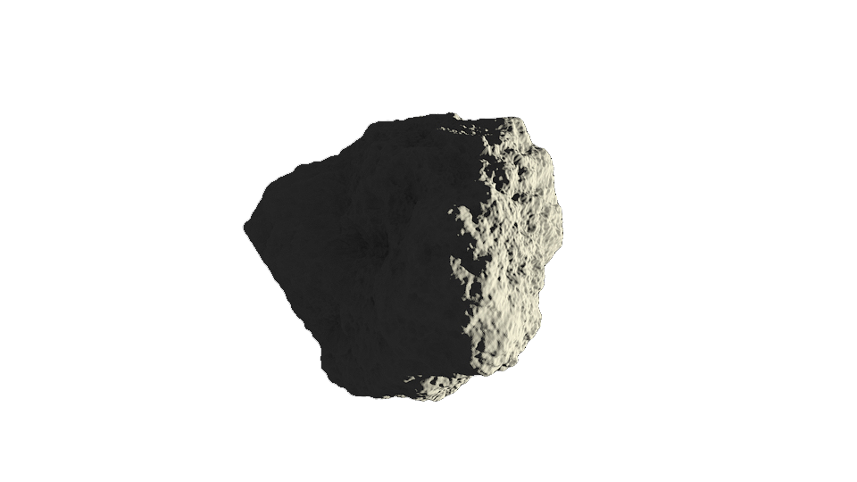

Non-Universal Sciences
Universal Sciences
Notes:
Torricelli’s hypothesis that Earth was surrounded by a “sea of air.” It wasn’t until later experiments at the tops of mountains in various conditions that pneumatics became considered a universal science.

Slide 12
Biology as Weird
Biological generalizations could have been otherwise
General claims in biology are often falsified
Biological explanations are historical
We have a single example of life &
we should not make universal
conjectures about life until we
discover other examples of life
Gould SJ. Wonderful life: the Burgess Shale and the nature of history. WW Norton & Company; 1990 Sep 17.
Beatty J. The evolutionary contingency thesis. Concepts, theories, and rationality in the biological sciences. 1995 Jul 15;45:81.
Richards RJ. The structure of narrative explanation in history and biology. History and evolution. 1992:19-53.
Cleland CE. Is a general theory of life possible? seeking the nature of life in the context of a single Example. Biological Theory. 2013 Jun 1;7(4):368-79.
Notes:
For hundreds of years, the presumption was that biology was as universal a science as physics. Imagine you’re an early naturalist and you see several species grouping in interesting ways. Prior to 1859, it would have been perfectly reasonable to conclude any of your observations were generalizable. But 1859 brought two huge blows to the notion of universal biology. First, Louis Pasteur decisively puts to rest spontaneous generation in favor of biogenesis: life must come from life. Second, Darwin publishes the Origin and argues forcefully for common descent. Neither Darwin nor Pasteur were the first to argue for these positions, but they had the greatest lasting impact.
Arcturus – George Wald

Slide 13
Biology as Not Universal
Biological generalizations could have been otherwise
General claims in biology are often falsified
Biological explanations are historical
We have a single example of life &
we should not make universal
conjectures about life until we
discover other examples of life
Notes:
For hundreds of years, the presumption was that biology was as universal a science as physics. Imagine you’re an early naturalist and you see several species grouping in interesting ways. Prior to 1859, it would have been perfectly reasonable to conclude any of your observations were generalizable. But 1859 brought two huge blows to the notion of universal biology. First, Louis Pasteur decisively puts to rest spontaneous generation in favor of biogenesis: life must come from life. Second, Darwin publishes the Origin and argues forcefully for common descent. Neither Darwin nor Pasteur were the first to argue for these positions, but they had the greatest lasting impact.
Arcturus – George Wald

Slide 14
Biology as Universal
The laws, theories, or principles in biology are not limited
Physics & chemistry are (presumably)
universal and have predictable effects on biology
Universal design problems: radiation,
inheritance, competition, etc.
Biology tends to converge on the same forms
time and again
Mayr — Biology is at least as general as our sample of it
Munson R. Is biology a provincial science?. Philosophy of Science. 1975 Dec 1;42(4):428-47.
Mariscal C. Universal Biology. Duke University Thesis. 2014.
Morris SC. The crucible of creation: the Burgess Shale and the rise of animals. Peterson's; 1999.
McGhee GR. Convergent evolution. Cambridge, MA: MIT Press; 2011.
Notes:
There are several responses one might give in favor of the view that biology is universal. The first comes from Munson himself, who argues none of the laws, theories, or principles in biology are limited in scope. Mayr adds on that biology is as general as all observed examples of life, so it should be treated as universal unless given reasons otherwise (which, presumably, would be examples of extremely different alien biology). Also, physics & chemistry are universal and have predictable effects on biology. Neither Munson nor Mayr would put forth this argument, as it seems to threaten the autonomy of biology, but I don’t doubt the autonomy of biology and so I have no problem allowing this insight. Lastly, there are universal design problems and occasional universal design solutions in biology.

Slide 15
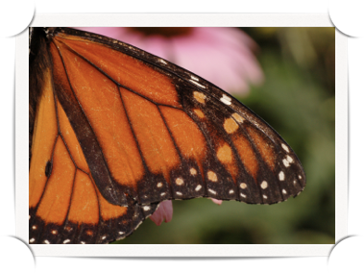
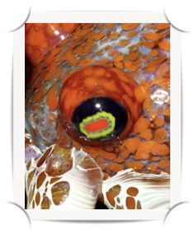
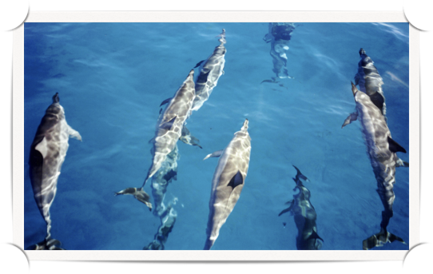
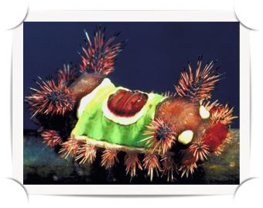

Examples of Convergence
Powell, R. & Mariscal, C. 2014. “There is Grandeur in This View of Life: The Bio-Philosophical Implications of Convergent Evolution.” Act Biotheoretica 62: 115-121.
Notes:
Wings and eyes are classic examples. The fusiform shape going through water is another. But in these discussions, convergence proponents marshall out the fact that urticating hair/stingers has convergently evolved a dozen times in various lineages as far apart as plants and animals. And the fact that hummingbird flowers (long, odorless, red flowers) have evolved nearly 20 times is presented next to some of these stronger cases. But obviously some of these examples cannot be generalizable, while others may be.
I think some of these responses miss the mark.

Slide 16





Not Just One Issue
Not Universal
Universal
1
4
18
Unique
Universal
Powell, R. & Mariscal, C. 2014. “There is Grandeur in This View of Life: The Bio-Philosophical Implications of Convergent Evolution.” Act Biotheoretica 62: 115-121.
Notes:
Much of the disagreement seems to be with respect to ‘scale,’ ‘interest,’ or description. The disagreement means that these camps keep talking past each other.
When you find yourself making a point again and again, perhaps you’re no longer trying to convince the person, you’re just trying to get them to acknowledge what you mean.
Indeed, I sometimes think many biological disagreements amount to this.
While this is certainly a debate about differences in focus and differences in relative significance, there are also key issues being left out. We’ll get to these now.

Slide 17
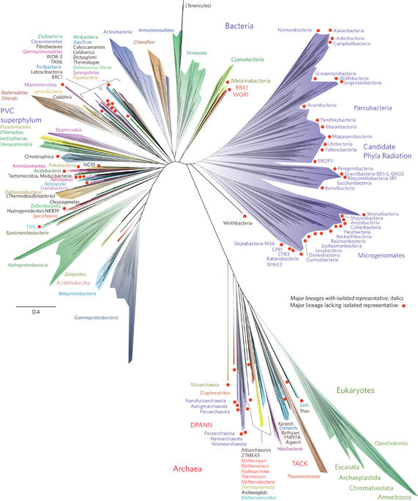



Some Distinctions
Independence – Relevant shared ancestry
Mariscal, C. 2016. “Universal biology: assessing universality from a single example.” In: The Impact of Discovering Life Beyond Earth, S.J. Dick (ed.). CUP, Cambridge.
Notes:
Spread is evidence of difference of underlying features, but is not demonstrative of such. An ideal observer would know the distinction in underlying features. Spread is the first step in this analysis – a simple, weighted accounting of taxa divergence. A biochemist with deep knowledge of underlying mechanisms might conclude that these causal situations are not actually as independent as phylogeny might suggest – they are greatly influenced by environmental factors, observer error, or underlying, deep homologies, for example. But that is a subsequent step.

Slide 18
Some Distinctions
Independence – Relevant shared ancestry
Mariscal, C. 2016. “Universal biology: assessing universality from a single example.” In: The Impact of Discovering Life Beyond Earth, S.J. Dick (ed.). CUP, Cambridge.
Notes:
Spread is evidence of difference of underlying features, but is not demonstrative of such. An ideal observer would know the distinction in underlying features. Spread is the first step in this analysis – a simple, weighted accounting of taxa divergence. A biochemist with deep knowledge of underlying mechanisms might conclude that these causal situations are not actually as independent as phylogeny might suggest – they are greatly influenced by environmental factors, observer error, or underlying, deep homologies, for example. But that is a subsequent step.

Slide 19
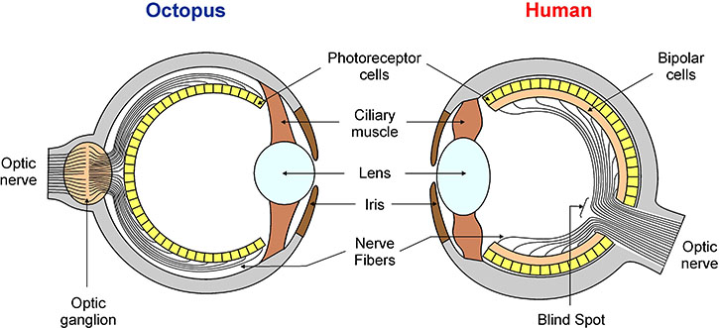
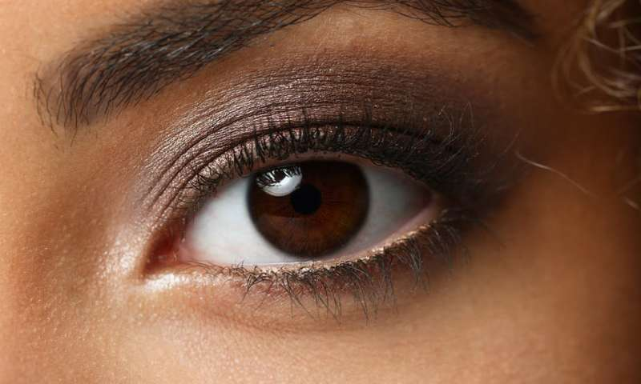
Some Distinctions
Trait Specificity – Degree of similarity of trait
Mariscal, C. & Doolittle, W.F. 2016. “Eukaryotes-first, how could that be?” Philosophical Transactions of the Royal Society B: Biological Sciences.
Notes:
Another disagreement between contingency and convergent proponents is due to the level of specificity within which they describe phenomena.
So you might think of a trait, say blubber, and describe it in very specific terms. Then, if it originates many times in evolution, you might conclude that it is the kind of feature likely to recur again and again. But that same trait can be described in fewer character dimensions, which would include a number of other instances. This can go too far, however, and give you a feature so vague as to be vacuously true of any instance of evolution. So the most interesting cases of convergence will be the ones with a high degree of specificity, although these will also be the least common.

Slide 20
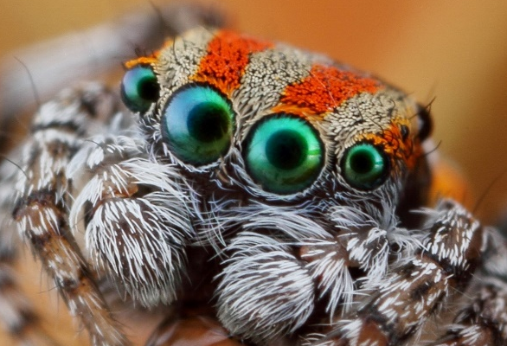
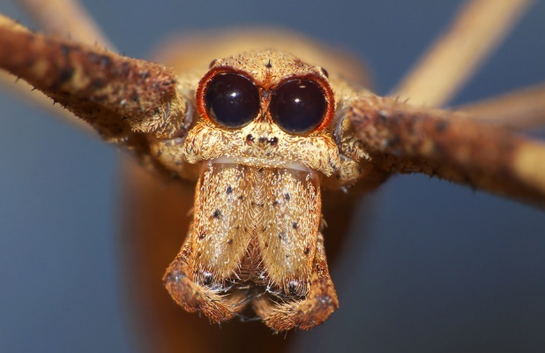
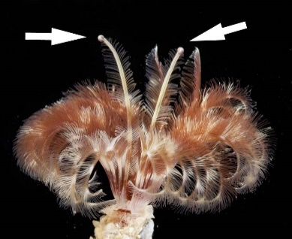
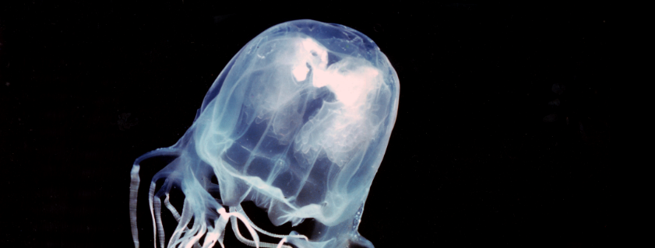
Some Distinctions
Trait Specificity – Degree of similarity of trait
Mariscal, C. & Doolittle, W.F. 2016. “Eukaryotes-first, how could that be?” Philosophical Transactions of the Royal Society B: Biological Sciences.
McGhee GR. Convergent evolution. Cambridge, MA: MIT Press; 2011.
Notes:
Another disagreement between contingency and convergent proponents is due to the level of specificity within which they describe phenomena.
So you might think of a trait, say blubber, and describe it in very specific terms. Then, if it originates many times in evolution, you might conclude that it is the kind of feature likely to recur again and again. But that same trait can be described in fewer character dimensions, which would include a number of other instances. This can go too far, however, and give you a feature so vague as to be vacuously true of any instance of evolution. So the most interesting cases of convergence will be the ones with a high degree of specificity, although these will also be the least common.

Slide 21
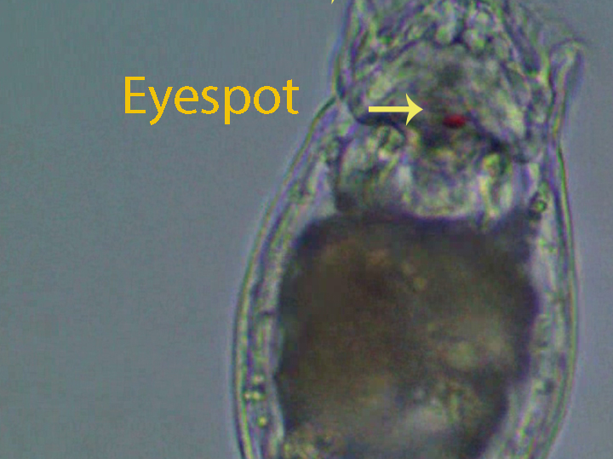
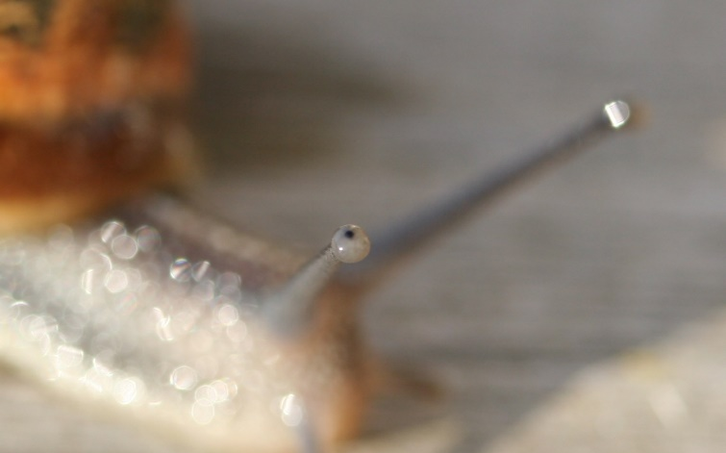
Some Distinctions
19
Trait Specificity – Degree of similarity of trait
7
6
McGhee GR. Convergent evolution. Cambridge, MA: MIT Press; 2011.
Notes:
Another disagreement between contingency and convergent proponents is due to the level of specificity within which they describe phenomena.
So you might think of a trait, say blubber, and describe it in very specific terms. Then, if it originates many times in evolution, you might conclude that it is the kind of feature likely to recur again and again. But that same trait can be described in fewer character dimensions, which would include a number of other instances. This can go too far, however, and give you a feature so vague as to be vacuously true of any instance of evolution. So the most interesting cases of convergence will be the ones with a high degree of specificity, although these will also be the least common.

Slide 22
Some Distinctions
Environmental Specificity – Degree of similarity of environment
Notes:
Recall that hummingbird flowers have evolved 18 times, while fusiform shapes have evolved far fewer. What’s missing here is that hummingbird flowers had a huge, unstated precondition. Namely, the existence of hummingbirds. Once those are acknowledged, it seems like a much less interesting generalization.
Notice that this scale is different than the trait specificity scale. There, when repeated features were more specific, they spoke to more surprising aspects of evolution. Here, the LESS specific conditions are, the more projectable to other environments they are.

Slide 23
Continua of Convergence
Environmental Specificity
Local
Universal
Trait Specificity
Independence
Vague
Identical
Related
Very Unrelated
Notes:
Note that all of these come in continua.
Instead, we’d like for true examples of convergence to intersect in all three.

Slide 24
Other Approaches
Evolutionary:
                Convergent Evolution
                Game Theory
                Artificial Life
                Synthetic Biology
                Long-term Evolutionary Experiments
Non-Evolutionary:
  Network & complex systems analyses
  Developmental pathways
  Scaling effects of physics
  Ecological and population dynamics
Weibull JW. Evolutionary game theory. MIT press; 1997.
Langton CG, editor. Artificial life: An overview. Mit Press; 1997.
Benner SA, Sismour AM. Synthetic biology. Nature Reviews Genetics. 2005 Jul;6(7):533.
Lenski RE, Rose MR, Simpson SC, Tadler SC. Long-term experimental evolution in Escherichia coli. I. Adaptation and divergence during 2,000 generations. The American Naturalist. 1991 Dec 1;138(6):1315-41.
Kauffman SA. Investigations. Oxford University Press; 2000 Oct 26.
Prud'homme B, Gompel N, Carroll SB. Emerging principles of regulatory evolution. Proceedings of the National Academy of Sciences. 2007 May 15;104(suppl 1):8605-12.
Gould SJ. Allometry and size in ontogeny and phylogeny. Biological Reviews. 1966 Nov;41(4):587-638.
May R, McLean AR, editors. Theoretical ecology: principles and applications. Oxford University Press on Demand; 2007 Feb 15
Notes:
There are several responses one might give in favor of the view that biology is universal. The first comes from Munson himself, who argues none of the laws, theories, or principles in biology are limited in scope. Mayr adds on that biology is as general as all observed examples of life, so it should be treated as universal unless given reasons otherwise (which, presumably, would be examples of extremely different alien biology). Also, physics & chemistry are universal and have predictable effects on biology. Neither Munson nor Mayr would put forth this argument, as it seems to threaten the autonomy of biology, but I don’t doubt the autonomy of biology and so I have no problem allowing this insight. Lastly, there are universal design problems and occasional universal design solutions in biology.

Slide 25


Slide 26
Conclusions
Unless you’re really, really pessimistic, something we’d call life probably exists elsewhere
Life on Earth is all related
There is a debate as to whether biology is representative of life elsewhere or not
Example: convergent evolution treats biology as universal and produces some fascinating results, if understood correctly
Other approaches have been productive to other researchers, and bringing them together may reveal as yet untold secrets of life.
Notes:
Many claims in biology are historical, some are not.
Assessing the plausibility of those assumptions is difficult, but can be done in some cases
It’s not all-or-nothing. Some aspects can be representative while others are unique and weird.

Slide 27






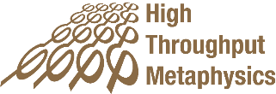
Thank You
✉ carlos@unr.edu
@proflos

Slide 28



