Slide 1
Human Genetic Modification
Lessons from Revolutionary Technologies
Carlos Mariscal
Philosophy Department
College of Liberal Arts

Slide 2
Outline
Gene Modification
A History of Genetic Modification
Lessons from the Past
Moving Forward
Arguments: Pro & Con
Inevitable Change
Trade-offs
How Does it Work?
The New Eugenics
A Timeline
IVF & Stem Cells
Revolutionary Technologies

Slide 3

Guiding Question:
Human genetic modification is becoming more and more common. What, if any, limits should we impose on it?
Notes:
Core Value: Having the opportunity to explore the transhuman and posthuman realms
Basic Conditions: Global security, Technological progress, Wide access
Transhuman: a human who uses human enhancements
Posthuman: a human who uses human
enhancements to greatly enhance a
capacity beyond what is possible by
any non-enhanced human.

Slide 4
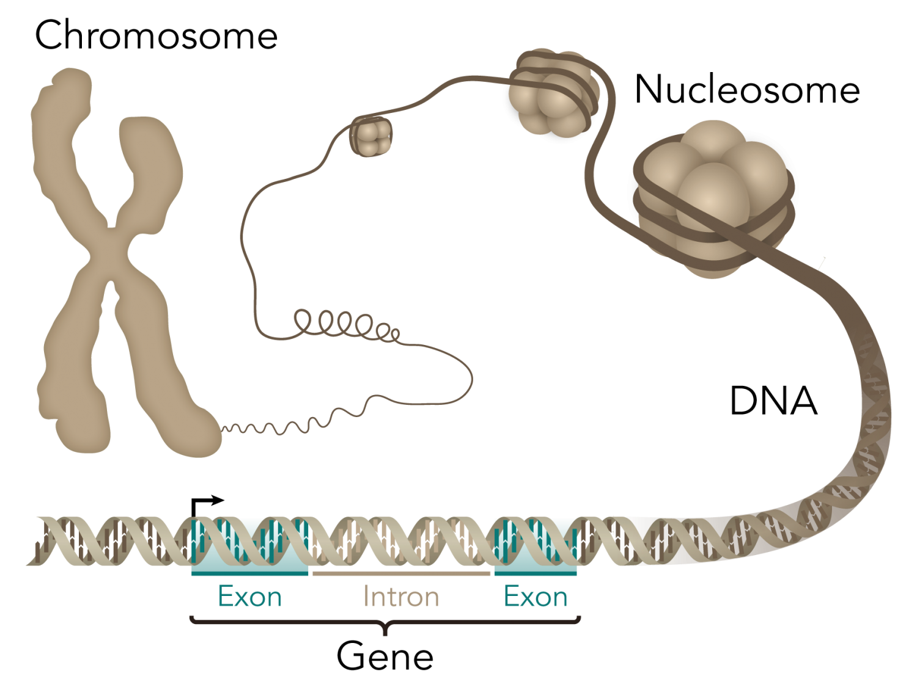
Genes
Units of heredity, often correlated to some characteristic.
Notes:
The internet allows for

Slide 5
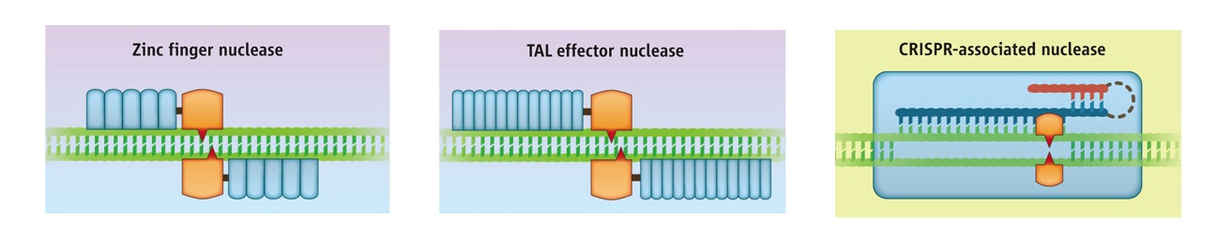
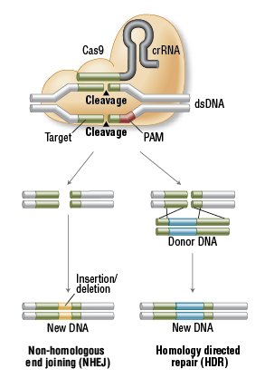
Gene Editing
Genome editing tools have two features:
Recognize specific DNA sequences (i.e. specific genes or non-coding elements)
Cut DNA (“nuclease”), which leaves a broken sequence
“delete”
“copy & paste”
van der Oost. Science (2013) 339:768.
Notes:
The internet allows for

Slide 6

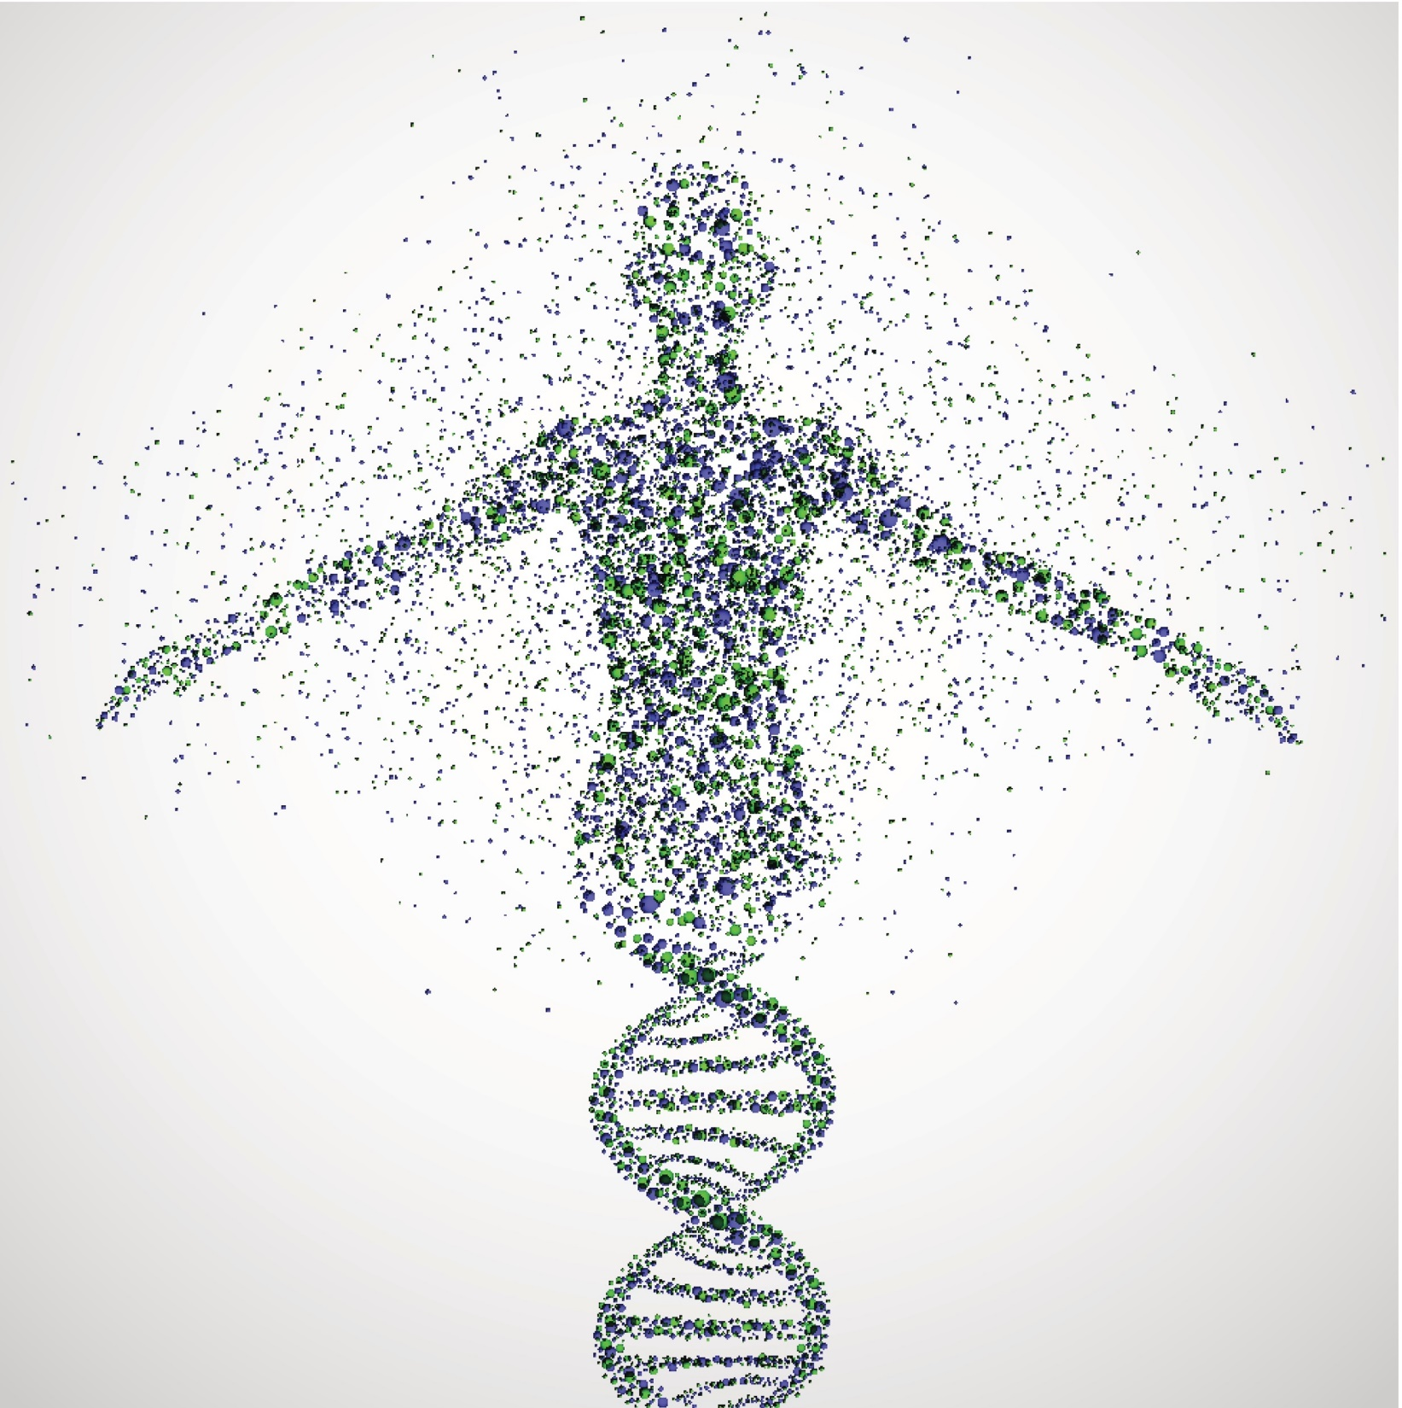
Gene Modification, Options
Zinc Finger Nucleases (ZFNs) – First developed in 1970s & 1980s. Binds to three-nucleotide sequences (but up to 18)
Inconsistent, convoluted, costly, and time consuming to create
Transcription Activator-Like Effector-based Nucleases (TALENs) – First developed in 1990s. Borrowed from bacteria, bind to longer sequences,
Non-trivial production, relatively inexpensive, orderable from a company.
Clustered Regularly Interspaced Short Palindromic Repeats (CRISPR) – Discovered in 1980s, developed recently. Cas family proteins connect to a guide-RNA which binds to 20-nucleotide sequence.
Easy, cheap, efficient, quick.
Notes:
The internet allows for

Slide 7
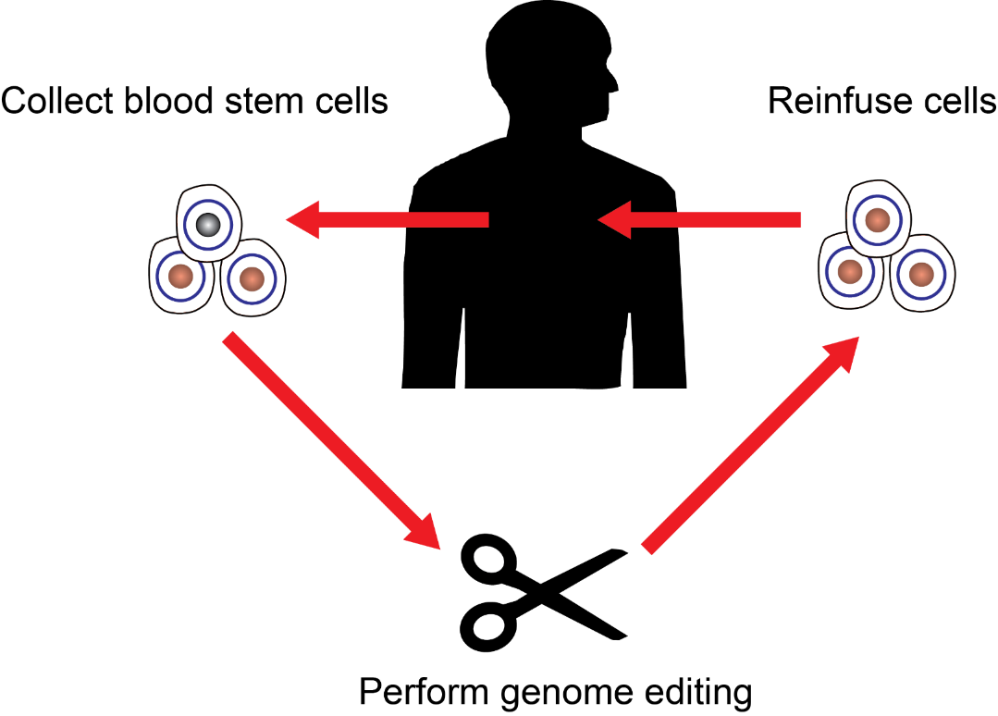
Gene Therapy
IDEAL:
Specific beneficial change at the intended genomic site without impacting remainder of genome.
WORRIES:
New technology
Uncertain efficacy
Off-target effects
Body response?
Notes:
The internet allows for

Slide 8
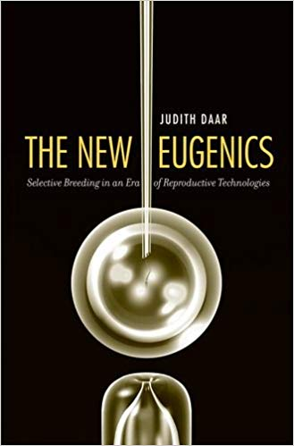
The New Eugenics
Artificial insemination by donor
Egg donation/surrogacy
Prenatal diagnosis of genetic disorders and pregnancy terminations of defective fetuses
Embryo selection
Gene therapy
Cloning
Genetic engineering

Slide 9
What is human enhancement?
Therapy:
biomedical interventions that are used to reduce or remove human disabilities in form or function to what is necessary to restore to ’typical’ health
Enhancement: biomedical interventions that are used to improve human form or functioning beyond
what is necessary to restore or sustain health.
Notes:
Core Value: Having the opportunity to explore the transhuman and posthuman realms
Basic Conditions: Global security, Technological progress, Wide access
Transhuman: a human who uses human enhancements
Posthuman: a human who uses human
enhancements to greatly enhance a
capacity beyond what is possible by
any non-enhanced human.

Slide 10
What is human enhancement?
Permanent:
Changes that cannot be undone
Stable:
Changes that can be undone, but need not be redone
Temporary:
Changes that need be updated each time
Notes:
Core Value: Having the opportunity to explore the transhuman and posthuman realms
Basic Conditions: Global security, Technological progress, Wide access
Transhuman: a human who uses human enhancements
Posthuman: a human who uses human
enhancements to greatly enhance a
capacity beyond what is possible by
any non-enhanced human.

Slide 11


Permanent
Stable
Temporary
e.g. braces, LASIK | e.g. wheelchairs, SSRIs | e.g. government policies, NGOs
e.g. steroids, botox | e.g. caffeine, recreational adderall | e.g. caffeine
Therapy
Enhancement
Notes:
Core Value: Having the opportunity to explore the transhuman and posthuman realms
Basic Conditions: Global security, Technological progress, Wide access

Slide 12
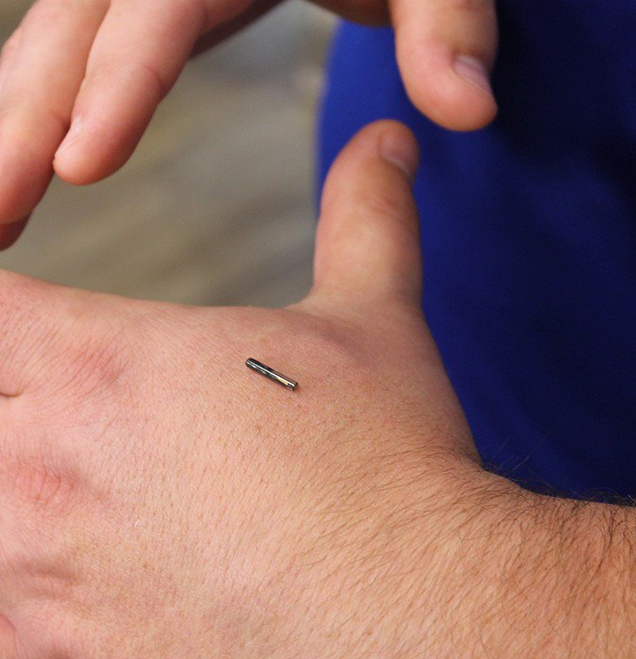
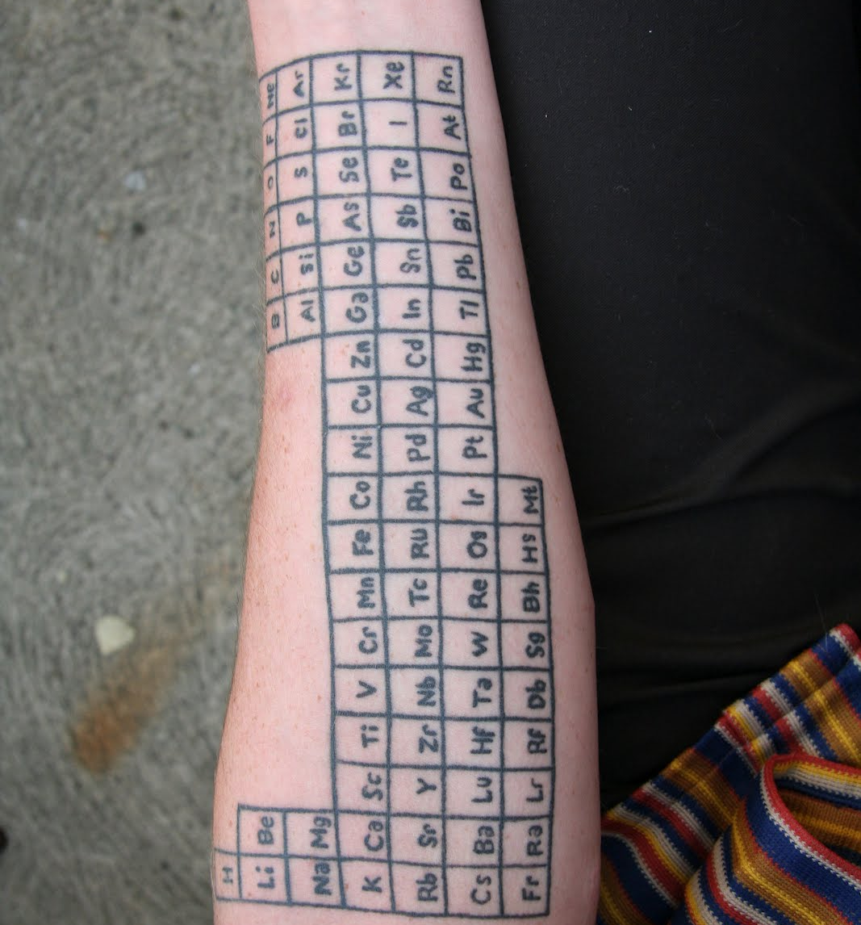
The Sheer Possibility of Enhancement
Body
  Somatic Enhancement (e.g. braces, tattoos, mutilation, plastic surgery, cryonics, transitioning, etc.) Usually cultural
  Prosthetic Enhancement (e.g. Google Glass, RFID chips, nanotechnology, etc.)
  Emotional (usually drugs, but lobotomies & electroshock also)
  Genetic Enhancement (Next Section)

Slide 13
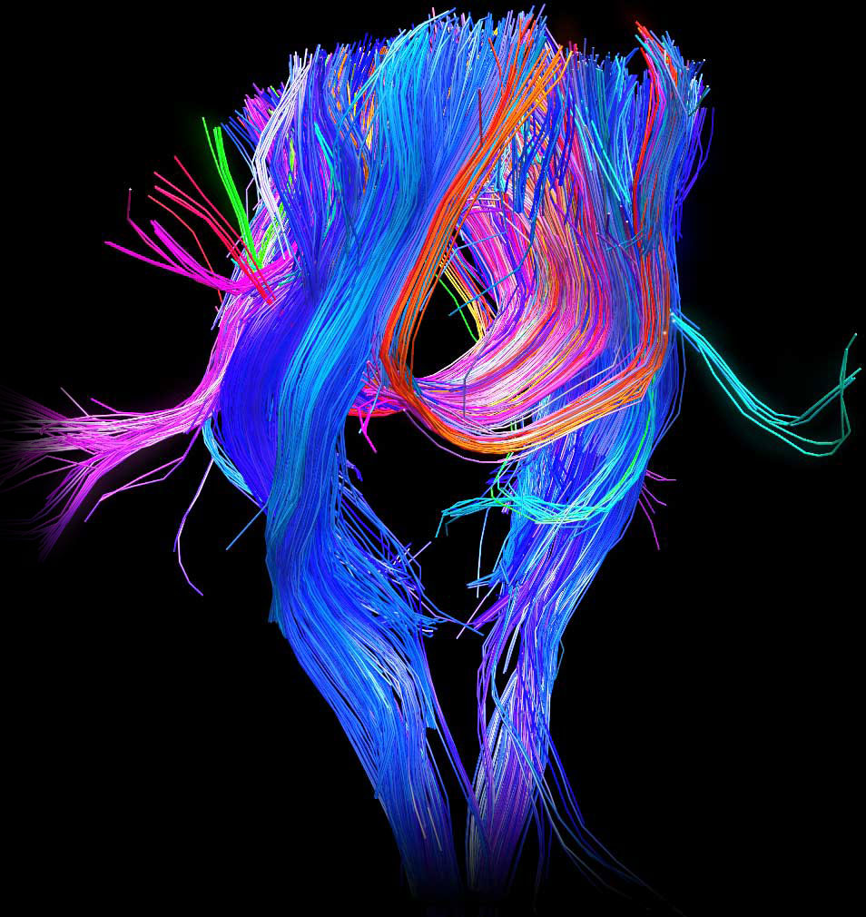
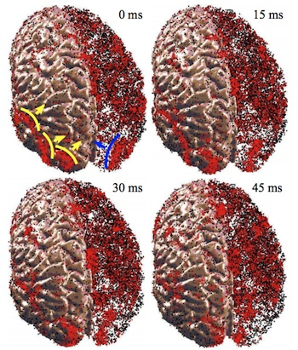
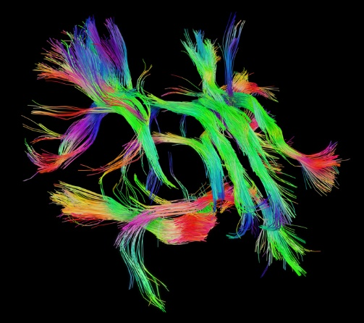
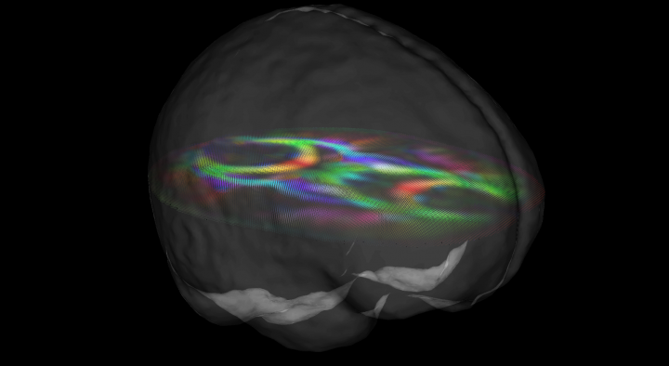
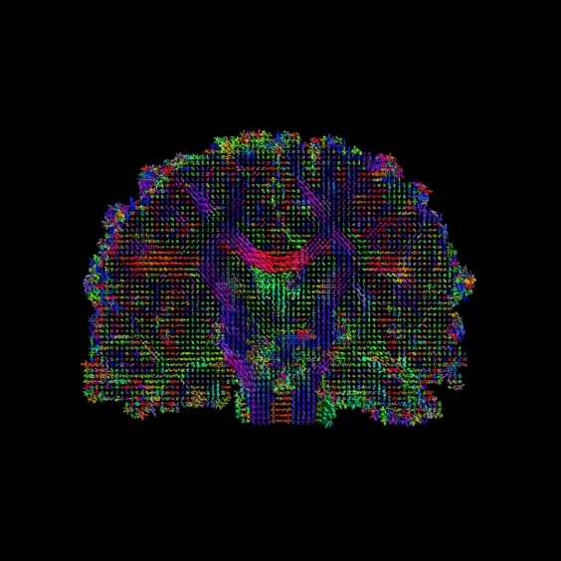
The Sheer Possibility of Enhancement
Mind
Functionalism – The mind is a set of functions (or a Turing machine), able to be brought about by many substrates
Embodied Cognition – The mind is essentially embodied, but the relationship can change
Connectionism – The mind is like a network, we can copy the network, but no part of it contains information independently
Revisionary Materialism – The mind may be physical, but we don’t know what parts matter

Slide 14

The Sheer Possibility of Enhancement
Society
Public policy (Eugenics, war, taxation, etc.)
Revolutionary technology (Telephone, Model T, Internet, etc.)
Revolutionary ideas (Democracy, communism, religion, etc.)
Social Movements (Suffragettes, Braceros, Tea Party, Black Lives Matter, #MeToo)

Slide 15
Outline
Gene Modification
A History of Genetic Modification
How Does it Work?
The New Eugenics
A Timeline

Slide 16
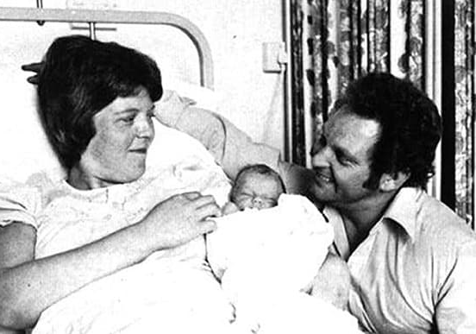
Genetic Timeline
“Shotgun” sequencing
1970
—
—
—
—
1975
—
—
—
—
1980
—
—
—
—
1985
—
—
—
—
1990
—
—
—
—
1995
—
—
—
—
2000
—
—
—
—
2005
—
—
—
—
2010
—
—
—
—
2015
—
—
—
—
2020
First IVF baby
Baby Louise Joy Brown
July 25, 1978
Notes:
Late 1860s: DNA discovered by Friedrich Miescher
1944: Avery, McLeod, and McCarthy argue DNA is hereditary material.
1953: Watson, Crick, Franklin, Wilks discover structure of DNA.
1970s: Sanger and Maxan & Gilbert invent methods of “shotgun” sequencing, which greatly increases the speed of genome sequencing
1983- Kary Mullis invented the Polymerase Chain Reaction (PCR). The PCR is able to rapidly ‘amplify’ or make copies of DNA segments
1990-2003- The Human Genome Project seeks to find genetic maps, physical maps, and the complete nucleotide sequence map of the human chromosomes.
Rebergy was settled with chakraberty (patenting microorganism) i.e. life
Insulin patent was granted a posteriori after chakrabarty settled.
Relaxin -A DNA fragment encoding human H2-preprorelaxin, said H2-preprorelaxin having the amino-acid sequence set out in Figure 2 http://www.epo.org/law-practice/case-law-appeals/recent/t950272eu2.html «a hormone which relaxes the uterus during childbirth, and which, it was hoped, could have medical application in reducing the need for caesarean deliveries in difficult pregnancies”
G0002/06 (Use of embryos/WARF) of 25.11.2008 - In 1998 the named inventor using the methods suggested in the application was the first to successfully isolate and culture human embryonic stem cells that can grow in vitro. The provision of these is a major scientific breakthrough and pioneering invention opening up a new and very exciting field of research having great potential for promising medical therapies and other applications, and worthy of patent protection. EP0770125 - PRIMATE EMBRYONIC STEM CELLS [
Brüstle case (2011) " (C-34/10), that Article 6(2)(c) of the EU directive excludes from patentability an invention which presupposes the destruction of a human embryo irrespective of the point in time at which such destruction takes place.
USPTO was grnating patents for decades until Myriad…
http://books.google.ch/books?id=d9UaB_jJ_80C&pg=PA126&lpg=PA126&dq=T+272/95+Relaxin/HOWARD+FLOREY&source=bl&ots=Iatzi2Zxk0&sig=E65NoH9lyZKDV1FdNxZLEjbfjRQ&hl=en&sa=X&ei=ydAhU7LfOKfB7AaA1IHIDA&ved=0CDgQ6AEwAg#v=onepage&q=T%20272%2F95%20Relaxin%2FHOWARD%20FLOREY&f=false
Mircroorganism landmark 1977 CCPA re Bergy
http://www.alrc.gov.au/publications/3-gene-patents/brief-history-gene-patents
http://www.nytimes.com/1988/04/13/us/harvard-gets-mouse-patent-a-world-first.html
https://casetext.com/case/in-re-application-of-bergy#.UzqL8WcrjvU
Note Pasteur granted a patent on new yeast strain for brewing in 1873
https://www.google.com/patents/US135245?dq=louis+pasteur&hl=en&sa=X&ei=UwRMU46uOunOygPVy4KYBg&sqi=2&pjf=1&ved=0CDUQ6AEwAA
novel method for producing yeast cultures. On 29 July 1873, microbiologist Louis Pasteur patented his improved yeast-making method at the French Patent Office.

Slide 17
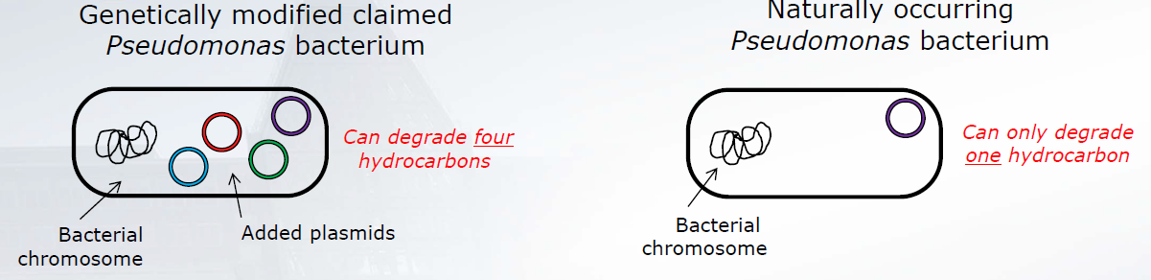
Genetic Timeline
Diamond v. Chakrabarty (1980)
“Shotgun” sequencing
Patented bacteria
1970
—
—
—
—
1975
—
—
—
—
1980
—
—
—
—
1985
—
—
—
—
1990
—
—
—
—
1995
—
—
—
—
2000
—
—
—
—
2005
—
—
—
—
2010
—
—
—
—
2015
—
—
—
—
2020
First IVF baby
Synthetic insulin
Genetic engineer developed a bacterium capable of breaking down crude oil, proposed to use in treating oil spills.
Supreme Court upholds the right to patent organisms
Notes:
Late 1860s: DNA discovered by Friedrich Miescher
1944: Avery, McLeod, and McCarthy argue DNA is hereditary material.
1953: Watson, Crick, Franklin, Wilks discover structure of DNA.
1970s: Sanger and Maxan & Gilbert invent methods of “shotgun” sequencing, which greatly increases the speed of genome sequencing
1983- Kary Mullis invented the Polymerase Chain Reaction (PCR). The PCR is able to rapidly ‘amplify’ or make copies of DNA segments
1990-2003- The Human Genome Project seeks to find genetic maps, physical maps, and the complete nucleotide sequence map of the human chromosomes.
Rebergy was settled with chakraberty (patenting microorganism) i.e. life
Insulin patent was granted a posteriori after chakrabarty settled.
Relaxin -A DNA fragment encoding human H2-preprorelaxin, said H2-preprorelaxin having the amino-acid sequence set out in Figure 2 http://www.epo.org/law-practice/case-law-appeals/recent/t950272eu2.html «a hormone which relaxes the uterus during childbirth, and which, it was hoped, could have medical application in reducing the need for caesarean deliveries in difficult pregnancies”
G0002/06 (Use of embryos/WARF) of 25.11.2008 - In 1998 the named inventor using the methods suggested in the application was the first to successfully isolate and culture human embryonic stem cells that can grow in vitro. The provision of these is a major scientific breakthrough and pioneering invention opening up a new and very exciting field of research having great potential for promising medical therapies and other applications, and worthy of patent protection. EP0770125 - PRIMATE EMBRYONIC STEM CELLS [
Brüstle case (2011) " (C-34/10), that Article 6(2)(c) of the EU directive excludes from patentability an invention which presupposes the destruction of a human embryo irrespective of the point in time at which such destruction takes place.
USPTO was grnating patents for decades until Myriad…
http://books.google.ch/books?id=d9UaB_jJ_80C&pg=PA126&lpg=PA126&dq=T+272/95+Relaxin/HOWARD+FLOREY&source=bl&ots=Iatzi2Zxk0&sig=E65NoH9lyZKDV1FdNxZLEjbfjRQ&hl=en&sa=X&ei=ydAhU7LfOKfB7AaA1IHIDA&ved=0CDgQ6AEwAg#v=onepage&q=T%20272%2F95%20Relaxin%2FHOWARD%20FLOREY&f=false
Mircroorganism landmark 1977 CCPA re Bergy
http://www.alrc.gov.au/publications/3-gene-patents/brief-history-gene-patents
http://www.nytimes.com/1988/04/13/us/harvard-gets-mouse-patent-a-world-first.html
https://casetext.com/case/in-re-application-of-bergy#.UzqL8WcrjvU
Note Pasteur granted a patent on new yeast strain for brewing in 1873
https://www.google.com/patents/US135245?dq=louis+pasteur&hl=en&sa=X&ei=UwRMU46uOunOygPVy4KYBg&sqi=2&pjf=1&ved=0CDUQ6AEwAA
novel method for producing yeast cultures. On 29 July 1873, microbiologist Louis Pasteur patented his improved yeast-making method at the French Patent Office.

Slide 18
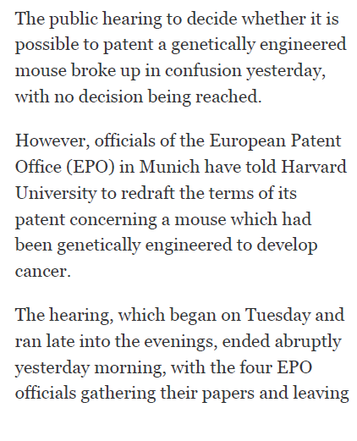
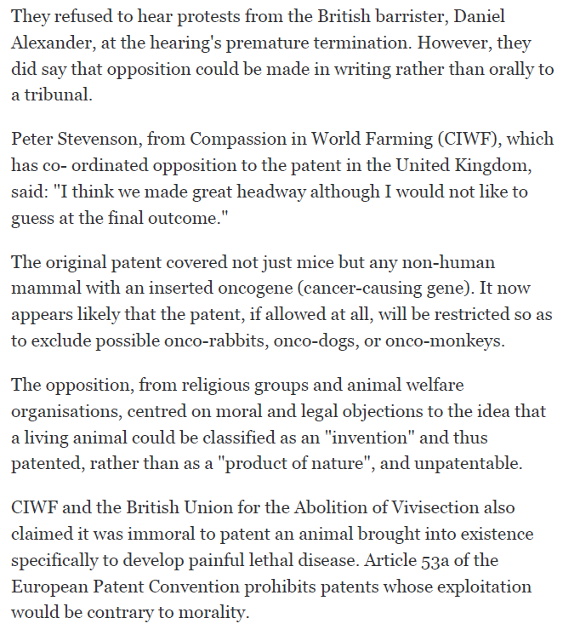
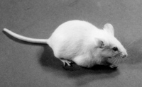
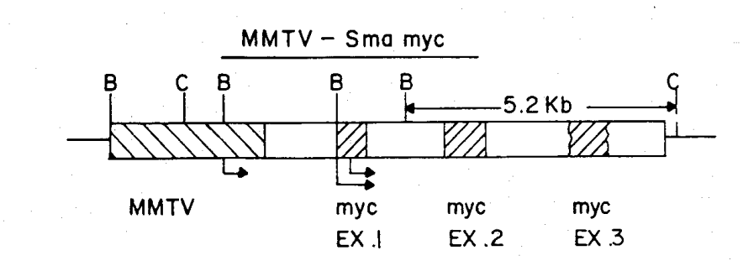

Genetic Timeline
“Shotgun” sequencing
Patented bacteria
1970
—
—
—
—
1975
—
—
—
—
1980
—
—
—
—
1985
—
—
—
—
1990
—
—
—
—
1995
—
—
—
—
2000
—
—
—
—
2005
—
—
—
—
2010
—
—
—
—
2015
—
—
—
—
2020
First IVF baby
Patented mouse
Synthetic insulin
Genetic ‘amplification’
Harvard OncoMouse (1984-2004)
Patent granted in US, Europe, Canada, and Japan
Notes:
Late 1860s: DNA discovered by Friedrich Miescher
1944: Avery, McLeod, and McCarthy argue DNA is hereditary material.
1953: Watson, Crick, Franklin, Wilks discover structure of DNA.
1970s: Sanger and Maxan & Gilbert invent methods of “shotgun” sequencing, which greatly increases the speed of genome sequencing
1983- Kary Mullis invented the Polymerase Chain Reaction (PCR). The PCR is able to rapidly ‘amplify’ or make copies of DNA segments
1990-2003- The Human Genome Project seeks to find genetic maps, physical maps, and the complete nucleotide sequence map of the human chromosomes.
Rebergy was settled with chakraberty (patenting microorganism) i.e. life
Insulin patent was granted a posteriori after chakrabarty settled.
Relaxin -A DNA fragment encoding human H2-preprorelaxin, said H2-preprorelaxin having the amino-acid sequence set out in Figure 2 http://www.epo.org/law-practice/case-law-appeals/recent/t950272eu2.html «a hormone which relaxes the uterus during childbirth, and which, it was hoped, could have medical application in reducing the need for caesarean deliveries in difficult pregnancies”
G0002/06 (Use of embryos/WARF) of 25.11.2008 - In 1998 the named inventor using the methods suggested in the application was the first to successfully isolate and culture human embryonic stem cells that can grow in vitro. The provision of these is a major scientific breakthrough and pioneering invention opening up a new and very exciting field of research having great potential for promising medical therapies and other applications, and worthy of patent protection. EP0770125 - PRIMATE EMBRYONIC STEM CELLS [
Brüstle case (2011) " (C-34/10), that Article 6(2)(c) of the EU directive excludes from patentability an invention which presupposes the destruction of a human embryo irrespective of the point in time at which such destruction takes place.
USPTO was grnating patents for decades until Myriad…
http://books.google.ch/books?id=d9UaB_jJ_80C&pg=PA126&lpg=PA126&dq=T+272/95+Relaxin/HOWARD+FLOREY&source=bl&ots=Iatzi2Zxk0&sig=E65NoH9lyZKDV1FdNxZLEjbfjRQ&hl=en&sa=X&ei=ydAhU7LfOKfB7AaA1IHIDA&ved=0CDgQ6AEwAg#v=onepage&q=T%20272%2F95%20Relaxin%2FHOWARD%20FLOREY&f=false
Mircroorganism landmark 1977 CCPA re Bergy
http://www.alrc.gov.au/publications/3-gene-patents/brief-history-gene-patents
http://www.nytimes.com/1988/04/13/us/harvard-gets-mouse-patent-a-world-first.html
https://casetext.com/case/in-re-application-of-bergy#.UzqL8WcrjvU
Note Pasteur granted a patent on new yeast strain for brewing in 1873
https://www.google.com/patents/US135245?dq=louis+pasteur&hl=en&sa=X&ei=UwRMU46uOunOygPVy4KYBg&sqi=2&pjf=1&ved=0CDUQ6AEwAA
novel method for producing yeast cultures. On 29 July 1873, microbiologist Louis Pasteur patented his improved yeast-making method at the French Patent Office.

Slide 19
Genetic Timeline
“Shotgun” sequencing
Patented bacteria
1970
—
—
—
—
1975
—
—
—
—
1980
—
—
—
—
1985
—
—
—
—
1990
—
—
—
—
1995
—
—
—
—
2000
—
—
—
—
2005
—
—
—
—
2010
—
—
—
—
2015
—
—
—
—
2020
First IVF baby
Patented mouse
Synthetic insulin
Genetic ‘amplification’
Human Genome Project
Notes:
Late 1860s: DNA discovered by Friedrich Miescher
1944: Avery, McLeod, and McCarthy argue DNA is hereditary material.
1953: Watson, Crick, Franklin, Wilks discover structure of DNA.
1970s: Sanger and Maxan & Gilbert invent methods of “shotgun” sequencing, which greatly increases the speed of genome sequencing
1983- Kary Mullis invented the Polymerase Chain Reaction (PCR). The PCR is able to rapidly ‘amplify’ or make copies of DNA segments
1990-2003- The Human Genome Project seeks to find genetic maps, physical maps, and the complete nucleotide sequence map of the human chromosomes.
Rebergy was settled with chakraberty (patenting microorganism) i.e. life
Insulin patent was granted a posteriori after chakrabarty settled.
Relaxin -A DNA fragment encoding human H2-preprorelaxin, said H2-preprorelaxin having the amino-acid sequence set out in Figure 2 http://www.epo.org/law-practice/case-law-appeals/recent/t950272eu2.html «a hormone which relaxes the uterus during childbirth, and which, it was hoped, could have medical application in reducing the need for caesarean deliveries in difficult pregnancies”
G0002/06 (Use of embryos/WARF) of 25.11.2008 - In 1998 the named inventor using the methods suggested in the application was the first to successfully isolate and culture human embryonic stem cells that can grow in vitro. The provision of these is a major scientific breakthrough and pioneering invention opening up a new and very exciting field of research having great potential for promising medical therapies and other applications, and worthy of patent protection. EP0770125 - PRIMATE EMBRYONIC STEM CELLS [
Brüstle case (2011) " (C-34/10), that Article 6(2)(c) of the EU directive excludes from patentability an invention which presupposes the destruction of a human embryo irrespective of the point in time at which such destruction takes place.
USPTO was grnating patents for decades until Myriad…
http://books.google.ch/books?id=d9UaB_jJ_80C&pg=PA126&lpg=PA126&dq=T+272/95+Relaxin/HOWARD+FLOREY&source=bl&ots=Iatzi2Zxk0&sig=E65NoH9lyZKDV1FdNxZLEjbfjRQ&hl=en&sa=X&ei=ydAhU7LfOKfB7AaA1IHIDA&ved=0CDgQ6AEwAg#v=onepage&q=T%20272%2F95%20Relaxin%2FHOWARD%20FLOREY&f=false
Mircroorganism landmark 1977 CCPA re Bergy
http://www.alrc.gov.au/publications/3-gene-patents/brief-history-gene-patents
http://www.nytimes.com/1988/04/13/us/harvard-gets-mouse-patent-a-world-first.html
https://casetext.com/case/in-re-application-of-bergy#.UzqL8WcrjvU
Note Pasteur granted a patent on new yeast strain for brewing in 1873
https://www.google.com/patents/US135245?dq=louis+pasteur&hl=en&sa=X&ei=UwRMU46uOunOygPVy4KYBg&sqi=2&pjf=1&ved=0CDUQ6AEwAA
novel method for producing yeast cultures. On 29 July 1873, microbiologist Louis Pasteur patented his improved yeast-making method at the French Patent Office.

Slide 20
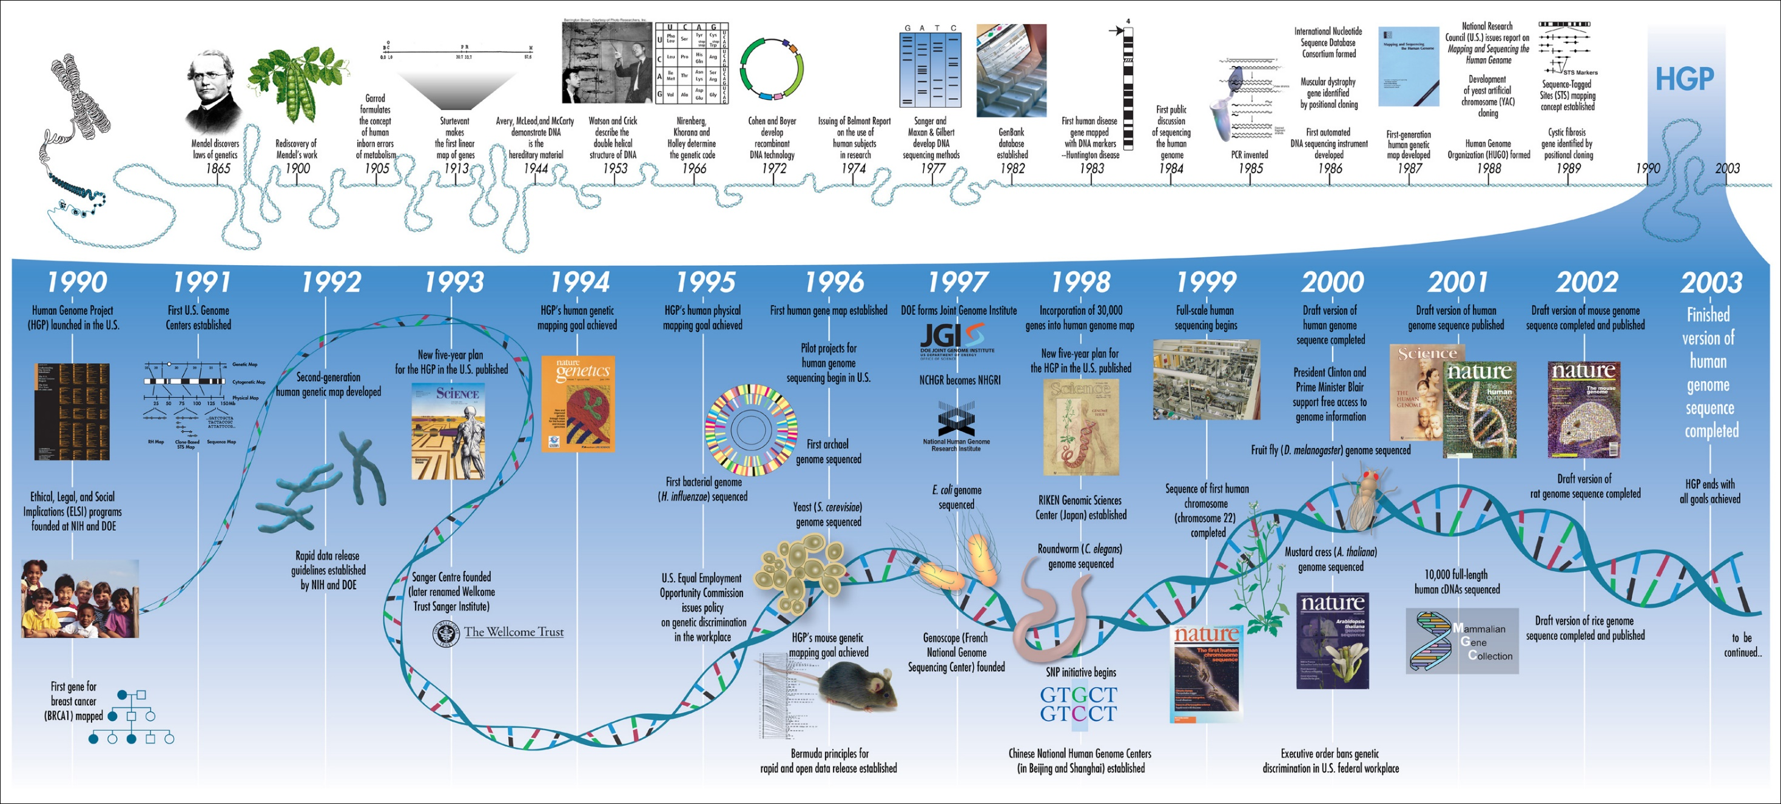
The Human Genome Project
$3B project conducted over 15 years
Composite genome from 10-20 primary samples taken from numerous anonymous donors across racial and ethnic groups.
Goals: to discover the genes responsible for all human traits
Results:
  Discovered that ‘race’ is difficult to justify genetically,
  mutation speed is 2x faster in men than women,
  humans have ¼ genes expected,
  200 directly inherited from bacteria,
  genes are more complicated than we thought
Notes:
Improvements in medicine: improved diagnosis of disease.
Microbial research: new energy sources, bio fuels.
DNA forensics: identifying potential suspects at a crime scene.
Agriculture: more nutritious produce.
Evolution and human migration: study migration of different population groups based on female genetic inheritance.
- Risk assessment: reduce the likelihood of heritable mutations.

Slide 21
The Human Genome Project
$3B project conducted over 15 years
Composite genome from 10-20 primary samples taken from numerous anonymous donors across racial and ethnic groups.
Goals: to discover the genes responsible for all human traits
Notes:
Improvements in medicine: improved diagnosis of disease.
Microbial research: new energy sources, bio fuels.
DNA forensics: identifying potential suspects at a crime scene.
Agriculture: more nutritious produce.
Evolution and human migration: study migration of different population groups based on female genetic inheritance.
- Risk assessment: reduce the likelihood of heritable mutations.

Slide 22
The Human Genome Project
$3B project conducted over 15 years
Composite genome from 10-20 primary samples taken from numerous anonymous donors across racial and ethnic groups.
Goals: to discover the genes responsible for all human traits
Results:
  Discovered that ‘race’ is difficult to justify genetically,
  mutation speed is 2x faster in men than women,
  humans have ¼ genes expected,
    200 directly inherited from bacteria,
  genes are more complicated than we thought
Notes:
Improvements in medicine: improved diagnosis of disease.
Microbial research: new energy sources, bio fuels.
DNA forensics: identifying potential suspects at a crime scene.
Agriculture: more nutritious produce.
Evolution and human migration: study migration of different population groups based on female genetic inheritance.
- Risk assessment: reduce the likelihood of heritable mutations.

Slide 23
Genetic Timeline
“Shotgun” sequencing
Patented bacteria
1970
—
—
—
—
1975
—
—
—
—
1980
—
—
—
—
1985
—
—
—
—
1990
—
—
—
—
1995
—
—
—
—
2000
—
—
—
—
2005
—
—
—
—
2010
—
—
—
—
2015
—
—
—
—
2020
First IVF baby
Patented mouse
Synthetic insulin
Embryonic Stem Cell research funded
Genetic ‘amplification’
Human Genome Project
Embryonic Stem Cell research limited
Notes:
Late 1860s: DNA discovered by Friedrich Miescher
1944: Avery, McLeod, and McCarthy argue DNA is hereditary material.
1953: Watson, Crick, Franklin, Wilks discover structure of DNA.
1970s: Sanger and Maxan & Gilbert invent methods of “shotgun” sequencing, which greatly increases the speed of genome sequencing
1983- Kary Mullis invented the Polymerase Chain Reaction (PCR). The PCR is able to rapidly ‘amplify’ or make copies of DNA segments
1990-2003- The Human Genome Project seeks to find genetic maps, physical maps, and the complete nucleotide sequence map of the human chromosomes.
Rebergy was settled with chakraberty (patenting microorganism) i.e. life
Insulin patent was granted a posteriori after chakrabarty settled.
Relaxin -A DNA fragment encoding human H2-preprorelaxin, said H2-preprorelaxin having the amino-acid sequence set out in Figure 2 http://www.epo.org/law-practice/case-law-appeals/recent/t950272eu2.html «a hormone which relaxes the uterus during childbirth, and which, it was hoped, could have medical application in reducing the need for caesarean deliveries in difficult pregnancies”
G0002/06 (Use of embryos/WARF) of 25.11.2008 - In 1998 the named inventor using the methods suggested in the application was the first to successfully isolate and culture human embryonic stem cells that can grow in vitro. The provision of these is a major scientific breakthrough and pioneering invention opening up a new and very exciting field of research having great potential for promising medical therapies and other applications, and worthy of patent protection. EP0770125 - PRIMATE EMBRYONIC STEM CELLS [
Brüstle case (2011) " (C-34/10), that Article 6(2)(c) of the EU directive excludes from patentability an invention which presupposes the destruction of a human embryo irrespective of the point in time at which such destruction takes place.
USPTO was grnating patents for decades until Myriad…
http://books.google.ch/books?id=d9UaB_jJ_80C&pg=PA126&lpg=PA126&dq=T+272/95+Relaxin/HOWARD+FLOREY&source=bl&ots=Iatzi2Zxk0&sig=E65NoH9lyZKDV1FdNxZLEjbfjRQ&hl=en&sa=X&ei=ydAhU7LfOKfB7AaA1IHIDA&ved=0CDgQ6AEwAg#v=onepage&q=T%20272%2F95%20Relaxin%2FHOWARD%20FLOREY&f=false
Mircroorganism landmark 1977 CCPA re Bergy
http://www.alrc.gov.au/publications/3-gene-patents/brief-history-gene-patents
http://www.nytimes.com/1988/04/13/us/harvard-gets-mouse-patent-a-world-first.html
https://casetext.com/case/in-re-application-of-bergy#.UzqL8WcrjvU
Note Pasteur granted a patent on new yeast strain for brewing in 1873
https://www.google.com/patents/US135245?dq=louis+pasteur&hl=en&sa=X&ei=UwRMU46uOunOygPVy4KYBg&sqi=2&pjf=1&ved=0CDUQ6AEwAA
novel method for producing yeast cultures. On 29 July 1873, microbiologist Louis Pasteur patented his improved yeast-making method at the French Patent Office.

Slide 24
Genetic Timeline
“Shotgun” sequencing
Patented bacteria
1970
—
—
—
—
1975
—
—
—
—
1980
—
—
—
—
1985
—
—
—
—
1990
—
—
—
—
1995
—
—
—
—
2000
—
—
—
—
2005
—
—
—
—
2010
—
—
—
—
2015
—
—
—
—
2020
First IVF baby
Patented mouse
Synthetic insulin
Embryonic Stem Cell research funded
Genetic ‘amplification’
Human Genome Project
Patented naturally occurring gene
Embryonic Stem Cell research limited
Notes:
Late 1860s: DNA discovered by Friedrich Miescher
1944: Avery, McLeod, and McCarthy argue DNA is hereditary material.
1953: Watson, Crick, Franklin, Wilks discover structure of DNA.
1970s: Sanger and Maxan & Gilbert invent methods of “shotgun” sequencing, which greatly increases the speed of genome sequencing
1983- Kary Mullis invented the Polymerase Chain Reaction (PCR). The PCR is able to rapidly ‘amplify’ or make copies of DNA segments
1990-2003- The Human Genome Project seeks to find genetic maps, physical maps, and the complete nucleotide sequence map of the human chromosomes.
Rebergy was settled with chakraberty (patenting microorganism) i.e. life
Insulin patent was granted a posteriori after chakrabarty settled.
Relaxin -A DNA fragment encoding human H2-preprorelaxin, said H2-preprorelaxin having the amino-acid sequence set out in Figure 2 http://www.epo.org/law-practice/case-law-appeals/recent/t950272eu2.html «a hormone which relaxes the uterus during childbirth, and which, it was hoped, could have medical application in reducing the need for caesarean deliveries in difficult pregnancies”
G0002/06 (Use of embryos/WARF) of 25.11.2008 - In 1998 the named inventor using the methods suggested in the application was the first to successfully isolate and culture human embryonic stem cells that can grow in vitro. The provision of these is a major scientific breakthrough and pioneering invention opening up a new and very exciting field of research having great potential for promising medical therapies and other applications, and worthy of patent protection. EP0770125 - PRIMATE EMBRYONIC STEM CELLS [
Brüstle case (2011) " (C-34/10), that Article 6(2)(c) of the EU directive excludes from patentability an invention which presupposes the destruction of a human embryo irrespective of the point in time at which such destruction takes place.
USPTO was grnating patents for decades until Myriad…
http://books.google.ch/books?id=d9UaB_jJ_80C&pg=PA126&lpg=PA126&dq=T+272/95+Relaxin/HOWARD+FLOREY&source=bl&ots=Iatzi2Zxk0&sig=E65NoH9lyZKDV1FdNxZLEjbfjRQ&hl=en&sa=X&ei=ydAhU7LfOKfB7AaA1IHIDA&ved=0CDgQ6AEwAg#v=onepage&q=T%20272%2F95%20Relaxin%2FHOWARD%20FLOREY&f=false
Mircroorganism landmark 1977 CCPA re Bergy
http://www.alrc.gov.au/publications/3-gene-patents/brief-history-gene-patents
http://www.nytimes.com/1988/04/13/us/harvard-gets-mouse-patent-a-world-first.html
https://casetext.com/case/in-re-application-of-bergy#.UzqL8WcrjvU
Note Pasteur granted a patent on new yeast strain for brewing in 1873
https://www.google.com/patents/US135245?dq=louis+pasteur&hl=en&sa=X&ei=UwRMU46uOunOygPVy4KYBg&sqi=2&pjf=1&ved=0CDUQ6AEwAA
novel method for producing yeast cultures. On 29 July 1873, microbiologist Louis Pasteur patented his improved yeast-making method at the French Patent Office.

Slide 25
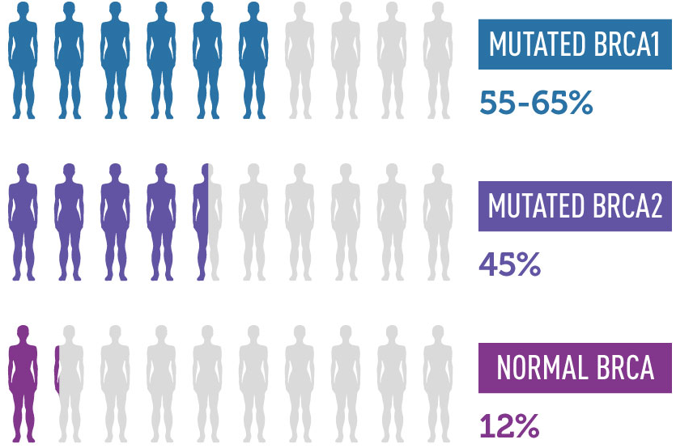
Patented naturally occurring gene
CHANCES OF DEVELOPING BREAST CANCER BY THE AGE OF 70
Suspected in 1990, discovered in 1994 by scientists at the University of Utah
Patented in 1995
Led to Myriad becoming worth $500M within 15 years.
Diagnosis was $3000+ and proprietary
Notes:
Late 1860s: DNA discovered by Friedrich Miescher
1944: Avery, McLeod, and McCarthy argue DNA is hereditary material.
1953: Watson, Crick, Franklin, Wilks discover structure of DNA.
1970s: Sanger and Maxan & Gilbert invent methods of “shotgun” sequencing, which greatly increases the speed of genome sequencing
1983- Kary Mullis invented the Polymerase Chain Reaction (PCR). The PCR is able to rapidly ‘amplify’ or make copies of DNA segments
1990-2003- The Human Genome Project seeks to find genetic maps, physical maps, and the complete nucleotide sequence map of the human chromosomes.
Rebergy was settled with chakraberty (patenting microorganism) i.e. life
Insulin patent was granted a posteriori after chakrabarty settled.
Relaxin -A DNA fragment encoding human H2-preprorelaxin, said H2-preprorelaxin having the amino-acid sequence set out in Figure 2 http://www.epo.org/law-practice/case-law-appeals/recent/t950272eu2.html «a hormone which relaxes the uterus during childbirth, and which, it was hoped, could have medical application in reducing the need for caesarean deliveries in difficult pregnancies”
G0002/06 (Use of embryos/WARF) of 25.11.2008 - In 1998 the named inventor using the methods suggested in the application was the first to successfully isolate and culture human embryonic stem cells that can grow in vitro. The provision of these is a major scientific breakthrough and pioneering invention opening up a new and very exciting field of research having great potential for promising medical therapies and other applications, and worthy of patent protection. EP0770125 - PRIMATE EMBRYONIC STEM CELLS [
Brüstle case (2011) " (C-34/10), that Article 6(2)(c) of the EU directive excludes from patentability an invention which presupposes the destruction of a human embryo irrespective of the point in time at which such destruction takes place.
USPTO was grnating patents for decades until Myriad…
http://books.google.ch/books?id=d9UaB_jJ_80C&pg=PA126&lpg=PA126&dq=T+272/95+Relaxin/HOWARD+FLOREY&source=bl&ots=Iatzi2Zxk0&sig=E65NoH9lyZKDV1FdNxZLEjbfjRQ&hl=en&sa=X&ei=ydAhU7LfOKfB7AaA1IHIDA&ved=0CDgQ6AEwAg#v=onepage&q=T%20272%2F95%20Relaxin%2FHOWARD%20FLOREY&f=false
Mircroorganism landmark 1977 CCPA re Bergy
http://www.alrc.gov.au/publications/3-gene-patents/brief-history-gene-patents
http://www.nytimes.com/1988/04/13/us/harvard-gets-mouse-patent-a-world-first.html
https://casetext.com/case/in-re-application-of-bergy#.UzqL8WcrjvU
Note Pasteur granted a patent on new yeast strain for brewing in 1873
https://www.google.com/patents/US135245?dq=louis+pasteur&hl=en&sa=X&ei=UwRMU46uOunOygPVy4KYBg&sqi=2&pjf=1&ved=0CDUQ6AEwAA
novel method for producing yeast cultures. On 29 July 1873, microbiologist Louis Pasteur patented his improved yeast-making method at the French Patent Office.

Slide 26
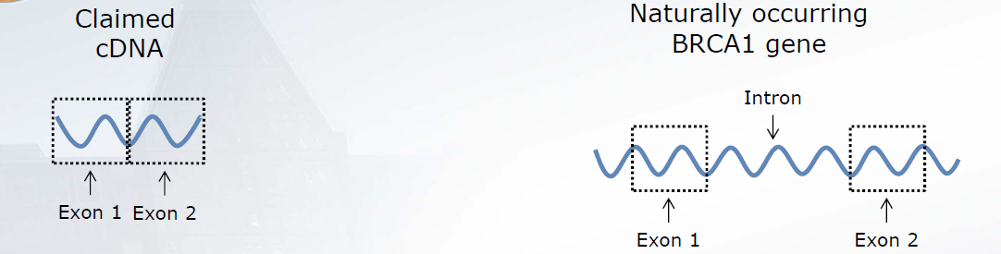
Association for Molecular Pathology v. Myriad Genetics, Inc. (2012)
Gene patent ruled invalid
Notes:
Late 1860s: DNA discovered by Friedrich Miescher
1944: Avery, McLeod, and McCarthy argue DNA is hereditary material.
1953: Watson, Crick, Franklin, Wilks discover structure of DNA.
1970s: Sanger and Maxan & Gilbert invent methods of “shotgun” sequencing, which greatly increases the speed of genome sequencing
1983- Kary Mullis invented the Polymerase Chain Reaction (PCR). The PCR is able to rapidly ‘amplify’ or make copies of DNA segments
1990-2003- The Human Genome Project seeks to find genetic maps, physical maps, and the complete nucleotide sequence map of the human chromosomes.
Rebergy was settled with chakraberty (patenting microorganism) i.e. life
Insulin patent was granted a posteriori after chakrabarty settled.
Relaxin -A DNA fragment encoding human H2-preprorelaxin, said H2-preprorelaxin having the amino-acid sequence set out in Figure 2 http://www.epo.org/law-practice/case-law-appeals/recent/t950272eu2.html «a hormone which relaxes the uterus during childbirth, and which, it was hoped, could have medical application in reducing the need for caesarean deliveries in difficult pregnancies”
G0002/06 (Use of embryos/WARF) of 25.11.2008 - In 1998 the named inventor using the methods suggested in the application was the first to successfully isolate and culture human embryonic stem cells that can grow in vitro. The provision of these is a major scientific breakthrough and pioneering invention opening up a new and very exciting field of research having great potential for promising medical therapies and other applications, and worthy of patent protection. EP0770125 - PRIMATE EMBRYONIC STEM CELLS [
Brüstle case (2011) " (C-34/10), that Article 6(2)(c) of the EU directive excludes from patentability an invention which presupposes the destruction of a human embryo irrespective of the point in time at which such destruction takes place.
USPTO was grnating patents for decades until Myriad…
http://books.google.ch/books?id=d9UaB_jJ_80C&pg=PA126&lpg=PA126&dq=T+272/95+Relaxin/HOWARD+FLOREY&source=bl&ots=Iatzi2Zxk0&sig=E65NoH9lyZKDV1FdNxZLEjbfjRQ&hl=en&sa=X&ei=ydAhU7LfOKfB7AaA1IHIDA&ved=0CDgQ6AEwAg#v=onepage&q=T%20272%2F95%20Relaxin%2FHOWARD%20FLOREY&f=false
Mircroorganism landmark 1977 CCPA re Bergy
http://www.alrc.gov.au/publications/3-gene-patents/brief-history-gene-patents
http://www.nytimes.com/1988/04/13/us/harvard-gets-mouse-patent-a-world-first.html
https://casetext.com/case/in-re-application-of-bergy#.UzqL8WcrjvU
Note Pasteur granted a patent on new yeast strain for brewing in 1873
https://www.google.com/patents/US135245?dq=louis+pasteur&hl=en&sa=X&ei=UwRMU46uOunOygPVy4KYBg&sqi=2&pjf=1&ved=0CDUQ6AEwAA
novel method for producing yeast cultures. On 29 July 1873, microbiologist Louis Pasteur patented his improved yeast-making method at the French Patent Office.

Slide 27
Genetic Timeline
“Shotgun” sequencing
Patented bacteria
1970
—
—
—
—
1975
—
—
—
—
1980
—
—
—
—
1985
—
—
—
—
1990
—
—
—
—
1995
—
—
—
—
2000
—
—
—
—
2005
—
—
—
—
2010
—
—
—
—
2015
—
—
—
—
2020
First IVF baby
Patented mouse
Synthetic insulin
Embryonic Stem Cell research funded
Genetic ‘amplification’
First animal cloned
Human Genome Project
Patented naturally occurring gene
Embryonic Stem Cell research limited
Gene patent ruled invalid
Notes:
Late 1860s: DNA discovered by Friedrich Miescher
1944: Avery, McLeod, and McCarthy argue DNA is hereditary material.
1953: Watson, Crick, Franklin, Wilks discover structure of DNA.
1970s: Sanger and Maxan & Gilbert invent methods of “shotgun” sequencing, which greatly increases the speed of genome sequencing
1983- Kary Mullis invented the Polymerase Chain Reaction (PCR). The PCR is able to rapidly ‘amplify’ or make copies of DNA segments
1990-2003- The Human Genome Project seeks to find genetic maps, physical maps, and the complete nucleotide sequence map of the human chromosomes.
Rebergy was settled with chakraberty (patenting microorganism) i.e. life
Insulin patent was granted a posteriori after chakrabarty settled.
Relaxin -A DNA fragment encoding human H2-preprorelaxin, said H2-preprorelaxin having the amino-acid sequence set out in Figure 2 http://www.epo.org/law-practice/case-law-appeals/recent/t950272eu2.html «a hormone which relaxes the uterus during childbirth, and which, it was hoped, could have medical application in reducing the need for caesarean deliveries in difficult pregnancies”
G0002/06 (Use of embryos/WARF) of 25.11.2008 - In 1998 the named inventor using the methods suggested in the application was the first to successfully isolate and culture human embryonic stem cells that can grow in vitro. The provision of these is a major scientific breakthrough and pioneering invention opening up a new and very exciting field of research having great potential for promising medical therapies and other applications, and worthy of patent protection. EP0770125 - PRIMATE EMBRYONIC STEM CELLS [
Brüstle case (2011) " (C-34/10), that Article 6(2)(c) of the EU directive excludes from patentability an invention which presupposes the destruction of a human embryo irrespective of the point in time at which such destruction takes place.
USPTO was grnating patents for decades until Myriad…
http://books.google.ch/books?id=d9UaB_jJ_80C&pg=PA126&lpg=PA126&dq=T+272/95+Relaxin/HOWARD+FLOREY&source=bl&ots=Iatzi2Zxk0&sig=E65NoH9lyZKDV1FdNxZLEjbfjRQ&hl=en&sa=X&ei=ydAhU7LfOKfB7AaA1IHIDA&ved=0CDgQ6AEwAg#v=onepage&q=T%20272%2F95%20Relaxin%2FHOWARD%20FLOREY&f=false
Mircroorganism landmark 1977 CCPA re Bergy
http://www.alrc.gov.au/publications/3-gene-patents/brief-history-gene-patents
http://www.nytimes.com/1988/04/13/us/harvard-gets-mouse-patent-a-world-first.html
https://casetext.com/case/in-re-application-of-bergy#.UzqL8WcrjvU
Note Pasteur granted a patent on new yeast strain for brewing in 1873
https://www.google.com/patents/US135245?dq=louis+pasteur&hl=en&sa=X&ei=UwRMU46uOunOygPVy4KYBg&sqi=2&pjf=1&ved=0CDUQ6AEwAA
novel method for producing yeast cultures. On 29 July 1873, microbiologist Louis Pasteur patented his improved yeast-making method at the French Patent Office.

Slide 28
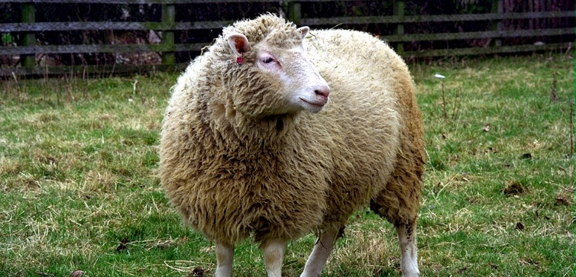
First animal cloned
1997-2003

Slide 29
Genetic Timeline
“Shotgun” sequencing
Patented bacteria
1970
—
—
—
—
1975
—
—
—
—
1980
—
—
—
—
1985
—
—
—
—
1990
—
—
—
—
1995
—
—
—
—
2000
—
—
—
—
2005
—
—
—
—
2010
—
—
—
—
2015
—
—
—
—
2020
First IVF baby
Patented mouse
Synthetic insulin
Embryonic Stem Cell research funded
Genetic ‘amplification’
First animal cloned
Human Genome Project
Patented naturally occurring gene
Jesse Gelsinger
Embryonic Stem Cell research limited
Notes:
The internet allows for

Slide 30
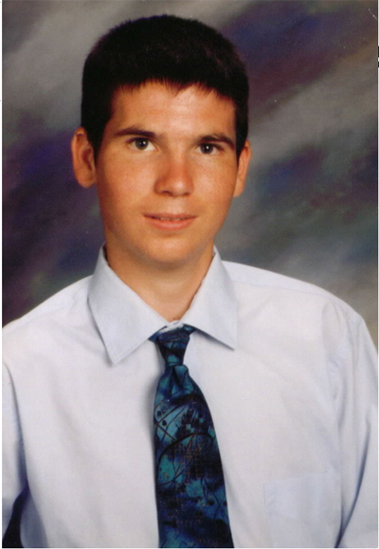
Genetic Timeline
“Shotgun” sequencing
1970
—
—
—
—
1975
—
—
—
—
1980
—
—
—
—
1985
—
—
—
—
1990
—
—
—
—
1995
—
—
—
—
2000
—
—
—
—
2005
—
—
—
—
2010
—
—
—
—
2015
—
—
—
—
2020
Suffered a liver disease that required 32 pills a day and a hyper low-protein diet
Part of an experimental treatment in which he was infected by a retrovirus carrying modified gene
Led to an immune shock: multiple organ failures, died shortly after
Allegations of conflict of interest for Penn researchers, allegations of lack of disclosure, allegations of doctors ignoring potential risk factors
Family settled for an undisclosed amount
First IVF baby
Synthetic insulin
Genetic ‘amplification’
First animal cloned
Human Genome Project
Jesse Gelsinger
Jesse Gelsinger (1981-1999)
Notes:
The internet allows for

Slide 31
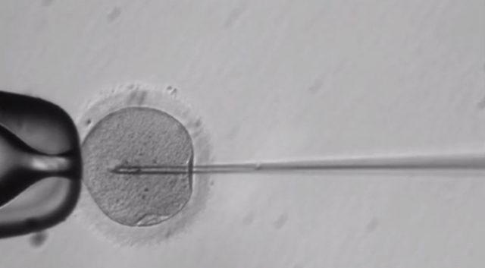
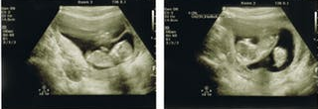
Genetic Timeline
“Shotgun” sequencing
Patented bacteria
1970
—
—
—
—
1975
—
—
—
—
1980
—
—
—
—
1985
—
—
—
—
1990
—
—
—
—
1995
—
—
—
—
2000
—
—
—
—
2005
—
—
—
—
2010
—
—
—
—
2015
—
—
—
—
2020
First IVF baby
Patented mouse
Synthetic insulin
Embryonic Stem Cell research funded
Genetic ‘amplification’
First animal cloned
Human Genome Project
Patented naturally occurring gene
Jesse Gelsinger
Embryonic Stem Cell research limited
Embryo modified
Notes:
Late 1860s: DNA discovered by Friedrich Miescher
1944: Avery, McLeod, and McCarthy argue DNA is hereditary material.
1953: Watson, Crick, Franklin, Wilks discover structure of DNA.
1970s: Sanger and Maxan & Gilbert invent methods of “shotgun” sequencing, which greatly increases the speed of genome sequencing
1983- Kary Mullis invented the Polymerase Chain Reaction (PCR). The PCR is able to rapidly ‘amplify’ or make copies of DNA segments
1990-2003- The Human Genome Project seeks to find genetic maps, physical maps, and the complete nucleotide sequence map of the human chromosomes.
Rebergy was settled with chakraberty (patenting microorganism) i.e. life
Insulin patent was granted a posteriori after chakrabarty settled.
Relaxin -A DNA fragment encoding human H2-preprorelaxin, said H2-preprorelaxin having the amino-acid sequence set out in Figure 2 http://www.epo.org/law-practice/case-law-appeals/recent/t950272eu2.html «a hormone which relaxes the uterus during childbirth, and which, it was hoped, could have medical application in reducing the need for caesarean deliveries in difficult pregnancies”
G0002/06 (Use of embryos/WARF) of 25.11.2008 - In 1998 the named inventor using the methods suggested in the application was the first to successfully isolate and culture human embryonic stem cells that can grow in vitro. The provision of these is a major scientific breakthrough and pioneering invention opening up a new and very exciting field of research having great potential for promising medical therapies and other applications, and worthy of patent protection. EP0770125 - PRIMATE EMBRYONIC STEM CELLS [
Brüstle case (2011) " (C-34/10), that Article 6(2)(c) of the EU directive excludes from patentability an invention which presupposes the destruction of a human embryo irrespective of the point in time at which such destruction takes place.
USPTO was grnating patents for decades until Myriad…
http://books.google.ch/books?id=d9UaB_jJ_80C&pg=PA126&lpg=PA126&dq=T+272/95+Relaxin/HOWARD+FLOREY&source=bl&ots=Iatzi2Zxk0&sig=E65NoH9lyZKDV1FdNxZLEjbfjRQ&hl=en&sa=X&ei=ydAhU7LfOKfB7AaA1IHIDA&ved=0CDgQ6AEwAg#v=onepage&q=T%20272%2F95%20Relaxin%2FHOWARD%20FLOREY&f=false
Mircroorganism landmark 1977 CCPA re Bergy
http://www.alrc.gov.au/publications/3-gene-patents/brief-history-gene-patents
http://www.nytimes.com/1988/04/13/us/harvard-gets-mouse-patent-a-world-first.html
https://casetext.com/case/in-re-application-of-bergy#.UzqL8WcrjvU
Note Pasteur granted a patent on new yeast strain for brewing in 1873
https://www.google.com/patents/US135245?dq=louis+pasteur&hl=en&sa=X&ei=UwRMU46uOunOygPVy4KYBg&sqi=2&pjf=1&ved=0CDUQ6AEwAA
novel method for producing yeast cultures. On 29 July 1873, microbiologist Louis Pasteur patented his improved yeast-making method at the French Patent Office.

Slide 32
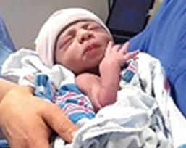
Genetic Timeline
“Shotgun” sequencing
Patented bacteria
1970
—
—
—
—
1975
—
—
—
—
1980
—
—
—
—
1985
—
—
—
—
1990
—
—
—
—
1995
—
—
—
—
2000
—
—
—
—
2005
—
—
—
—
2010
—
—
—
—
2015
—
—
—
—
2020
First IVF baby
Patented mouse
Synthetic insulin
Embryonic Stem Cell research funded
Genetic ‘amplification’
First animal cloned
Human Genome Project
Patented naturally occurring gene
CRISPR as biotechnology
Embryonic Stem Cell research limited
Gene patent ruled invalid
Embryo modified
FDA approved stem cell therapy
First three-parent baby
Baby modified
Germline ‘moratorium’
Notes:
Late 1860s: DNA discovered by Friedrich Miescher
1944: Avery, McLeod, and McCarthy argue DNA is hereditary material.
1953: Watson, Crick, Franklin, Wilks discover structure of DNA.
1970s: Sanger and Maxan & Gilbert invent methods of “shotgun” sequencing, which greatly increases the speed of genome sequencing
1983- Kary Mullis invented the Polymerase Chain Reaction (PCR). The PCR is able to rapidly ‘amplify’ or make copies of DNA segments
1990-2003- The Human Genome Project seeks to find genetic maps, physical maps, and the complete nucleotide sequence map of the human chromosomes.
Rebergy was settled with chakraberty (patenting microorganism) i.e. life
Insulin patent was granted a posteriori after chakrabarty settled.
Relaxin -A DNA fragment encoding human H2-preprorelaxin, said H2-preprorelaxin having the amino-acid sequence set out in Figure 2 http://www.epo.org/law-practice/case-law-appeals/recent/t950272eu2.html «a hormone which relaxes the uterus during childbirth, and which, it was hoped, could have medical application in reducing the need for caesarean deliveries in difficult pregnancies”
G0002/06 (Use of embryos/WARF) of 25.11.2008 - In 1998 the named inventor using the methods suggested in the application was the first to successfully isolate and culture human embryonic stem cells that can grow in vitro. The provision of these is a major scientific breakthrough and pioneering invention opening up a new and very exciting field of research having great potential for promising medical therapies and other applications, and worthy of patent protection. EP0770125 - PRIMATE EMBRYONIC STEM CELLS [
Brüstle case (2011) " (C-34/10), that Article 6(2)(c) of the EU directive excludes from patentability an invention which presupposes the destruction of a human embryo irrespective of the point in time at which such destruction takes place.
USPTO was grnating patents for decades until Myriad…
http://books.google.ch/books?id=d9UaB_jJ_80C&pg=PA126&lpg=PA126&dq=T+272/95+Relaxin/HOWARD+FLOREY&source=bl&ots=Iatzi2Zxk0&sig=E65NoH9lyZKDV1FdNxZLEjbfjRQ&hl=en&sa=X&ei=ydAhU7LfOKfB7AaA1IHIDA&ved=0CDgQ6AEwAg#v=onepage&q=T%20272%2F95%20Relaxin%2FHOWARD%20FLOREY&f=false
Mircroorganism landmark 1977 CCPA re Bergy
http://www.alrc.gov.au/publications/3-gene-patents/brief-history-gene-patents
http://www.nytimes.com/1988/04/13/us/harvard-gets-mouse-patent-a-world-first.html
https://casetext.com/case/in-re-application-of-bergy#.UzqL8WcrjvU
Note Pasteur granted a patent on new yeast strain for brewing in 1873
https://www.google.com/patents/US135245?dq=louis+pasteur&hl=en&sa=X&ei=UwRMU46uOunOygPVy4KYBg&sqi=2&pjf=1&ved=0CDUQ6AEwAA
novel method for producing yeast cultures. On 29 July 1873, microbiologist Louis Pasteur patented his improved yeast-making method at the French Patent Office.

Slide 33
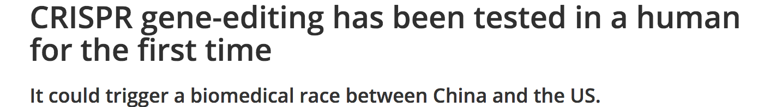
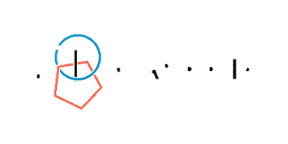


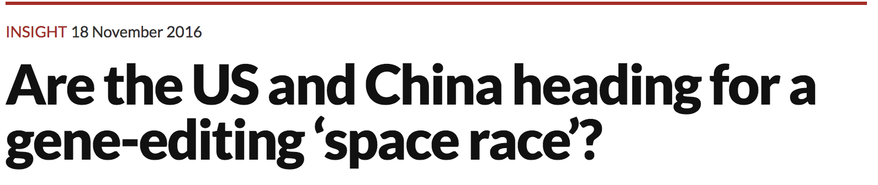




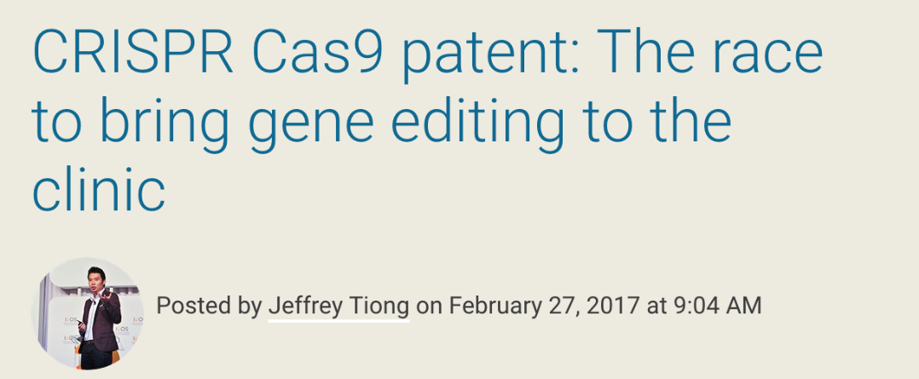



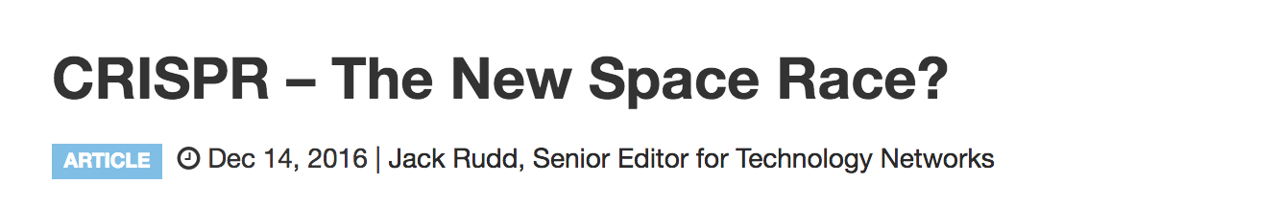



Genetic Timeline
International Competition
Private Companies
1970
—
—
—
—
1975
—
—
—
—
1980
—
—
—
—
1985
—
—
—
—
1990
—
—
—
—
1995
—
—
—
—
2000
—
—
—
—
2005
—
—
—
—
2010
—
—
—
—
2015
—
—
—
—
2020
“delete”
Notes:
Late 1860s: DNA discovered by Friedrich Miescher
1944: Avery, McLeod, and McCarthy argue DNA is hereditary material.
1953: Watson, Crick, Franklin, Wilks discover structure of DNA.
1970s: Sanger and Maxan & Gilbert invent methods of “shotgun” sequencing, which greatly increases the speed of genome sequencing
1983- Kary Mullis invented the Polymerase Chain Reaction (PCR). The PCR is able to rapidly ‘amplify’ or make copies of DNA segments
1990-2003- The Human Genome Project seeks to find genetic maps, physical maps, and the complete nucleotide sequence map of the human chromosomes.
Rebergy was settled with chakraberty (patenting microorganism) i.e. life
Insulin patent was granted a posteriori after chakrabarty settled.
Relaxin -A DNA fragment encoding human H2-preprorelaxin, said H2-preprorelaxin having the amino-acid sequence set out in Figure 2 http://www.epo.org/law-practice/case-law-appeals/recent/t950272eu2.html «a hormone which relaxes the uterus during childbirth, and which, it was hoped, could have medical application in reducing the need for caesarean deliveries in difficult pregnancies”
G0002/06 (Use of embryos/WARF) of 25.11.2008 - In 1998 the named inventor using the methods suggested in the application was the first to successfully isolate and culture human embryonic stem cells that can grow in vitro. The provision of these is a major scientific breakthrough and pioneering invention opening up a new and very exciting field of research having great potential for promising medical therapies and other applications, and worthy of patent protection. EP0770125 - PRIMATE EMBRYONIC STEM CELLS [
Brüstle case (2011) " (C-34/10), that Article 6(2)(c) of the EU directive excludes from patentability an invention which presupposes the destruction of a human embryo irrespective of the point in time at which such destruction takes place.
USPTO was grnating patents for decades until Myriad…
http://books.google.ch/books?id=d9UaB_jJ_80C&pg=PA126&lpg=PA126&dq=T+272/95+Relaxin/HOWARD+FLOREY&source=bl&ots=Iatzi2Zxk0&sig=E65NoH9lyZKDV1FdNxZLEjbfjRQ&hl=en&sa=X&ei=ydAhU7LfOKfB7AaA1IHIDA&ved=0CDgQ6AEwAg#v=onepage&q=T%20272%2F95%20Relaxin%2FHOWARD%20FLOREY&f=false
Mircroorganism landmark 1977 CCPA re Bergy
http://www.alrc.gov.au/publications/3-gene-patents/brief-history-gene-patents
http://www.nytimes.com/1988/04/13/us/harvard-gets-mouse-patent-a-world-first.html
https://casetext.com/case/in-re-application-of-bergy#.UzqL8WcrjvU
Note Pasteur granted a patent on new yeast strain for brewing in 1873
https://www.google.com/patents/US135245?dq=louis+pasteur&hl=en&sa=X&ei=UwRMU46uOunOygPVy4KYBg&sqi=2&pjf=1&ved=0CDUQ6AEwAA
novel method for producing yeast cultures. On 29 July 1873, microbiologist Louis Pasteur patented his improved yeast-making method at the French Patent Office.

Slide 34
Outline
Genetic Modification
A History of Genetic Modification
Lessons from
the Past
How Does it Work?
The New Eugenics
A Timeline
IVF & Stem Cells
Revolutionary Technologies

Slide 35
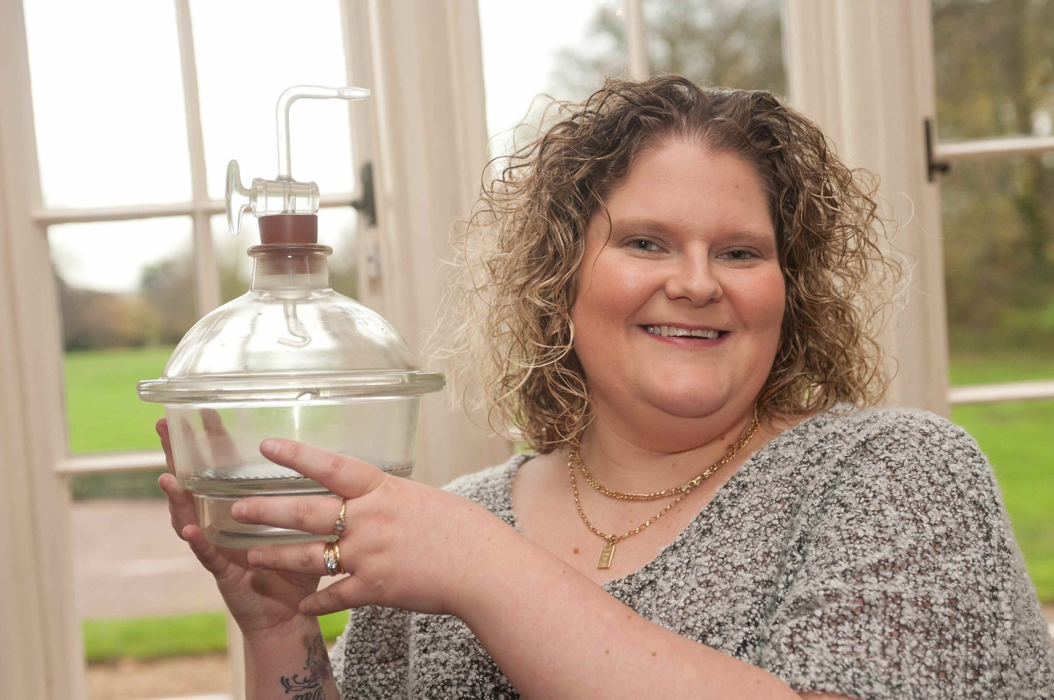
In Vitro Fertilization
First IVF baby
1970
—
—
—
—
1975
—
—
—
—
1980
—
—
—
—
1985
—
—
—
—
1990
—
—
—
—
1995
—
—
—
—
2000
—
—
—
—
2005
—
—
—
—
2010
—
—
—
—
2015
—
—
—
—
2020
Louise Brown, born July 25, 1978 in England
Her parents spent £50,000, waited nine years, solicited US doctors, and used a Mexican hospital to make her happen.
Were never told that she was the first child born from IVF; dealt with blood-spattered hate mail for years
More than 8,000,000 IVF worldwide; 1.6 percent of babies born every year
Notes:
Late 1860s: DNA discovered by Friedrich Miescher
1944: Avery, McLeod, and McCarthy argue DNA is hereditary material.
1953: Watson, Crick, Franklin, Wilks discover structure of DNA.
1970s: Sanger and Maxan & Gilbert invent methods of “shotgun” sequencing, which greatly increases the speed of genome sequencing
1983- Kary Mullis invented the Polymerase Chain Reaction (PCR). The PCR is able to rapidly ‘amplify’ or make copies of DNA segments
1990-2003- The Human Genome Project seeks to find genetic maps, physical maps, and the complete nucleotide sequence map of the human chromosomes.
Rebergy was settled with chakraberty (patenting microorganism) i.e. life
Insulin patent was granted a posteriori after chakrabarty settled.
Relaxin -A DNA fragment encoding human H2-preprorelaxin, said H2-preprorelaxin having the amino-acid sequence set out in Figure 2 http://www.epo.org/law-practice/case-law-appeals/recent/t950272eu2.html «a hormone which relaxes the uterus during childbirth, and which, it was hoped, could have medical application in reducing the need for caesarean deliveries in difficult pregnancies”
G0002/06 (Use of embryos/WARF) of 25.11.2008 - In 1998 the named inventor using the methods suggested in the application was the first to successfully isolate and culture human embryonic stem cells that can grow in vitro. The provision of these is a major scientific breakthrough and pioneering invention opening up a new and very exciting field of research having great potential for promising medical therapies and other applications, and worthy of patent protection. EP0770125 - PRIMATE EMBRYONIC STEM CELLS [
Brüstle case (2011) " (C-34/10), that Article 6(2)(c) of the EU directive excludes from patentability an invention which presupposes the destruction of a human embryo irrespective of the point in time at which such destruction takes place.
USPTO was grnating patents for decades until Myriad…
http://books.google.ch/books?id=d9UaB_jJ_80C&pg=PA126&lpg=PA126&dq=T+272/95+Relaxin/HOWARD+FLOREY&source=bl&ots=Iatzi2Zxk0&sig=E65NoH9lyZKDV1FdNxZLEjbfjRQ&hl=en&sa=X&ei=ydAhU7LfOKfB7AaA1IHIDA&ved=0CDgQ6AEwAg#v=onepage&q=T%20272%2F95%20Relaxin%2FHOWARD%20FLOREY&f=false
Mircroorganism landmark 1977 CCPA re Bergy
http://www.alrc.gov.au/publications/3-gene-patents/brief-history-gene-patents
http://www.nytimes.com/1988/04/13/us/harvard-gets-mouse-patent-a-world-first.html
https://casetext.com/case/in-re-application-of-bergy#.UzqL8WcrjvU
Note Pasteur granted a patent on new yeast strain for brewing in 1873
https://www.google.com/patents/US135245?dq=louis+pasteur&hl=en&sa=X&ei=UwRMU46uOunOygPVy4KYBg&sqi=2&pjf=1&ved=0CDUQ6AEwAA
novel method for producing yeast cultures. On 29 July 1873, microbiologist Louis Pasteur patented his improved yeast-making method at the French Patent Office.

Slide 36
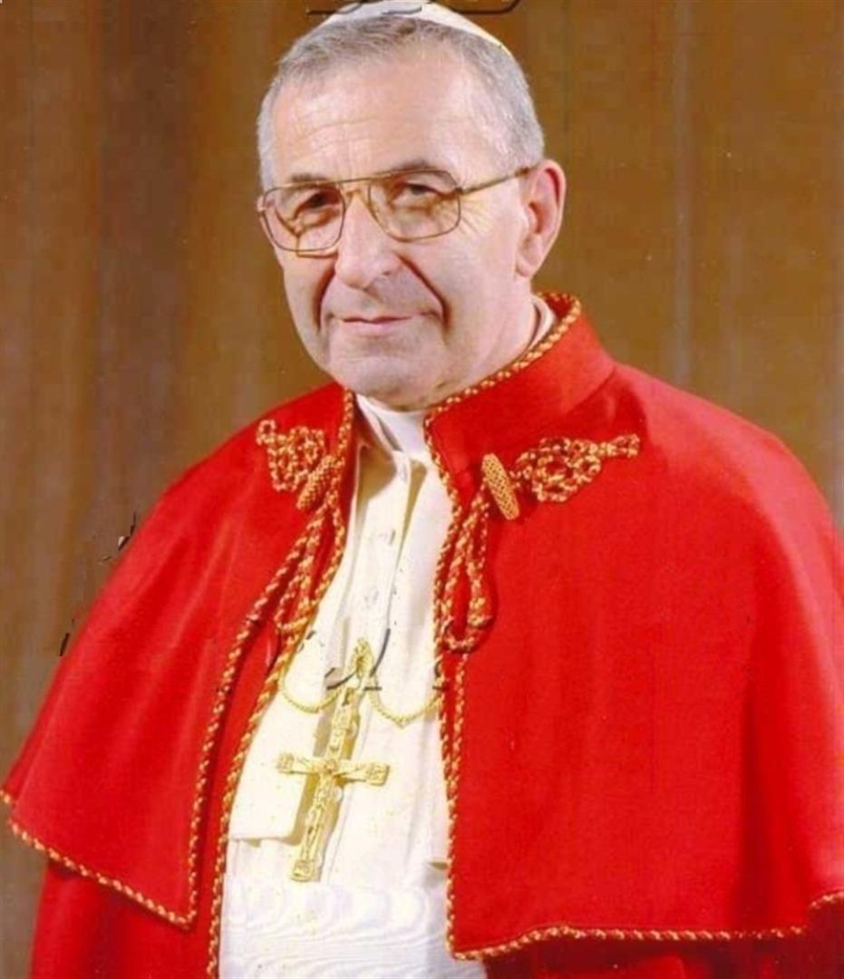
IVF Fears
Various religious groups asserted assisted reproduction and in-vitro fertilization was unnatural
People worried it would pressure women to have children or the babies would be ostracized
Pope John Paul I expressed concerns artificial insemination could lead to women being used as baby factories.
Worries that it would lead to the end of the nuclear family and beginning of a laboratory technology
Worries the babies would be deformed or dead

Slide 37

Did the concerns Pan Out?
CLAIM: IVF is unnatural
  Trivially, YES: but it’s up for debate whether that matters.
CLAIM: Society will pressure women/shun IVF babies
  PERHAPS: 38% of people view infertility as a
  disease, no stats on perception of IVF offspring
CLAIM: IVF technology will create an
industry of ‘professional mothers.’
  YES: Many countries have had to specifically outlaw ‘medical tourism’ that allows American couples to farm out their spawn

Slide 38
CLAIM: Families will end, Brave New World will begin
  NO: IVF costs $12,000+ and isn’t 100%. It is unlikely to ever become the default mode of birth.
CLAIM: Babies will be deformed or dead
  NO: Most do okay, although there is much
  anecdotal data that they have health issues
CLAIM: IVF technology will create a permanent separation between the ‘haves’ and the ‘have-nots’
    NOT REALLY: IVF babies blend in, pre-implantation diagnosis has not yet created a race of superior beings
Did the concerns Pan Out?

Slide 39
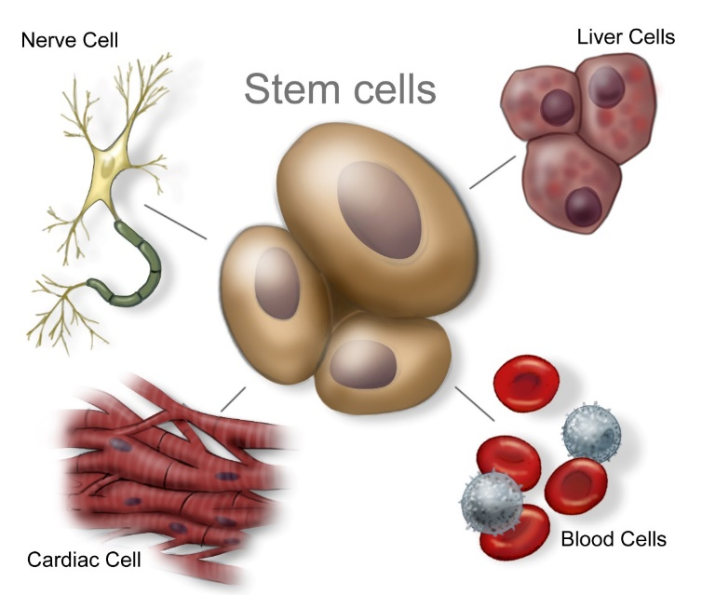
Embryonic Stem Cell Research
1970
—
—
—
—
1975
—
—
—
—
1980
—
—
—
—
1985
—
—
—
—
1990
—
—
—
—
1995
—
—
—
—
2000
—
—
—
—
2005
—
—
—
—
2010
—
—
—
—
2015
—
—
—
—
2020
Embryonic Stem Cell research funded
Embryonic Stem Cell research limited
Induced pluripotency discovered
FDA approved stem cell therapy
Notes:
Late 1860s: DNA discovered by Friedrich Miescher
1944: Avery, McLeod, and McCarthy argue DNA is hereditary material.
1953: Watson, Crick, Franklin, Wilks discover structure of DNA.
1970s: Sanger and Maxan & Gilbert invent methods of “shotgun” sequencing, which greatly increases the speed of genome sequencing
1983- Kary Mullis invented the Polymerase Chain Reaction (PCR). The PCR is able to rapidly ‘amplify’ or make copies of DNA segments
1990-2003- The Human Genome Project seeks to find genetic maps, physical maps, and the complete nucleotide sequence map of the human chromosomes.
Rebergy was settled with chakraberty (patenting microorganism) i.e. life
Insulin patent was granted a posteriori after chakrabarty settled.
Relaxin -A DNA fragment encoding human H2-preprorelaxin, said H2-preprorelaxin having the amino-acid sequence set out in Figure 2 http://www.epo.org/law-practice/case-law-appeals/recent/t950272eu2.html «a hormone which relaxes the uterus during childbirth, and which, it was hoped, could have medical application in reducing the need for caesarean deliveries in difficult pregnancies”
G0002/06 (Use of embryos/WARF) of 25.11.2008 - In 1998 the named inventor using the methods suggested in the application was the first to successfully isolate and culture human embryonic stem cells that can grow in vitro. The provision of these is a major scientific breakthrough and pioneering invention opening up a new and very exciting field of research having great potential for promising medical therapies and other applications, and worthy of patent protection. EP0770125 - PRIMATE EMBRYONIC STEM CELLS [
Brüstle case (2011) " (C-34/10), that Article 6(2)(c) of the EU directive excludes from patentability an invention which presupposes the destruction of a human embryo irrespective of the point in time at which such destruction takes place.
USPTO was grnating patents for decades until Myriad…
http://books.google.ch/books?id=d9UaB_jJ_80C&pg=PA126&lpg=PA126&dq=T+272/95+Relaxin/HOWARD+FLOREY&source=bl&ots=Iatzi2Zxk0&sig=E65NoH9lyZKDV1FdNxZLEjbfjRQ&hl=en&sa=X&ei=ydAhU7LfOKfB7AaA1IHIDA&ved=0CDgQ6AEwAg#v=onepage&q=T%20272%2F95%20Relaxin%2FHOWARD%20FLOREY&f=false
Mircroorganism landmark 1977 CCPA re Bergy
http://www.alrc.gov.au/publications/3-gene-patents/brief-history-gene-patents
http://www.nytimes.com/1988/04/13/us/harvard-gets-mouse-patent-a-world-first.html
https://casetext.com/case/in-re-application-of-bergy#.UzqL8WcrjvU
Note Pasteur granted a patent on new yeast strain for brewing in 1873
https://www.google.com/patents/US135245?dq=louis+pasteur&hl=en&sa=X&ei=UwRMU46uOunOygPVy4KYBg&sqi=2&pjf=1&ved=0CDUQ6AEwAA
novel method for producing yeast cultures. On 29 July 1873, microbiologist Louis Pasteur patented his improved yeast-making method at the French Patent Office.

Slide 40
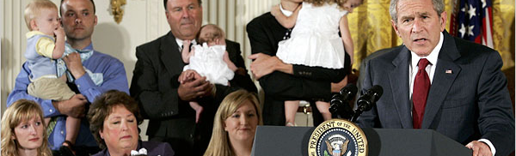
Embryonic Stem Cell research limited
The George W. Bush administration limited federal funding to 71 existing stem cell lines and created a council to monitor stem cell research, recommend appropriate guidelines, and consider medical and ethical ramifications of biotechnology
Used first veto as president five years later when Congress tried to lift this ban
Notes:
International collaboration slowed, administrative juggling increased (from severing public funds from private funds), and research suffered (only 21 lines proved useful, but all were of dubious quality and from the same ethnic groups). A handful of American scientists in this area emigrated to Singapore and China to continue their research

Slide 41
Embryonic Stem Cell research limited
Federal funding amounted to $250 million, but private funds added much more
International collaboration slowed, administrative juggling increased, and several researchers left the U.S.
Researchers still cannot create new lines using tax dollars, although in 2009, adult stem cells were able to be made pluripotent.
Notes:
International collaboration slowed, administrative juggling increased (from severing public funds from private funds), and research suffered (only 21 lines proved useful, but all were of dubious quality and from the same ethnic groups). A handful of American scientists in this area emigrated to Singapore and China to continue their research

Slide 42
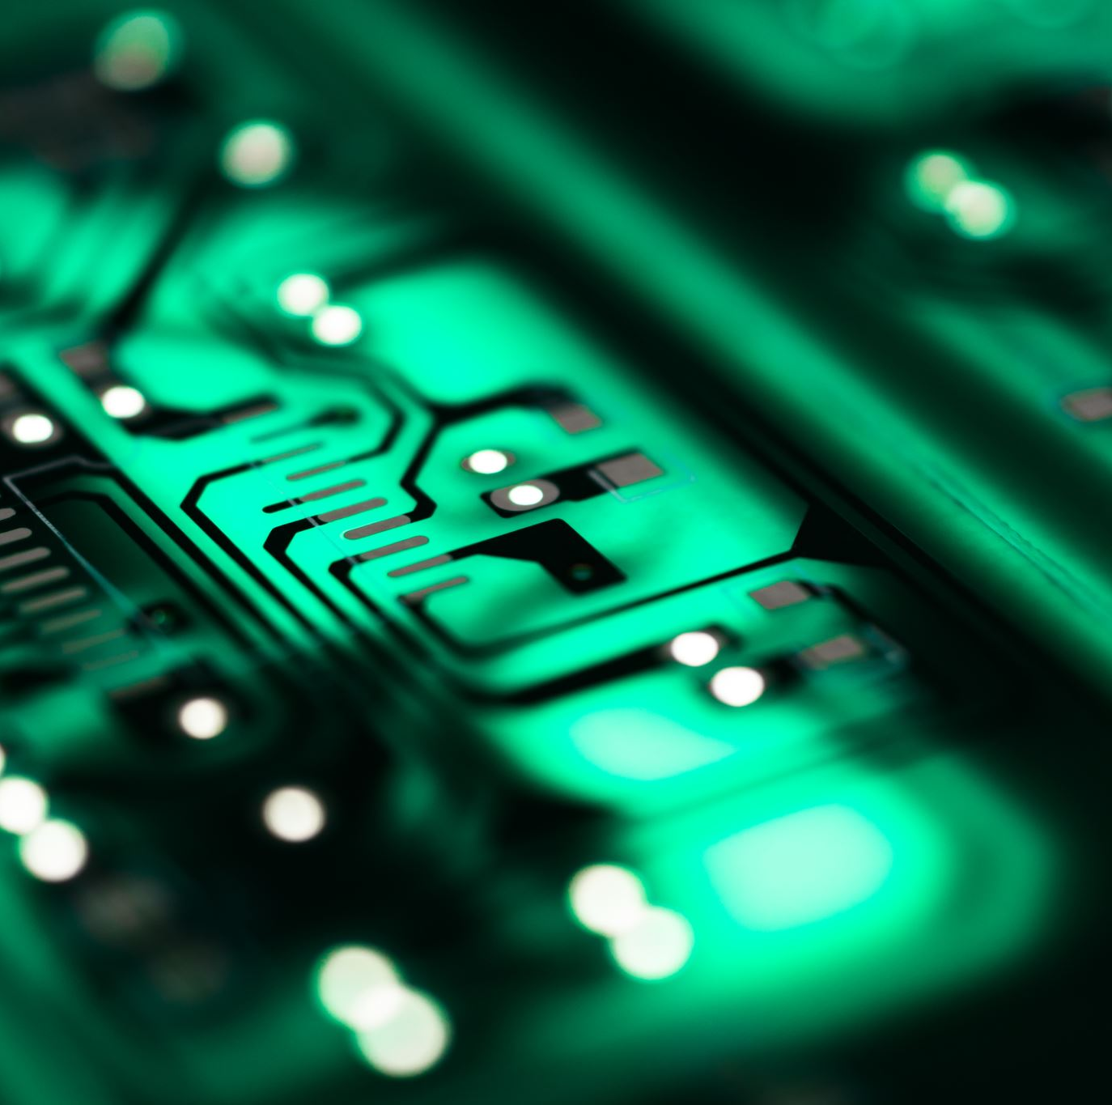
Revolutionary Technologies
A revolutionary technology is one that changes the landscape in which in was developed.
The Printing Press
The Steam Engine
The car
Printing
The Personal Computer
The Internet
Social Media

Slide 43
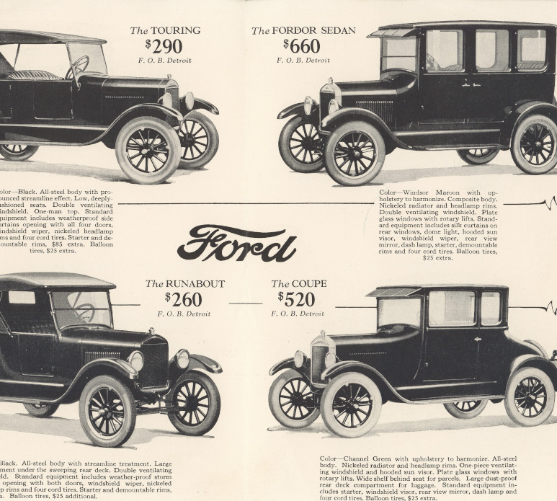
The Model T
Not a good car: ever had turn signals, had to go uphill in reverse.
But a cheap car: brought cars from a luxury item to a new status

Slide 44
The Model T
Revolutionary Process: Assembly line process was used for WWII and afterward
Pervasive: produced 15M Model Ts in 20 years, nearly 50 percent of cars sold one year

Slide 45
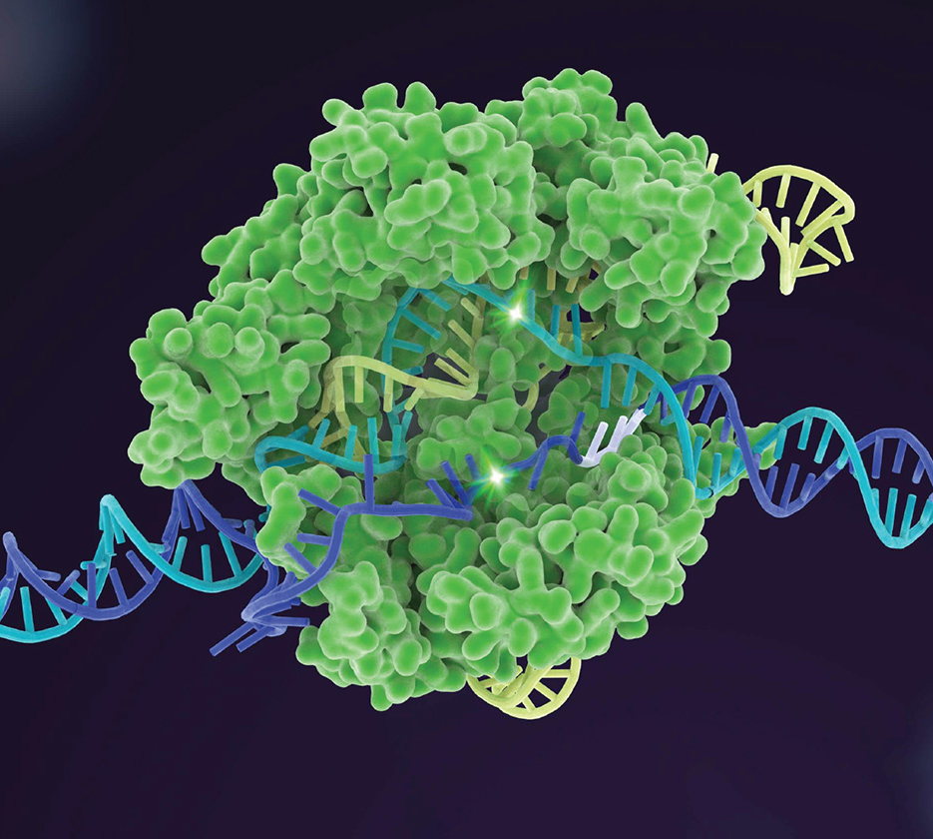
CRISPR-Cas9
Cheap & Easy: you can literally order everything you need online for $$$s
Quick: a few days (at most) compared to 2-3 years in the 1990s.
Soon to be pervasive

Slide 46
Outline
Genetic Modification
A History of Genetic Modification
Lessons from
the Past
Moving Forward
Arguments: Pro & Con
Inevitable Change
Trade-offs
How Does it Work?
The New Eugenics
A Timeline
IVF & Stem Cells
Revolutionary Technologies

Slide 47
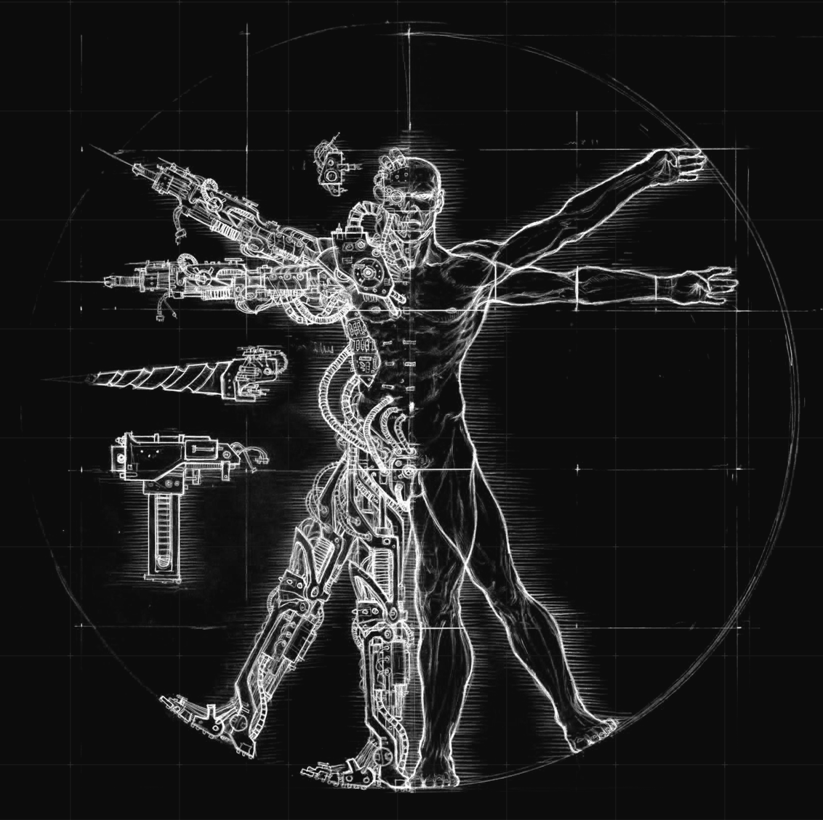
Human Modification – Arguments
No action is itself an action: We accept natural disorders as if they are inevitable, but human modification can eliminate so many evils in the world
Personal freedom: We have the right to life, freedom, and happiness. We own our bodies and ought to be able to modify them at our leisure.
Notes:
aeouaeou
Evidence-based outcomes > Worst-case scenarios
No action is itself an action
Justification for major policy changes ∝ Knowledge of effects
Technology = Opportunity & Risk (not merely risk)
Natural harms are harms
Immediate risks > Remote risks
Irreversible impacts > Transient impacts
All interest holders should be at the table
Freedom & accountability > Centralized bans
Choose actions most likely to do most good for the most
Continuously assess, reevaluate, & remediate

Slide 48
Human Modification – Problems
Cavalier – will not solve the problem and may get us addicted to further piecemeal answers. Serious modifications that are irreversible will never offer better benefits than risks. Details matter
Unintended (health) consequences – Modification has always had negative effects
Distributive Justice Worries – divisions between haves & have nots, access, cost, cultural peer pressure, and impact.

Slide 49
Human Modification – Problems
Historical precedent – Every time it has been done before, it has ended poorly… very poorly
Codifying value – Values change over time, engineering could limit or channel how these values could change. (And some groups may make awful choices)
Ratchet – Genetic modification may lead to progressively more modification, pre-empting other, better solutions

Slide 50

Guiding Question:
What limits should we impose on human genetic modification?
Ban it Delay it Ban parts of it Allow everything
Information
Power
Time
Notes:
Core Value: Having the opportunity to explore the transhuman and posthuman realms
Basic Conditions: Global security, Technological progress, Wide access
Transhuman: a human who uses human enhancements
Posthuman: a human who uses human
enhancements to greatly enhance a
capacity beyond what is possible by
any non-enhanced human.

Slide 51
Capitalism – Where there is money to be had, humans will follow
Liberalism – We don’t like regulating industries based on other people’s moral qualms
Knowledge – Research will continue because researchers want to continue.
Competition – Genetic Space Race/ Corporate competition
Innate desire to control – Parents will want a say in whether their children have a disease, adults will push for cosmetic genetic engineering, nature will not be left alone if we do not like its products
Inevitable Human Modification
Notes:
The internet allows for

Slide 52
Initial Condemnation
Ambivalence
Questioning & Limited Use
Change in Public Perceptions
Advocacy & Widespread Acceptance
Inevitable Change
Notes:
The internet allows for

Slide 53
The Power/Information Trade-Off
Power
As our understanding of a revolutionary technology increases, entrenched interests and practices make it harder to change.
Information
Time
Notes:
The internet allows for

Slide 54
A Dynamic Approach
The lesson from revolutionary technologies is that we don’t know, ahead of time, what will be a problem and what won’t.
A dynamic approach is the only way to address this issue.
Information
Power
Time
Notes:
Core Value: Having the opportunity to explore the transhuman and posthuman realms
Basic Conditions: Global security, Technological progress, Wide access
Transhuman: a human who uses human enhancements
Posthuman: a human who uses human
enhancements to greatly enhance a
capacity beyond what is possible by
any non-enhanced human.

Slide 55

An Imagined Dynamic Approach
Possible Problems Averted: City Planning, collisions, car safety, moving and parking infractions, toxicity of lead in gasoline
Possible Problems Missed: air pollution, climate change, oil demand and geopolitical strife
(Now) Useless concerns: the fate of the horse industry, shift away from railroads
Established 1967 1917
Information
Power
Time
Notes:
Core Value: Having the opportunity to explore the transhuman and posthuman realms
Basic Conditions: Global security, Technological progress, Wide access
Transhuman: a human who uses human enhancements
Posthuman: a human who uses human
enhancements to greatly enhance a
capacity beyond what is possible by
any non-enhanced human.

Slide 56
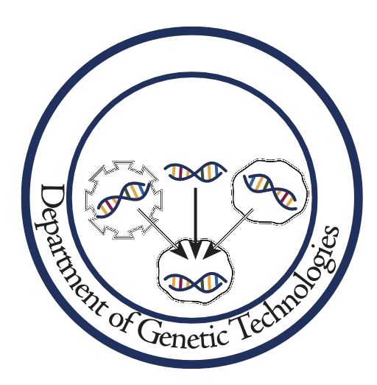
An Imagined Dynamic Approach
Power
Information
Established 2021
Time
Notes:
Core Value: Having the opportunity to explore the transhuman and posthuman realms
Basic Conditions: Global security, Technological progress, Wide access
Transhuman: a human who uses human enhancements
Posthuman: a human who uses human
enhancements to greatly enhance a
capacity beyond what is possible by
any non-enhanced human.

Slide 57
Thank You!
Carlos Mariscal
carlos@unr.edu
Philosophy Department
College of Liberal Arts
University of Nevada, Reno

