Slide 1
Baby Logic!

Slide 2
Some Definitions
Logic: the study of reasoning about the truth or falsity of statements.
Reason: The drawing of inferences or conclusions from known or assumed facts.
Argument: A set of sentences in which the final sentence (conclusion) follows from the truth of the prior sentences (premises).
Premise: A sentence that either makes a claim or establishes a relationship between two or more other claims.
Conclusion: The final sentence in an argument.

Slide 3
Example Argument
Premise
Premise
Conclusion
All men are mortal.
Socrates is a man.
Therefore, Socrates is mortal.
All As are Bs
s is an A
Therefore, s is a B
Premise
Premise
Premise
Premise
Conclusion
Taco₁ from Taco Bell was bad.
.
.
.
Taco_{n} from Taco Bell was bad.
Therefore, taco_{n+1} from Taco Bell is likely to be bad.
A₁ was B
.
.
.
A_{n} was B
Therefore, A_{n+1} is probably a B

Slide 4
Induction Deduction
A type of logic which involves going from a series of specific cases to a general statement.
Good arguments are termed “strong”
Strong: A property of arguments such that if the premises of the argument are true, the conclusion is likely to be true.
Inductive arguments are not “truth preserving”
Cogent: A strong argument with true premises
A type of logic in which one goes from a general statement to a specific instance.
Good arguments are termed “valid”
Validity: A property of arguments such that if the premises are true, the conclusion must follow with 100% certainty.
Deductive arguments are “truth preserving.”
Sound: A valid argument with true premises

Slide 5
Induction

Slide 6
Three Inductive Arguments
Argument from Analogy: One entity shares some properties with one or more entities, thus it is likely to share other properties as well.
Inductive Generalization: Several entities exhibit a pattern, therefore other entities (and possibly all other entities) will likely also fit into that pattern.
  Enumeration: Several entities exhibit a pattern, therefore the next entity will likely also fit into that pattern.
  Prediction: A pattern has been observed in the past, therefore it is likely to also occur in the future.
Inference to the Best Explanation (IBE): Of the available explanations for a particular phenomenon, one is the best and thus is more likely to be the correct explanation. Also called “Abduction.”

Slide 7
Argument from analogy
Earth is in the habitable zone, has an Earth-sized mass, takes between 350-390 days to orbit its star, and is host to lots of life.
Kepler 452b is in the habitable zone, has an Earth-sized mass, and takes between 350 and 390 days to orbit its star.
Therefore, it is likely to also host lots of life.
The Fate of the Furious has many of the same cast members, cars, crew, producers, writers, and plot as all prior Fast & Furious films.
I thought those films were far too fast and/or furious for me.
Therefore, I am also likely to think the Fate of the Furious will be too fast or furious for me.

Slide 8
Evaluating Arguments from Analogy
Truth of similarity
  Duh.
Relevance of aspects of similarity.
  “Barack Obama and George Washington are both similar in that neither was in the hit 2003 film 2 Fast 2 Furious, but that doesn’t seem relevant.”
Number of aspects of similarity.
  “Batman, Bruce Wayne, and Alfred all share the same address, but two of those share more properties in common with each other than the other.”
Diversity of aspects of similarity.
  More is better.
Disanalogy of other properties.
  Dissimilarities matter, important dissimilarities break arguments from analogy.

Slide 9
Inductive Generalizations
Prediction:
Every day, the sun has risen
Therefore, the sun will come out to-morrow!
Enumeration:
I’ve looked at a thousand emeralds and all have been green.
Therefore, the next emerald is probably green.

Slide 10
Evaluating Inductive Generalizations
Truth of premises
  No, seriously, duh.
Representativeness of sample.
  A biased sample is less likely to be generalizable than a representative sample, all else being equal.
Size of sample.
  A small sample is less likely to be generalizable than a larger sample, all else being equal.
  T, H, T, H, H, T, T, H vs. T, H, H, H, H, T, H, T
Naturalness of generalization
  We will spend all of Monday on this issue.

Slide 11
Inference to the Best Explanation
Holmes spots a stub of cigarette marked “Bradley, Oxford Street” outside the hut on the Moors.
That brand of cigarette is John Watson’s favorite.
John Watson is not unlikely to follow Holmes.
There are many brands of cigarettes, so spotting this one is unlikely to be a coincidence.
Therefore, it is likely John Watson is inside the hut on the Moors
The address is printed in rough characters.
Rough characters indicate an uneducated authorship.
The words pasted on the anonymous note are of a unique font.
The Times newspaper uses that font.
The Times newspaper is read by educated people.
Therefore, the note was written by an educated person posing as an uneducated person.

Slide 12
Evaluating Inferences to the Best Explanation
Consistency of explanation – Whether the whole of the explanation is free of contradictions.
  No ‘ad hoc’ hypotheses, or hypotheses introduced to explain away inconsistencies.
Adequacy of explanation – Whether the explanation fits all of the data
Testability – Whether there is some way to demonstrate whether the explanation is true or false.
  An explanation is testable only if it can predict something other than what it was introduced to explain.
Fruitfulness – How many novel predictions are made
Simplicity – Number of assumptions made (fewer is better)
Conservatism – How well a theory fits with established knowledge
Scope – The amount of diverse phenomena explained
  Einsteinian relativity accounts for the orbit of Mercury, Newtonian mechanics does not.

Slide 13
The Problem of Induction

Slide 14
Outline
David Hume
Two Kinds of Skepticism
  Cartesian Skepticism: About knowledge
  Humean Skepticism: About justification
Two kinds of justifications
  Relations of Ideas (Analytic Truths)
  Matters of Fact (Synthetic Truths)
The Principle of the Uniformity of Nature (PUN)
The Problem of Induction
  PUN is not justified analytically
  PUN is not justified synthetically
Where to go from Here

Slide 15
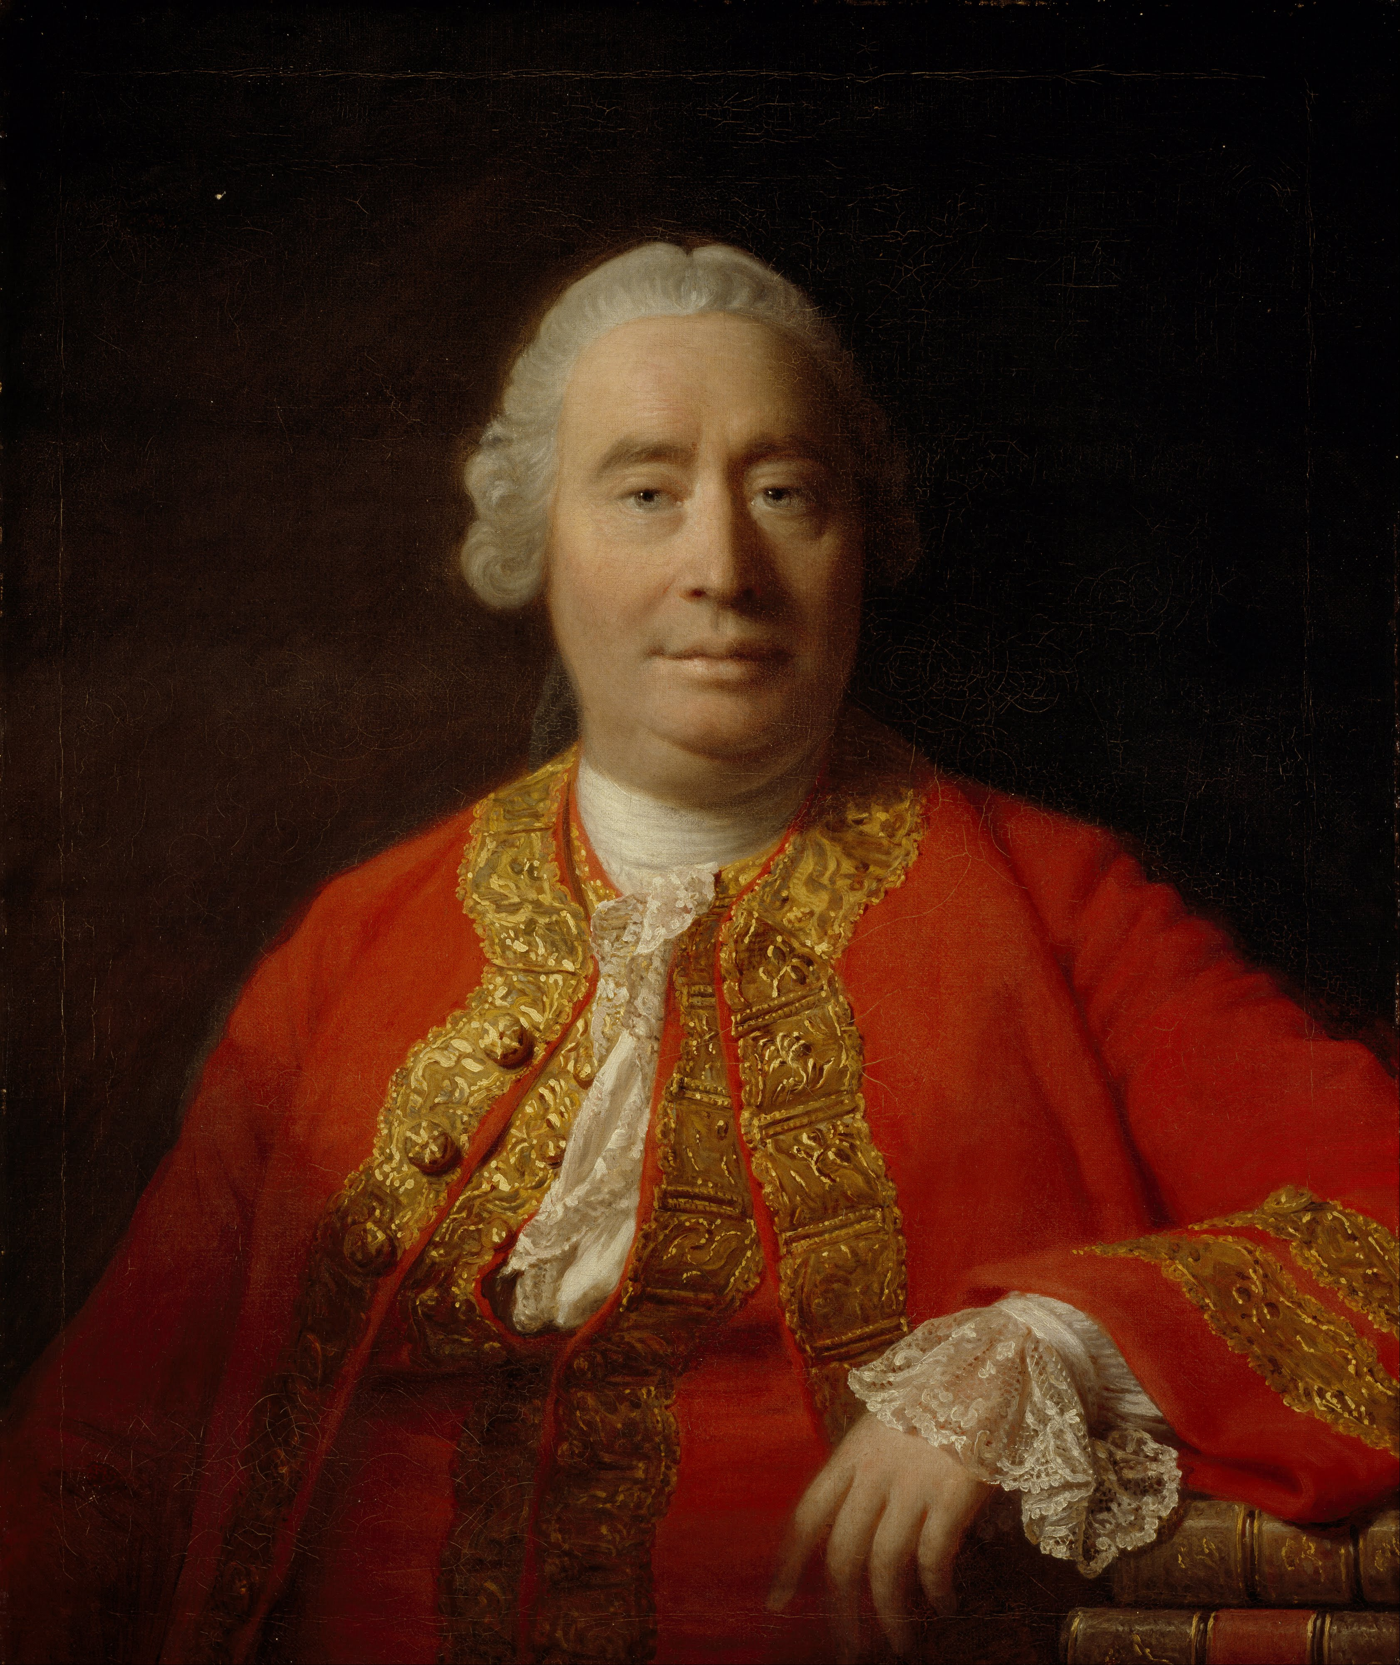
David Hume (1711-1776)
Scottish philosopher and historian
Considered the greatest philosopher to write in the English language
Greatest Philosophical Work: A Treatise of Human Nature (1739)
(this was began when he was 23 years old)
Famous doctrines: empiricism, skepticism.
Immanuel Kant said Hume “awoke me from my dogmatic slumber.”

Slide 16
Two Kinds of Skepticism
Skepticism about knowledge
  Perhaps after reading Descartes we conclude we can’t be absolutely certain about the external world.
  Perhaps we can live with this.
Skepticism about justification
  Hume is here to tell us we have no reason whatsoever to believe certain things we thought obvious.
  This would be hard to live with.

Slide 17
Relations of Ideas vs. Matters of Fact
“All the objects of human reason or enquiry may naturally be divided into two kinds, to wit, Relations of Ideas, and Matters of Fact.”

Slide 18
Relations of Ideas
  Relations of ideas “are discoverable by the mere operation of thought, without dependence on what is anywhere existent in the universe.”
Relations of ideas are statements that are true simply in virtue of the concepts contained in them, and not in virtue of the way the world is.
They are “true by definition.”
They usually seem to be fairly trivial truths.
Relations of ideas are also called analytic truths.
      EXAMPLES:
      “All triangles have three sides."
      “Seven plus five is equal to 12.”
      “If Bob is a bachelor, then Bob is unmarried.”
      “It is what it is.”

Slide 19
Matters of Fact
  Hume says, “The contrary of every matter of fact is still possible.”
Matters of fact are statements that are not relations of ideas.
If true, they not true in virtue of the concepts contained in them but in virtue of the way the world is.
They are NOT true by definition.
They tend to be substantive rather than trivial.
Matters of fact are also called synthetic truths.
    EXAMPLES:
    ‘The earth is round.’
    “The sun will rise tomorrow.”
    ‘All bachelors have messy apartments.’
    ‘Either it’s raining or it’s snowing.’

Slide 20
Remember Induction?
Every time I have eaten bread in the past it has nourished me.
———————
Therefore, the next time I eat bread it will nourish me.
The “Problem of Induction” is an argument (a deductive argument) for the following conclusion:
  The premises of an inductive argument never provide any reason to think that the conclusion is true.
Hume aims to show induction is unjustified; the premises of such arguments provide no reason at all to think their conclusion is true.
So if Hume is right, then the next time you eat bread, it is not rational to assume it will nourish you!

Slide 21
The Principle of the Uniformity of Nature
  “all inferences from experience [about what will happen in the future] suppose, as their foundation, that the future will resemble the past … . If there be any suspicion, that the course of nature may change, and that the past may be no rule for the future, all experience becomes useless, and can give rise to no inference or conclusion.”
PUN: The future, by and large, will resemble the past.

Slide 22
The Problem of Induction
FIRST PART:
If there is any reason to believe PUN, then our justification for PUN is either a relation of ideas or a matter of fact.
Our justification for PUN is not a relation of ideas.
Our justification is not a matter of fact.
———————
Therefore, there is no reason to believe PUN.
A → B or C
Not B
Not C
———
Not A

Slide 23
Argument for premise 2
If PUN is “a relation of ideas” (a priori), then the future would resemble the past as a matter of logic.
If the future would resemble the past as a matter of logic, then it would be a logical contradiction to suppose the future not resembling the past.
It is not a contradiction to suppose the future might not resemble the past.
———————
Therefore, PUN is not “a relation of ideas” (a priori).
A → B
B → C
Not C
—
Not A

Slide 24
Argument for premise 3
If our justification for PUN is ‘a matter of fact’ (a posteriori), then it is justified by causal relations.
Causal relations are justified by induction.
Induction is justified by assuming the future will be like the past.
The future being like the past is justified by the uniformity of nature (PUN).
———————
Therefore, if our justification for PUN is ‘a matter of fact’ (a posteriori), then it is justified by itself.
If a principle is justified, then it cannot be its own justification.
Therefore, our justification for PUN is not ‘a matter of fact.’
A → B
B → C
C → D
D → A
—
A → A
If A → A, then Not A
Not A

Slide 25
The Problem of Induction
SECOND PART:
There is no reason to believe PUN.
If there is no reason to believe PUN, then the premises of an inductive argument never provide any reason to think that the conclusion is true.
—————————
Therefore, the premises of an inductive argument never provide any reason to think that the conclusion is true.

Slide 26
Induction is unjustified

Slide 27
Welsey Salmon twists the knife
Hume shows you cannot justify induction deductively, but you also cannot justify it inductively.
  “If you could justify inductive reasoning inductively, why then couldn’t psychics gaze into a crystal ball to ‘justify’ the method of using crystal balls to acquire knowledge?
  “…Or, using the very same ’inductive’ evidence that you have that counter-inductive reasoning doesn’t work, why couldn’t a ‘counter-inductivist’ counter-inductively justify the counter-inductive method?” — Wesley Salmon
You have absolutely no reason to think the sun will rise tomorrow. No reason to think your next breath won’t kill you.

Slide 28
Hume’s Response: Deal with it
  “Even after we have experience of the operations of cause and effect, our conclusions from that experience are not founded on reasoning, or any process of the understanding.”
  “Men are not impelled by any reasoning or process of the understanding, but rather from Custom or Habit.... Custom, then, is the great guide of human life.”
Thus while we cannot really know the true causal powers of things or the course of the future, we can know the customs or habits that our mind has formed through its experiences.
So statements about the causal powers of things really should be reconceived as statements about the connections in our minds between the ideas of those things.

Slide 29
Baby Logic!!

Slide 30
Induction Deduction
A type of logic which involves going from a series of specific cases to a general statement.
Good arguments are termed “strong”
Strong: A property of arguments such that if the premises of the argument are true, the conclusion is likely to be true.
Inductive arguments are not “truth preserving”
Cogent: A strong argument with true premises
A type of logic in which one goes from a general statement to a specific instance.
Good arguments are termed “valid”
Validity: A property of arguments such that if the premises are true, the conclusion must follow with 100% certainty.
Deductive arguments are “truth preserving.”
Sound: A valid argument with true premises

Slide 31
Induction Deduction
A type of logic which involves going from a series of specific cases to a general statement.
Good arguments are termed “strong”
Strong: A property of arguments such that if the premises of the argument are true, the conclusion is likely to be true.
Inductive arguments are not “truth preserving”
Cogent: A strong argument with true premises
A type of logic in which one goes from a general statement to a specific instance.
Good arguments are termed “valid”
Validity: A property of arguments such that if the premises are true, the conclusion must follow with 100% certainty.
Deductive arguments are “truth preserving.”
Sound: A valid argument with true premises

Slide 32
Six Deductive Definitions
Conjunction: A connection of two or more statements where, if the conjunction is true, then both statements must be true
Disjunction: A connection between two or more statements where, if the disjunction is true, then at least one of its statements must be true.
Negation: The denial of a statement. If the statement is true, its negation is false.
Conditional: A connection of two statements where, if the first is true, then the other must also be true.
Biconditional: A connection of two statements where, if either is true, then the other must be as well.
Contradiction: A conjunction of a statement and its negation.
AND, &, • Λ
OR, EITHER, ν
NOT, ~, ¬
IF/THEN, →, ⇒ ⊃
IF AND ONLY IF, ↔, ⇔, ≡
⊥

Slide 33
Four Deductive Arguments
Modus Ponens: If this, then that. This. Therefore, that.
Modus Tollens: If this, then that. It’s not that. Therefore, it wasn’t this.
Hypothetical Syllogism: If this, then that. If that, then the other thing. Therefore, if this, then the other thing.
Deductive Syllogism: It’s either this or that. It’s not this. Therefore, it must be that.
P → Q,
P,
Q
P → Q,
~Q,
~P
P → Q,
Q → R,
P → R
P v Q,
~P
Q

Slide 34
Modus Ponens
If this sentence is a conditional, then Benjamin Young is God.
That sentence was a conditional.
Therefore, Benjamin Young is God.
A → B
A
—
B
2+2=4
If 2+2=4, then I understand arithmetic.
Therefore, I understand arithmetic.
A
A → B
—
B

Slide 35
Evaluating Modus Ponens
Are the claims in the premises true?
  Duh.
Do any conditionals imply an untrue connection?.
  Perhaps it is not the case that what Sean Spicer says has the force of truth just because he said it.
Do any of the conditionals have a false antecedent?
  All conditionals with false antecedents are assumed to be true.
  (Think: benefit of the doubt)
  ”If I were the president, I would have a secretary of Keeping it Real.”
Is there any equivocation?
  “If there are laws, then there are law givers. There are laws of nature. Therefore, there must be a cosmic law giver.”

Slide 36
Modus Tollens
If this sentence is a conditional, then Benjamin Young is God.
Benjamin Young is not God.
Therefore, that sentence was not a conditional
A → B
~B
—
~A
I do not understand arithmetic.
If 2+2=5, then I understand arithmetic.
Therefore, 2+2≠5
~B
A → B
—
~A

Slide 37
Evaluating Modus Tollens
Are the claims in the premises true?
  Duh.
Do any conditionals imply an untrue connection?.
  Perhaps it is not the case that what Sean Spicer says has the force of truth just because he said it.
Do any of the conditionals have a true consequent?
  All conditionals with true consequents are assumed to be true.
  (Think: benefit of the doubt)
  ”If I were the president, I’d live in Reno.”
Is there any equivocation?
  “If there are laws, then there are law givers. There are laws of nature. Therefore, there must be a cosmic law giver.”

Slide 38
Three kinds of Skepticism
Descartes’ Skepticism of Knowledge: Given that we are sometimes misled, it seems we cannot be certain about any of our ways of knowing the world.
Hume’s Skepticism of Justification: Our criterion for inductive justification itself has no justification. The fact that it often works or has often worked does not support that it will continue to work.
Goodman’s Skepticism of Regularities: No amount of evidence can provide support for any general proposition because it simultaneously provides evidence for an infinite number of general propositions.

Slide 39
Hempel’s Ravens
Suppose we ignore Hume and believe induction works.
Now suppose I begin observing a pattern: each raven I see has been black.
After enough examples, by induction, I may conclude that all ravens are black.
And every time I observe a raven, I am further confirming my inductive generalization.
‘(r → b)’
(r₁ & b)
(r₂ & b)
(r₃ & b)
.
.
.
ALL (r → b)

Slide 40
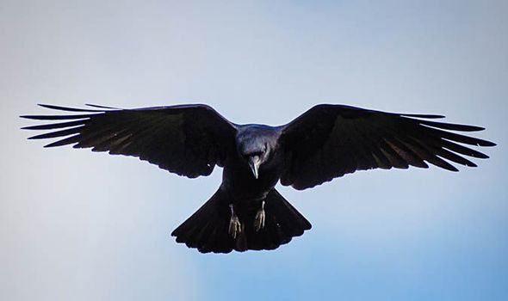
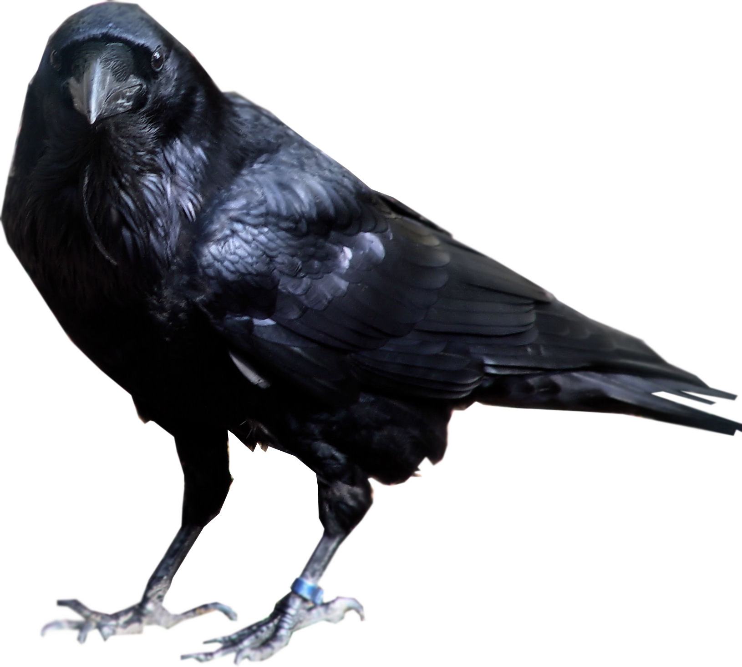
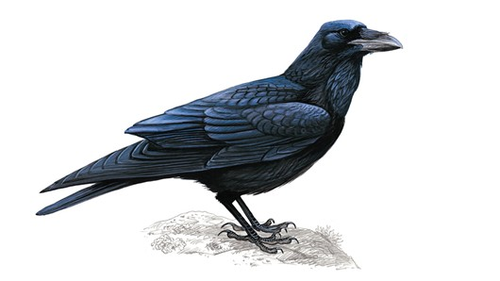
Hempel’s Ravens
(r₂ & b)
(r₃ & b)
(r₁ & b)
Maybe IF
ANYTHING IS
A RAVEN, THEN
IT IS BLACK
(r → b)

Slide 41
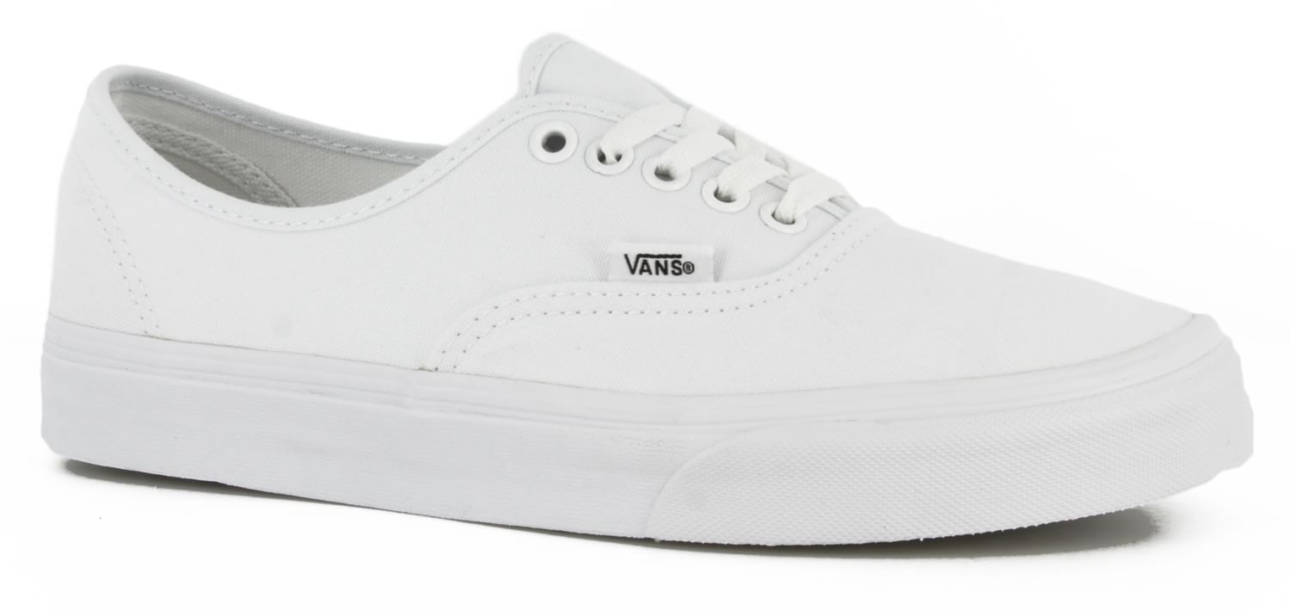

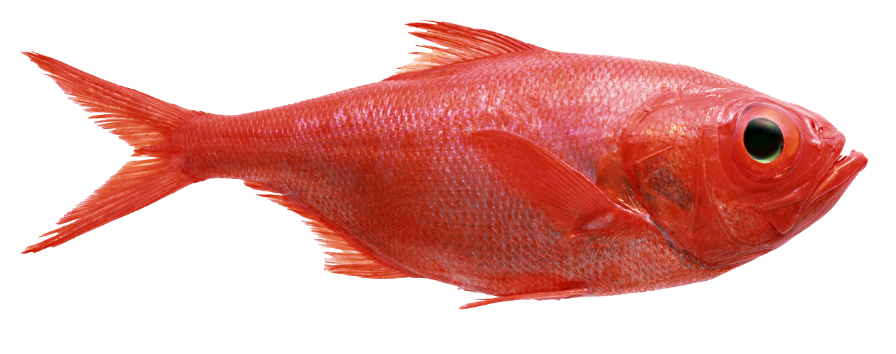
Hempel’s Ravens
(~b₂ & ~r)
(~b₃ & ~r)
(~b₁ & ~r)
Maybe IF
ITS NOT BLACK, THEN ITS NOT A RAVEN
(~b → ~r)

Slide 42
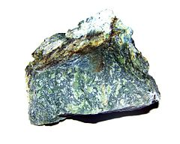
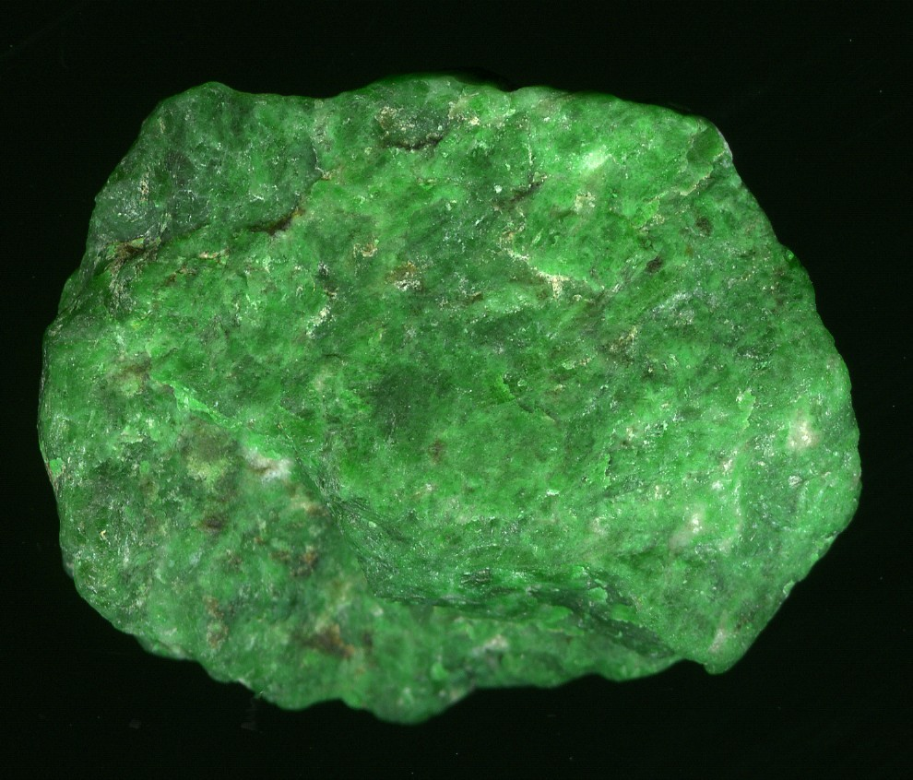
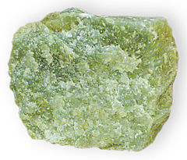
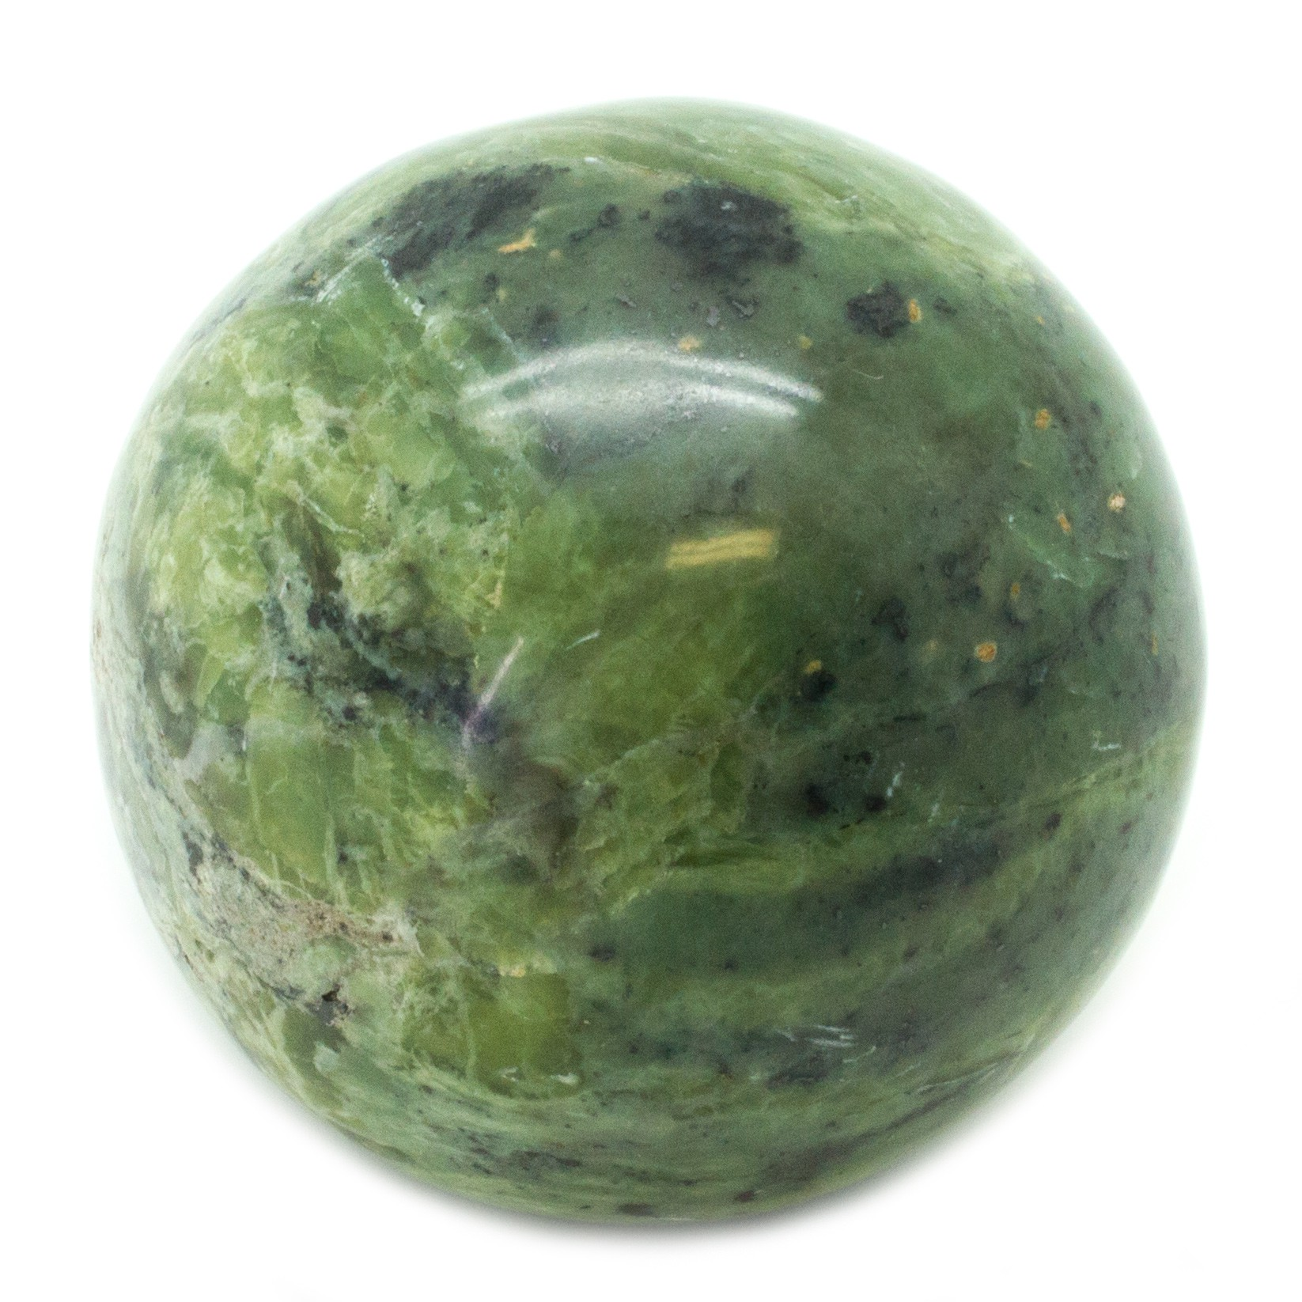
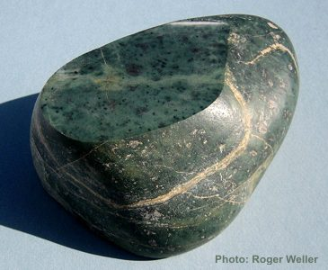
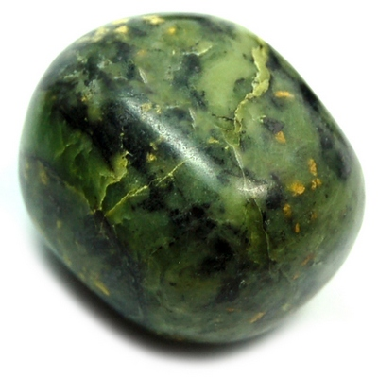


Goodman’s New Riddle
Suppose you are a geologist in a world that has never discovered jade.
You find the first example.
It is green and has a specific gravity of 2.94, a hardness of 6 Mohs, and an Index of refraction of 1.65.
You find a second example.
It is green and has a specific gravity of 3.1, a hardness of 6 Mohs, and an Index of refraction of 1.662.
You find hundreds more examples, each with a specific gravity between 2.90 and 3.10, each with a hardness of 6 Mohs, and each with an index of refraction of 1.64-1.667.

Slide 43
Goodman’s New Riddle
You draw some conclusions, which only get more and more reinforced:
  All jade rocks are green.
  All jade rocks have a specific gravity of 3 ± 0.1.
  All jade rocks have a hardness of 6 Mohs.
  All jade rocks have an index of refraction of 1.653 ± 0.014
You publish a series of papers and become famous.
Did you do anything wrong? Did you do science?

Slide 44
Goodman’s New Riddle
After a new tool is discovered, another scientist makes new analyses argues you’ve confused two different rocks: jadeite and nephrite.
Ten percent of your rocks are jadeite, 90 percent are nephrite, and each is formed through radically different processes.
There is no such thing as jade.
(Unless by ‘jade’ you mean what people refer to as the set of both jadeite and nephrite)

Slide 45
Noticing a trend, inferring a tendency
13
12
11
10
9
8
7
6
5
4
3
2
1
But what tendency?
Next measurement
will continue to be
an increase?
Next measurement
will continue to be
less than 13?
Next measurement
will continue to not
be 14?
1 2 3 4 5 6 7 8 9 10 11 12 13 14 15 16 17 18 19 20
Notes:
Predicate = adjective

Slide 46
Projectible properties
  A hypothesis is projectible iff it is supported, unviolated, and unexhausted, and all hypotheses conflicting with it are overridden.
  A hypothesis is unprojectible iff it is unsupported, exhausted, violated, or overridden.
  A hypothesis is nonprojectible iff it conflicts with a projectible hypothesis.
All of these seem to be a matter of custom or habit.
Are any properties really real?
But this means that in novel scenarios, we may not actually be aware of which properties are projectible.
This is no bueno.
Notes:
Predicate here means adjective.

Slide 47
Conjectures and Refutations
(This is an example of a conjunction)

Slide 48
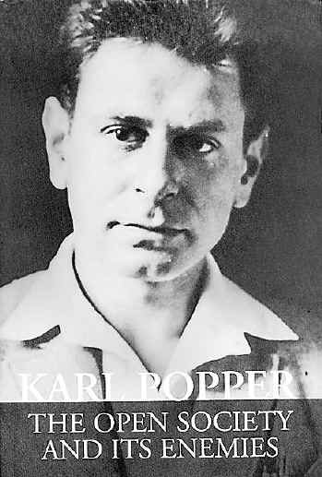
Sir Karl Popper (1902-1994)
Hume was right: induction is unjustified.
Spent some time in Adler’s clinic:
“Adlerian therapy is a brief, psychoeducational approach that is both humanistic and goal oriented. It emphasizes the individual's strivings for success, connectedness with others, and contributions to society as being hallmarks of mental health.” –APA
Worried that it was pseudoscience.
The Demarcation Problem: when does something count as science and when does it count as pseudoscience?

Slide 49
The Demarcation Problem
What is science?
What is the difference between science and pseudo-science?
What is the difference between good science and bad science?
Are Christian Science, Intelligent Design, Scientology, astrology sciences? If not, why not and why does it matter?
How does knowledge grow?

Slide 50
Why Science Seems to Need Induction
Inductivists believe that science proceeds by induction;
  Science is objective because it is based on actual observations rather than just speculation
  Science goes from particular observation statements inductively to general rules.
But if Hume is right, induction is not justified.
If Goodman is right, induction doesn’t guide us to make some predictions rather than others.
Custom and habit is all there is to it, which seems bad from the standpoint of science.

Slide 51
Why Science Seems to Need Induction
Induction:
Going from particular observations to universal rules.
Socrates is man
Socrates is a mortal
Plato is a man
Plato is mortal
…
Carlos is a man
Carlos is mortal
_____________________
All men are mortal
Inductive conclusions typically contain more (or perhaps just different) information than their premises.
Deduction:
Going from certain truths to further certain truths.
All men are mortal
Socrates is a man
____________________
Socrates is mortal
Problematically, deductive conclusions contain less information than their premises.
It is hard to do science if you can never move beyond certain truths.

Slide 52
What is pseudoscience?
Good question.
Examples:
  Astrology – no known laws of physics are consistent with stars effecting personalities and futures in predictable ways. Multiple studies show confirmation bias in horoscopes.
  Homeopathy – Principles are self-defeating, 230+ trials show it is no better than placebo, animal studies corroborate this, claims don’t hold up to scrutiny
  Phrenology? – brain features not correlated with skull features, racist conclusions seem to be result of confirmation bias,
  Evolutionary psychology? – Adaptationist thinking, assumptions about human past not justified by evidence, false atomization: properties may not actually exist

Slide 53
What is pseudoscience?
Many examples in psychology and political theory claim to be scientific
Examples:
  Freudian psychoanalysis
  Adlerian psychology
  Jungian psychology
  Marx’s scientific socialism
  Spengler’s Decline of the West
  Nazi science
Question: Is there any evidence these theories could not explain?

Slide 54
Explaining John Wayne

Slide 55
Baby Logic!!!

Slide 56
Some Definitions
Logic: the study of reasoning about the truth or falsity of statements.
Reason: The drawing of inferences or conclusions from known or assumed facts.
Argument: A set of sentences in which the final sentence (conclusion) follows from the truth of the prior sentences (premises).
Premise: A sentence that either makes a claim or establishes a relationship between two or more other claims.
Conclusion: The final sentence in an argument.

Slide 57
Induction Deduction
A type of logic which involves going from a series of specific cases to a general statement.
Good arguments are termed “strong”
Strong: A property of arguments such that if the premises of the argument are true, the conclusion is likely to be true.
Inductive arguments are not “truth preserving”
Cogent: A strong argument with true premises
A type of logic in which one goes from a general statement to a specific instance.
Good arguments are termed “valid”
Validity: A property of arguments such that if the premises are true, the conclusion must follow with 100% certainty.
Deductive arguments are “truth preserving.”
Sound: A valid argument with true premises

Slide 58
Six Deductive Definitions
Conjunction: A connection of two or more statements where, if the conjunction is true, then both statements must be true
Disjunction: A connection between two or more statements where, if the disjunction is true, then at least one of its statements must be true.
Negation: The denial of a statement. If the statement is true, its negation is false.
Conditional: A connection of two statements where, if the first is true, then the other must also be true.
Biconditional: A connection of two statements where, if either is true, then the other must be as well.
Contradiction: A conjunction of a statement and its negation.
AND, &, • Λ
OR, EITHER, ν
NOT, ~, ¬
IF/THEN, →, ⇒ ⊃
IF AND ONLY IF, ↔, ⇔, ≡
⊥

Slide 59
Four Deductive Arguments
Modus Ponens: If this, then that. This. Therefore, that.
Modus Tollens: If this, then that. It’s not that. Therefore, it wasn’t this.
Hypothetical Syllogism: If this, then that. If that, then the other thing. Therefore, if this, then the other thing.
Deductive Syllogism: It’s either this or that. It’s not this. Therefore, it must be that.
P → Q,
P,
Q
P → Q,
~Q,
~P
P → Q,
Q → R,
P → R
P v Q,
~P
Q

Slide 60
Hypothetical Syllogism
If she weighs as a duck, then she’s made of wood.
If she’s made of wood, then she’s a witch.
If she’s a witch, we burn her!
Therefore, if she weighs as a duck, then we burn her!
A → B
B → C
C → D
—
A → D
If North Korea makes a threat, the U.S. will respond with a fire and fury like the world has never seen.
If U.S. will respond with a fire and fury like the world has never seen, North Korea will regret it.
Therefore, if North Korea makes a threat, they will regret it
A → B
B → C
—
A → C

Slide 61
Evaluating Hypothetical Syllogisms
Truth of premises
  Mega duh
Do any conditionals imply an untrue connection?.
  Perhaps it is not the case that duck weight is correlated with witchitude.
Do any of the conditionals have a false antecedent or true consequent?
  All conditionals with false antecedents/true consequents are assumed to be true.
  (Think: benefit of the doubt)
  ”If I were the president, I would have a secretary of Keeping it Real.”
  ”If the U.S. makes a threat, North Korea makes a threat.”
Is there any equivocation?
  “If there are laws, then there are law givers. There are laws of nature. Therefore, there must be a cosmic law giver.”

Slide 62
Disjunctive Syllogism
Either she goes or I go!
She did not go.
Therefore, I go?
A v B
~A
—
B
‘The president himself called it a ban. Is he confused or are you confused, or—?”
“I’m not confused.”
Therefore, the president is confused.
A v B
~B
—
A

Slide 63
Evaluating Disjunctive Syllogisms
Truth of premises
Is there a false dichotomy?
  Are these the only two options?
Must one of the two options be true?
Is there any equivocation?
  “If there are laws, then there are law givers. There are laws of nature. Therefore, there must be a cosmic law giver.”

Slide 64
Deductive Fallacies
Fallacy: Bad reasoning, regardless of whether the premises or conclusion are true.
Examples:
  Denying the Antecedent: “If 2+2=5, then Climate Change is real.
  But 2+2≠5.
  So, Climate Change must not be real.”
  Affirming the Consequent: “If 2+2=5, then Climate Change is real.
  I know Climate Change is real.
  So, 2+2 must be 5!”
  Illegitimate Syllogism: ”If I save my money, I’ll be happy.
  If I win the lottery, I’ll be happy.
  Therefore, if I save my money, I’ll win the lottery!”
  False Dichotomy: “Love me or leave me. You haven’t left me. Therefore, you must love me!
  (Said as one is lacing up their boots.)”
  Non Sequitur: “If you didn’t complain in the past,
  your complaint now is illegitimate.”

Slide 65
Deductive Fallacies
Fallacy: Bad reasoning, regardless of whether the premises or conclusion are true.
Examples:
  Denying the Antecedent: “If 2+2=5, then Climate Change is real.
  But 2+2≠5.
  So, Climate Change must not be real.”
  Affirming the Consequent: “If 2+2=5, then Climate Change is real.
  I know Climate Change is real.
  So, 2+2 must be 5!”
  Illegitimate Syllogism: ”If I save my money, I’ll be happy.
  If I win the lottery, I’ll be happy.
  Therefore, if I save my money, I’ll win the lottery!”
  False Dichotomy: “Love me or leave me. You haven’t left me. Therefore, you must love me!
  (Said as one is lacing up their boots.)”
  Non Sequitur: “If you didn’t complain in the past,
  your protest now is illegitimate.”

Slide 66
Valid Argument Fallacy
Modus Ponens
Affirming the Consequent
A → B
A
—
B
A → B
B
—
A
Modus Tollens
Denying the Antecedent
A → B
~B
—
~A
A → B
~A
—
~B

Slide 67
Testing a rule
Rule: “If there’s an A on the red side, there will be a 3 on the teal side.”
How do you test this rule?
A
C
3
7

Slide 68

Back to Popper!

Slide 69
Explaining John Wayne
John Wayne tries to drown child
John Wayne tries to teach child
Adlarian explanation:
John Wayne suffered from feelings of inferiority (producing, perhaps, the need to prove to himself that he dared to drown a child).
Freudian explanation:
John Wayne is repressed (say, from an Oedipus complex)
Adlarian explanation:
John Wayne suffered from feelings of inferiority (producing, perhaps, the need to teach a child).
Freudian explanation:
John Wayne has achieved sublimation

Slide 70
Confirmation bias everywhere
“Admirers of Marx, Freud and Adler were impressed by the ability of the theories to explain everything that happened within their domain. They saw confirming instances everywhere; whatever happened always confirmed it. Its truth appeared manifest; people who did not see the truth refused to because of their class interest or because of their repressions which were crying out for treatment. A Marxist could not open a newspaper without finding on every page confirming evidence for his interpretation of history“ (1963, p. 45)
If we cannot learn from our mistakes, how can we improve our theories?

Slide 71
Explanations are cheap
“I could not think of any human behaviour which could not be interpreted in terms of either theory. It was precisely this fact — that they always fitted, that they were always confirmed — which in the eyes of their admirers constituted the strongest argument in favour of these theories. It began to dawn on me that this apparent strength was in fact their weakness.” – Karl Popper
Everything confirms their theories, nothing falsifies them.
Not just every actual thing, but every conceivable thing.
Conclusion: Pseudoscience is distinctively unfalsifiable

Slide 72
What is Science?
Consider Newton, Einstein:
  Most conceivable evidence would falsify these theories
  (e.g. if all apples just floated whenever they were left alone)
  But no actual evidence has…
  (we’ll get back to this.)
In fact, consider Einstein’s General Theory of Relativity, which claims, among other things, that matter bends space.
He predicts: if we could compare the position of a far-off object when there was a massive object in between to when there wasn’t, we would see evidence of his view.
Evidence NOBODY had ever seen, nor predicted before him.
It takes four years (and a world war) before anybody is able to test his theory.

Slide 73
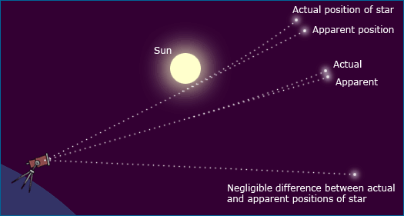
1919

Slide 74
“The Problem of the Criterion”
Observation: Pseudoscientific theories take no risk, but Einstein’s was very risky.
One could easily imagine the results not matching his prediction.
So, Popper claims:
  Falsifiability is the criterion of science
Falsifiability: the logical possibility of being shown to be false by observation. The possibility of such proof existing without self-contradiction.

Slide 75
“The Problem of the Criterion”
Falsification of scientific claim is logically valid:
  If Theory T is true, then we should see Observation O.
  We do not see Observation O.
  Therefore, Theory T is not true.
On the other hand, the confirmation we see of pseudoscience, is fallacious:
  If Theory T is true, then we should see Observation O.
  We see Observation O.
  Therefore, Theory T is true.

Slide 76
Quiz! Are these claims falsifiable?
Big Foot is Real.
Big Foot is not Real.
5 + 7 = 12
Fifty percent of the students at UNR are taller than average.
The USA is the highest taxed nation in the world.
Aliens landed at Roswell and the government covered it up.
Alcibiades spoke with a lisp.
Human beings descended from Australopithecus.
Much biological change is explained by Evolution by Natural Selection.
We live in but one of a multiverse.

Slide 77
Mr. Popper’s Principles
Deduction is the only logic; there is no inductive logic.
Theory of rationality: accept the boldest/riskiest/highest content theory which is falsifiable, but not yet falsified.
  Timid: the Earth has been around for a long time
  Bold: the Earth has been around for hundreds or thousands of millions of years
  Boldest: The Earth came into being 4.55 Billion years ago on a Tuesday.
It is only when theories are falsified that we get feedback from Nature and a chance to improve our knowledge.
Theories that survive rigorous attempts at falsification are NOT proved nor confirmed; they are “corroborated” but can only be held tentatively.

Slide 78
Mr. Popper’s Theory of Rationality
Everything is possible, as far as we can tell, we are in perfect ignorance
  E.g., F=ma or F=mv or F=m²a or…
Experience rules out some possibilities
Scientific theories are constrained by observational data.
“Genuine test” is defined in terms of attempts to falsify.
Theories can be protected from the evidence by qualifications, ad hoc changes, discounting data, etc.
  E.g.: Is the theory of global warming falsified by time periods of cooling?
BUT: Non-falsifiability is not meaningless:
  “I personally do not doubt that much of what they say is of considerable importance and may well play its part one day in a psychological science which is testable” (Popper, 1963)

Slide 79
Context of Discovery & Justification
Popper (1934) distinguishes between
  The Context of Discovery – which is not logical, but creative.
  The Context of Justification – which is the difficult project of testing theories, whereby we find singular evidence that can show a theory is false. We can never confirm theories as true, however.
Discovery: there is no particular method of inventing theories.
Justification is also problematic:
  A theoretical system can always escape falsification by e.g. doubting the observations (“The extroversion scale has limited validity”), or changing a definition (“Rocks of specific gravity 3.11 are not jade”).
  Astrology makes falsifiable predictions but then does not test or modify the theory.

Slide 80
Dealing with Justification
Decide in advance the sort of observation statements you will accept, the conditions that will falsify your theory… then give up on theories that miss certain benchmarks (Difficult, but reasonable)
Rule: Only revise theories, introduce new theories, or introduce those auxiliary hypotheses that do not diminish the degree of falsifiability of the system
  Theory: “All ravens are black except for Peter”
    Ad hoc theory: The amendment to the theory decreased its falsifiability
  Theory: “God created the Earth, with all current species in it, 4000 years ago”
    Falsifying evidence: Fossil record
    Ad hoc amendment: God put the fossil record there to test our faith.
Popper: New hypotheses replacing old rejected ones should have more falsifiability
  But: Unrealistic to always expect more falsifiability?

Slide 81
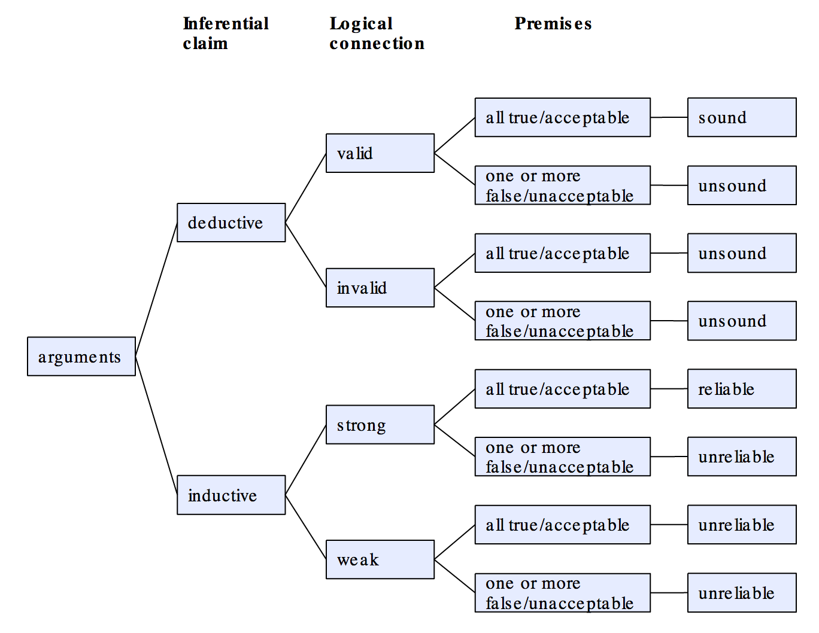
Logic

Slide 82
Logical Fallacies!!

Slide 83
Some Definitions
Logic: the study of reasoning about the truth or falsity of statements.
Reason: The drawing of inferences or conclusions from known or assumed facts.
Argument: A set of sentences in which the final sentence (conclusion) follows from the truth of the prior sentences (premises).
Premise: A sentence that either makes a claim or establishes a relationship between two or more other claims.
Conclusion: The final sentence in an argument.

Slide 84
Deductive Fallacies
Fallacy: Bad reasoning, regardless of whether the premises or conclusion are true.
Examples:
  Denying the Antecedent: “If 2+2=5, then Climate Change is real.
  But 2+2≠5.
  So, Climate Change must not be real.”
  Affirming the Consequent: “If 2+2=5, then Climate Change is real.
  I know Climate Change is real.
  So, 2+2 must be 5!”
  Illegitimate Syllogism: ”If I save my money, I’ll be happy.
  If I win the lottery, I’ll be happy.
  Therefore, if I save my money, I’ll win the lottery!”
  False Dichotomy: “Love me or leave me. You haven’t left me. Therefore, you must love me!
  (Said as one is lacing up their boots.)”
  Non Sequitur: “If you didn’t complain in the past,
  your complaint now is illegitimate.”

Slide 85
Valid Argument Fallacy
Hypothetical Syllogism
Illegitimate Syllogism
Non Sequitur
A → B
B → C
—
A → C
A → B
C → B
—
A → C
A
B
—
C
Disjunctive Syllogism
Affirming a Disjunct
False Dichotomy
A v B
~B
—
A
A v B
A
—
~B
A v B (ignores C)
~A
—
B

Slide 86
Valid Argument Fallacy Fallacy
Hypothetical Syllogism
Illegitimate Syllogism
Non Sequitur
A → B
B → C
—
A → C
A → B
C → B
—
A → C
A
B
—
C
Disjunctive Syllogism
Affirming a Disjunct
False Dichotomy
A v B
~B
—
A
A v B
A
—
~B
A v B (ignores C)
~A
—
B

Slide 87
Induction Deduction
A type of logic which involves going from a series of specific cases to a general statement.
Good arguments are termed “strong”
Strong: A property of arguments such that if the premises of the argument are true, the conclusion is likely to be true.
Inductive arguments are not “truth preserving”
Cogent: A strong argument with true premises
A type of logic in which one goes from a general statement to a specific instance.
Good arguments are termed “valid”
Validity: A property of arguments such that if the premises are true, the conclusion must follow with 100% certainty.
Deductive arguments are “truth preserving.”
Sound: A valid argument with true premises

Slide 88
Three Inductive Arguments
Argument from Analogy: One entity shares some properties with one or more entites, thus it is likely to share other properties as well.
Inductive Generalization: Several entities exhibit a pattern, therefore other entities (and possibly all other entities) will likely also fit into that pattern.
  Enumeration: Several entities exhibit a pattern, therefore the next entity will likely also fit into that pattern.
  Prediction: A pattern has been observed in the past, therefore it is likely to also occur in the future.
Inference to the Best Explanation (IBE): Of the available explanations for a particular phenomenon, one is the best and thus is more likely to be the correct explanation. Also called “Abduction.”

Slide 89
Inductive Fallacies
Fallacy: Bad reasoning, regardless of whether the premises or conclusion are true.
Examples:
  False Analogies: “You and Richard Spencer both like talking about Richard Spencer getting punched, you must have so much in common!”
  Hasty Generalization: “We’re on a winning streak. Next stop: the Super Bowl”
    Biased Generalization: “Several Wisconsin rural counties went heavily against Hillary Clinton, so she didn’t win because she didn’t reach out to the white working class.”
    Slothful Induction: “Over 97 percent of climate scientists agree on anthropogenic climate change, but we should wait until all of the science is in.”
    Gambler’s Fallacy: ”Now we’re on a losing streak, this next hand will turn it around!”
    Appeal to Anecdotal Evidence: “Everyone I know voted for Gary Johnson, how could he not have become president?”
  Post Hoc Ergo Propter Hoc: “Donald Trump won the election, then General Motors chose to not leave the U.S. So, Trump has already saved many jobs.”

Slide 90
Probabilistic Fallacies
Suppose that you are worried that you might have a rare disease. You decide to get tested, and suppose that the testing methods for this disease are correct 99 percent of the time (in other words, if you have the disease, it shows that you do with 99 percent probability, and if you don't have the disease, it shows that you do not with 99 percent probability). Suppose this disease is actually quite rare, occurring randomly in the general population in only one of every 10,000 people.
You take the test. The results come back positive, what are your chances that you actually have the disease?
  .99
  .90
  .10
  .01

Slide 91
Probabilistic Fallacies
Suppose that you are worried that you might have a rare disease. You decide to get tested, and suppose that the testing methods for this disease are correct 99 percent of the time (in other words, if you have the disease, it shows that you do with 99 percent probability, and if you don't have the disease, it shows that you do not with 99 percent probability). Suppose this disease is actually quite rare, occurring randomly in the general population in only one of every 10,000 people.
You take the test. The results come back positive, what are your chances that you actually have the disease?
  .99
  .90
  .10
  .01

Slide 92
Bayes Theorem
P(D): Probability of hypothesis D (Disease).
P(D|T): Probability of D if evidence T (Test Result) is true.
Bayes Theorem:
In this example, P(T|D)=.99, P(D)=.0001, and P(T) may be derived by conditioning on whether event D does or does not occur:
P(D|T) = P(T|D) x P(D)
P(D|T) = [P(T|D) x P(D)] + [P(T|~D) x P(~D)]
P(D|T) = [.99 x .0001] + [.01 x .9999]
.01 = [.99 x .0001] + [.01 x .9999]

Slide 93
Class Experiment!
(all but Group 1 close your eyes)

Slide 94
Left Row
Do you think the tallest redwood in the world is taller than 50 feet?

Slide 95
Left Row
Do you think the tallest redwood in the world is taller than 50 feet?
How tall do you think the tallest redwood in the world is?

Slide 96
Second Group
Do you think the tallest redwood in the world is taller than 100 feet?

Slide 97
Second Group
Do you think the tallest redwood in the world is taller than 100 feet?
How tall do you think the tallest redwood in the world is?

Slide 98
Third Group
Do you think the tallest redwood in the world is taller than 250 feet?

Slide 99
Third Group
Do you think the tallest redwood in the world is taller than 250 feet?
How tall do you think the tallest redwood in the world is?

Slide 100
Fourth Group
Do you think the tallest redwood in the world is taller than 1000 feet?

Slide 101
Fourth Group
Do you think the tallest redwood in the world is taller than 1000 feet?
How tall do you think the tallest redwood in the world is?

Slide 102
 | Group 1 | Group 2 | Group 3 | Group 4
i
ii
iii
iv

Slide 103
Identify the argument
If you would hope for peace, prepare for war.
You are preparing for war
You must hope for peace!
If all you have is a hammer, every problem looks like a nail.
Every problem looks like a nail.
All I have is a hammer.
If you can make it here, you can make it anywhere.
You can make it here.
You can make it anywhere
If ifs and buts were candies and nuts, we’d all have a Merry Christmas.
Ifs and buts are not candies and nuts.
We won’t have a Merry Christmas ☹

Slide 104
Identify the argument
Every day I turn on the news, I am sad.
If I turn on the news tomorrow, I’ll be sad.
If it walks like a duck, acts like a duck, quacks like a duck, it’s probably a duck.
He hasn’t called me back, even though I sent him 200 messages telling him how much I liked our date.
I can’t imagine a good reason he would see those messages and not call me back.
He probably hasn’t checked his phone yet.
Every day I’ve ever been alive, I’ve lived to see the next.
I will see all of the days.

Slide 105
Identify the argument
If you can’t take the heat, get out of the kitchen.
If you get out of the kitchen, get out of my life.
If you can’t take the heat, get out of my life.
If it’s raining, it’s pouring.
If it’s not sunny, it’s pouring.
So, if it’s rainy, it’s not sunny.
Go big or go home.
You went big!
You’ll probably go home now.
It’s all or nothing.
It’s not nothing.
It’s all.

Slide 106
Logical Positivism

Slide 107
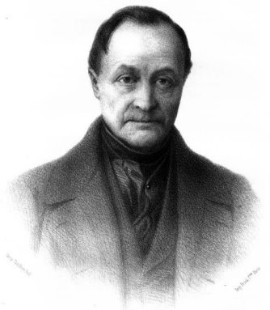
19th Century: Comte’s positivism
“Positive philosophy” - the idea of enlightenment and belief in the progress and unity of science.
The “Positive” is real, useful, certain, precise, and edifying
Comte’s progressionist philosophy of history:
  The theological stage - belief in supernatural powers
    Animism
    Polytheism
    Monotheisme
  The metaphysical stage - belief in abstract powers
    Isolated speculation
    Branches of philosophy
    Philosophical systems
  The scientific stage – belief in invariant patterns
    Specific matters of fact
    Fewer and fewer, more general facts (theories)
A. Comte
(1798-1857)
complexity
generality
Sociology
Biology
Chemistry
Physics
Astronomy
Notes:
The positive is:
What is real (non-imagined)
no loose speculations, but the real and experience-based. Science as descriptive
What is useful
skepticism regarding “armchair philosophy”
What is certain (beyond discussion)
What is precise
distancing the vague and opaque in contemporary philosophy
What is edifying
Philosophy should help build up, not break down

Slide 108
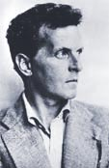
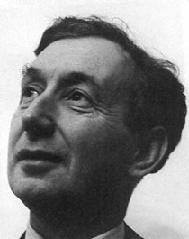
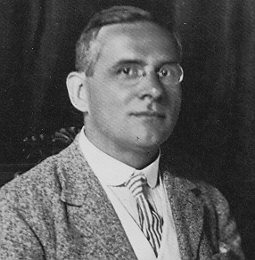
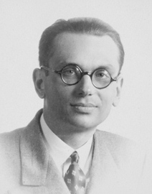
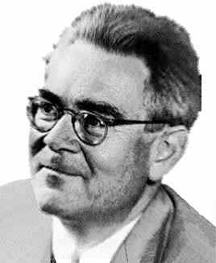
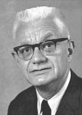
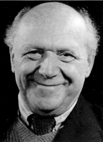
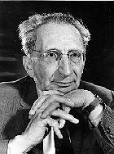
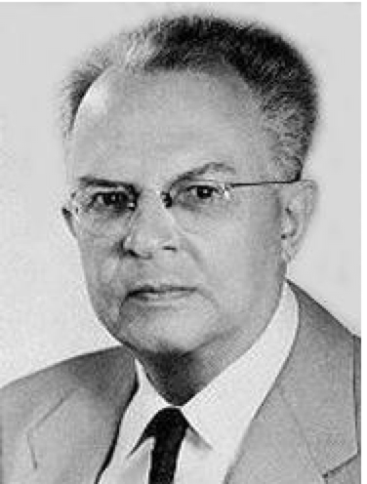
The Vienna Circle
Alfred J. Ayer
(1910-1989)
Charlie Popper
(1902-1994)
Ludwig Wittgenstein
(1889-1951)
Moritz Schlick
(1882-1936)
Kurt Gödel
(1906-1978)
Herbert Feigl
(1902-1988)
Rudolf Carnap
(1891-1970)
Hans Reichenbach
(1891-1953)
Carl G. Hempel
(1905-1997)
Otto Neurath
(1882-1945)

Slide 109
Logical positivism
- some characteristics
Rationality, ”positive knowledge.”
  (Only ‘bad science’ needs historical or psychological explanations)
Sharp distinction between Science / Non-science
(Anti-metaphysical)
Source of knowledge: observations + logic (cf. ”logical empiricism”)
The total
knowledge is
cumulative
(analytic and
synthetic)
knowledge
’nonsense’
Laws and theories
Induction
data data data ...
Notes:
(Nonsense incl. Hegel and Heidegger in philosophy and nazism in politics)
(implied): a teleological picture of the scientific method (as intrinsically goal-directed towards objective knowledge) with an asymmetry between explanations of ’good’ and ’bad’ science. Only bad science, pseudoscience, etc., needs ’external’ historical or psychological explanations.

Slide 110
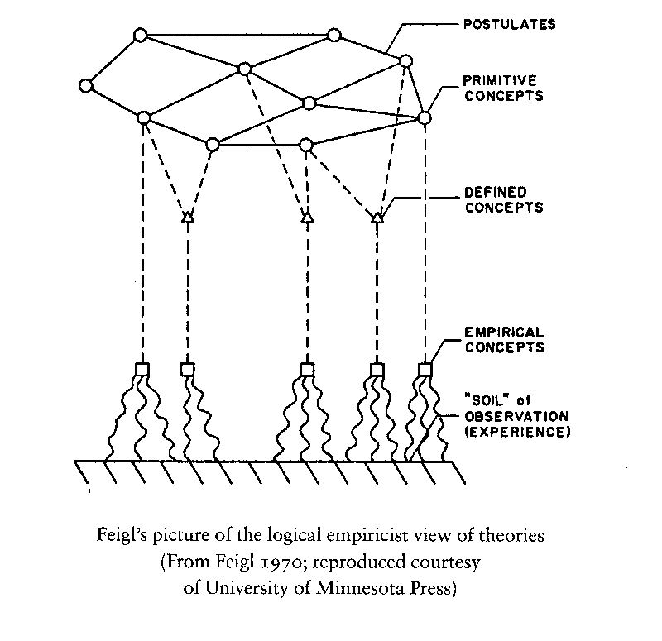
Logical positivism
- some characteristics
complexity
generality
Sociology
Biology
Chemistry
Physics
Astronomy
Unified, reductive science grounded in physics
(methodological monism/ methodological reductionism/ ontological reductionism)
The language of Observation and the language of Theory are seen as sharply separated
  ”the iron bar lights red” // ”Helium atoms have each 2 e–”
the language of Theory
the language of Observation

Slide 111
Logical positivism
- some characteristics
Language has a logical structure
  Philosophy is useful for science because it understands logic
Verificationist theory of meaning (What is meaningful = what is verifiable)
  (by implication, metaphysics is considered as meaningless)
  ”Snow is white” is true if and only if the object we mean by ‘snow’ is actually the color we designate as ‘white’.
Context of Discovery vs. Context of Justification
Science should be value-free
  Emphasis on ”facts” and the objectivity of science.
  Objectivity conceived as methods to secure a mirror-like relation between theories and observations

Slide 112
Logical positivism
- objections
Verifiability theory of meaning
  Leads to strange conclusions: snow being white also supports ”snow is white until the year 2018”
  Is not itself verifiable
Theoretical, ontological, and methodological reductionism
  Theoretical reductionism is implausible & ontological reductionism is unverifiable
Induction is problematic (see Hume, Goodman, Hempel)
Analytic/Synthetic distinction is problematic (Quine)
Progress of science is problematic (Kuhn)
Observation/Theory distinction is problematic (Kuhn)
Science should be value free (Douglas, Longino, Kuhn)

Slide 113
Later “positivism”
- as an ethos
Ethos: A practically-moral way to take a stance or act, an attitude, a set of social norms and values
  May be expressed at special occasions, in salutary speeches etc.; but more often an ethos is expressed in actions and not in words.
(not a consistent philosophical position)
(not an ideology in the sense of ”false consciousness” or a ”political agenda”)
An ideology in the sense of a non-scientific “practical everyday stance”

Slide 114
“The positivist ethos of science”
Science is the highest form of cultural human activity.
Science aims at positive, certain knowledge, by means of the scientific method (hypothetical-deductive, theory-testing, falsification, etc.).
Science is (or should be) autonomous; only guided by curiosity and the inner developmental logic of each speciality.
Knowledge is justified, true (or very probable) beliefs. Truth is an epistemic, not an ontologic (about being) or axiologic (about values) concept.
Knowledge is neutral regarding use or misuse. There is no ”ethically wrong” or ”irresponsible” knowledge; only knowledge used wrongly in specific situations.
There is (or should be) a sharp division between science and non-science like politics, religion, etc.
Use/misuse is a political question. If a researcher asserts anything about this, it is in his/her role not as a researcher but as a citizen, a lay person, a politician.
Natural science is only committed to search for true knowledge, not ”good knowledge”. Science forms the basis for technology that can be applied to acceptable or intolerable purposes, but the ethics and politics involved in this is foreign to science.

Slide 115
“The positivist ethos of science”
According to Robert K. Merton, the ethos of science can be expressed in the norms ‘CUDOS’
  Communism (knowledge is a common good)
  Universality (science is for all disregarding social, political, religious etc. background)
  Disinterestedness (objectivity)
  Organized Skepticism (the system of critical testing and evaluation)

Slide 116
“The positivist ethos of science”
Science is the highest form of cultural human activity.
Science aims at positive, certain knowledge, by means of the scientific method (hypothetical-deductive, theory-testing, falsification, etc.).
Science is (or should be) autonomous; only guided by curiosity and the inner developmental logic of each speciality.
Knowledge is justified, true (or very probable) beliefs. Truth is an epistemic, not an ontologic (about being) or axiologic (about values) concept.
Knowledge is neutral regarding use or misuse. There is no ”ethically wrong” or ”irresponsible” knowledge; only knowledge used wrongly in specific situations.
There is (or should be) a sharp division between science and non-science like politics, religion, etc.
Use/misuse is a political question. If a researcher asserts anything about this, it is in his/her role not as a researcher but as a citizen, a lay person, a politician.
Natural science is only committed to search for true knowledge, not ”good knowledge”. Science forms the basis for technology that can be applied to acceptable or intolerable purposes, but the ethics and politics involved in this is foreign to science.

Slide 117
“The positivist ethos of science”
- Rebuttal
Science is the highest form of cultural human activity.
  Is this ethnochauvism? Scientism?
  Demanding a single highest cultural activity is very restrictive
Science aims at positive, certain knowledge, by means of the scientific method (hypothetical-deductive, theory-testing, falsification, etc.).
  Emphasis on certainty is implausible and leads to skepticism
  Naïve version of how science actually works
Science is (or should be) autonomous; only guided by curiosity and the inner developmental logic of each specialty.
  Forever? When should society decide that the whims of scientific research are enough?

Slide 118
“The positivist ethos of science”
Science is the highest form of cultural human activity.
Science aims at positive, certain knowledge, by means of the scientific method (hypothetical-deductive, theory-testing, falsification, etc.).
Science is (or should be) autonomous; only guided by curiosity and the inner developmental logic of each speciality.
Knowledge is justified, true (or very probable) beliefs. Truth is an epistemic, not an ontologic (about being) or axiologic (about values) concept.
Knowledge is neutral regarding use or misuse. There is no ”ethically wrong” or ”irresponsible” knowledge; only knowledge used wrongly in specific situations.
There is (or should be) a sharp division between science and non-science like politics, religion, etc.
Use/misuse is a political question. If a researcher asserts anything about this, it is in his/her role not as a researcher but as a citizen, a lay person, a politician.
Natural science is only committed to search for true knowledge, not ”good knowledge”. Science forms the basis for technology that can be applied to acceptable or intolerable purposes, but the ethics and politics involved in this is foreign to science.

Slide 119
“The positivist ethos of science”
- Rebuttal
Knowledge is justified, true (or very probable) beliefs. Truth is an epistemic, not an ontologic (about being) or axiologic (about values) concept.
  Knowledge cannot be accounted for like this
  Values and science cannot be separated, science cannot justify itself like that.
Knowledge is neutral regarding use or misuse. There is no ‘ethically wrong’ or ‘irresponsible’ knowledge; only knowledge used wrongly in specific situations.
  Does this free scientists of social responsibility?
There is (or should be) a sharp division between science and non-science like politics, religion, etc.
  You cannot always separate science from the use of science (e.g. atom bomb and Oppenheimer)

Slide 120
“The positivist ethos of science”
Science is the highest form of cultural human activity.
Science aims at positive, certain knowledge, by means of the scientific method (hypothetical-deductive, theory-testing, falsification, etc.).
Science is (or should be) autonomous; only guided by curiosity and the inner developmental logic of each speciality.
Knowledge is justified, true (or very probable) beliefs. Truth is an epistemic, not an ontologic (about being) or axiologic (about values) concept.
Knowledge is neutral regarding use or misuse. There is no ”ethically wrong” or ”irresponsible” knowledge; only knowledge used wrongly in specific situations.
There is (or should be) a sharp division between science and non-science like politics, religion, etc.
Use/misuse is a political question. If a researcher asserts anything about this, it is in his/her role not as a researcher but as a citizen, a lay person, a politician.
Natural science is only committed to search for true knowledge, not ”good knowledge”. Science forms the basis for technology that can be applied to acceptable or intolerable purposes, but the ethics and politics involved in this is foreign to science.

Slide 121
“The positivist ethos of science”
- Rebuttal
Use/misuse is a political question. If a researcher asserts anything about this, it is in his/her role not as a researcher but as a citizen, a lay person, a politician.
  Science is often political (e.g. climate change, alt facts)
  Can the scientist always distinguish between his role as a scientist and his active interests in funding, patents, or his role as a politically engaged citizen?
  The science of today is the ideology of tomorrow
  You can only believe something is apolitical if you agree with its politics.
Natural science is only committed to search for true knowledge, not ”good knowledge”. Science forms the basis for technology that can be applied to acceptable or intolerable purposes, but the ethics and politics involved in this is foreign to science.
  It is dangerous to believe that anything can be freed from ethical responsibility.
  Science and technology are tightly interwoven. Science advances through new technology and technology is made possible by new science.

Slide 122
The Web of Belief

Slide 123
Where we are so far…
David Hume questioned the justification for induction.
  Principles of induction (uniformity of nature, cause & effect, etc.) cannot be justified as relations of ideas (analytic truths) or matters of fact (synthetic truths). Induction cannot justify itself.
Nelson Goodman and Carl Hempel raised other problems for induction.
  Even if induction could be justified, we could not be justified in any particular induction about the future.
Karl Popper discards induction
  We never use induction, instead we generate risky claims (context of discovery) and test them (context of justification).
  Unlike induction, testing by falsification is logically valid (modus tollens)

Slide 124
Where we are so far…
Logical Positivists have a scientistic view of science
  Only verifiable things are meaningful
  Scientific theories are linguistic objects and are different than observational language
  Science is unified, we’ll eventually have a translation for all theoretical terms.
  Science is value free
Notes:
(Darcy: but are these theories themselves physical objects that are verifiable?)
(Erica: that seems highly implausible?)
(Cameron: no it isn’t, that’s silly)

Slide 125
DeMorgan’s Law
~(A & B) ↔ (~A v ~B)
  “I didn’t kick both a puppy and a kitten IF and ONLY IF I either didn’t kick a puppy or I didn’t kick a kitten”
~(A v B) ↔ (~A & ~B)
    “I didn’t kick either a puppy and a kitten is true IF and ONLY IF I didn’t kick a puppy and I didn’t kick a kitten”

Slide 126
Crucial Experiments
Recall that Popper argued his method of falsification was logically valid:
  If this Theory T is true, we should see Observation O.
  We do not see Observation O.
  Therefore, Theory T is not true.
But is this the actual method of science?

Slide 127
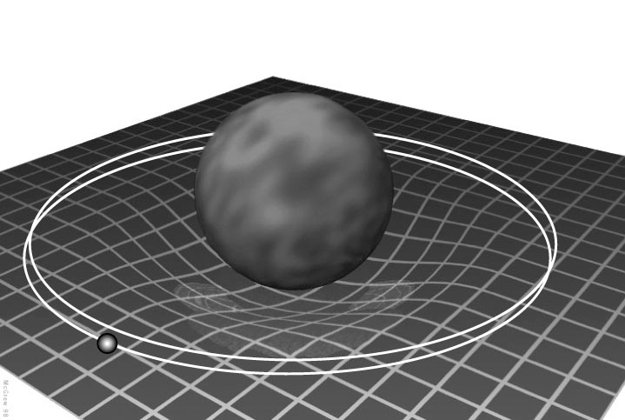

Slide 128
The Orbit of Mercury
For centuries, the orbit of Mercury was known to be wrong.
  If Newtonian Mechanics is True, then the Orbit of Mercury Should be This.
  The Orbit of Mercury is not This.
  Therefore…. Maybe we missed a hidden planet ‘Vulcan’ or something.
This is just one of thousands of examples in which a theory was held in the face of contrary evidence.
1. P → Q
2. ~Q
C. ~P

Slide 129
Underdetermination
Aside
Determination
Conclusion 1
Conclusion 2
Evidence
Reasoning
Evidence
Reasoning
Conclusion
…
Conclusion n
Notes:
There’s also over determination.

Slide 130
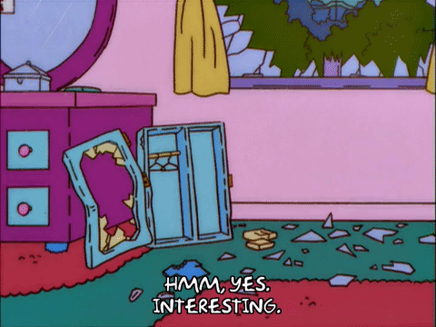

Underdetermination
Aside
Determination

Slide 131
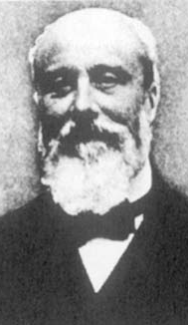
Pierre Duhem’s Underdetermination
1. (A & B) → Q
2. ~Q
3. ~A v ~B
  If Newtonian Mechanics is True
  and my observations are accurate,
  then the Orbit of Mercury should be
  X.
  The Orbit of Mercury is not X.
  Therefore, either Newtonian
  Mechanics is not true or my
  observation is not accurate, or…
Any evidence to the contrary simply shows that
one of my (implicit or explicit) assumptions is incorrect.
Notes:
For the orbit of Mercury, many scientists presumed the incorrect assumption was that there was no hidden planet, but Einstein showed this was not necessary.

Slide 132
Back to Mercury’s orbit…
~Newtonian Mechanics
Newtonian
Mechanics
+
Hidden Planet
Newtonian
Mechanics
+
Reasoning
Reasoning
~Newtonian Mechanics
…
Something else
1. P {& A₁ & A₂ …& A_{n}} → Q
2. ~Q
C. ~P v ~A₁ v ~A₂... ~A_{n}
1. P → Q
2. ~Q
C. ~P
Notes:
There’s also over determination.

Slide 133
So What?
Just because we can never guarantee we have logically refuted a hypothesis, doesn’t mean some approaches aren’t more rational than others.
  Kinds, amount, and certainty of evidence, assumptions, hypotheses, etc.
Choosing a hypothesis to accept is a matter of balancing pros and cons, and future hypotheses may fit all prior evidence better than past ones.

Slide 134
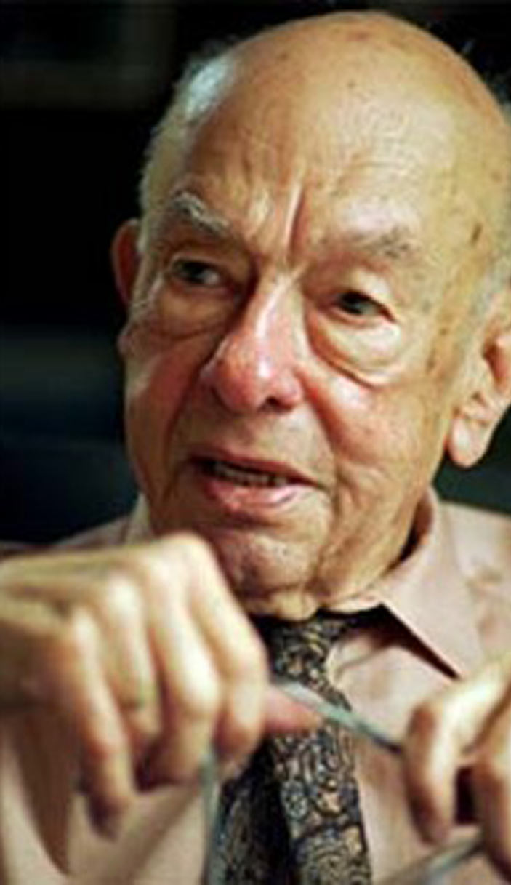
W.V.O. Quine’s Two Dogmas
Important iconoclast, central to analytic philosophy.
First Dogma: the Analytic/Synthetic distinction (relations of ideas/matters of fact distinction).
  Quine argues there is no way of making sense of analytic concepts/matters of fact without some experience about the world. In fact, sometimes experience can make us question analytic claims.
Before we get to the second Dogma, a detour on epistemology…

Slide 135
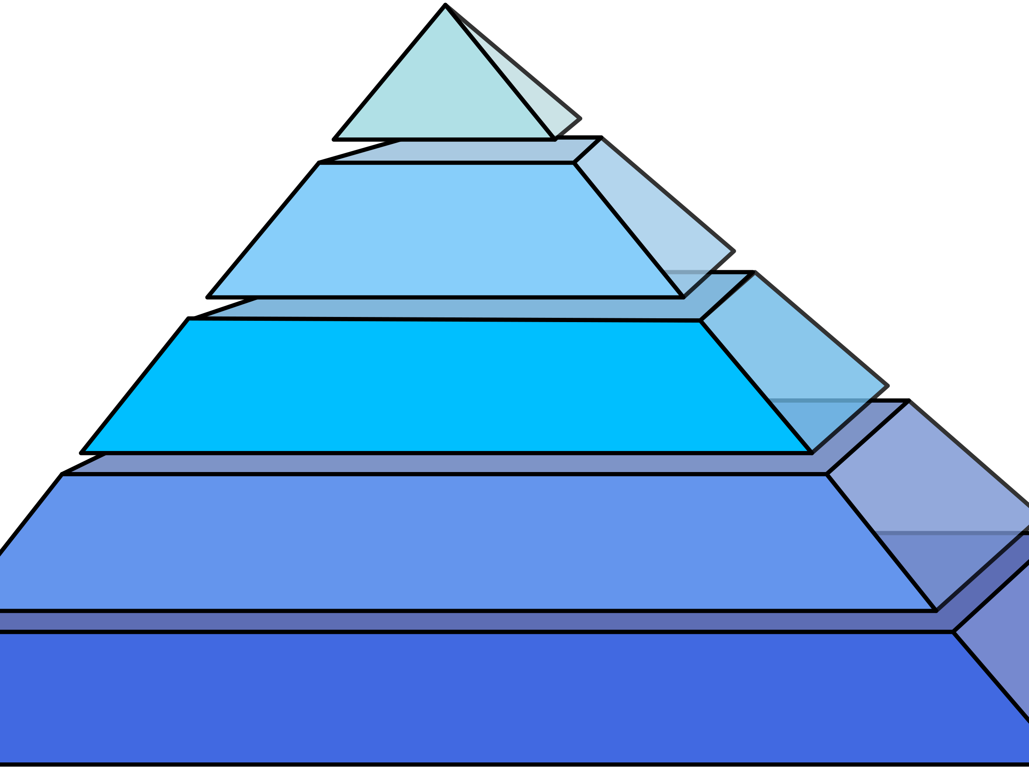
Senses
Mathematics
My Mind
Idea of God, God, and His Benevolence
“Cogito ergo sum”
”I think, therefore I am.”
Descartes’
Foundationalism

Slide 136
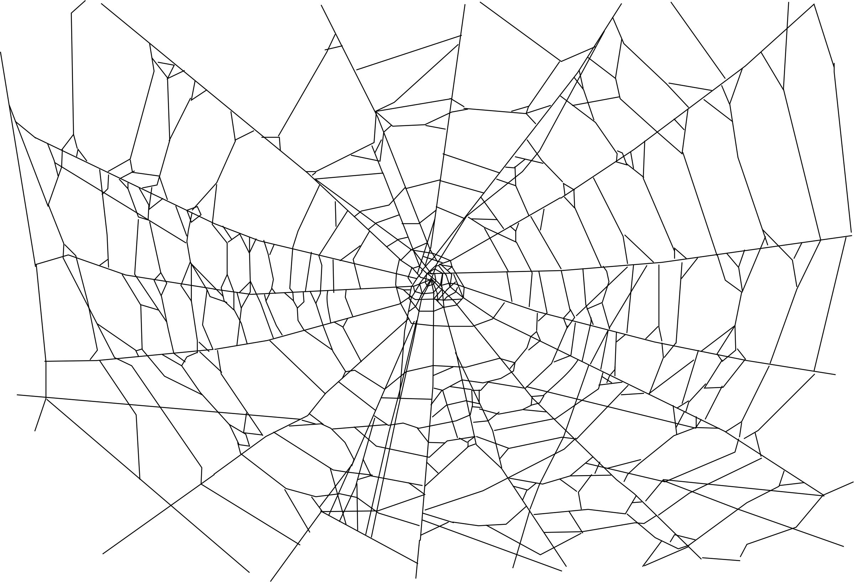
Observations
Observations
Observations
Auxiliary
Hypotheses
Theory
Auxiliary
Hypotheses
Auxiliary
Hypotheses
Background
Beliefs
Theory
Observations
Theory
Theory
Logic
Background
Beliefs
Auxiliary
Hypotheses
Background
Beliefs
Observations
Theory
Auxiliary
Hypotheses
Observations
Theory
Quine’s
Web
Auxiliary
Hypotheses
Theory
Observations
Observations
Observations

Slide 137
W.V.O. Quine’s Two Dogmas
Important iconoclast, central to analytic philosophy.
First Dogma: the Analytic/Synthetic distinction (relations of ideas/matters of fact distinction).
  Quine argues there is no way of making sense of analytic concepts/matters of fact without some experience about the world. In fact, sometimes experience can make us question analytic claims.
Second Dogma: Reductionism/the “Crucial Experiment.”
  Popper claims it is possible to reject a claim in the face of contravening evidence, but that’s not rationally required. Rejecting a number of other background assumptions may be equally reasonable
    “Any statement can be held true come what may, if we make drastic enough adjustments elsewhere in the system.”

Slide 138
Why Underdetermination Matters
A sufficiently strong form of underdetermination implies that non-rational factors always play a role in how scientists accept theories.
But if scientists are (semi-)irrational in how they accept theories, then few beliefs are (fully) rational.
So sufficiently strong form of underdetermination implies few (or no) beliefs are (fully) rational.

Slide 139
Why Underdetermination Matters
Popper is convinced that the mark of science is falsifiability, which he took to be both a logical process and an attitude on behalf of the scientist.
But if there is no such thing as a crucial experiment, then the logic that motivates Popper is flawed.
If it is hard to know ahead of time what the correct standard of falsification is, so accepting falsification may vary depending on the observer.
There is no assumption, no fact, no knowledge immune to revision. When faced with inconsistent beliefs, there is little to guide us except for our non-rational aesthetic judgments as to which beliefs to discard.

Slide 140
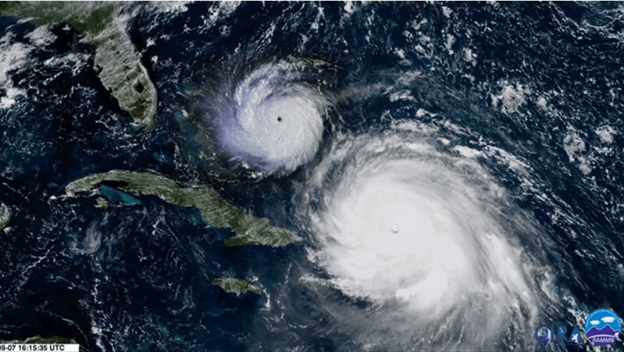

Slide 141
W.V.O. Quine’s Two Dogmas
“Any statement can be held true come what may, if we make drastic enough adjustments elsewhere in the system.”
So… these two are equivalent ways to resolve a tension in your evidence/reasoning:
Rationality doesn’t prescribe one alternative over another, though our psychology usually makes us to choose the explanation that is most consistent with our prior beliefs
Believing storms are rare & basing economic decisions on rare events is irrational
Believing Irma is evidence of climate change’s predictions of stronger storms

Slide 142
Recap
Underdetermination occurs when evidence and reasoning fail to demand a unique conclusion.
Certain forms of underdetermination suggest that science is not as rational as it appears.

Slide 143
Scientific Values
One should favor theories with:
  the broadest Universality – The amount of diverse phenomena explained
    For example, a theory of Mt. Everest is less universal than a theory of mountains
  the highest degree of Precision
  Consistency of explanation – Whether the whole of the explanation is free of contradictions.
    No ‘ad hoc’ hypotheses, or hypotheses introduced to explain away inconsistencies.
  Adequacy of explanation – Whether the explanation fits all of the data
  Testability – Whether there is some way to demonstrate whether the explanation is true or false.
    An explanation is testable only if it can predict something other than what it was introduced to explain.
    The empirical content of a theory increases with its degree of falsifiability. The more a statement forbids, the more it says about the world
  Simplicity – Number of assumptions made (fewer is better)
Notes:
Simplicity
Precision
Falsifiability
Conservativeness
Fruitfulness
Reproducibility
Scope
Consistency
Disinterestedness

Slide 144
Underdetermination moving forward
Underdetermination was also used for skeptical arguments about the external world
  e.g. the Cartesian demon, Bostrom’s Simulation argument, etc.
Underdetermination/overdetermination is key in questions of moral responsibility
  e.g. Frankfurt’s principle of alternate possibilities, neuroethics cases
Quine, Wittgenstein and others have used underdetermination arguments in mind, language, free will, etc.

Slide 145


Reference underdetermination
“A rabbit!”
“Food!”
“Gavagai!”
“It is a sign it
will rain”
“Momentary
rabbit stage”

Slide 146
Underdetermination moving forward
Underdetermination was also used for skeptical arguments about the external world
  e.g. the Cartesian demon, Bostrom’s Simulation argument, etc.
Underdetermination/overdetermination is key in questions of moral responsibility
  e.g. Frankfurt’s principle of alternate possibilities, neuroethics cases
Quine, Wittgenstein and others have used underdetermination arguments in mind, language, free will, etc.
Underdetermination is later used to attack the conclusions of science.
  Because there are always multiple interpretations for any given data, the conclusions of science have more to do with social culture of scientific labs and communities than with their observations.

Slide 147
The Structure of
Scientific Revolutions

Slide 148
The Demarcation Problem Redux
What is science?
  Inductivism?
    Hume’s Problem of Induction – Induction is unjustified/unjustifiable, but we behave as such by custom/habit
    Goodman’s New Riddle of Induction – Even particular inductive claims are unjustifiable, but we act as if it is by custom/habit
  Positivist approach? Popper’s Falsificationism?
    Duhem-Quine Thesis of Underdetermination – There is no such thing as a ‘crucial experiment,’
      Duhem – So we use broad reasoning to try to infer what hypotheses to accept, realizing they may be overturned in time.
      Quine – The unit of debate is the whole of our beliefs (holism), and there is no strictly rational way to decide between small changes in our background assumptions or broad overall changes in our world view, psychology is what matters
Perhaps we should rethink some assumptions?

Slide 149
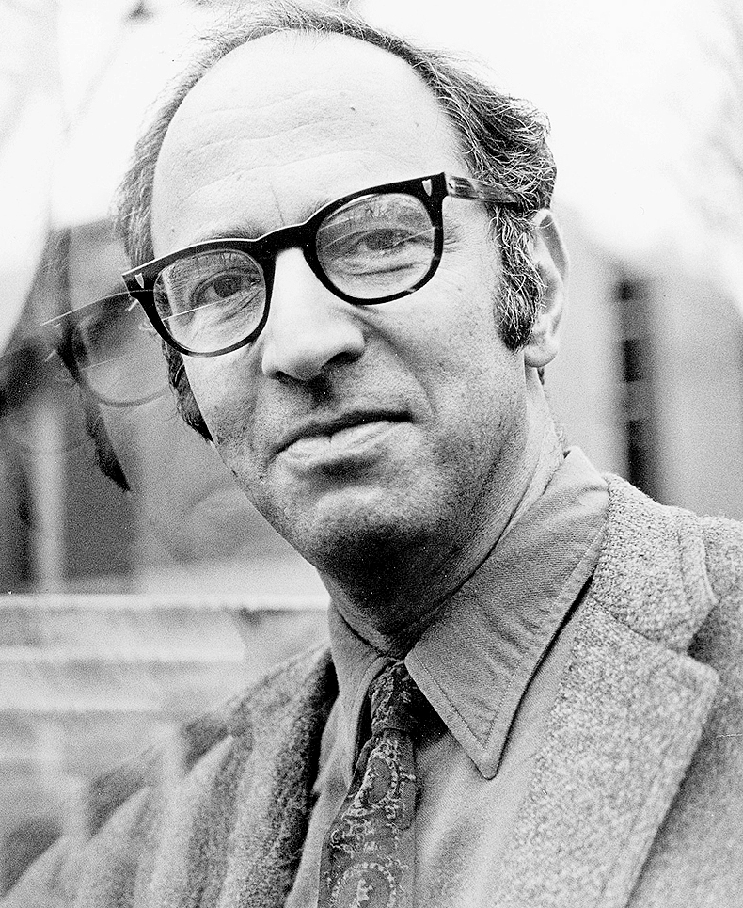
Thomas Kuhn
Harvard Ph.D. in quantum physics (1949),
elected to Society of Fellows, chosen to
teach a course on science for humanities
students.
Read Newton, Galileo, Aristotle (“Aristotle
appeared not only ignorant of mechanics, but a dreadfully bad physical scientist as well. About motion, in particular, his writings seemed to me full of egregious errors, both of logic and of observation.”)
Realized he misunderstood Aristotle (e.g. ‘motion’ meant change in general, not merely change in position.)
Denied tenure at Harvard, moved to Berkeley, wrote the Copernican Revolution, SSR
1922-1996

Slide 150
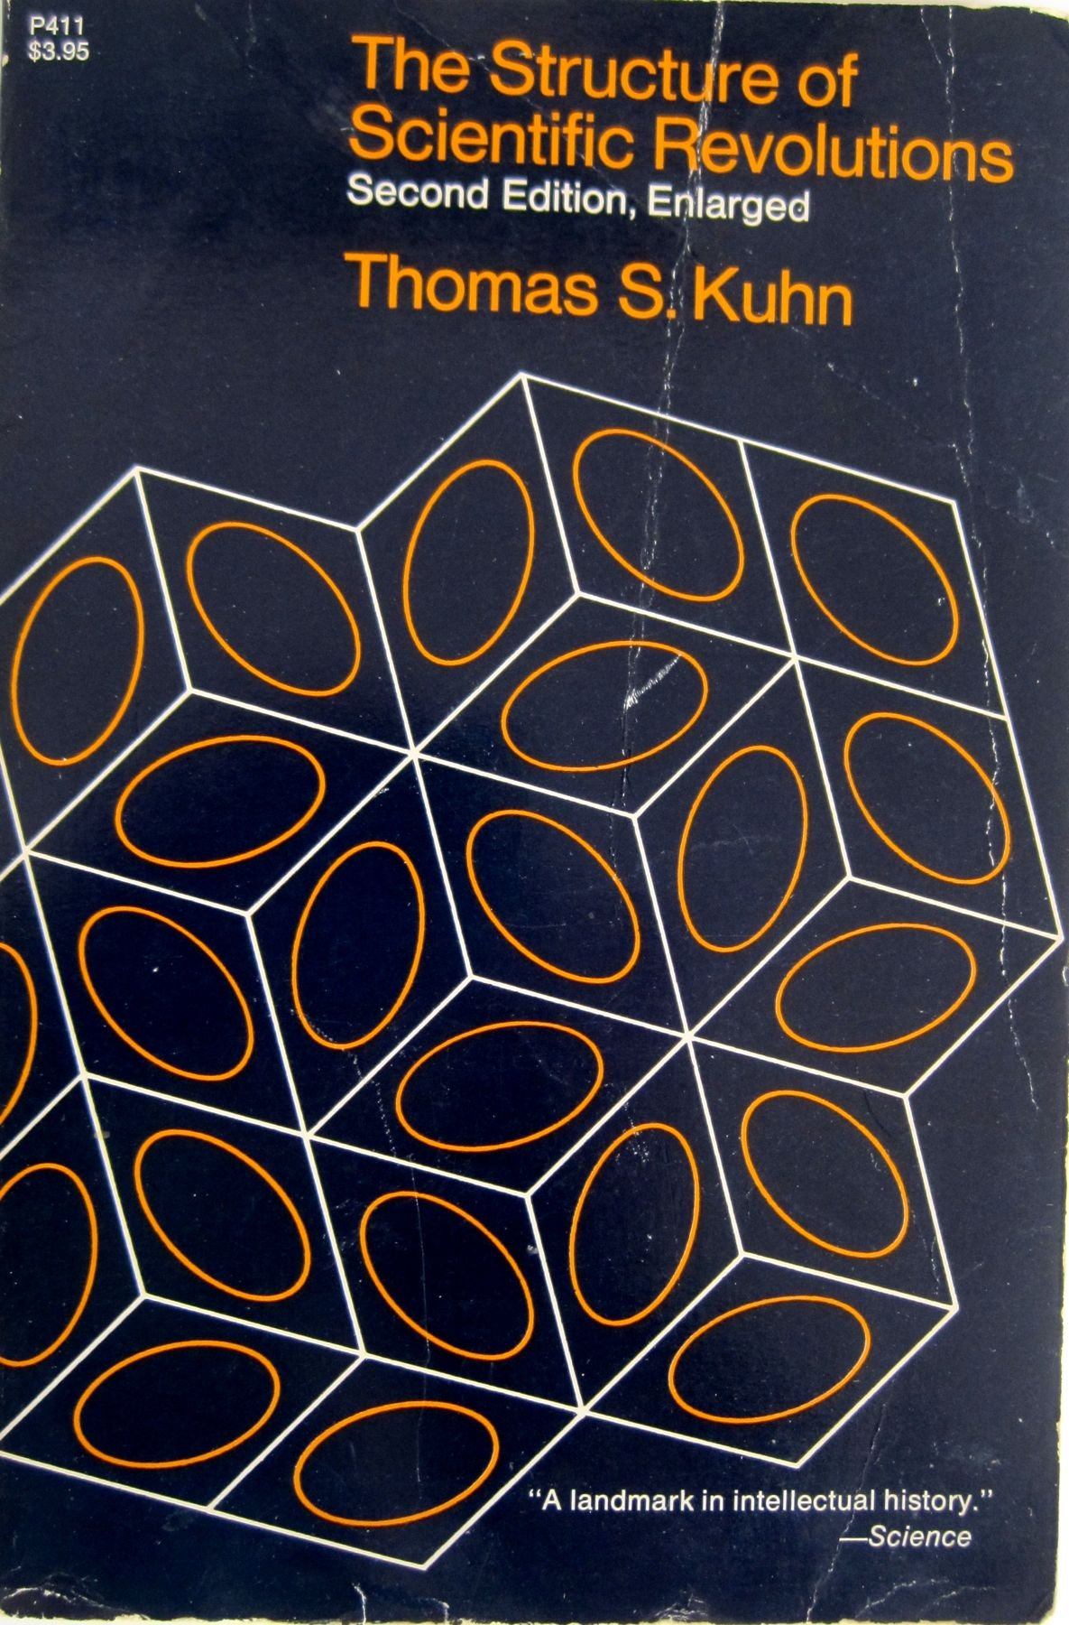
Thomas Kuhn’s Structure of Scientific Revolutions
Start with history of science – how science actually seems to work over long periods of time
What is the unit of analysis?
  Scientific communities – identified, roughly, by building location, terms, and interactions
  Normal Science – what scientists actually do in daily life
  Theory change – how scientific communities react in periods of massive historical change
1922-1996

Slide 151
Normal Science
Received beliefs: form the foundation of the "educational initiation that prepares and licenses the student for professional practice" (5). (The idea is to establish fluency/indoctrinate students in the received beliefs)
Normal science: "means research firmly based upon one or more past scientific achievements, achievements that some particular scientific community acknowledges for a time as supplying the foundation for its further practice"
  There are paradigmatic solutions that drew people away from earlier views
  There are many problems left to solve
  Scientists assume they know what the world is like, disruptive novelties are suppressed, observations are forced into the conceptual boxes supplied by professional scientists
A shift in professional commitments to shared assumptions takes place when an anomaly "subverts the existing tradition of scientific practice"
  When a shift takes place, "a scientist's world is qualitatively transformed [and] quantitatively enriched by fundamental novelties of either fact or theory" (7)

Slide 152
Paradigms
Paradigms are universally recognized scientific achievements that provide model problems and solutions to a community of practitioners. (“Paradigm” is Greek for model, pattern.)
Kuhn also describes these as the entire constellation of assumptions, beliefs, values and practices shared by members of a scientific community (because they were all trained on the same paradigm examples of good practice)
A scientific community cannot practice its trade without some set of received beliefs. A paradigm must exist.
  Is this accurate? If so, is science unique in this?
Margaret Masterson describes 21 separate definitions of ‘paradigm’ used in the 175-page book.

Slide 153
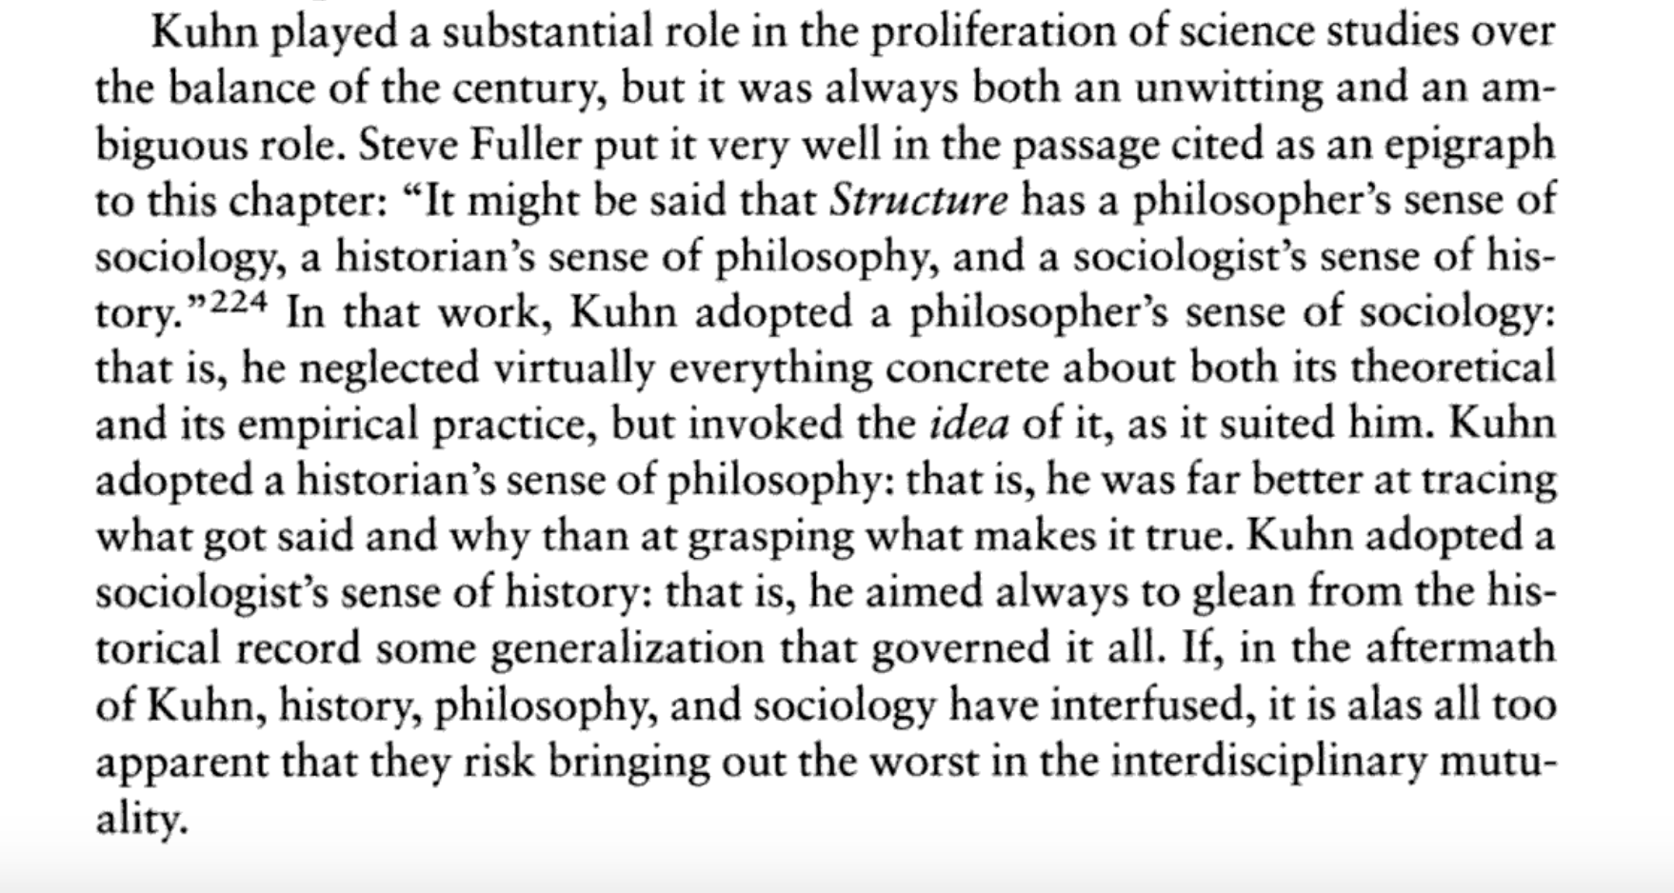

Slide 154
The Structure of Scientific Revolutions
Preparadigmatic science: there exists a range of different schools, not united by a common paradigm
Normal science: research firmly based on such a paradigm (the coming of maturity of a science); attempt to force nature into the paradigm and stay within it
Anomaly: Important problems resist solution, evidence in tension begins to pile up
Crisis: Scientists grow more insecure with the adequacy of the paradigm, the paradigm is loosened, contending theories emerge
Scientific Revolution: A young scientist or a scholar from another field enters, proposes a new paradigm, and other scientists who see it as fruitful come to embrace it.

Slide 155
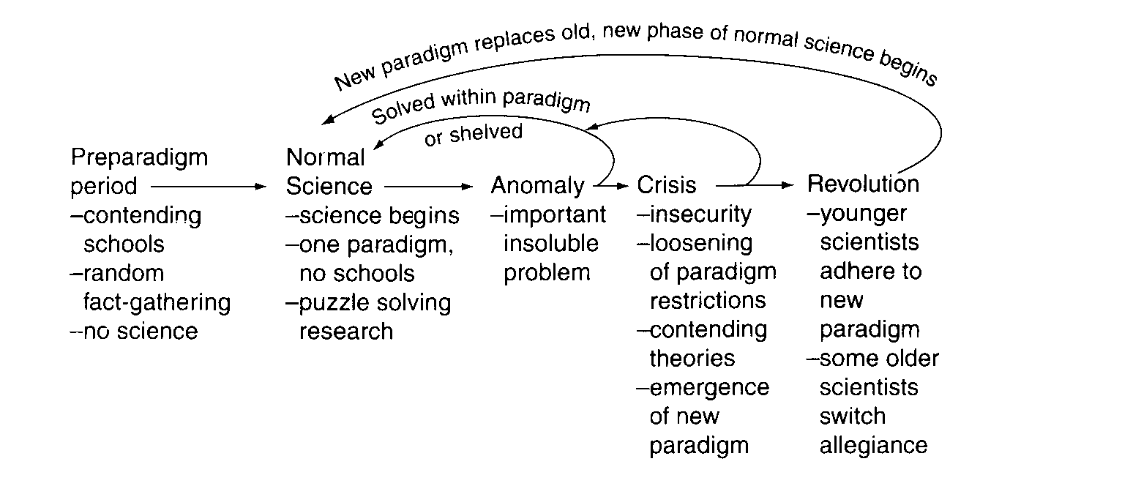

Slide 156
Scientific Revolutions
A scientific theory is declared invalid only if an alternative candidate is available to take its place.
  “The methodological stereotype of falsification by direct comparison with nature does not exist in actual science”
Paradigm choice can never be settled by logic and experiment alone. (Later Kuhn advocates scientific values as reasons)
Early Kuhn accepts revolutions are an act of faith: new paradigms have problems (‘Kuhnian loss’), but inspire some to think they may be fruitful
  “In paradigm choice there is no standard higher than the assent of the relevant community.”

Slide 157
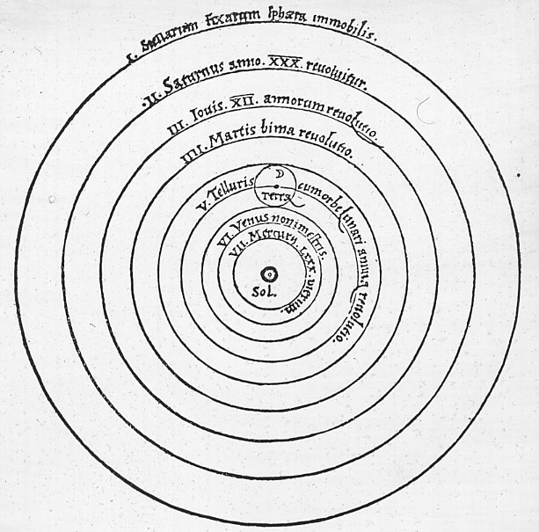
Classic Cases
Copernican Revolution
Newtonian Physics/Einsteinian Relativity/Quantum Mechanics
Lavoisier’s Chemical Revolution/Second Chemical Revolution
Darwinian Revolution/Modern Synthesis/Genomics
Freudian Revolution/Behaviorism/Cognitive Revolution
Uniformitarianism/Plate Tectonics

Slide 158
SSR, part 2

Slide 159
The dialogue so far
What is science?
  Inductivism?
    Hume & Goodman render this irrational, Popper agrees
  Positivist approach? Popper’s Falsificationism?
    Duhem-Quine Thesis of Underdetermination – No such thing as a ‘crucial experiment,’
  Kuhn: we should look at science how it is practiced in order to tell what it is and its nature. History is a guide.
    Science proceeds by normal science (puzzle solving), crisis, and radical scientific revolutions, in which everything changes.

Slide 160
After a paradigm is created…
A paradigm transforms a group into a profession or, at least, a discipline.
From this follows the formation of specialized journals, textbooks, articles, the foundation of professional bodies, and a claim to a special place in academe:
“addressed only to professional colleagues, [those] whose knowledge of a shared paradigm can be assumed and who prove to be the only ones able to read the papers addressed to them.”
Some scientists never accept the new paradigm:
  “Science advances one funeral at a time” – Max Planck

Slide 161
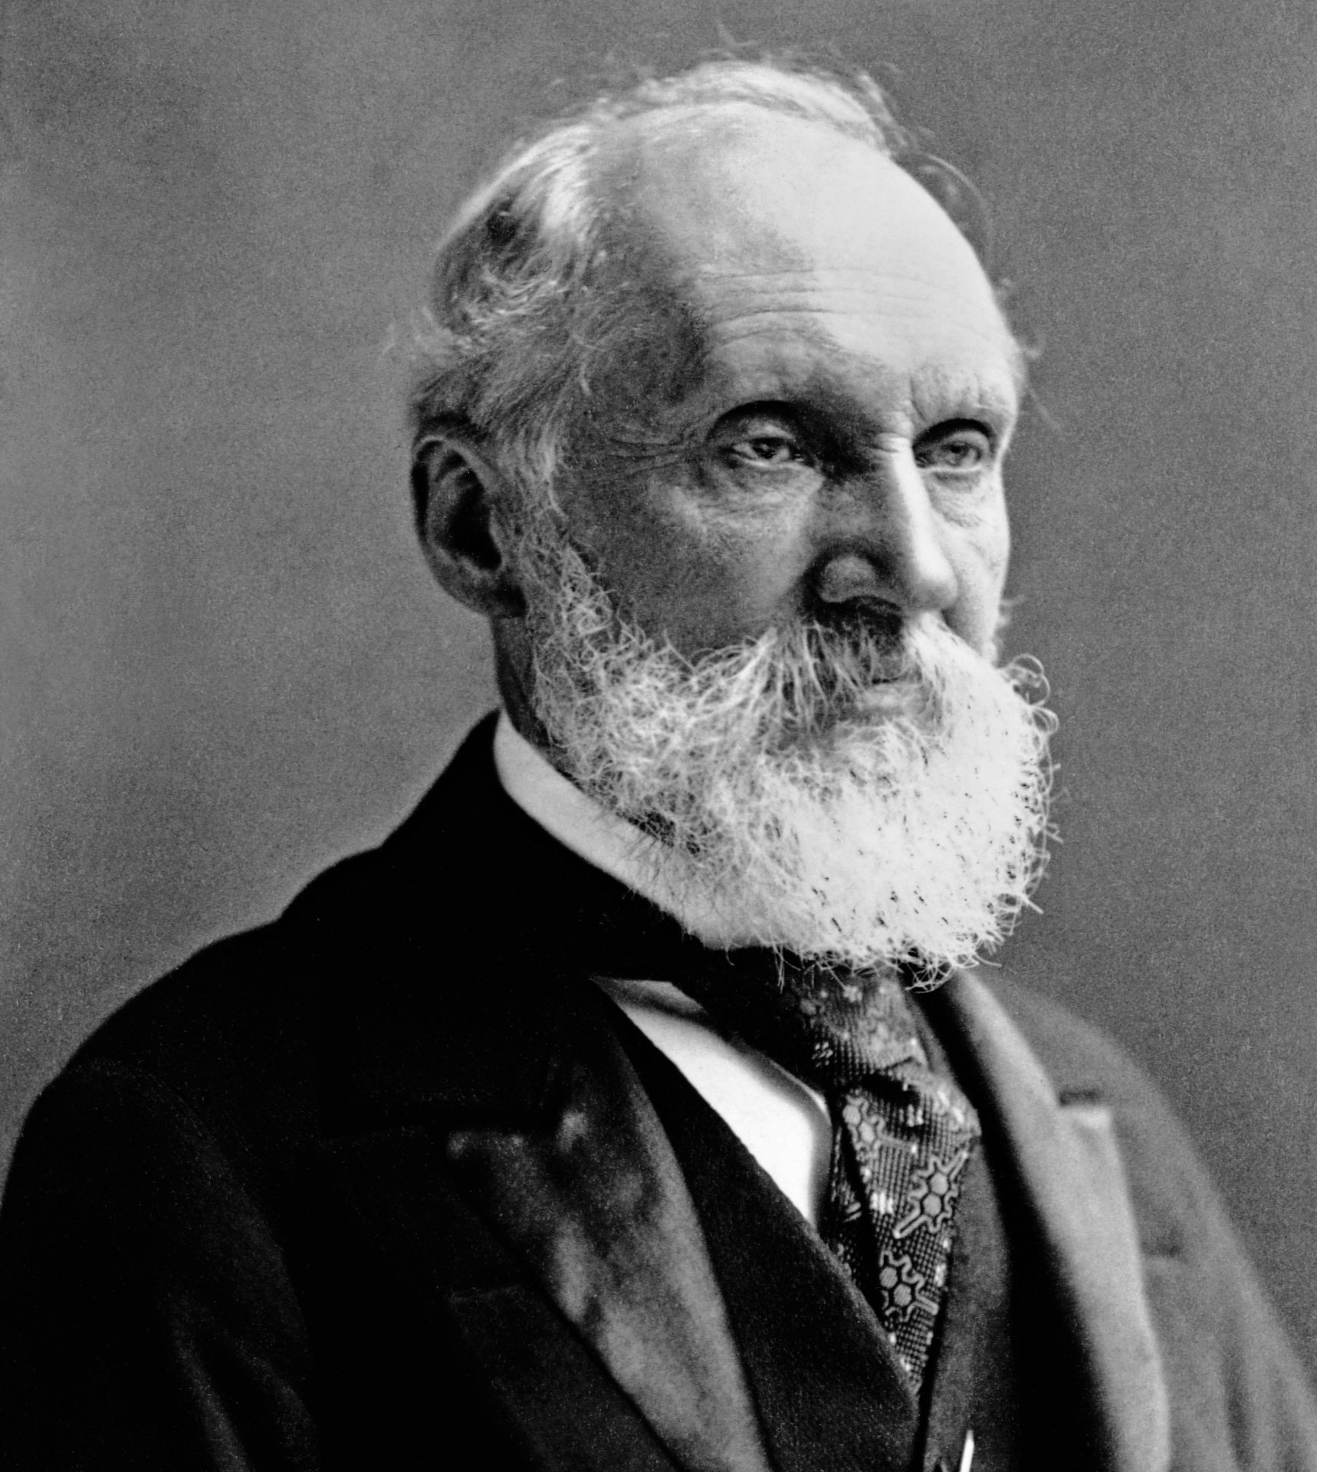
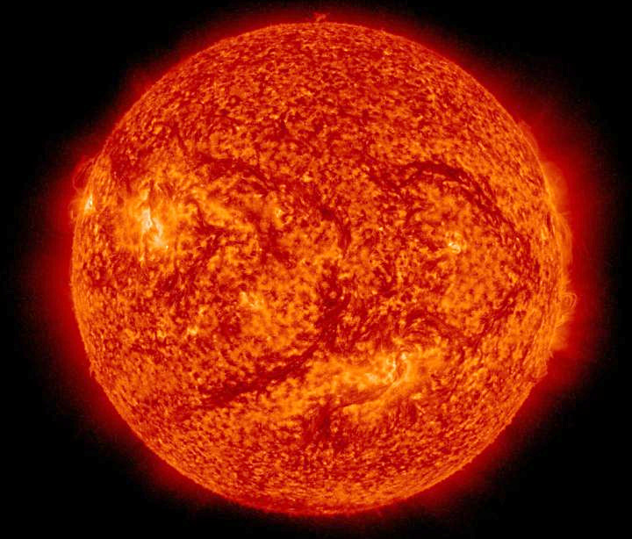
One Funeral at a Time…
William Thompson
a.k.a. Lord Kelvin

Slide 162
Kuhn vs. Logical Positivists
The total
knowledge is
not cumulative
Kuhn: Science is not a steady, cumulative acquisition of knowledge.
Instead, science is
“a series of peaceful interludes punctuated by intellectually violent revolutions… the tradition-shattering complements to the tradition-bound activity of normal science.”
Also argues against the ability to describe the world using solely observation language.
the language of Theory
the language of Observation

Slide 163
理論觀察 theoriegeladenheid van de waarneming
Théorie de la charge d'observation
Theorie-Belastbarkeit der Beobachtung
観察の理論的ラディネス
관측의 이론적 부담
Teori gözlem yüklülüğü тэорыя нагружаная назірання теорија-ладеннесс посматрања
Observación cargada de teoría
Teori-gözlem ağırlığı теорія навантаженості спостереження
טעאָריע-לאַדעננעסס פון אָבסערוואַציע

Slide 164
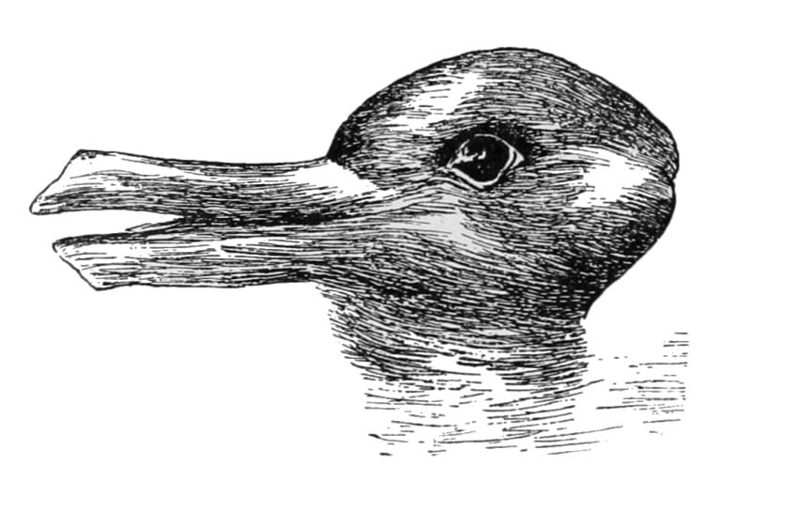
Gestalt switch: one cannot see both the rabbit and the duck at the same time.
One view is not more true than the other

Slide 165
Kuhn vs. Popper
Kuhn: Normal science is puzzle solving. If the puzzle is not solved, the community assumes the failure reflects on the scientist not on the paradigm.
  “To turn Sir Karl’s view on its head, it is precisely the abandonment of critical discourse that marks the transition to a science”
The scientist who pauses to examine every anomaly he notes will seldom get significant work done.

Slide 166
Kuhn vs. Popper
Popper: Experiments test theories, not paradigms. ‘Normal science’ is not true/good science
  “The ‘normal’ scientist, as described by Kuhn, has been badly taught. He has been taught in a dogmatic spirit: he is a victim of indoctrination. He has learned a technique which can be applied without asking for the reason why … He is merely content to solve ‘puzzles’.
  I admit that this kind of attitude exists … But I can only say that I see a very great danger in it and … the possibility of its becoming normal… a danger to science and, indeed, to our civilisation.”
(By the way, Popper also never understood the force of the Underdetermination argument)

Slide 167
Life within a disciplinary matrix
Normal science is distinctive in that it attempts to find further justification for what is presumed in advance.
Tasks
  Fact Gathering – seeking more and better facts that fit the paradigm
  Matching of facts with theory – fitting old facts to new theory or vice versa
  Articulation of theory – developing the theory, integrating it with other disciplines, sussing out implications, developing new methodology, new laws or constants.
  "The problems of paradigm articulation are simultaneously theoretical and experimental" (33).
Many disciplinary matrices can claim the same exemplars, though understand them differently (e.g. evolution, game theory, etc.)
To desert the exemplar is to cease practicing the science it defines (34).

Slide 168
Incommensurability
Kuhn: Work using different exemplars cannot be compared.
  Disagreement over the list of problems to be solved.
    Old problems are discarded (i.e. what makes objects at motion stay in motion for Newton, what causes consciousness for behaviorists)
  Disagreement over how to describe basic observations: Theory-laddenness of observation means that actual data looks different under different paradigms
    Trance/resting, Phlogiston/combustion, gravity as force/as space, bad design as evidence of evolution/as mark of a maker, etc.
  Words mean different things and assume a different nature of the world across a transition
    Trance/resting, Phlogiston/combustion, gravity as force/as space, bad design as evidence of evolution/as mark of a maker, etc.
To the extent that two scientific schools disagree about what is a problem and what a solution, they will inevitably talk through each other when debating the relative merits of their respective paradigms (109).

Slide 169
Incommensurability across theory change
“self-moving!”
“clock + mind!”
“Life!”
“vitalism!_{1,2,3}”
“just a list of
properties!”
Kuhn: there’s no adequate translation,
and reference is difficult to recover
unless one’s exemplars are accepted

Slide 170
Problems for Paradigms

Slide 171
Mastermind’s Analysis
The metaphysical paradigm involves the ontological elements of a theory, namely those assumptions that affect the way in which man views the world and his place in it.
The sociological paradigm refers to a concrete scientific achievement that functions as a model or framework within which scientific research is conducted.
Finally, the artefact paradigm concerns a distinct set of tools, techniques or instrumentation that are considered relevant to he validation of scientific knowledge.

Slide 172
Paradigms Exemplars & Disciplinary Matrices
Paradigms Exemplars are universally recognized scientific achievements that provide model problems and solutions to a community of practitioners. Normal science is not given rules, merely exemplars
Paradigms Disciplinary Matrices the entire constellation of assumptions, beliefs, values and practices shared by members of a scientific community (because they were all trained on the same paradigm examples of good practice)
A scientific community cannot practice its trade without some set of received beliefs. A disciplinary matrix and key exemplars must exist.
  Is this accurate? If so, is science unique in this?

Slide 173
Does Incommensurability make sense?
Some data seems to withstand paradigm shifts
  i.e. Apparent location of stars, Icelandic data on genealogy, Pavlov’s work..
Kuhn responds: When two scientific schools disagree about
  what are the problems
  what counts as a solution
  what the data actually are
  what the words and concepts mean
  what the nature of the world is
They will talk past each other in debating their respective paradigms.
Why does it seem as if sciences have a steady history if these shifts are so radical?
So how can one choose between different paradigms?

Slide 174
Are anomalies really ignored in Normal Science?
Problematically, when negative results fail to bolster a paradigm, they are deemed incomplete, failures, and are often not published
Nevertheless, many scientists genuinely worry about these in private.
Dunbar (1997) Spent a year in four highly productive molecular biology labs:
  Anomalies, especially those challenging core assumptions, were especially closely attended to and used to generate new hypotheses
When writing about why gravity worked, Newton famously said, “Hypotheses non fingo” (“I feign no hypothesis”)
In 19th century, Mercury’s orbit was not fully explained by Newton’s theory.
  A scientist at the time says that no planet had “extracted more pain and trouble” and “awarded [astronomers] with so much anxiety”

Slide 175
How revolutionary are Revolutions?
Kuhn views the transfer of allegiance from paradigm to paradigm is a conversion experience or a political revolution (i.e. can be smooth and short or violent and long).
Some paradigms coexist for long periods of time (catastrophism vs. uniformitarianism, phenetics vs. cladist, memists)
Converting people is difficult. Typically new paradigms are introduced by a person new to the field. (*cough*)
Counterexamples:
  Physicists of all ages came to adopt quantum theory and relativity rather than Newtonian dynamics as closer to the truth in a very short period of time.
  Biologists seemed to accept Darwinian evolution nearly immediately (albeit misunderstand it and eventually reject it for a generation)

Slide 176
Does Science Progress?
For Logical Positivists, science progressed
Kuhn sees each paradigm shift as
fundamentally changing the notion of
what knowledge was – reinterpreting past
‘knowledge’ as errant mistakes that can only within the new disciplinary matrix count as true knowledge
  e.g. design → EES, Origin myths → Big Bang, soul → cognitive science
Progress ‘occurs’ within normal science, but can be overturned, coopted, ignored, or ridiculed by new disciplinary matrices.
We may have to relinquish the notion, explicit or implicit, that changes of paradigm carry scientists and those who learn from them closer and closer to the truth (171).
The total
knowledge is
cumulative
It does specialize more, though..

Slide 177
Is Kuhn an anti-realist?
Paradigm shifts mean we literally cannot say science has progressed/accumulated knowledge, as the nature and number of problems are transformed in a revolution
Relativism: Different theories are equally true, it’s all relative to what a group believes
  “In paradigm choice there is no standard higher than the assent of the relevant community.”
So does truth change when the community changes its mind?
Does anything go? If the scientific community rejects rigid standards and accepts superstition, does it now count as science?
He seems to imply that one scientific paradigm is no better of a representation than any other.

Slide 178
Lakatos & Feyerabend
Never the twain shall meet.

Slide 179
Science Studies
Kuhn created a boom in ‘science studies’ – research into the history, sociology, and psychology of science.
Kuhn's rejection of hard science determining scientific outcomes appeared to permit appeal to other factors, external to science, in explaining why a scientific revolution took the course that it did (e.g. Sociology).
Kuhn was not sympathetic to such developments – and spent much of his career in a disciplinary exile.

Slide 180
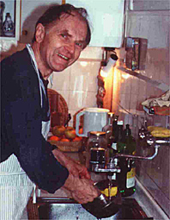
Feyerabend - Against Method
"All Methodologies have their limitations and the only 'rule' that survives is 'anything goes.' (Feyerabend, 1975, pg. 296)
Therefore, the most reasonable position is that of methodological pluralism

Slide 181
Anything goes?
Hypotheses contradicting well-confirmed theories give us evidence that cannot be obtained in other ways
If there is a driving force in science, it is aesthetics.
Science is an essentially anarchistic enterprise
Teaching the scientific method, insofar as it tamps down on creativity, is harmful.
Feyerabend even defends astrology and creationism as viable paths toward knowledge.

Slide 182
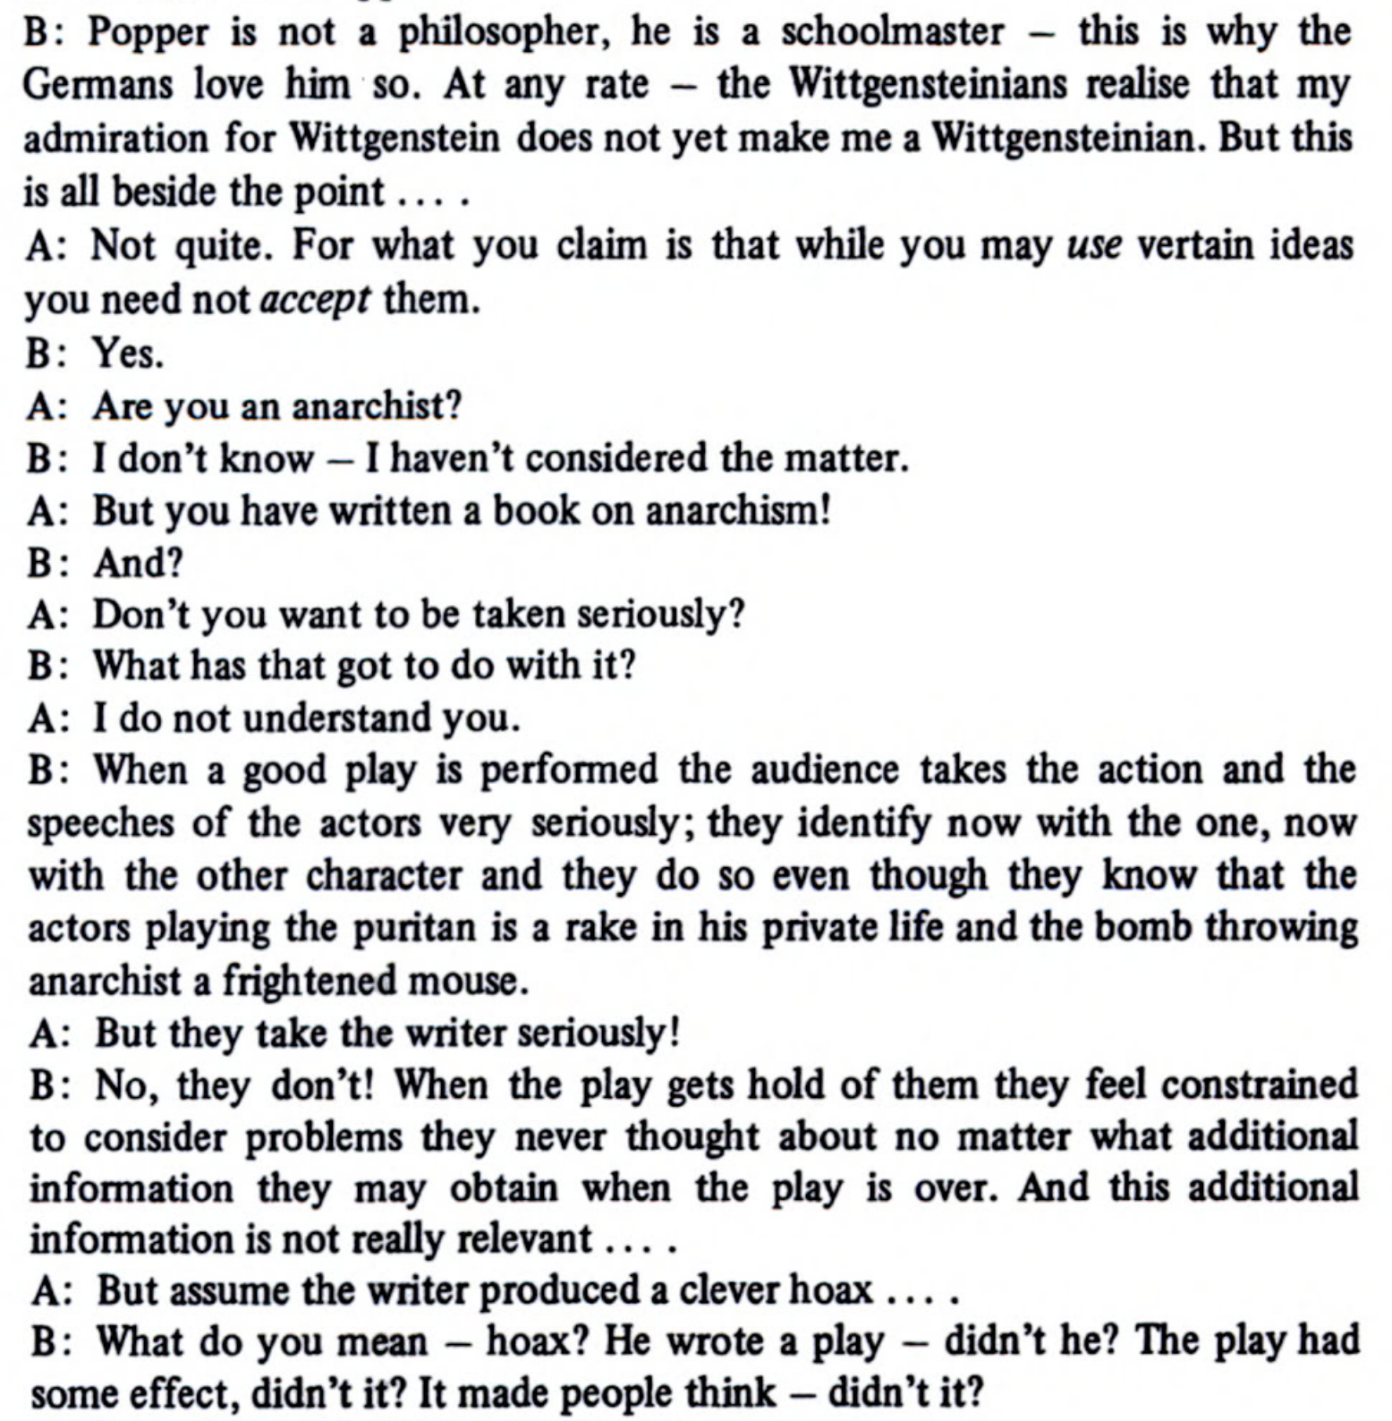

Slide 183
Feyerabend’s Logical Argument
If we knew all of the facts of the world, we would know which rules would constitute an effective method for figuring out the world.
The effectiveness of the method depends on the nature of the world.
But: the nature of the world is precisely what the method is intend to discover.
Therefore, we can only be justified in using any particular method if and only if we already know all of the facts in the world.
Therefore, there is no method or procedure that is justified. Anything goes.

Slide 184
Feyerabend’s Comparative Argument
Even well established theories may have weaknesses that can only be discovered when compared to other theories (e.g. Einstein v. Newton).
  “Some of the most important formal properties of a theory are found by contrast, not analysis” (1988, p. 21)
Therefore, we should let as many ideas coexist as possible – never discarding any.
We should seek out contradiction of facts, even ones that seem to be natural interpretations.
Any attempt to make this precise seems either vague or false.
Philosophers love consistency

Slide 185
Feyerabend and Mill
Mill in On Liberty:
  “The peculiar evil of silencing the expression of an opinion is, that it is robbing the human race; posterity as well as the existing generation; those who dissent from the opinion, still more than those who hold it. If the opinion is right, they are deprived of the opportunity of exchanging error for truth: if wrong, they lose, what is almost as great a benefit, the clearer perception and livelier impression of truth, produced by its collision with error.”
Let 1000 flowers bloom, even if you think some are false and harmful. Even harmful ideas strengthen the reasons and the meaning of true ideas
Note: Mill still believes in truth, still believes in a method.

Slide 186
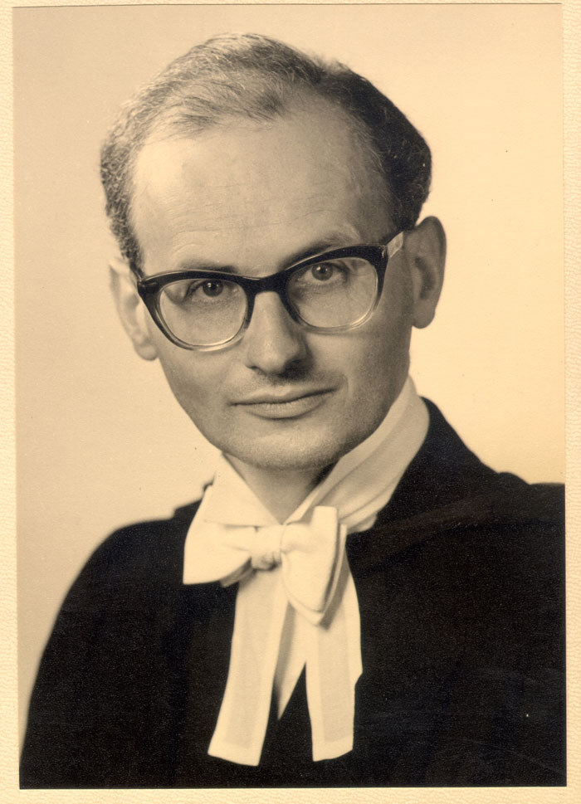
Imre Lakatos
Born Avrum Lipschitz, led a Marxist revolutionary force against the Nazis in WWII Hungary.
Considers Kuhn’s alternative to Popper and argues it is not a fruitful approach to take
But accepts that Underdetermination suffices to reject a naïve interpretation of Popper
“The Methodology of Scientific Research Programmes”
  How do scientists decide whether, or when, their theory is refuted?
  How do we explain why scientists persist in working on theories in the face of counter-examples?
1922-1974

Slide 187
Pumping up Popper
Naïve falsificationism
A theory is falsified by an observational statement that conflicts with it
Sophisticated falsificationism
A theory T₁ is falsified if another theory T₂ has been proposed with the following characteristics:
  T₂ has excess empirical content over T₁: that is, if it predicts novel facts
  T₂ explains the empirical content of T₁
  Some of the excess content of T₂ is corroborated

Slide 188
“The Methodology of Scientific Research Programmes”
Lakatos: Scientific theories are not really falsifiable. They are “research programmes” that consist of:
  a “negative heuristic” or “hard core” of fundamental principles that contain what the theory really says about the world (Kuhnian disciplinary matrices)
  a ”positive heuristic” or “protective belt” of “auxiliary hypotheses” that explain how the fundamental principles apply to particular cases to deal with apparent discrepancies. These include ceteris paribus (“other things being equal”) clauses that accommodate problematic cases. These indicate what needs to be done in order to increase the explanatory and predictive power of the programme. (Quinean Holism)
Contrary to Popper, even good theories have “defense-mechanisms.”

Slide 189
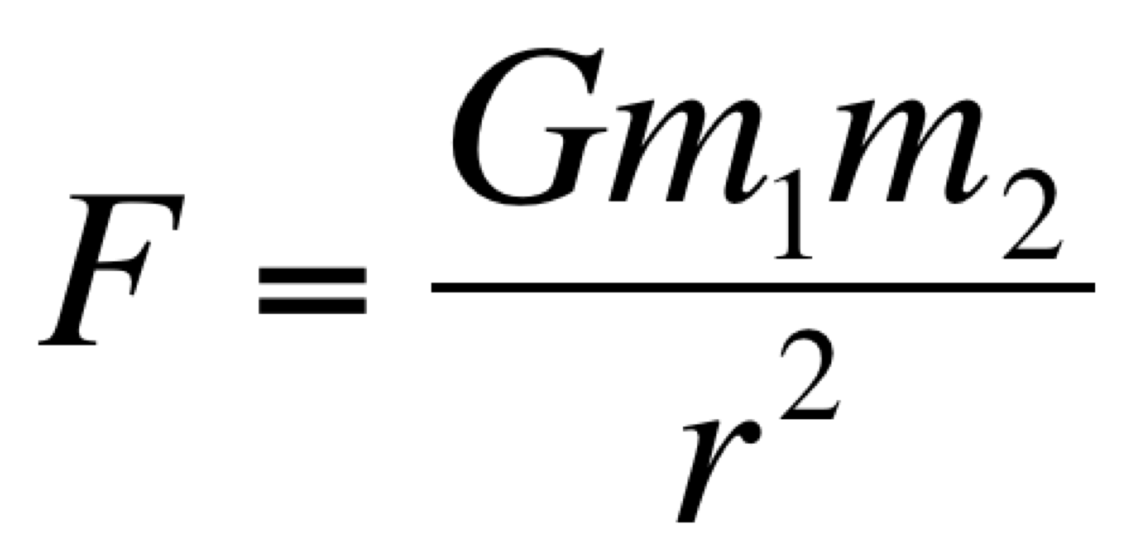
Case Study: Neptune
Newtonian Gravitation Theory: Predicts that every acceleration of every body can be traced to an interaction with some other body, according to their masses and the distance between them.
BUT: In 1821, a slight discrepancy is noted between the actual motion of Uranus and the motion predicted by Newton’s law of gravitation. Do we reject Newton?
No: The theory demands that the missing mass be found. In 1843, John Crouch Adams deduces, from Newton’s law and Uranus’ orbit, the approximate location of a new planet, discovering it in 1846.

Slide 190
Case Study: Vulcan
Newtonian Gravitation Theory: Predicts that every acceleration of every body can be traced to an interaction with some other body, according to their masses and the distance between them.
BUT: Mercury’s perihelion is found to precess at a rate that does not agree with Newton’s theory. The difference is 43” per century. Astronomers posit…
  There is another planet, Vulcan, near Mercury
  The force of gravity is not r², but r^{2.000000097}
  There is a cloud of matter that affects Mercury’s orbit.
In 1916, Einstein shows that general relativity predicts precisely the missing 43”, with Eddington’s observation in 1919, we finally reject Newton.

Slide 191
So what is science?
Lakatos: The fundamental difference is between progressive and degenerating research programmes.
Progressive research programmes lead to novel predictions, new problems, and new solutions.
Degenerating programmes spend their time trying to adjust after the fact to new information, and to protect themselves from refutation by constant adjustment.
The “pseudo-sciences” are really degenerating programmes whose practitioners are mainly devoted to defending the programme against contrary evidence. The progressive programmes view contrary evidence as a challenge that will broaden and deepen the theory.

Slide 192
Pseudoscience Examples (for Lakatos)
Ptolemaic Astronomy
Freudian Psychoanalysis
Soviet Lysenkoism
Bohrian QM (post Heisenberg)
Astrology

Slide 193
Pseudoscience Examples (for Lakatos)
Ptolemaic Astronomy
Freudian Psychoanalysis
Soviet Lysenkoism
Bohrian QM (post Heisenberg)
Astrology
Sociology
Economics
Darwinian Biology

Slide 194
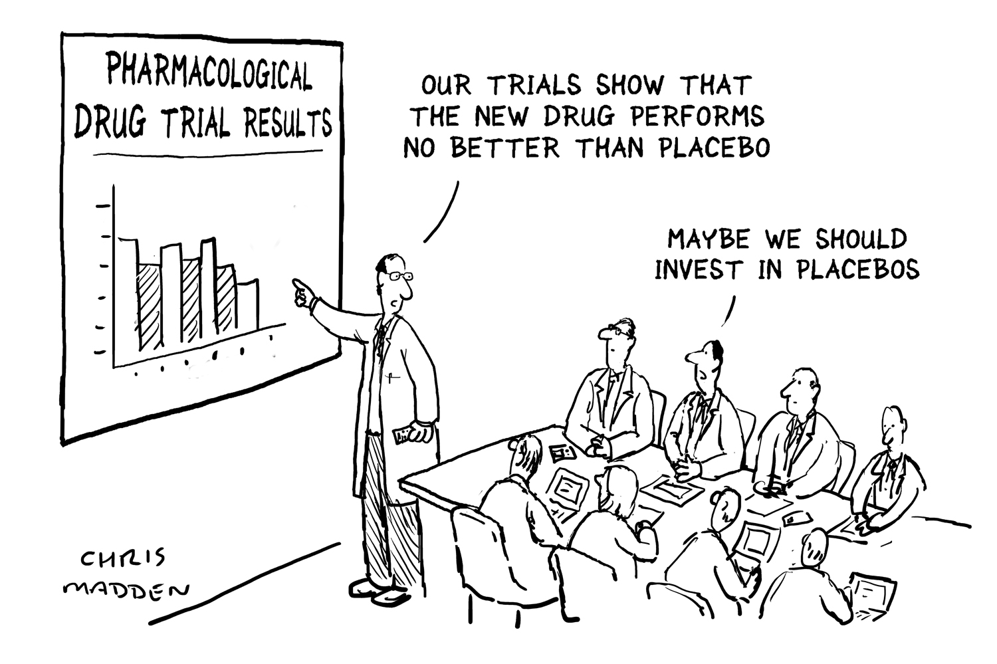
Case Study: Placebos/Nocebo
Clients of Healers & Homeopathists, subjects in ‘no-intervention’ groups can also see positive changes
Is this pseudoscience?
Brain’s reward system
releases signal
substances that have
the same type of
effect as drugs.
The placebo effect
is getting stronger
and there are key
differences between
kinds of placebos

Slide 195
Feyerabend on Lakatos
  “Lakatos realized and admitted that the existing standards of rationality, standards of logic included, were too restrictive and would have hindered science had they been applied with determination. He therefore permitted the scientist to violate them (he admits that science is not "rational" in the sense of these standards). However, he demanded that research programmes show certain features in the long run — they must be progressive.... I have argued that this demand no longer restricts scientific practice. Any development agrees with it.”
Before Lakatos died, Lakatos and Feyerabend planned to produce a joint work in which Lakatos would develop a rationalist description of science and Feyerabend would attack it.
Other issues:
  Lakatos doesn’t avoid the underdetermination problem
  Lakatos’ notion of a progressive research programme depends on unstated values about what makes research programs ‘progressive’

Slide 196
Scientific Realism

Slide 197
Scientific Realism
Scientific Realism is the thesis that what science dictates is (approximately) true.
  Progressivism: Science progresses toward truth. Whether our theories truly represent the world or not, future scientific theories will likely do so
  Theory Realism: (mature) scientific theories accurately describe the world (e.g. space does bend as GR says it does, species do evolve as the PNS says they do)
  Entity Realism: The un/observable entities that science posits exist actually refer to something that exists (e.g. electrons actually exist, tectonic plates actually exist)
  Structural Realism: The math that underlies scientific theories is an accurate description of the world, regardless of whether the entities or interpretation are true (e.g. whatever the status of the entities or interpretation, E = mc² and

Slide 198
Scientific Anti-Realism
Scientific Anti-Realism is the thesis that what science dictates is not (approximately) true.
  Constructive Empiricism: Scientific theories provide (what they take to be) literal descriptions of the world, they aim to describe the way the world appears to us, but accepting scientific theories means only that we accept the accuracy of their description of observable entities.
  Fallibilism: human fallibility should make us doubt our scientific theories.
  Weak Fallibilism: Some of our theories may be true, but we can never know which ones are.
  Strong Fallibilism: All of our theories are probably false.
  Instrumentalism: Scientific theories are tools or instruments that are reliably usable in our experience, but do not reveal realities beyond experience.
  Constructivism: Scientific knowledge is constructed by the scientific community. Scientists generate ideas & theories (perhaps facts) to explain the world within some local norms of explanation.
  Idealism: the 'world’ depends on a subjective mind/worldview.
  Solipsism: some version of your mind is all that there is.

Slide 199
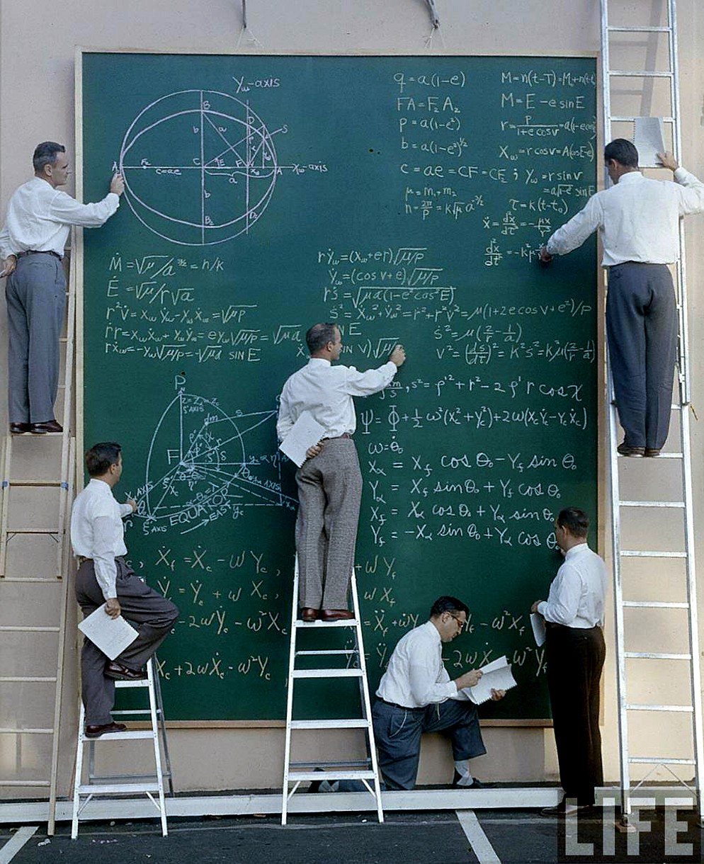
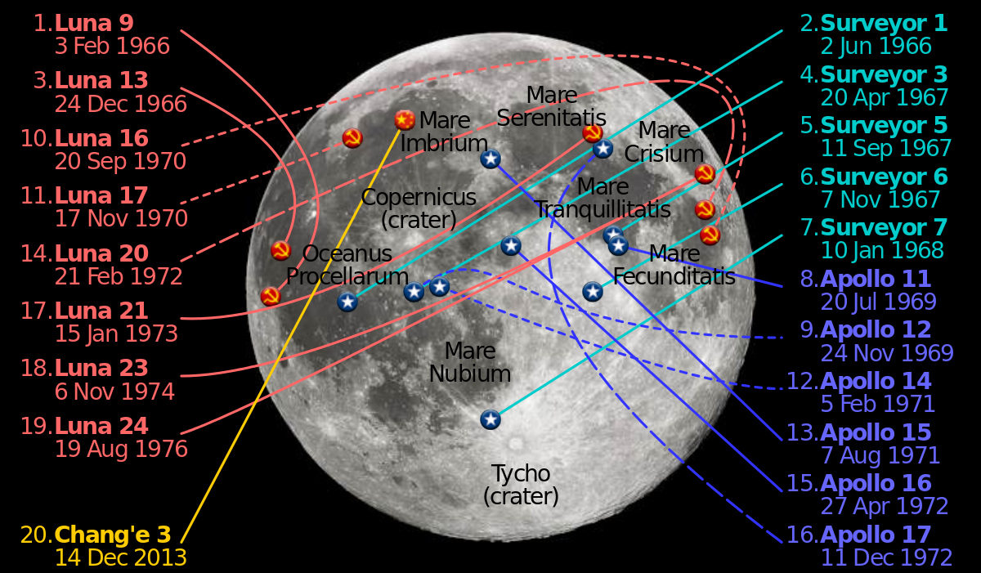
The “No Miracles” Argument
“Realism is the only philosophy that does not make the success of science a miracle.”
– Hilary Putnam

Slide 200
“No Miracles” as an IBE
There are two possibilities: science typically describes reality or it does not.
Science is extremely successful and it is difficult to see how it could continue to be so successful if it did not describe reality.
So… Science describes the way the world really is because that’s the best explanation.

Slide 201
Inference to the Best Explanation?
Anti-Realists: IBE does not need to be an inference to the truth of an explanation.
IBE is comparative and explanations need not be true to be better than the alternatives. IBE as a measure of truth is unjustified.
  Response: IBE is as problematic as induction or deduction. We have to start somewhere and assuming the truth of a likely explanation is the best place.

Slide 202

Larry Laudan
Empirical problems are problems about the world and demand to be solved. They are theory-laden
Conceptual Problems can be
  Internal: when a theory exhibits internal inconsistencies, is vague, or unclear
  External: when a theory is in conflict with another theory, which practitioners of the theory believe to be well founded

Slide 203
Larry Laudan
The aim of science is to solve and generalize solutions to empirical problems, while minimizing the scope of anomalous empirical problems as well as any conceptual problems.
A theory is assessed on whether it provides acceptable answers to interesting questions/problems, not whether it is “true”

Slide 204
Larry Laudan and Theory Change
Realists assume that theoretical terms typically refer to real entities, but history shows this to not always be true:
  Tectonic plates/Copernican astronomy, we believe, are true, even though the theories were unsuccessful at predictions
  Successful theories, historically, have rarely been judged to be true by future science. That current successful theories are true is a baseless claim
History of science tells us not to be so confident in the truth of theories

Slide 205
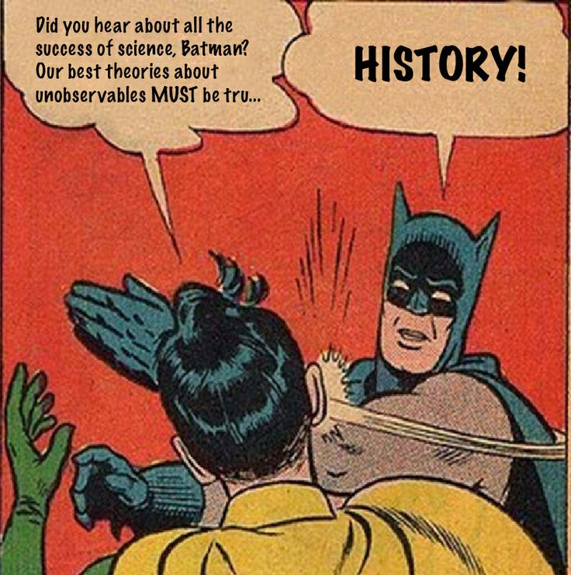
Pessimistic Meta-Induction
Putnam: All past scientific theories have been shown to be false by future research, so induction says we should assume that is true for all theories.
Lauden: past theories were all false, but still successful, so we have reason to doubt that success is correlated with truth. The Inference to the Best Explanation motivation for Scientific Realism fails.

Slide 206
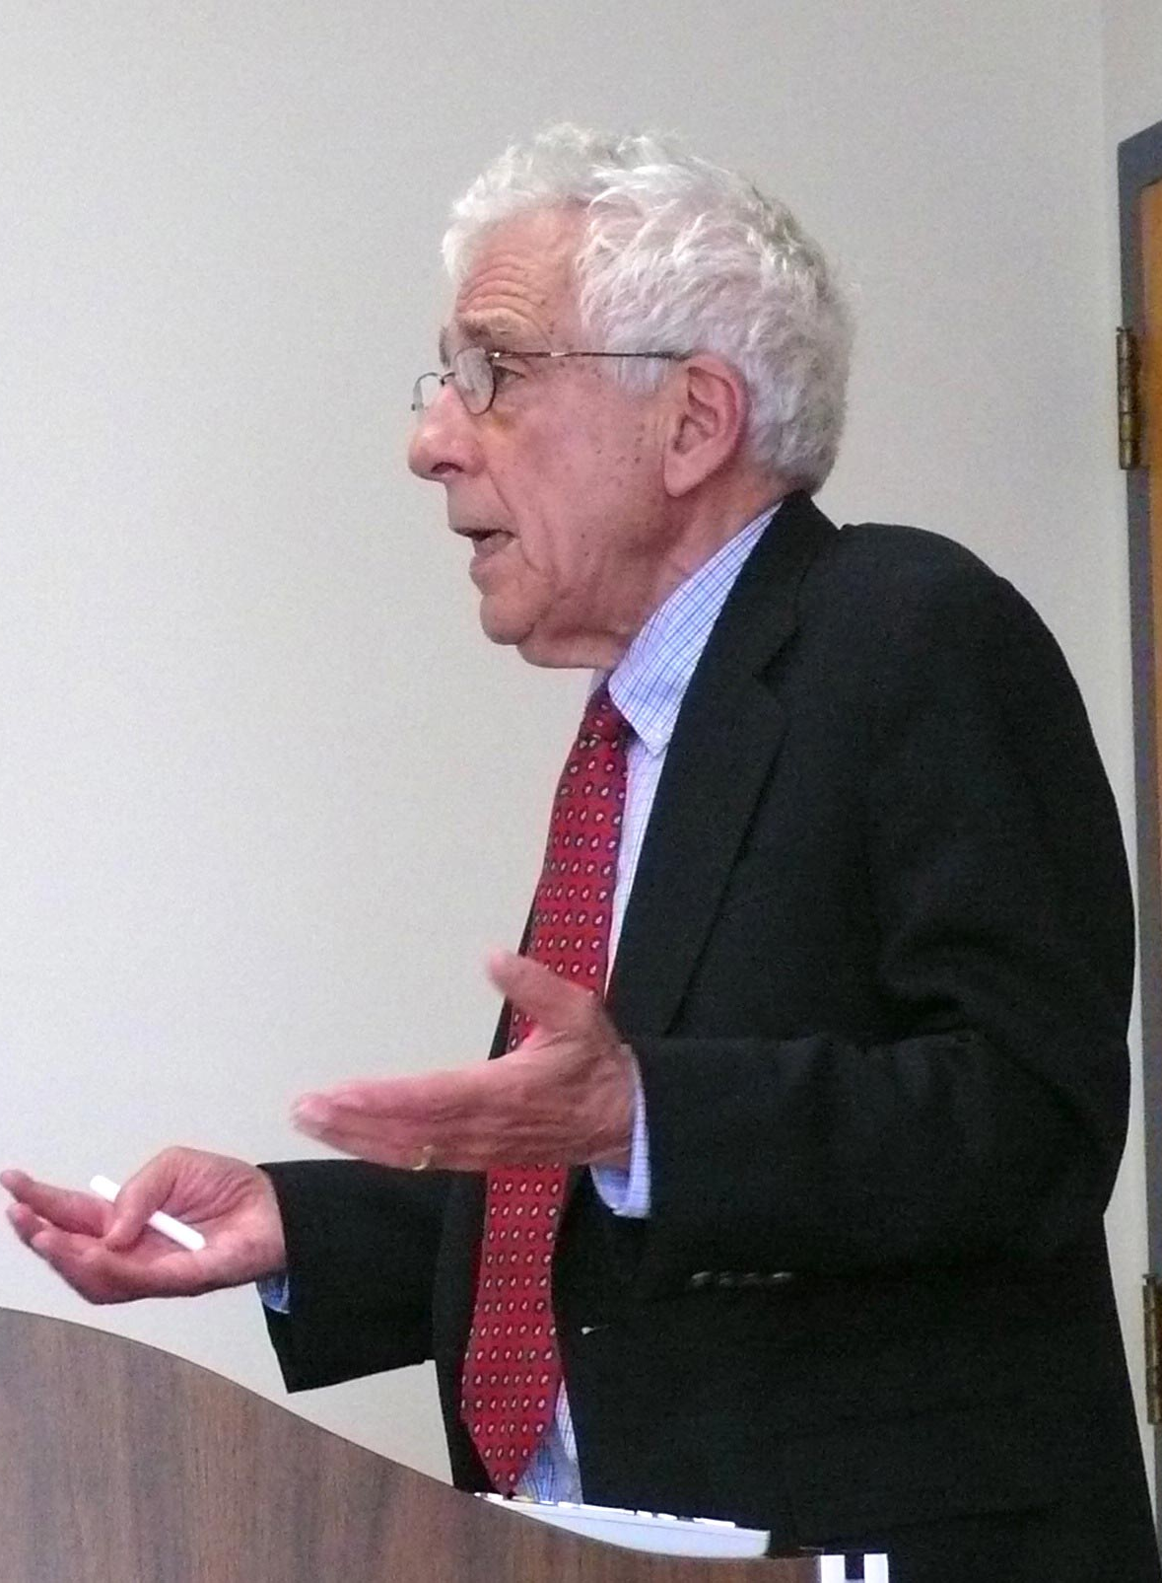
A Debate
Kyle Stanford: Maybe the world is too wacky for us to understand (c.f. GR).
Scientific Realist: Most of the historical examples don’t stand up to scrutiny (most scientists did not believe them, they were unsuccessful, they made few novel predictions, etc.). Science’s history is actually good for the realist
  Laudan: Nevertheless, there are some difficult examples.
Peter Achinstein: Many different sources of evidence sometimes point to a single solution that undermines underdetermination worries (Avogadro, Bell, etc.).
  Laudan: Unless the data is biased, you’d never know…
    Achinstein: that’s either false or arbitrary.

Slide 207
Scientific Anti-Realism
Scientific Anti-Realism is the thesis that what science dictates is not (approximately) true.
  Constructive Empiricism: Scientific theories provide (what they take to be) literal descriptions of the world, they aim to describe the way the world appears to us, but accepting scientific theories means only that we accept the accuracy of their description of observable entities.
  Fallibilism: human fallibility should make us doubt our scientific theories.
  Weak Fallibilism: Some of our theories may be true, but we can never know which ones are.
  Strong Fallibilism: All of our theories are probably false.
  Instrumentalism: Scientific theories are tools or instruments that are reliably usable in our experience, but do not reveal realities beyond experience.
  Constructivism: Scientific knowledge is constructed by the scientific community. Scientists generate ideas & theories (perhaps facts) to explain the world within some local norms of explanation.
  Idealism: the 'world’ depends on a subjective mind/worldview.
  Solipsism: some version of your mind is all that there is.
Notes:
Most major contenders still share a basically positive attitude toward science. This has not always been acknowledged and a contrary suspicion still attaches to constructivism, which is frequently regarded as anti-science.

Slide 208
Scientific Anti-Realism
Scientific Anti-Realism is the thesis that what science dictates is not (approximately) true.
  Constructive Empiricism: Scientific theories provide (what they take to be) literal descriptions of the world, they aim to describe the way the world appears to us, but accepting scientific theories means only that we accept the accuracy of their description of observable entities.
  Fallibilism: human fallibility should make us doubt our scientific theories.
  Weak Fallibilism: Some of our theories may be true, but we can never know which ones are.
  Strong Fallibilism: All of our theories are probably false.
  Instrumentalism: Scientific theories are tools or instruments that are reliably usable in our experience, but do not reveal realities beyond experience.
  Constructivism: Scientific knowledge is constructed by the scientific community. Scientists generate ideas & theories (perhaps facts) to explain the world within some local norms of explanation.
  Idealism: the 'world’ depends on a subjective mind/worldview.
  Solipsism: some version of your mind is all that there is.
Notes:
Most major contenders still share a basically positive attitude toward science. This has not always been acknowledged and a contrary suspicion still attaches to constructivism, which is frequently regarded as anti-science.

Slide 209

Entity Realism
Ian Hacking: who cares if the theory is real? Ptolemy had all of the processes wrong, but we still believe there are stars.
  “If I can spray it, it’s real.”
Don’t worry about how it fits into the world, but merely that there is a thing there.
The LAWS of physics lie. But they tell you about the stuff that they are describing: the causal powers of matter.
The test is engineering, not theory.

Slide 210
Cracking Hacking
Entity Realism is too restrictive: some entities are observable, but cannot be manipulated (e.g. exoplanets)
Entity Realism is too permissive: the manipulation of some entities sometimes turns out to be spurious (e.g. phlogiston)

Slide 211
Structural Realism
Scientists often posit entities that turn out to be unreal, theories that turn out to be false, but many of the observations and relationships measured seem to survive theory change.
Structural realism: it’s not the entities or the theories, but the math and relation between variables that is real. We change our understanding of the theories and items, but the structure (math) always is the same.
ACTUALLY…. There are also many cases where the math has not withstood the test of time (e.g. Dirac)

Slide 212

Constructive Empiricism
Constructive empiricism – science gives us empirically adequate theories, but we should not assume the truth of anything we could never observe.
The point is, we cannot observe the unobservable, but we can correct for some stuff size weight etc.
Empirical adequacy (not truth) is the goal of science

Slide 213

The Observable/Detectable Distinction
Observable: what can be experience with the senses
Unobservable: what cannot be experienced with unaided senses.
Detectable: what science can reveal.
Interpretation: giving a sensical account of a detection.
Both detection and observation rely highly on theory (theory-laden)

Slide 214

The Observabe/Detectable Distinction
Objections:
  Observation is a silly criterion. I wear glasses. I cannot see Jupiter without a telescope. Some people are blind. Is science different for us?
    We’re talking about technology, not magic, possibility not actuality.
  But seriously, there’s not really a good distinction between the observable and unobservable, observable and detectable. There is a continuum.
    It’s okay, we’re flexible.
  Can we divide our language into a theoretical and non-theoretical part?
    We’re very flexible.
Notes:
had a very high current density, was concentrated into a very small area and was very hot and therefore charred any non-metallic specimens that were examined. When it was found that you could successfully examine biological specimens in the electron microscope after treating them with osmium and cutting very thin slices of the sample, the electron microscope began to appear as a viable proposition.

Slide 215
Instrumentalism
Instrumentalism: Scientific theories are tools or instruments that are reliably usable in our experience, but do not reveal realities beyond experience.
Science seeks merely more successful models and explanations.
BUT: Some models are successful in new, wildly distinct situations. Some theories fit together very, very well
  Continued adequacy just shows a theory’s continued utility.
Notes:
“We are free to choose between alternative theories, but there are no isolated conventions.”

Slide 216
Scientific Anti-Realism

Slide 217
Constructivism
Constructivism: Scientific knowledge is constructed by the scientific community.
Scientists generate ideas & theories (perhaps facts) to explain the world within some local norms of explanation.
Constructivists take the lessons of Underdetermination, Theory-ladenness of Observation, and Scientific Revolutions seriously.
Notes:
“We are free to choose between alternative theories, but there are no isolated conventions.”

Slide 218

Constructivism
  “We are free to choose between alternative theories, but there are no isolated conventions.”

Slide 219
Scientific Values

Slide 220
Questions of Scientific Value
How much do internal or external factors matter to scientific theories/experiments/conclusions?
  Should they matter?
Who decides what scientists should study and why?
  Who should decide this?
  How should we ensure science is ethical?
  Who should pay for which sciences and how much?
Who should have access to the results?
What role should it play in public policy/media?

Slide 221
The Ethos of Science
Robjert K. Merton’s CUDOS conditions:
Communism: the results of scientific investigation are a product of social collaboration and are assigned to the community. ’Private science’ is bad science, ‘open access’ is good science.
Universalism: Scientific claims should be evaluated according to pre-established impersonal criteria rather than by consideration of personal or social attributes of their protagonists. Jerks can do good science, too.
Disinterestedness: Institutions of science ought not be invested in particular pet hypotheses.
Organized Skepticism: Scientific explanations ought to be subjected to the most rigorous community standards. Do science even the jerks have to accept.

Slide 222
Reminder of some basic distinctions
Matters of Fact/Synthetic Claims: Facts that are about the world in some way. These must be investigated in order to assess their truth value.
  Example: My brother, John Cusack, loves chinchillas.
Relations of Ideas/Analytic Claims: Facts that can be discovered through simple reasoning about concepts and their meanings.
  Example: My brother is my relative.
Ought/Value/Normative Claims: Facts that depend on some ordering of preferences/duties/morals/obligations/ethics
  Example: My brother, by loving chinchillas, shows he is a ne’er-do-well scoundrel.

Slide 223



Questioning basic distinctions
Synthetic Facts
Analytic Facts
Normative Facts

Slide 224
Underdetermination… yet again
Synthetic facts do not guarantee an interpretation. Evidence does not determine theory.
Decisions between the many possible and plausible interpretations for facts depends on some ordering of which interpretations are preferable.
So values & normative claims are relevant to deciding on which theories to accept.
Same goes for choices of which science to perform: values must play a role.

Slide 225
Epistemic Values | Moral Values | Aesthetic Values
  Simplicity
  Precision
  Falsifiability
  Conservativeness
  Fruitfulness
  Reproducibility
  Scope
  Consistency
  Disinterestedness
  Justice
  Fairness
  Pain/Pleasure
  Courage
  Temperance
  Virtuousness
  Obedience
  Respect for Autonomy
  Beneficence
Beauty
Symmetry
Organized
Expensive
Well-known
History
Spartan/Byzantine
Tasty
Pleasing
Important

Slide 226

Epistemic values in science
Copernicus Ptolemy

Slide 227
Epistemic values in science
Copernicus Ptolemy
✔ ✘
? ?
✘ ✔
? ✘
✘ ✔
✔ ✘
? ?
✔ ✔
✔ ?
  Simplicity
  Scope
  Precision
  Falsifiability
  Conservativeness
  Fruitfulness
  Reproducibility
  Consistency
  Disinterestedness

Slide 228
Do non-epistemic values have a role in science?
Yes – Science is (or should be) informed by personal and societal values
No – Science is (or should be) value-free
Maybe – Some values are important, others are detrimental

Slide 229
Vannevar Bush’s “Linear Model”
Logical positivist heritage: Science should be value-free & emphasis on ”facts” and the objectivity of science.
  (Objectivity was conceived as methods to secure a mirror-like relation between theories and observations)
The Linear Model:
  Basic Research → Applied Research → Social Diffusion
  Scientific Knowledge → Free market of science → Social benefit
  Basic research: investigates what scientists find interesting,
  Applied research: investigates specific subjects/development of new technologies.

Slide 230
Vannevar Bush’s “Linear Model”
Science should be…
  Autonomous: Science should not be subject to political and social forces.
    E.g. Governments should provide money for science but leave the dispersal of it to scientists. If they choose to fund basic science research into fruit flies instead of cancer research, that is up to scientists.
  Impartial: only epistemic values should play in scientific research, theory creation, analysis, etc.
    E.g. racist theories of biology and psychology were as improper as ignoring racial features in medical practice due to impropriety.
  Neutral: Facts do not dictate a course of action.
    E.g. Climate scientists may tell us the costs and consequences of mitigating/adapting/engineering in response to Climate Change, but these facts do not dictate the right course of action.

Slide 231
Against the Autonomy of Science
Perhaps non-epistemic values ought not play a role in science, nevertheless as a matter of fact, they do:
  Government funding as a matter of practicality and political fact takes some non-epistemic values into account when funding science.
  Some science is deemed morally impermissible by public pressure, even though it would probably bring about very important discoveries (e.g. purposeful wild children, limitless ‘guinea pigging’)
The autonomy ideal that science should be left alone seems problematic both practically and morally.

Slide 232
Impartiality and Neutrality
  Impartial: only epistemic values should play in scientific research, theory creation, analysis, etc.
    E.g. racist theories of biology and psychology were as improper as ignoring racial features in medical practice due to impropriety.
  Neutral: Facts do not dictate a course of action.
    E.g. Climate scientists may tell us the costs and consequences of mitigating/adapting/engineering in response to Climate Change, but these facts do not dictate the right course of action.

Slide 233
The Fact/Value Dichotomy

Slide 234
Reminder of some basic distinctions
Matters of Fact/Synthetic Claims: Facts that are about the world in some way. These must be investigated in order to assess their truth value.
  Example: My brother, John Cusack, loves chinchillas.
Relations of Ideas/Analytic Claims: Facts that can be discovered through simple reasoning about concepts and their meanings.
  Example: My brother is my relative.
Ought/Value/Normative Claims: Facts that depend on some ordering of preferences/duties/morals/obligations/ethics
  Example: My brother, by loving chinchillas, shows he is a ne’er-do-well scoundrel.

Slide 235
Against the fact/value dichotomy
Putnam: there is no sharp fact/value dichotomy, no neat descriptive/normative division.
Our conceptual schemes dictate what objects we take to exist, and deciding between conceptual schemes is value-laden.

Slide 236

Against the fact/value dichotomy
Every claim presupposes an entire system of value commitments, purposes, considerations of relevance, etc.

Slide 237
Feminist Philosophy of Science

Slide 238
Harding’s Three Levels
Feminist Empiricists – Seek to work within science to seek equity. Attempt to improve representation for women and women’s issues in science. Attempt to address fundamental problems
Standpoint Epistemologists – Seek to challenge basic androcentric tenets of science, propose a ‘standpoint’ based approach that would mitigate
Postmodernist Feminists – Seek to challenge science as an institution, challenge the goals of science, goals of rationality/objectivity/etc. Not much of a positive program.

Slide 239
Feminist Critiques of Science
Science has been…
Anthropocentric: treating humans as the default unit of analysis and value to the detriment of non-human animal and environmental concerns.
Androcentric: treating males as the default and females as a modification, focusing on European male problems to the marginalization of other perspectives.
Sexist: implying the inferiority of women, the legitimacy of their subordination and sex-based prescriptions.

Slide 240
Fox Keller’s Three Questions
Why were women excluded from participation in scientific inquiry?
How are gender stereotypes scientifically ratified through a physiological reductionism in biology?
What is the influence of gender on the construction of science?

Slide 241
Inductive Risk

Slide 242
The Argument from Inductive Risk
A challenge to the linear model’s impartiality of science.
In order to draw a conclusion from data, the scientist must make a choice regarding the method to be used in reaching a conclusion.
The probability of making different kinds of errors depends on the choice of method.
Non-epistemic values may legitimately influence the scientist’s preference regarding different kinds of errors (e.g. risk avoidance in cancer treatment)
Therefore, non-epistemic values may legitimately influence the scientist’s choice of methods for drawing conclusions from data.
Thus, non-epistemic values may legitimately make a difference to the conclusion the scientist draws from data.

Slide 243


Example: Clinical Equipoise
Equipoise: the state or situation that exists when there is no clear indication that any of several options is either inferior or superior.
In medical trials: it is deemed ethically prohibited to fail to give someone a treatment if it is known to be effective, all else being equal.
  Therefore, once we have a community understanding of the efficacy of a drug, we can never test it against a placebo again.
False positive bias in favor of treatment.

Slide 244
The Argument from Inductive Risk
Normative argument: Rudner: you should be more likely to demand certainty if your experiment could destroy the Universe than if it could not.
Descriptive argument: scientists as a matter of fact use non-epistemic values in the context of doing science.

Slide 245
Against Inductive Risk
Jeffrey: ACTUALLY, the scientist’s role stops with the assessment of confidence. Any further decision-making is done in the capacity of a citizen and person rather than in the capacity of a scientist. (Descriptive objection)
Levi: The scientist should seek the truth and nothing but the truth. When scientists seek to avoid some errors rather than others, they are performing poorly as scientists. (Normative objection)

Slide 246
Douglas: Middle Ground?
In contexts in which scientists assess evidence that is relevant for policy-making and they have some insight as to the impact of their choices, they ought to apply non-epistemic values.
NOTICE: this still presumes there are situations in science where we can arrive at conclusions without, to some extent, importing our values.

Slide 247
Epistemic Values | Moral Values | Aesthetic Values
  Simplicity
  Precision
  Falsifiability
  Conservativeness
  Fruitfulness
  Reproducibility
  Scope
  Consistency
  Disinterestedness
  Justice
  Fairness
  Pain/Pleasure
  Courage
  Temperance
  Virtuousness
  Obedience
  Respect for Autonomy
  Beneficence
Beauty
Symmetry
Organized
Expensive
Well-known
History
Spartan/Byzantine
Tasty
Pleasing
Important

Slide 248
The role of values in science
Douglas: epistemic values are reasons/criteria for adequacy of scientific claims, not genuine values.
Some values (e.g. simplicity) ought to be internal to science in order to maintain the integrity of the scientific process.
Other values (e.g. investigating insects rather than investigating exoplanets) ought only have an indirect role in the scientific process – at early stages or under extraordinary circumstances.

Slide 249
Douglas – There’s inductive risk all over
Design: Choice of methodology and significance threshold can be influenced by how impactful error could be.
  e.g. new cancer treatments
Practice: The characterization of data sometimes depends on the consequences of false positives/negatives. Judgment calls may be biased in favor of one or the other.
  e.g. rat liver tumor interpretation
Interpretation: Results are often not obvious (underdetermination). Background assumptions and different emphases of the experimentation can yield very different results
  e.g. climate change

Slide 250
Feminist Epistemology

Slide 251
Harding’s Three Levels
Feminist Empiricists – Seek to work within science to seek equity. Attempt to improve representation for women and women’s issues in science. Attempt to address fundamental pro
Standpoint Epistemologists – Seek to challenge basic androcentric tenets of science, propose a ‘standpoint’ based approach that would mitigate
Postmodernist Feminists – Seek to challenge science as an institution, challenge the goals of science, goals of rationality/objectivity/etc. Not much of a positive program.

Slide 252
Longino’s four avenues of critical discourse
Recognized avenues for criticism for all aspects of science (e.g. journals and meetings)
Shared standards by which to evaluate arguments and their criticisms.
Habit of adjusting beliefs in the face of effective criticism. Scientists need not abandon their beliefs– in fact, a plurality of minority opinions is desirable. Instead, they must be willing to respond to this criticism in good faith and give good effort.
Equal distribution of intellectual authority. Scientists ought not be discriminated against because of their race, ethnicity, gender, age, position, political beliefs, or anything else not part of the shared standards of evidence. (This is where double-blind reviews would be good.)

Slide 253
Is Feminist Empiricism enough?
Harding: Focusing on equity did not challenge the logic of scientific inquiry or explanation.
The fact that equity has failed reveals formal equality is not enough.
Harding: The problems with science are more than exclusion, they are in the very conception of science itself.

Slide 254
Is this enough?
“The particular methods and norms of the special sciences are themselves sexist and androcentric … constructed primarily to produce answers to the kinds of questions an androcentric society has about nature and social life. ‘Scientific’ and ‘Masculine’ are mutually reinforcing cultural constructs…
Masculine bias is evident in both the definition of what counts as a scientific problem and in the concepts, theories, methods and interpretations of research.”
Identified abstract, mastery, quantitative measures, ‘value-neutrality,’ social impartiality, objectivity, and power with masculinity while excluding women from the role of knower, defined them as/ with the object of inquiry/control
Given the extent of the intellectual contamination, feminists should repudiate science-as-usual in its entirety.

Slide 255
Standpoint Epistemology
Science cannot describe the world from “God’s Eye View,” all ’objective’ facts, ’objectively’ important research, etc. are actually embedded in a value-laden milieu
The ideal of ‘value free’ or ‘value neutral’ science is a farce. All human endeavors belie the values humans have.
Nor can we limit the sorts of values that are relevant: aesthetic, moral, epistemic, etc.

Slide 256
Standpoint Epistemology
If objective, value-free science cannot exist, then pretending it does marginalizes underrepresented voices (e.g. women)
We should accept we all come with a standpoint.

Slide 257
Standpoint Epistemology
From true objectivity to impartial intersubjective agreement.
Accept we all have standpoints and test claims against them.
Given entrenched, often unknown beliefs, we must seek out alternative perspectives if we are to reach genuine knowledge. Diversity matters.
Fish do not know they’re in water.
Scientists (and everyone else) do not know what dogma they’ve accepted as fact that is actually questionable.

Slide 258
Standpoint Epistemology
Underdetermination & value-laden theory choice & all perspectives have a standpoint → Attempts to reach ‘objectivity’ marginalize those who do not have power.
Instead, we should accept the contingent, uncertain, ambiguous, unstable, local, and contestable nature of any understanding of the world, the self, and the good.
All claims and worldviews are situated. Different individuals have access to different kinds of facts.
Harding: the minority always understands the majority better than the majority understands the minority. So we should try to listen to marginalized people.

Slide 259
Feminist Postmodernism
Harding’s Dilemma: how could a radical critique of all science leave any possibility for a feminist science?
Once we accept standpoint epistemology, inevitably we are led to cultural relativism
The proper role of feminism is critique: disruption of authoritative discourses rather than constitution of a “successor science” with its own authoritarian posture

Slide 260

Gross & Levitt
Gross, a biologist and Levitt, a mathematician, argued they are trying to save the "academic left" from itself by exposing misuses and abuses of science to advance political goals.
Some good, some bad fights are picked: accusing constructivists of positing a false dichotomy between ’reality’ and ‘convention’
Inspired Alan Sokal to investigate. He concludes 80% of book is accurate.

Slide 261
Science Studies
Pre-Kuhn:
History of Science
Philosophy of Science (this class)
Ethics of Science
Science Policy
Science Communication
Science Journalism
Post Kuhn:
Social Anthropology & Cultural Anthropology
Rhetoric of Science
Aesthetics of science
Feminist Critiques of Science
Science and Technology Studies/Science, Technology, and Society (another class)
Sociology of Scientific Knowledge (SSK)
Social Constructivism
Deconstructionism
Postmodernism

Slide 262
Postmodernist Approaches to Science
Given that nature hasn’t changed across theory change, the explanation for how we come to believe our scientific knowledge is more social than not.
Science is social practice.
Give underdetermination, theory-ladenness of observation, and wide disagreement, science’s descsriptions of the world are as unlikely to be true (albeit more instrumentally useful) as the myths of pre-scientific peoples
Notes:
Sociology of Scientific Knowledge:
‘weak’ sociology of science: sociology is relevant to failed scientific theories, as researchers’ biases and political/economic interests may explain their failure
Strong Programme: Barnes & Bloor, ‘true’ and ‘false’ scientific theories should be treated the same way because social factors are relevant in the formation of each

Slide 263
SCIENCE WARS!!!
The Sokal Affair

Slide 264

The Sokal Hoax
Sokal writes a satirical article, “Transgressing the Boundaries: Towards a Transformative Hermeneutics of Quantum Gravity” for Social Text, a non-peer reviewed journal (Impact: 0.16-0.70)
After some back-and-forth with the editors and several revisions, the article is published.
Sokal reveals it is a hoax in another journal the same day.
All hell breaks loose.

Slide 265
Sokal in satire
“Here my aim is to [take] account of recent developments in quantum gravity: the emerging branch of physics in which Heisenberg's quantum mechanics and Einstein's general relativity are at once synthesized and superseded. In quantum gravity, as we shall see, the space-time manifold ceases to exist as an objective physical reality; geometry becomes relational and contextual; and the foundational conceptual categories of prior science — among them, existence itself — become problematized and relativized. This conceptual revolution, I will argue, has profound implications for the content of a future postmodern and liberatory science.”
“…the postmodern sciences deconstruct and transcend the Cartesian metaphysical distinctions between humankind and Nature, observer and observed, Subject and Object. Already quantum mechanics, earlier in this century, shattered the ingenuous Newtonian faith in an objective, pre-linguistic world of material objects ‘out there’”

Slide 266
Sokal in satire
The satirical article claims…
Draws connections between psychoanalysis and quantum field theory.
Attaches New Age bizarre ideas to quantum gravity.
Links feminist politics to set theory, fluid mechanics, and post-quantum physics.
Calls reality a ‘social and linguistic construct.’
Science is no better than ‘counter-hegemonic’ narratives of marginalized communities.
Argues postmodernism refutes the authoritarianism and elitism in science, paving a way for a Democratic approach to scientific work

Slide 267
The Admission
“What concerns me is the proliferation, not just of nonsense and sloppy thinking per se, but of a particular kind of nonsense and sloppy thinking: one that denies the existence of objective realities, or downplays their practical relevance.”
“But why did I do it? I confess that I'm an unabashed Old Leftist who never quite understood how deconstruction was supposed to help the working class. And I'm a stodgy old scientist who believes, naïvely, that there exists an external world, that there exist objective truths about that world, and that my job is to discover some of them.”

Slide 268
The Admission
“There is a world; its properties are not merely social constructions; facts and evidence do matter. What sane person would contend otherwise?”
“If all is discourse and ‘text,’ then knowledge of the real world is superfluous; even physics becomes just another branch of Cultural Studies. If, moreover, all is rhetoric and ‘language games,’ then internal logical consistency is superfluous too: a patina of theoretical sophistication serves equally well. Incomprehensibility becomes a virtue; allusions, metaphors and puns substitute for evidence and logic.”

Slide 269
Response
Stanley Fish: Sociologies and humanists accept the world as both real and a construction. Science studies aim to study the nature and activity of science. It may turn out that
David Bloor: Sokal has entered into a debate that has been ongoing for years or decades. He had no understanding of the issues nor reasoning
Andrew Ross and Bruce Robbins: Questioning scientific realism, scientific authority, science’s agenda and accountability is not the same thing as questioning the external world. Science would be authoritarian and unethical without outsiders questioning it.
Rush Limbaugh: Is surprised this is a big story, argues Fish’s response is an example of what Sokal satirized.

Slide 270
Trying to Find Common Ground
“Ignoring some self-promoting and cynical rhetoricians, I have never met a serious social critic or historian of science who espoused anything close to a doctrine of pure relativism. The true, insightful, and fundamental statement that science, as a quintessentially human activity, must reflect a surrounding social context does not imply either that no accessible external reality exists, or that science, as a socially embedded and constructed institution, cannot achieve progressively more adequate understanding of nature's facts and mechanisms. '' – Stephen J. Gould

Slide 271
A Plea for Science Studies
The Realist-Rationalist Cluster
In the most prominent areas of science, the research is progressive, and this progressive character is manifested in increased powers of prediction and intervention.
Those increased powers of prediction and intervention give us the right to claim that the kinds of entities described in scientific research exist independently of our theorizing about them and that many of our descriptions are approximately correct.
Nonetheless, our claims are vulnerable to future refutation. We have the right to claim that our representations of nature are roughly correct while acknowledging that we may have to revise them tomorrow.
Typically our views in the most prominent areas of science rest upon evidence, and disputes are settled by appeal to canons of reason and evidence.
Those canons of reason and evidence also progress with time as we discover not only more about the world but also more about how to learn about the world.

Slide 272
A Plea for Science Studies
The Socio‐Historical Cluster
Science is done by human beings, that is, by cognitively limited beings who live in social groups with complicated structures and long histories.
No scientist ever comes to the laboratory or the field without categories and preconceptions that have been shaped by the prior history of the group to which he or she belongs.
The social structures present within science affect the ways in which research is transmitted and received, and this can have an impact on intratheoretical debates.
The social structures in which science is embedded affect the kinds of questions that are taken to be most significant and, sometimes, the answers that are proposed and accepted

Slide 273
A Plea for Science Studies
Four Dogmas of Science Studies:
Theory-ladenness of Observation: Since our observations of the world presuppose concepts and categories, some claim that we thus find in nature only what we bring to it, that the world is “constructed” by us as conforming to our prior categories.
The Underdetermination of Theory by Evidence: Since it's always possible to identify alternative hypotheses as relevant in ambiguous experiments, some claim the world can have no bearing on what scientists accept.
The Variety of Belief: Nature is the same, yet beliefs differ, indicating the culture of scientists matters to what they believe. Some claim, since nature is the same, only the culture matters.
“Actors' Categories”: in telling the story of a scientific development, historians claim we must not employ concepts that were not available to the people involved.

Slide 274
Sokal Hoax in Retrospect
Everyone agrees that:
  Science is a human endeavor
  Some factors outside of experiment/observation, such as history or politics, in part, determine the outcomes of science
  Science increases in utility over time
People disagree about the extent to which:
  The pessimistic meta-induction of history matters/whether radical underdetermination is possible
  Theory-ladenness swamps out possibility of new evidence
  Culture impacts the interpretation of data.

Slide 275
Scientific Explanation

Slide 276
The Vienna Circle
Alfred J. Ayer
(1910-1989)
Chuck Pop
(1902-1994)
Ludwig Wittgenstein
(1889-1951)
Moritz Schlick
(1882-1936)
Kurt Gödel
(1906-1978)
Herbert Feigl
(1902-1988)
Rudolf Carnap
(1891-1970)
Otto Neurath
(1882-1945)
Hans Reichenbach
(1891-1953)
Carl G. Hempel
(1905-1997)

Slide 277
The Vienna Circle
Carl G. Hempel
(1905-1997)

Slide 278
“Two Models of Scientific Explanation”
“[T]wo pervasive human concerns which provide, I think, the basic motivation for all scientific research . One of these is man's persistent desire to improve his strategic position in the world by means of dependable methods for predicting and, whenever possible, controlling the events that occur in it… there is a second basic motivation for the scientific quest, namely, man's insatiable intellectual curiosity, his deep concern to know the world he lives in, and to explain, and thus to understand, the unending flow of phenomena it presents to him.”
Carl G. Hempel
(1905-1997)

Slide 279
“Two Models of Scientific Explanation”
“[T]wo pervasive human concerns which provide, I think, the basic motivation for all scientific research . One of these is man's persistent desire to improve his strategic position in the world by means of dependable methods for predicting and, whenever possible, controlling the events that occur in it… there is a second basic motivation for the scientific quest, namely, man's insatiable intellectual curiosity, his deep concern to know the world he lives in, and to explain, and thus to understand, the unending flow of phenomena it presents to him.”
Carl G. Hempel
(1905-1997)

Slide 280
Scientific Explanation
Most agree: explanation is about the world: answers to how it is what it is.
All agree: understanding is psychological: answers to how one knows it.
All agree: predictions are about as-yet-unobserved phenomena, typically ones in the future.
Most agree: controlling requires understanding causal factors/mechanisms
Most agree: knowledge involves justified, true belief.
Most agree: theories allow prediction, explanation, understanding, possibility of control.
Some controversies:
  The relationship between explanation and prediction
  The relationship between explanation and understanding
  What explanation is.

Slide 281
Covering Law Model
Question: why was 2016 the hottest year on record?
LAW: CO₂ and other GHGs have higher black-body radiation than the normal atmosphere.
FACT: CO₂ and other GHGs continue to increase yearly.
FACT: No other factors decreased the temperature artificially.
So, 2016 was the hottest year on record thus far.
Scientific explanations are answers to why questions (e.g. why is the sky blue?)
Scientific explanations have the form of a deductive logical argument (premises explain the conclusion)
Explanations and predictions are temporal inversions (e.g. an explanation, had it been available in the past, would have been a prediction).
Involve laws or (if the science lacks laws) inductive generalizations

Slide 282
The idea behind the Covering Law Model
Explanation and prediction are central to science
Laws and empirical facts are the way to understand explanation and prediction
To give a conceptual analysis of what we mean by explanation, and to show that our commonsense idea of explanation is implicitly based on the D-N structure.
Explanations that don’t (at least implicitly) have these ingredients turn out to be pseudo-explanations.
Explanations that claim to provide more than what the Covering Law Model provides are delusions.

Slide 283

The Problem of Symmetry
Why is the shadow 42 ft. long?
Laws: of trigonometry.
Light travels in straight lines
Angle of elevation is 58.24°.
Flagpole is 25 ft. high.
SO, shadow is 42 ft. long.

Slide 284
The Problem of Symmetry
Why is the flagpole 25 ft. high?
Laws: of trigonometry.
Light travels in straight lines
Angle of elevation is 58.24°.
Shadow is 20 ft. long.
SO, the flagpole is 25 ft. high.
Huh?

Slide 285

The Problem of Irrelevance
Why Arnold not Pregnant?
Law: Birth control prevents pregnancy
Fact: Arnold has been taking birth control pills
SO, Arnold has not become pregnant
Huh?

Slide 286

Causal explanation Accounts
Salmon’s Causal Mechanical Account: physical processes that continuously transmit a local modification of structure are explanatory.
Woodward’s Manipulation Account: causal relations are a dependence relation, such that manipulating the ’cause’ could alter the ’effect.’ An explanation cites systematic difference making patterns that hold across an invariant range of counterfactual conditionals.
Machnamer, Darden, Craver (MDC)’s Mechanistic Account: Mechanisms are entities and activities organized in such a way as to produce regular changes. Scientific explanations provide the mechanisms for particular phenomena.

Slide 287
Causal explanation Accounts
Accommodate asymmetric relations: shadow is not causal in flagpole height, flagpole is causal in the shadow length.
Do not face the problem of irrelevance: birth control is not the relevant causal factor.
Cannot be the whole of explanation. Some explanations are not causal:
  Equivalence: PV = nRT, Water = H₂O
  Complex systems: smoking explains cancer, buying a lottery ticket explains winning the lottery

Slide 288

Unificationist Accounts
“Science advances our understanding of nature by showing us how to derive descriptions of many phenomena, using the same patterns of derivation again and again, and in demonstrating this, it teaches us how to reduce the number of types of facts we have to accept as ultimate (or brute).”
Science proceeds by minimizing phenomena to be explained (as just another special case)
Kitcher has particularly stringent acceptable argumentative patterns that guide us to restrict the kinds of explanations that are successful.

Slide 289
Problems for Unificationists
Multiple Realizability: some unifications (e.g. reductions to physics) leave out some phenomena that we wish to explain
How to choose between inconsistent unifications?
  Predictive pattern: Newtonian laws at t₁ predict the state at t₂.
  Retrodictive pattern: Newtonian laws at t₂ retrodict the state at t₁.
Unification can be done trivially:
  Feynman once said he could unify all theories by setting them to zero.

Slide 290
Pragmatic Explanations
Van Fraassen: Explanation is not a formal relationship, but a pragmatic relationship – context and practice dependent: “Why” questions are asked, and regarded as answered, within specific contexts
Example: why did you kill your wife with a knife?

Slide 291
Pragmatic Explanations
Achinstein rejects Salmon's narrow association of understanding with causation, as well as van Fraassen's analysis in terms of why-questions.
Achinstein: scientific explanations are given by humans with the intention of eliciting understanding in other humans.
  Bad explanation: “The speed of light is 186,000 miles a second in a vacuum.” (Because nobody understands it.)
  Better explanation: “Light could go around the planet five times in one second.”
Understanding is: “knowledge that a content-giving proposition is true.” (i.e. not “it is what it is”)

Slide 292
Why explanation matters

Slide 293
Thus far…
The Covering Law model:
  Explanations are answers to why questions
  Explanations are logical arguments
  Required laws of nature or inductive generalizations
  Connection between prediction and explanation
Causal accounts:
  Explanations reveal causal structure of world
  Explanations are causal sequences
  Assumed an understanding of causation
  Connection between control and explanation
Pragmatic accounts:
  Explanations make sense of the world for others.
  Explanations are acts of communication
  Required neither
  Connection between understanding and explanation

Slide 294
Nearby Debate: Reductionism
Reductionism: are various descriptions of the same object or theory equally real, important, or explanatory?
  e.g. My thought, “chinchillas go well with red wine.” Does it add to the explanation if we appeal to particular neurons firing in my brain, biochemistry, physics, etc.?
Part of the layer-cake model logical positivist heritage

Slide 295
Kinds of Reductionism
Theoretical
  Terms in a theory of a higher level are ‘bridged’ with terms at a lower level. (e.g. thermodynamics ⇒ statistical mechanics)
  – Ontological
    The thesis that entities at a higher level simply are entities at a lower level (e.g. Mendelism ⇒ molecular biology)
  – Explanatory
    The thesis that explanations are always made more complete by appeal to lower-level phenomena (e.g. ecology ⇒ local populations)
Methodological
  In which investigation should always assume a lower-level explanation is possible & more desirable than a higher-level explanation (e.g. psychology ⇒ neuroscience)

Slide 296



Explanatory Reductionism
Every explanation is improved by adding underlying physical facts
‘Higher’ sciences have no natural kinds, they are merely epistemically different from physics or molecular chemistry

Slide 297
Underdetermination Determination Overdetermination
Aside

Slide 298

Underdetermination Determination Overdetermination
Aside

Slide 299
Eliminativism by Causal Exclusion
Following Kim (1992, 1993, 1998), Rosenberg asks:
  “if the physical facts at t1 explain the physical facts at t2, what can the evolutionary facts at t1 or t2 explain? They seem to either over-determine the answer or provide no explanation at all.”
Higher-level Generalization:
Lower-level Generalization:
If P → Q
If A → B
→
→
Notes:
Natural Kinds

Slide 300
Why be tempted by Reductionism?
Successful scientific history of reduction to underlying physical facts
Ontic dependence of special sciences: Everything living, psychological, etc. is also physical, but the reverse is untrue.
Causation seems to require a physical basis.
Notes:
Natural Kinds

Slide 301



Anti-Reductionism
In some cases, the best explanation makes no reference to the underlying physical facts.
‘Higher’ sciences may
have natural kinds/are autonomous.
Notes:
Round hole, square peg. Quantum facts are superfluous to this level of an explanation

Slide 302

Non-Physical Explanations
I have 23 strawberries and three students.
I wish to distribute them evenly without cutting any (strawberries).
Notes:
Mother has 23 strawberries

Slide 303
Notes:
One to abhijit

Slide 304
Notes:
One to lupe

Slide 305
Notes:
One to sally

Slide 306
Notes:
Why 23? This would work equally well with any prime number

Slide 307
Notes:
say 3

Slide 308
Notes:
3 strawberries don’t go into two children evenly.

Slide 309
That strawberries are countable is a physical, contingent fact, but that countable things obey a priori principles of mathematics is not.
Similarly, that solid blocks and round holes are manifested by wood is a physical, contingent fact, but the outcome is not.
Notes:
Lange 2012 argues that the counterfactual world in which 23 divides into three is so far removed that a physical explanation will always be inferior
Evolution is as general as probability.
Possible world in which improbable things happen is closer than 2+2=5
Distinctively mathematical explanations

Slide 310

Breadth vs. Depth
Reductionist explanations
will always contain more
‘depth,’ that is – will always
contain more features of
the world.
But this also makes them
less general.
Commonly, there is a trade-
off between accuracy and
generality.
Anti-reductionists take general claims to be explanatory, even if they are (slightly) inaccurate.

Slide 311


Nearby Debate: Laws of Nature
Usually of the form “whenever and wherever conditions x occur, then so always and without exception will conditions y occur.”
Are different than accidental generalizations:
Uranium-235
Gold-197

Slide 312
Nearby Debate: Laws of Nature
Laws of Nature are…
  True
  Synthetic (matters of fact, not relations of ideas)
  Universal (e.g. cannot mention particulars, not spatio-temporally limited)
  Statements (e.g. not feelings or gestures)
  Have a natural necessity (not accidental), as marked by their ability to support counterfactuals
  Function in scientific explanations
  Receive confirmation from a small number of positive instances.

Slide 313

How the Laws of Physics Lie
Nancy Cartwright: All the so-called laws of physics are “tweaked” so as to make them fit exceptions.
  “Rendered as descriptions of fact, they are false; amended to be true, they lose their fundamental explanatory force” (1980, 75).
Consider:
Nancy Cartwright
1944-
Notes:
Explanatory, but not true, as no situation ever occurs in which two objects have no other forces acting on them.
Can be amended to be true, but then it is no longer explanatory as it only applies in idealized circumstances.

Slide 314
(Yet another) Distinction
Abstraction: removing details in an explanation in order to make it more understandable (e.g. maps do not include all features of the terrain)
Idealization: introduce false details in an explanation in order to make it more understandable (e.g. there are no such things as infinite population sizes, yet Hardy-Weinberg equilibrium seems explanatory)

Slide 315

Explanatory Fictions
For Nancy Cartwright, an explanation may reveal the secret causal powers of objects even if the literal, strict interpretation never actually occurs in the real world.
For Alisa Bokulich, explanations are successful when they correctly specify and map onto counterfactual relations.
  So, idealizations are explanatory for both.

Slide 316
Not everybody agrees…
The Covering Law model:
  Explanations are answers to why questions
  Explanations are logical arguments
  Required laws of nature or inductive generalizations
  Connection between prediction and explanation
Causal accounts:
  Explanations reveal causal structure of world
  Explanations are causal sequences
  Assumed an understanding of causation
  Connection between control and explanation
Pragmatic accounts:
  Explanations make sense of the world for others.
  Explanations are acts of communication
  Required neither
  Connection between understanding and explanation

Slide 317
An Aside on Various Philosophies of Science

Slide 318
Philosophy of Logic
conceptual analysis of logical consequence.
logical monism vs. pluralism: whether, given a language, there is only one admissible specification of the logical consequence relation (as the logical monist insists), or whether there are several such specifications (as the logical pluralist contends)
the applications of logic, and I explore the connections between the application of logic and of mathematics.

Slide 319
Philosophy of Mathematics
Ontological issues: Do mathematical objects exist? What kind of objects are they?
  Realists: Platonism (math is abstract, eternal, unchanging, not in space/time), Empiricism (math is contingent facts discovered by experience), Monism (everything is math), Logicism (math is reducible to logic… which is false)
  Anti-Realists: Formalists/Deductivists (math is a game, specify the rules, specify the consequences), Fictionalism (math is stories about ’2+2=4’ is as true as ’sherlock holmes lives in 221B Baker Street.’), Conventionalism (axioms should be chosen based on their utility), Psychologism (mathematical facts derive from psychological facts), Intuitionism/constructivism/finitism (there are no non-experienced mathematical truths”), Structuralism (mathematical objects are exhaustively defined by their places in such structures, consequently having no intrinsic properties),
Epistemological issues: How do we have mathematical knowledge?
Applicability: How can mathematics be applied to the physical world?
2
II
II
••
二
貳
이
β

Slide 320
Philosophy of Probability
  “If this calculus be condemned, then the whole of the sciences must also be condemned” –Henri Poincaré (1902)
What is the correct formal theory of probability?
  Kolmogorov’s axioms? Something else?
What do probability statements mean?
  Objective: Frequentist long-run (probabilities are statements about the eventual, possibly infinite outcomes given a certain setup), Propensities (probabilities are statements about properties of objects and the
  Subjectivism: Probabilities are ’in the head,’ subjective degrees of belief that we have about statements in the world.

Slide 321
Philosophy of Physics
Philosophy of Physics as Conceptual Physics
  Clarifying Special & General Relativity, Quantum Mechanics
Philosophy of Physics as Philosophy of Science
  Theoretical and Explanatory Reductionism/Anti-Reductionism
  Laws of Nature
Philosophy of Physics as Philosophy of Nature
  The nature of space/time (absolute, relative, geometry, directional, etc.)
  Symmetry vs. directionality
  The relationship between the micro/macro

Slide 322
Philosophy of Psychology

Slide 323
Philosophy of Biology
Philosophy of Biology as Conceptual Biology
  Clarifying Evolutionary Theory
  Clarifying concepts like Fitness, Species, Function, Drift, Adaptationism, etc.
  The role of model organisms
Philosophy of Biology as Philosophy of Science
  Theoretical and Explanatory Reductionism/Anti-Reductionism
  Laws in Biology
Philosophy of Biology as Philosophy of Nature
  Evolutionary Contingency, Convergence, Major Transitions in Evolution
  Biological individuality, DST, levels of selection
  Applications for race, gender, language, mind,

Slide 324
Philosophy of Chemistry

Slide 325
Philosophy of the Cognitive Sciences
Understanding

Slide 326
Philosophy of Cognitive Science

Slide 327
Introspection vs. Behaviorism
Introspection: When one listens attentively there is an internal focusing of one’s attention and a listening. The internal attention is a function of mind, and the external listening is a function of bodily behavior.
Behaviorism: ‘Listening Attentively’ is a unified act not composed of two distinct components involving conscious attentive focus, and bodily listening. All that is involved is listening attentively to whatever one is listening to.

Slide 328
Problems for Behaviorism
Philosophy
Unreliability of behavior (Putnam’s Super-Spartans)
Mental Causation
Psychology
Latent (not conditioned) learning experiments
Place (not bodily) learning experiments
Linguistics
Deep structure of language

Slide 329
Mental architecture
A mental architecture is a model of how the mind is organized and how it works to process information
In what format does a cognitive system carry information?
How does that system transform and process information?
How is the mind as a whole organized into information-processing sub-systems?

Slide 330
Shannon Information
Take two machines:
  One produces A, B, C, and D, each 25% of the time.
  The other produces A=50%, B=12.5%, C=12.5%, and D=25%
Which one is producing more information?
Shannon: If you had to predict the next symbol in the machine, what is the minimum number of Yes/No questions you would expect to ask?

Slide 331
Shannon Information
Machine 1 (Equiprobable)
Machine 2 (A=.5, B=C, D=.25)
Is it A or B?
Is it A?
Is it A? Is it C?
A
Is it B or C?
A B C D
D
Is it B?
Two questions per symbol
B C
1.75 questions per symbol on avg.

Slide 332
Shannon Information
Machine 2 is producing less information than Machine 1 because it takes fewer steps/questions/bits to find out what symbol is next.
So, a completely random sequence contains more ‘information’ than one that is compactable in some way.
  e.g. Memorizing 32 unique names is more difficult than memorizing 32 names that include some repeats (thanks Joshes & Tylers!)
So we understand information. What about transmission?

Slide 333

A sample program
Q₁ 0 R Q₂
Q₁ 1 0 Q₁
Q₂ 0 1 Q₃
Q₂ 1 R Q₂
Convention: the machine starts in Q₁ and halts in Q₃
”If you see a zero, go right, switch to Q2”
“If you see a one, make it a zero.”
“If you see a 0, make it a 1, halt.”
“If you see a 1, go right.”

Slide 334
Running the program
Q₁ 1 1 0 1 1 0
Q₁ 0 1 0 1 1 0
Q₂ 0 1 0 1 1 0
Q₂ 0 1 0 1 1 0
Q₃ 0 1 1 1 1 0
Q₁ 0 R Q₂
Q₁ 1 0 Q₁
Q₂ 0 1 Q₃
Q₂ 1 R Q₂

Slide 335
Universal Turing machine
The Turing machine is a model of how information-processing can take place
    purely algorithmic process
    even though cells on the tape carry information, they can be manipulated and transformed in a purely mechanical way
Intelligent symbol manipulation without a “homunculus” – the stored program (TM table) does the job of the homunculus

Slide 336
Turing: Can Machines Think?
Arguments for the possibility of thinking machines (or intelligent computers) often take the following form:
  An entity is intelligent if it displays certain behavioral repertoires X
  Computers can be programmed to display those behavioral repertoires X
  Therefore, computers can be intelligent

Slide 337
Turing’s Imitation Game
Machine
Interrogator
Human

Slide 338
The Turing Test
“I believe that in about fifty years’ time it will be possible to programme computers, with a storage capacity of about 10⁹, to make them play the imitation game so well that an average interrogator will not have more than 70 per cent chance of making the right identification after 5 minutes of questioning” – Alan Turing (1950)

Slide 339


Can a Machine Pass?
The Loebner Prize: In 1990 Hugh Loebner agreed with The Cambridge Center for Behavioral Studies to underwrite a contest designed to implement the Turing Test. Dr. Loebner pledged a Grand Prize of $100,000 and a Gold Medal (solid—not gold-plated!) for the first computer whose responses were indistinguishable from a human's.
This award was given in 2014 to the program “Eugene Goostman,” which imitated a 13-year-old Ukrainian ESL child.

Slide 340
Cheap Tricks? Back to Weizenbaum’s ELIZA (1966)
Eliza used a number of simple strategies:
  Keywords and pre-canned responses
    “Perhaps I could learn to get along with my mother”
      → “Can you tell me more about your family?”
  Parroting
    “My boyfriend made me come here”
      → “Your boyfriend made you come here?”
  Highly general questions
      → “In what way?”
      → “Can you give a specific example?”

Slide 341
Basic Objections
“Hollow Shell” Objection –
  Premise 1 is questionable: Just because something displays certain behavioral repertoires X doesn’t mean that it is intelligent; maybe it just behaves as if
“Behavioral Shortcoming” Objection –
  Premise 2 is questionable: I doubt that you can program a computer to do X

Slide 342
Hollow Shell Objections
Theology: Machines don’t have a soul.
Head in Sand: AI will lead to a dreadful dystopia.
Math: Gödel Incompleteness shows there are some problems that cannot be solved within a system. Computers will face this.
Consciousness: Machines cannot feel joy at winning an Oscar, sorrow at losing it, confusion of it being the same Oscar, misery at being on live TV.
Turing: God could totally give them a soul.
Turing: I beat the Nazis. This is not an argument.
Turing: Human intelligence can’t answer lots of things. So what?
Turing: A machine that could pass this test would feign all those emotions as well as any human. I should have as much confidence in it being intelligent as I do in any of you.

Slide 343
Behavioral Shortcoming Objections
Various Disabilities: Machines will never learn, be creative, make mistakes, etc.
Lady Lovelace’s Objection: Machines do what they’re told, they can never create anything surprising.
Continuity of the Nervous System: We’re analogue, not digital.
Informality of Behavior: We don’t operate by hard rules, like a program does.
Turing: They can do many things, but if you always move the goalposts to ensure humans are special, this debate will get boring.
Turing: I expected you would say that. Yes they can.
Turing: a digital machine can imitate an analogue machine
Turing: How do you know?

Slide 344

Big Question:
Is this room isomorphic to a Turing Machine?

Slide 345
The main claims
The Machine is input-output identical to a real Human speaker
The “internal processing” in the Machine is purely syntactic (based on the shapes of the symbols)
The person in the Machine has no understanding of Human Speech
Therefore, what is going on in someone who really does understand Chinese (or anything else) cannot be the sort of processing that takes place in the Machine

Slide 346
What is genuine understanding?
Cannot be understood in purely behavioral terms
    i.e. producing the appropriate outputs for given inputs
    The Chinese Room ‘passes’ the Turing Test
“Understanding a language, or indeed having mental states at all, involves more than just having a bunch of formal symbols. It involves having an interpretation or a meaning attached to those symbols” –John Searle

Slide 347
Arguments in Against Searle
Systems Response: The whole system understands, not the cogs inside it.
Strong AI ≈ Very Good Weak AI: Suppose we simulate all of the synapses and everything else you want.
Other Minds: You don’t know that any of us have minds either, nor that we won’t build a mind in the future
Evolution: If understanding is optional for success, why do we understand?

Slide 348
Chalmer’s Parody
Programs are purely formal (syntactic).
Human minds have mental contents (semantics).
Syntax by itself is neither constitutive of, nor sufficient for, semantic content.
Therefore, programs by themselves are not constitutive of nor sufficient for minds.
Recipes are syntactic.
Cakes are crumbly.
Syntax is not sufficient for crumbliness.
Therefore, implementation of a recipe is not sufficient for making a cake.

Slide 349
Challenges to the cognitive scientific approach
Consciousness – Cognitive science ignores the importance of consciousness in human thinking.
Dynamical systems – The mind is a dynamical system, not a computational system.
Emotion – Cognitive science neglects the important role of emotions in human thinking.
Embodiment – Cognitive science disregards the significant role of physical environments in human thinking, which is embedded in and extended into the world, and vice versa.
Social – Human thought is inherently social, brains in vats impossible

Slide 350
Current Active Research Areas
Artificial Intelligence Functional brain Imaging Philosophy of Mind Psycholinguistics Neural Network Modeling Neural basis of Cognition |  | Cognitive Neuroscience Decision Making Visual Perception Human-Computer Interaction Neuropsychology | Computational Modeling Learning and Memory Robotics Object Recognition Speech & Communication Perception and Action

Slide 351
What is cognitive science?
Is it one science, none, or many?
Hallmarks of a science:
Agreed upon subject matter, assumptions, jargon
Accepted cases of exemplary research
Fruitful research questions
A distinctive methodology
?
✔
?
✘

Slide 352
What is the subject matter?
Perception – vision, audition, olfaction, tactition..
Attention, memory, learning
Thinking (reasoning, planning, decision making, problem solving ...)
Language competence, comprehension and production
Volition, intentional action, social cognition
Consciousness
Emotions
Imagination
Meta-cognition
...

Slide 353

Levels of explanation
A Experimental psychology
B Cognitive neuroscience
Behavioral neuroscience
C Systems neuroscience
D Cellular neuroscience
E-H Molecular neuroscience

Slide 354

Contemporary Neuroscience
Notes:
Functional imaging as the new phrenology – a search for associations rather than mechanisms

Slide 355
General worries
Dangerous to infer function of neural areas directly from what happens when they are damaged
(e.g. “cutting power cord → no more CSI” does not imply “power cord ↔ CSI”)
Functional imaging as the new phrenology – a search for associations rather than mechanisms
Translation across structural measures equally fraught

Slide 356
Scientific Posters

Slide 357


Slide 358


Slide 359


Slide 360

CRAP

Slide 361


Slide 362
Contrast – Size/Shape
The more similar elements are, the more likely they are to be lost.
Similar (but not exact) elements look like mistakes.

Slide 363

Contrast – Color/Tone
The very same color can look very different when paired with different colors

Slide 364

Contrast – Color/Tone
Opposites are called ‘complimentary’ and can make elements ’pop’
Nearby colors are called ‘analogous’ and can make elements blend or clash.

Slide 365
Contrast – Color/Tone
Can You Read This?
Can You Read This?
Can You Read This?
Can You Read This?
Can You Read This?
Can You Read This?
Can You Read This?
Can You Read This?
Can You Read This?
Can You Read This?
Can You Read This?
Can You Read This?

Slide 366
Repetition –
Establish a style
  Repeat that style
Repeated elements imply they are of comparable importance.
  The meaning of life will be revealed in class on Wednesday.

Slide 367
Commonly repeated elements
Graphic Style (Motifs)
Font Type and Size
Decorative Elements
Shapes
Colors
Placement of Details
Alignments

Slide 368
Alignment
Rule of thumb:
every element in a poster should be aligned with at
least one other element

Slide 369
Alignment
Rule of thumb:
every element in a poster should be aligned with at
least one other element
Source: this bothers you.

Slide 370
Proximity
Related items should be close to each other physically.
Unrelated items should be far apart.

Slide 371
Proximity
Related items should be close to each other physically.
Unrelated items should be far apart.

Slide 372


Slide 373
Special features of posters
Limit text: aim for 200-500 words

Slide 374
Special features of posters
Limit text
Conceptual flow should be obvious:
a
NOT

Slide 375
Special features of posters
Limit text
Conceptual flow should be obvious
Fonts between 40 pt. and 140 pt.
Title
Heading
Body Text
Captions

Slide 376
Special features of posters
Limit text
Conceptual flow should be obvious
Fonts between 40 pt. and 140 pt.
Think about it like an illustrated abstract:
  Who am I discussing?
  What am I saying?
  How does my argument work?
  Why is it important? Why should you care?

Slide 377

Special features of posters
Limit text
Conceptual flow should be obvious
Fonts between 40 pt. and 140 pt.
Think about it like an illustrated abstract
Use appropriate resolution images

Slide 378
Special features of posters
Limit text
Conceptual flow should be obvious
Fonts between 40 pt. and 140 pt.
Think about it like an illustrated abstract
Use appropriate resolution images
Avoid busy backgrounds

Slide 379
Special features of posters
Limit text
Conceptual flow should be obvious
Fonts between 40 pt. and 140 pt.
Think about it like an illustrated abstract
Use appropriate resolution images
Avoid busy backgrounds.
Print out multiple drafts
Prepare a 3-5 minute spiel on your poster

Slide 381
The Public and Science
Major Trends, Major Problems

Slide 382
Problems in science
Systemic woes:
Subject matter biases (e.g. male topics, Western, etc.)
Access biases (e.g. women, minorities, non-English language scholars, etc.)
Societal woes:
Science funding
Science communication
Politics in science
Publishing woes:
Reproducibility Crisis
Bad studies (p-hacking, etc.)
Positive/novel results bias
Access
Job Woes:
Peer review (bullying, biases, stealing, incompetence, etc.
The Postdoc Crisis
Work/Life Balance

Slide 383



Slide 384



Slide 386


Slide 387


Slide 388


Slide 389


Slide 390


Slide 391


Slide 392


Slide 393



Slide 394


Slide 395


Slide 396


Slide 397


Slide 398
In sum…
Real dollar funding for science in USA was going up until this year, but percentage of GDP funding has been going down consistently
Other countries are catching up in funding, PhDs, and patents
Health is getting a bigger slice of funding, other areas less
More PhDs are being granted, fewer jobs are available, fewer papers are accepted, fewer grants are given
Hype is increasing
More adjuncts, more for-profit colleges

Slide 399
“Born Secret”
Let’s get nuclear

Slide 400
Problems in science
Systemic woes:
Subject matter biases (e.g. male topics, Western, etc.)
Access biases (e.g. women, minorities, non-English language scholars, etc.)
Societal woes:
Science funding
Science communication
Politics in science
Publishing woes:
Reproducibility Crisis
Bad studies (p-hacking, etc.)
Positive/novel results bias
Subject matter limitations
Job Woes:
Peer review (bullying, biases, stealing, incompetence, etc.
The Postdoc Crisis
Work/Life Balance

Slide 401
Guiding Questions
What research should never be conducted?
Is there research about which the public should never know?
Key concept – Dual-Use Technologies, technologies that can be used for peaceful or military purposes
Notes:
Healthcare, agriculture, and war

Slide 402
Dual Use Research & Technology
Defined in terms of what is expected to follow from the science
Research that is only (or primarily) for peaceful or neutral purposes:
  Pure Research: e.g. investigating cognitive biases or biodiversity, Large Hadron Collider
  Commercial Research: e.g. the telephone, antibiotics
Military Research: e.g. bombs, torture techniques, tanks
Research that can serve peaceful, neutral, or military purposes:
  Dual Use Research: e.g. lasers, drones,

Slide 403
The United States at War
The United States has not declared war since 1941 (AUMFs aside)
Nevertheless, it has been involved in wars for 187/241 years
(longest period of peace: 7 years)

Slide 404
Timeline of Nuclear Weapons
1933: Leo Szilárd invents the concept of a chain reaction
1939-April: Nazi Germany begins the Nuclear Energy Project
1939-October: Szilárd and Einstein convince Eisenhower to investigate nuclear power
1941-October: Eisenhower approves project to produce Nuclear weapons
1942-April: Stalin is informed nuclear scientists haven’t been publishing & they may be working on a weapon.
1943-March: Japan concludes researching a weapon is unfeasible, begins development of radar
1945-July-August: United States detonates three nuclear weapons: Trinity, Little Boy, Fat Man.

Slide 405
Timeline of Nuclear Weapons
1949-August: Soviet Union detonates “First Lightning” (Joe 1)
1952-October: United Kingdom conducts “Operation Hurricane”
1952-November: United States detonates “Ivy Mike”
1953-August: Soviet Union detonates its first H-Bomb (Joe 4)
1958: United Kingdom tests first H-Bomb
1960-February: France detonates first A-Bomb, “Gerboise bleue”
1964-October: China detonates first A-Bomb
1967-June: China detonates first H-Bomb
1968-July: Nuclear Non-Proliferation Treaty

Slide 406

Timeline of Nuclear Weapons
1949-August: Soviet Union detonates “First Lightning” (Joe 1)
1952-October: United Kingdom conducts “Operation Hurricane”
1952-November: United States detonates “Ivy Mike”
1953-August: Soviet Union detonates its first H-Bomb (Joe 4)
1958: United Kingdom tests first H-Bomb
1960-February: France detonates first A-Bomb, “Gerboise bleue”
1964-October: China detonates first A-Bomb
1967-June: China detonates first H-Bomb
1968-July: Nuclear Non-Proliferation Treaty
Notes:
Outdated: USA has 4670 bombs (Bulletin Atomic Scientists) According to the Federation of American Scientists. Technically, Israel is a not-so-secret mystery, India, Pakistan, and North Korea haven’t signed the NPT

Slide 407

Timeline of Nuclear Weapons
1949-August: Soviet Union detonates “First Lightning” (Joe 1)
1952-October: United Kingdom conducts “Operation Hurricane”
1952-November: United States detonates “Ivy Mike”
1953-August: Soviet Union detonates its first H-Bomb (Joe 4)
1958: United Kingdom tests first H-Bomb
1960-February: France detonates first A-Bomb, “Gerboise bleue”
1964-October: China detonates first A-Bomb
1967-June: China detonates first H-Bomb
1968-July: Nuclear Non-Proliferation Treaty

Slide 408


Slide 409
Near v. Minnesota (1931)
  “Congress shall make no law… abridging the freedom of speech, or of the press….” – First Amendment
  In a time of war… “No one would question but that a government might prevent actual obstruction to its recruiting service or the publication of the sailing dates of transports or the number and location of troops. On similar grounds, the primary requirements of decency may be enforced against obscene publications.” – Near v. Minnesota (1931)
Question: What fits into this category?

Slide 410

United States vs. Progressive Inc.
How to make an H-Bomb:
  “The physical pressure and heat generated by x- and gamma radiation, moving outward from the trigger at the speed of light, bounces against the weapon's inner wall and is reflected with enormous force into the sides of a carrot-shaped "pencil" which contains the fusion fuel.”
Notes:
With no security clearance, Morland was able to discover a secret that only four countries had.

Slide 411
United States vs. Progressive Inc.
Morland: secrecy itself protects and perpetuates a climate of fear, produces nuclear weapons, and stifles debate
Blocked for six months in appeals.
Multiple hearings, public and in camera
Injunction vacated when other newspapers published much of the same material.
No country developed an H-bomb for the next 35 years
Morland claims this helped non-proliferation

Slide 412
United States vs. Progressive Inc.
Was the research itself problematic?
Are there areas in which scientists should not research/participate?
To what extent should scientists lend their authority?
  Better Torture techniques?
  Dual Use research?
  Science March?

Slide 413
Science Education, Science Outreach,
& Citizen Science
Who does science, why, and how?

Slide 414
Problems in science
Systemic woes:
Subject matter biases (e.g. male topics, Western, etc.)
Access biases (e.g. women, minorities, non-English language scholars, etc.)
Societal woes:
Science funding
Science communication
Politics in science
Publishing woes:
Reproducibility Crisis
Bad studies (p-hacking, etc.)
Positive/novel results bias
Subject matter limitations
Job Woes:
Peer review (bullying, biases, stealing, incompetence, etc.
The Postdoc Crisis
Work/Life Balance

Slide 415



Slide 416




Slide 417




Slide 418




Slide 419


Slide 420


Slide 421


Slide 422


Slide 423


Slide 424


Slide 425



Slide 426



Slide 427



Slide 428





Slide 429



Slide 430



Slide 431



Slide 432



Slide 433



Slide 434







Slide 435


Slide 436


Slide 437
Kinds of Citizen Science
SciStarter
GalaxyZoo
PenguinWatch
Quantum Moves
Fold.it

Slide 438


Slide 439
 | Hypothesis Testing | ~Hypothesis Testing
Manipulation | Lab Experiments, Some Field Experiments e.g. particle physics, psychology | Some Field Experiments e.g. soil & nutrient modification, some knockouts
~Manipulation | Natural experiments, e.g. disasters, geographically varying policies | Observational Science, e.g. astronomy, some geology, Human Genome Project
Notes:
Not even talking about modeling here.

Slide 440

Citizen Science over Time
Notes:
Citizen science is becoming increasingly prevalent in the peer-reviewed literature. We can see a dramatic growth between 1997 and 2014 in the number of publications featuring citizen science.

Slide 441
Why Citizen Science
Benefits:
  Engaging the public (better outreach)
  Broader resource base (better science): especially useful in scientific questions where scientists need lots of data or lots of resources: big projects, unique events, etc.
Drawbacks:
  Self-selecting bias: May be a problem for many projects
  Bad data?
    Novice, yet well-meaning citizens: Perhaps avoidable with training or data integrity checks
    Trolls: Perhaps easy to avoid on the assumption that they won’t dedicate lots of effort
  Hard to piece together data: design & big data concerns

Slide 442
Academic Venues
From Journals to Conferences to Piracy

Slide 443
Problems in science
Systemic woes:
Subject matter biases (e.g. male topics, Western, etc.)
Access biases (e.g. women, minorities, non-English language scholars, etc.)
Societal woes:
Science funding
Science communication
Politics in science
Publishing woes:
Reproducibility Crisis
Bad studies (p-hacking, etc.)
Positive/novel results bias
Subject matter limitations
Job Woes:
Peer review (bullying, biases, stealing, incompetence, etc.
The Postdoc Crisis
Work/Life Balance

Slide 444

Peer review: the ideal

Slide 445

Peer review: the truth

Slide 446

History of Peer Review
Either started in the Royal Society of Edinburgh in 1731 or in the Royal Society of London’s “Committee on Papers” for the Philosophical Transactions journal 1752.
Initial purpose: to help select manuscripts, not vet them.
William Whewell developed explicit peer reviews in 1831 to be published alongside articles.
Anonymity for reviewers came shortly thereafter (but is still rare for the submitter)

Slide 447


Three studies
Outcome measures for creative products.
Under competitive conditions, direct competitors in the same exhibition receive significantly lower review scores (close to zero), indicating self-interested behavior and gaming of the review system.
Balietti et al. 2016:
  “Our results show that competition leads to more innovation but also to more unfair reviews and to a lower level of agreement between reviewers… not to a higher average quality of published artworks. In fact, competition increases the rejection rates of both low-quality and high-quality contributions.”
Stefano Balietti et al. PNAS 2016;113:8414-8419

Slide 448
Three studies
Peters & Ceci 1982: Retyped 12 studies and resubmitted them w/ less prestigious affiliations: nine weren’t caught, eight of those were rejected.

Slide 449
Three studies
In 1994, the General Accounting Office Reviewed 246 grants, interviewed 1400 reviewers at NIH, NSF, NEH, issued 133-page report finding:
  Reviewers often knew applicants and tended to give them higher scores than they would give strangers.
  Prestigious applicants got the benefit of the doubt over lesser-known colleagues.
  Applicants from top institutions enjoyed a halo effect that boosted scores.
  Gender gap: NSF & NEH favored men, NIH favored women.
  Recommended adding more women, minority members, and junior researchers to review processes, but otherwise left the system alone.

Slide 450
Peer Review & Publishers

Slide 451
Problems with Peer Review – Incentives
Researchers review to…
Read latest articles? ✔
Serve their field? ✔
Shape the field? ✔
Add a brief line to their CV/end-of-year evaluation? ✔
Curry favor with the editor? ✔
Force writers to cite you? ✔
Sabotage competitors? ✔
Steal ideas? ✔
Make money? ✘

Slide 452
Problems with Peer Review – Structure
Reviewers can be:
Lazy
Unqualified
Tardy
Wooed by ‘Halo effect’ & prestige effect
Competitors w/ conflicts of interest
Collaborators w/ vested interest
Editors can be:
Lazy
Unqualified
Biased toward positive, novel results
Wooed by ‘Halo effect’ & prestige effect
Unaware of security concerns
Unable to find appropriate reviewers

Slide 453
The Elsevier Boycott
Elsevier is a huge, very profitable journal publishing house. It makes $25.2B annually and has a higher profit margin than Apple.
In 2012, 3000+ researchers signed on to boycott them, claiming…
  They charge exorbitantly high prices for their journals.
  They sell journals in very large “bundles,” so libraries must buy a large set with many unwanted journals, or none at all. Elsevier thus makes huge profits.
  They support measures such as SOPA, PIPA and the Research Works Act, that aim to restrict the free exchange of information.
Notes:
1 & 3 are not unique, 2 is not really true.

Slide 454

Annual cost for journal subscriptions

Slide 455


Slide 456

Leaving Peer-Reviewed Journals
Elsevier is not unique. Researchers write, edit, and review the articles, then they (or their institutions) buy back that content at huge cost.
Online repositories, like Arxiv.org, biorxiv.org, philsci-archive.pitt.edu, academia.edu
Posting journal articles on author sites
Illegally up/downloading articles to sites like scihub.cc, libgen.io, archive.org, bookzz.org, etc.
Notes:
1 & 3 are not unique, 2 is not really true.

Slide 457


Slide 458
Wrong + Wrong = ???
How ought we to think about Sci-hub and other academic piracy?
  Robin Hood?
  Potentially illicit state actor?
  Parasites?
  Rebalancing international research?
  A short-term solution to a long-term problem?

Slide 459
Solutions?
Journals
Seek triple-blind reviews OR experiment with open peer review
Minimize costs, maximize offerings
Unbundle journals
Eschew bias toward novel, positive results
Periodically audit raw data
Community
Publish in arχiv, bioarχiv, open access journals, host own papers, etc.
Train in peer review

Slide 460
Problems for Science from Science
Bias, Replicability, Negative Results, Piracy, and Politics

Slide 461
Problems in science
Systemic woes:
Subject matter biases (e.g. male topics, Western, etc.)
Access biases (e.g. women, minorities, non-English language scholars, etc.)
Societal woes:
Science funding
Science communication
Politics in science
Publishing woes:
Reproducibility Crisis
Bad studies (p-hacking, etc.)
Positive/novel results bias
Subject matter limitations
Job Woes:
Peer review (bullying, biases, stealing, incompetence, etc.
The Postdoc Crisis
Work/Life Balance

Slide 462
The Mythology of Science
Good studies that are theoretically grounded and are well designed will eventually be published whether they are positive or negative
Science is self correcting: only replicable findings pass the test, their epistemological status becomes more sound.
Studies specifies the conditions under which the effect is seen, replications can extend it and more accurately estimate the strength of the effect.
Notes:
Brandt et al, 2013

Slide 463
Of ALL articles in top 10 psychological journals from 1900, only 1.6% used the term "replication"
Analysis of 500 randomly chosen articles from 1.6%: 68% of articles using the term replication are designed to replicate
Notes:
Mackel, Plucker, Hegarty (2012) Replications in Psychology Research How Often Do They Really Occur? Perspectives on Psychological Science

Slide 464


Slide 465
Nozek & Open Science Consortium
250+ authors selected 117 articles out of 488 articles published in 2008 from three important journals:
  Psychological Science (PSCI)
  Journal of Personality and Social Psychology (JPSP)
  Journal of Experimental Psychology: Learning, Memory, and Cognition (JEP: LMC).
They selected (primarily) the final experiment in each article and finished attempts to replicate 100 articles, they found…

Slide 466


Replications – 30-40% successful
Effects – 54% decrease
Scientific Markets – 71% accurate
Notes:
Open Science Collaboration. (2015). Estimating the reproducibility of psychological science. Science, 349(6251), aac4716.

Slide 467


Since repeated in economics: 60% replicable, but 75% of scientist bets accurate

Slide 468
How big of a problem?
In an attempt to develop treatments for different types of tumors, 53 landmark studies published in biomedical journals were replicated in course of 10 years:
Only 6 (11%) were successfully replicated.
"Some non-reproducible preclinical papers had spawned an entire field, with hundreds of secondary publications that expanded on elements of the original observation but did not actually seek to confirm or falsify its fundamental basis." (Begley & Ellis 2012)

Slide 469
Fascination with statistical significance
Analysis of 165 articles in 4 major APA journals:
  94% reports on statistical significance
  Out of that, 96% rejects null hypothesis
Although it’s present in other sciences, appears less prominent. In medical journals:
  70% reports on statistical significance
  Out of that, 84% rejects null hypothesis
Notes:
Sterling, Rosenbaum, Weinkam (1995): Publication decisions revisited: The effect of the outcome of statistical tests on the decision to publish and vice versa. The American Statistician

Slide 470
Skewed Incentives in Science
Principles for funding and publishing research support innovative findings, but not testing the robustness of the existing findings
Journal biases against publishing direct replications
Journal biases against publishing negative results
  “Negative results are as fundamental for the scientific progress as attractive, counterintuitive positive results – regardless of a person’s Popperian passion for falsification.” (Kahneman 2012)

Slide 471
Where do these patterns originate?
Everywhere:
Editorial: of 79 editors of high impact journals 94% claims they do not encourage replications (Madden 1995)
Reviewer: 60% reviewers favour novel findings over replications – "waist of journal space" (Neuliep & Crandall 1993)
Author: probability of submitting positive results are eight times higher than negative findings (Greenwald 1975)

Slide 472
How to interpret null findings
"unsucessful replications"
Real effect, but does not replicate
Original effect was not real
Original effect was real, but not as strong as found in the original study
Design or analysis of either original study or replication was flawed

Slide 473

What should we expect?
(Pashler & Harris, 2012, p. 532)
Notes:
Michel 2014 On the empitenss of failed replications. Harvard Blog.

Slide 474
Negative Results

Slide 475
Problems in science
Systemic woes:
Subject matter biases (e.g. male topics, Western, etc.)
Access biases (e.g. women, minorities, non-English language scholars, etc.)
Assholes
Societal woes:
Science funding
Science communication
Politics in science
Publishing woes:
Reproducibility Crisis
Bad studies (p-hacking, etc.)
Positive/novel results bias
Subject matter limitations
Job Woes:
Peer review (bullying, biases, stealing, incompetence, etc.
The Postdoc Crisis
Work/Life Balance

Slide 476
Counterarguments
Michel, “On the Emptiness of Failed Replications”:
Direct replications are hard/impossible – science is more of an art than a science.
Positive results are more interesting/important than negative results.
Null results can be caused by errors in designing or conducting the research and therefore have little value.
Many effects are robust but subtle. Negative findings discourage such research.
Failed replications could harm the reputation of the original authors.
Notes:
Michel 2014 On the emptiness of failed replications. Harvard Blog.

Slide 477
Solutions?
Study Design
Sample size planned based on the effect size
Preregister studies, if possible
Stop using p-value, measure effect size, strength, and confidence as well.
Require independent replications in original studies
Community
Share/integrate data
Meta-analysis (even small scale) on the data
Remove novelty requirement for publication (e.g. PLOS)
Post publication peer review
Notes:
Nosek, Spies, Motyl 2012 Scientific utopia II. Restructuring incentives and practices to promote truth over publishability. Perspectives on Psychological Science

Slide 478
Guiding Questions
What is a null model?
What does a negative result imply?
Why don’t we publish negative results?
(Pashler & Harris, 2012, p. 532)

Slide 479

Null hypothesis
A null hypothesis (also null model) is the commonly accepted model.
Null hypotheses typically are statements…
  of equality
  of a lack of a relationship
  of a lack of a causal relationship
  the opposite of what is being tested
  the assumptions with which we start

Slide 480


Slide 481
Hypothesis Testing
Modus tollens:
If the null is true, the sample should be uncorrelated.
The sample is highly correlated with 95% confidence.
Therefore, the null is likely not true.

Slide 482
Hypothesis Testing
Affirming the Consequent:
If the null is true, the sample should be uncorrelated.
The sample is not highly correlated with 95% confidence.
Therefore, the null likely is true.

Slide 483
Null hypothesis
 | The Null is TRUE
You reject the null | ‘False Positive’ Error of Rashness (Type 1 Error) α
You do not reject the null | ☺

Slide 484

Hypothesis Testing
Modus Ponens:
If the sample is correlated, then we should reject the null.
The sample is highly correlated with 95% confidence.
Therefore, the null is likely false.

Slide 485
Hypothesis Testing
Denying the antecedent:
If the sample is correlated, then we should reject the null.
The sample is not highly correlated with 95% confidence.
Therefore, the null is likely true.
Underdetermination: Because the null could be false for many reasons, we cannot make the positive claim

Slide 486
Null hypothesis
 | The Null is TRUE | The Null is False
You reject the null | ‘False Positive’ Error of Rashness (Type 1 Error) α | ☺
You do not reject the null | ☺ | ‘False Negative’ Error of Insensitivity (Type 2 Error) β

Slide 487
Significance and power
Significance level: largest p-value your data may have in order to reject the null hypothesis.
  Typically 95%/0.05, but depends on the subject matter
Power of a test: The probability of rejecting the null hypothesis when tested against the true alternative hypothesis.
  Polling: there are about 200M voting age Americans. A random sample of 1067 yields a 95% confidence of ±3% with respect to a hypothetical matchup. (That is, if a race is 50-50, 95% of polls will measure each candidate within 47-53%)
You would need to interview 4269 people to have a 95% confidence of getting within 1% of the final total.
You would need to interview 7396 people to have a 99% confidence of getting within 1% of the final total.

Slide 488


Slide 489
What happens when we reject a null?
Find the variables we wish to measure
Develop an appropriate null (not always obvious)
Measure the data (typically a small sampling)
Run statistical tests
Find the data very unlikely to be due to chance (say p < 0.05)
Conclude that an alternative hypothesis is more likely to be true (>95% confidence) than the null

Slide 490
What happens when we accept a null?
Find the variables we wish to measure
Develop an appropriate null (not always obvious)
Measure the data (typically a small sampling)
Run statistical tests
Find the data very unlikely to be due to chance (say p > 0.05)
Conclude that (probably) either null is true, the alternative hypothesis was not true, or the measurement was faulty.

Slide 491
Inferring the truth of the null
Advocates of post-experiment power analysis: If the power of the measurement was high and the null could not be rejected, it is more likely that the null was true.
  If you poll 7396 Americans and cannot reject the null that the race is 50-50, then it’s probable that the race actually is 50-50.

Slide 492

Accepting the null
Critics: The p-value also determines the observed power. This is not new evidence.
The p-value is based on the assumption that the null hypothesis is true. Trying to prove the null using a p-value is, therefore, trying to prove it’s true based on the assumption that it’s true.

Slide 493

Nulls are tested against alternatives. But there are infinite alternative hypotheses

Slide 494
Accepting the null
Critics: The p-value also determines the observed power. This is not new evidence.
The p-value is based on the assumption that the null hypothesis is true. Trying to prove the null using a p-value is, therefore, trying to prove it’s true based on the assumption that it’s true.

Slide 495
Machery
E1
The problem is that people interpret power and p-values as evidence.
P-values are just properties of data, whether they serve as evidence for or against a hypothesis depends on the interpretation.
E2

Slide 496
So what does a negative result imply?
The alternative is probably not a much better fit to the data than the null.

Slide 497

Why we should publish negative results
Publishing only positive results skews the data by only including certain pieces of information
Huge waste of time/resources (can ruin careers) as other scientists attempt to conduct the same experiments.
May help reproducibility crisis.

Slide 498
Why don’t we publish negative results?
Negative results are demotivating/projects may stop due to lack of will
Likely to be low-impact: editors and readers hate ’boring’ data
May be harmful to career

Slide 499
Solutions?
Study Design
Sample size planned based on the effect size
Preregister studies, if possible
Stop using p-value, measure effect size, strength, and confidence as well.
Note negative results even in positive papers
Community
Share inconclusive data publicly
Don’t judge young people who publish negative results
More established authors should publish negative results
Remove positive requirement for publication (e.g. PLOS)
Notes:
Nosek, Spies, Motyl 2012 Scientific utopia II. Restructuring incentives and practices to promote truth over publishability. Perspectives on Psychological Science

Slide 500
Scientific Misconduct
Falsification, Harrassment, and Worse

Slide 501
Problems in science
Systemic woes:
Subject matter biases (e.g. male topics, Western, etc.)
Access biases (e.g. women, minorities, non-English language scholars, etc.)
Assholes
Societal woes:
Science funding
Science communication
Politics in science
Publishing woes:
Reproducibility Crisis
Bad studies (p-hacking, etc.)
Positive/novel results bias
Subject matter limitations
Job Woes:
Peer review (bullying, biases, stealing, incompetence, etc.
The Postdoc Crisis
Work/Life Balance

Slide 502
Kinds of Research Misconduct
Data:
  Fabrication: reporting non-existent data
  Falsification: reporting manipulated, distorted, or selective data.
Authorship:
  Plagiarism: the appropriation of another’s ideas without proper credit.
  Honorary/Ghost Authors: including authors that did not contribute to the work or removing authors that did
  Other: abuse of peer review process, duplicate publications, etc.
Personal:
  Sabotage: interference to prevent the success of others
  Sexual Harassment: unwanted sexual advances or remarks
  Sexual Assault: unwanted sexual contact
  Other: exploitation, abuse of power, etc.
Notes:
inappropriate or sexual remarks, comments about physical beauty, cognitive sex differences, or other such jokes.
physical sexual harassment, unwanted sexual contact, or sexual contact in which they could not or did not give consent, or felt it would be unsafe to fight back or not give consent

Slide 503

Causes of Scientific Misconduct
Professional pressure
Personal problems
Cultural differences
Motivated reasoning
“[Competitiveness] is the dominant motive in science. It starts at the beginning: if you publish first, you become a professor first.”
James Watson, Geneticist
The Eighth Day of Creation

Slide 504

Causes of Scientific Misconduct
Professional Pressure
Personal problems
Cultural Differences
“[Competitiveness] is the dominant motive in science. It starts at the beginning: if you publish first, you become a professor first.”
James Watson, Geneticist
The Eighth Day of Creation

Slide 505
Detecting Scientific Misconduct
How it is detected
Suspected and reported by a colleague
Research fails to be replicated
Who is held accountable:
All authors that are involved in the data in question are questioned
Primary author, culpable authors, and the lab PI are held accountable

Slide 506


Fabrication
William Summerlin publishes several studies claiming to have performed successful skin grafts between unrelated mice (by culturing the skin in special medium for several weeks)
Under questioning, he admits that he has used a black permanent marker to enhance the color, but maintains that the transplant was genuine.
It wasn’t.

Slide 507

Falsified and Manipulated Data
Andrew Wakefield &12 colleagues published a case series in the Lancet analyzing the measles, mumps, and rubella (MMR) vaccination
Suggested that the MMR may predispose to behavioral regression and pervasive developmental disorder in children.
In other words, MMR vaccination may trigger Autism.

Slide 508
Falsified and Manipulated Data
Problems:
Small, biased sample population
Incorrect usage of Procedures leading to Erroneous Data
Reproductions seemed to refute Wakefield’s claim
Conflicts of Interest (Wakefield was paid over £430,000 to prove vaccines were unsafe)
In 2003, 10 of 12 authors retract their support, the Lancet retracts the study in 2004
Wakefield loses his medical license in 2010

Slide 509


Slide 510

Disneyland Measles Outbreak (2015)
125 cases: 110 in California + 7 other states
  49 (45%) unvaccinated
  12 (10%): too young
  28 (26%): intentionally unvaccinated
  47 (43%): unknown status

Slide 511

Falsification and Plagiarism
Vijay Soman receives a paper for review from the NEJM, recommends rejection, then publishes a paper on the same topic to AJM.
Helena Wachslicht-Rodbard, whose manuscript Soman had rejected, issues a complaint.
Soman is investigated and 12 of his 14 articles included fradulent data.
He loses his professorship at Columbia

Slide 512

Honorary & Ghost Authors
Honorary authors: authors who did not contribute but are still listed as authors
Ghost authors: authors who made major contributions but are not listed as authors
Wislar et al. (BMJ 2011) sampled 896 authors from 5 leading medical journals
  630 responses (70%)
  21% had honorary or ghost authorship or both
    18% honorary
    8% had ghost authorship

Slide 513

Questionable research practices
Anonymous survey- 6000 APA members:
74% did not report all dependent variables, only the ones that produce significant effects
71% stopped collecting data when they reached statistical significance
54% reports the unexpected
results as if they were
expected
50% omitted negative findings
as pilot studies or stated they
were methodologicaly flawed,
whilst positive findings were
accepted.
1.7% fabricated data
Notes:
John, Loewenstein, Prelec 2012: Measuring the prevalence of questionable research practices with incentives for truth-telling. Psychological science.

Slide 514

Questionable research practices
Anonymous survey- 1138 members of the German Psychological Association APA members:
Could not replicate the
results of the survey
Found the effects to be half of the original survey
Notes:
Schwartz & Fiedler

Slide 515
Other Questionable Practices
Standards in psychological research not recognized as questionable (Ioannidis, 2005) :
Researchers interpret many small experiments as adding up to a large, robust experiment
Researchers believe continuing data collection until statistical significance is reached is tantamount to increasing the research power.
All questionable practices more common in experimental than correlational studies.
Notes:
Ionnidis 2005: Why most published research findings are false. PLoS medicine.

Slide 516
Nature 453, 980-982 (19 June 2008)
SURVEY of 2,212 Researchers observed 201 instances of misconduct
"A post doc changed the numbers in assays in order to 'improve' the data."
"A colleague duplicated results between three different papers but differently labeled data in each paper."
"A co-investigator on a large, interdisciplinary grant application reported that a postdoctoral fellow in his laboratory falsified data submitted as preliminary data in the grant. As principal investigator of the grant, I submitted supplementary data to correct the application."
"A colleague used Photoshop to eliminate background bands on a western blot to make the data look more specific than they were."

Slide 517

P-Hacking, Peaking, etc.

Slide 518



Sabotage!
Heather Ames, a graduate student, notices her experiments seem to systematically fail, but work if done in other labs.
She contacts police, they set up a concealed camera and catch Vipul Bhrigu, a postdoc, systematically spraying ethanol on her samples.
Bhrigu pleads guilty to destruction, fined $10k+, but flees the country
Notes:
Ended when ‘gossip’ spread and because penicillin was too costly.

Slide 519


Exploitation
Guatemala Study (1946-1948)
1,308 male prisoners infected with syphilis,
about half received treatment.
Goal was to observe efficacy of penicillin for prevention and treatment
Paid for by U.S. National Institute of Health,
with consent of Guatemalan
government (but not of the
prisoners)
Researchers were part of a
similar study in the U.S. that
went on for 40 years.
Notes:
Ended when ‘gossip’ spread and because penicillin was too costly.

Slide 520


Survey of Academic Field Experiences (SAFE): Trainees Report Harassment and Assault
A majority (64%) of all survey respondents, stated that they had personally experienced sexual harassment
Over 20% of respondents reported that they had personally experienced sexual assault
                Women respondents experienced 3.5x more sexual harassment than men
                Only 37/139 reported the event to an authority figure, and only 7 of those were satisfied with the outcome of reporting
Notes:
Clancy, Kathryn B. H. et al. "Survey Of Academic Field Experiences (SAFE): Trainees Report Harassment And Assault". PLoS ONE 9.7 (2014): e102172. Web.
inappropriate or sexual remarks, comments about physical beauty, cognitive sex differences, or other such jokes.
physical sexual harassment, unwanted sexual contact, or sexual contact in which they could not or did not give consent, or felt it would be unsafe to fight back or not give consent

Slide 521


Slide 522



Slide 523



Slide 524


Slide 525
Research Integrity Recommendations
Adopt zero tolerance
Protect whistleblowers
Clarify how to report
Train the mentors
Model ethical behavior

Slide 526
Fin.

Slide 527
A Philosophy of Science Five-Year Test
Explanations are ________
Data ____ interpretations
Values are ___________
Scientists are __________
Science is ___________
Cheap Hard
Don’t force Force
Ineliminable Eliminable
People Automata
Hard Easy

